Slide 1
Water storage levels across Australia

Slide 2
Learning intentions
We are learning to interpret and work with megalitres in a real-world context.
We are learning to interpret and compare real-world data sets and analyse graphs in terms of their range and shape.

Slide 3
Why do I need to know this?
Learning about megalitres and water storage shows us not only how much water is available but also the need to use it wisely since there's only a limited supply.
By examining water levels in different cities, we discover that water isn't equally available everywhere, which can be due to varying rainfall or how we use our water locally.
Information is increasingly being shared through data and visual displays, making the ability to understand and interpreting them an increasingly important skill to master.

Slide 4
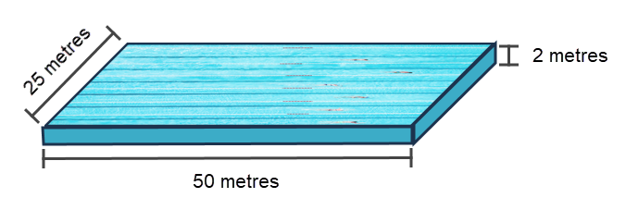
Answer to how many litres of water are in an Olympic sized swimming pool

Slide 5
How many litres of water are in an Olympic sized swimming pool?
2,500,000 litres
Two million, five hundred thousand litres

Slide 6
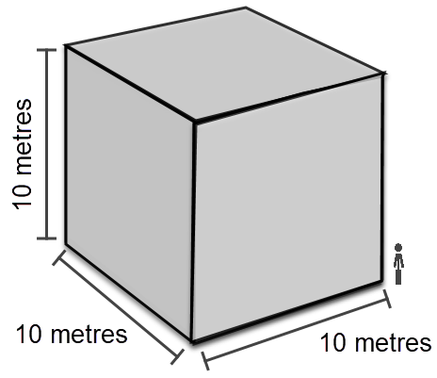
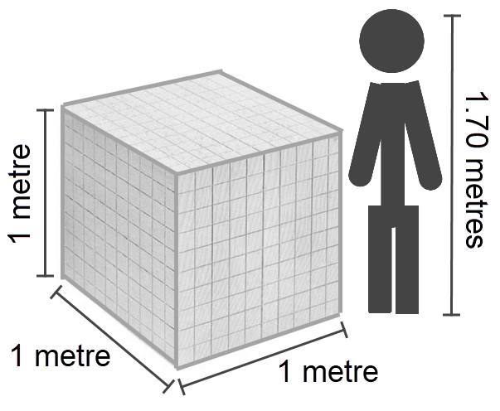
1 kilolitre
1,000 litres
1 cubic metre
1 megalitre
1,000,000 litres
1000 cubic meters

Slide 7
Activity
Select a capital city and compare its current and past water storage levels to that of your state’s/territory’s.
For each investigate:
lowest and highest water storage level
the range of data (difference lowest to highest)
shape of graph
current water storage levels.
Comment on what’s the same and different between data for the two locations. Prepare 3 points of interest to share about your findings.

Slide 8
Exit ticket
List one thing that you:
found interesting or surprising in today’s lesson
are wondering about from today’s lesson

