Slide 1


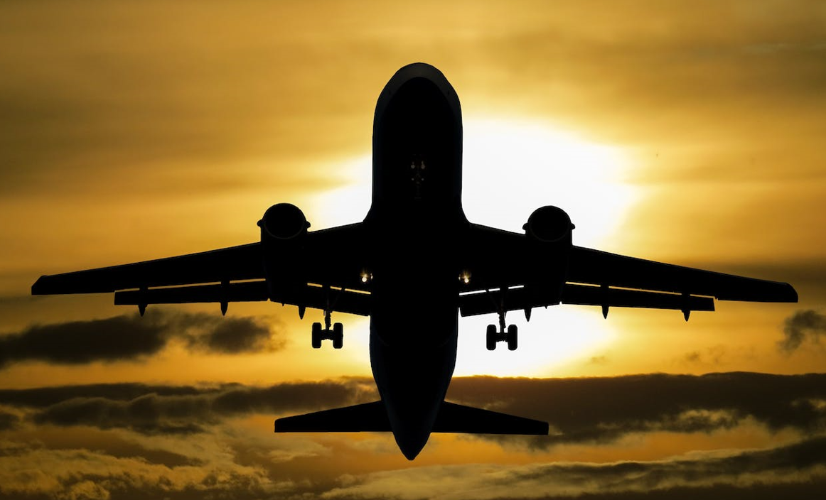
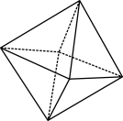

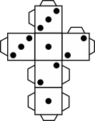
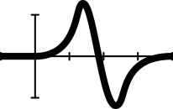


Capital Airways: Part 2
Notes:
Image: Free download via Pexels: CCO
Year 10
Space/Algebra
55 mins
AC9M10SP02, AC9M10A04
Lesson summary
This is the second lesson in the Capital Airways series and follows the lesson Capital Airways: Part 2. Students investigate a network through an airline route map. The task is a mathematical modelling activity whereby students collaborate to re-design the network map to improve the airline’s profitability.
Resources
Teacher’s slides (PowerPoint)
Capital Airways Activity 2 worksheet (Word)
Capital Airways spreadsheet (Excel)
Laptops / iPads with spreadsheet package available

Slide 2

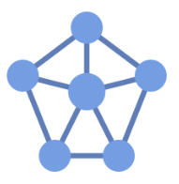
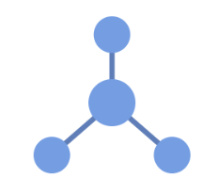
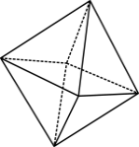

The language of networks
A vertex (plural vertices) is represented by a circle or dot in a network diagram. It may also be called a node.
Vertices are often given labels to indicate what is being represented e.g. the name of a person, place or computer.
NETWORK DIAGRAMS
An edge is the line segment that joins two vertices.
Edges are often given a weight, which is a number that represents the relationship between two vertices, such as a distance, travel time or cost.
EDGE
VERTEX
The degree of a vertex is a number indicating how many edges are connected to it. This vertex has degree 3.
Notes:
This lesson follows Capital Airways: Part 1, which is required learning before this part of the lesson, which involves students conducting a mathematical investigation on networks.
Begin this lesson by first covering the learnings of Part 1. Download the teacher’s slides that accompany this lesson and go to slide 2 to refer to the network diagrams, key vocabulary and main concepts. If not already done so last lesson, go through the solutions to Activity 1 and ensure that all students feel confident to keep learning.

Slide 3
Activity 2 – Improving the Capital Airways network
After your tour around the network, you realise that Capital Airways is in serious trouble. It can be hard making a profit as an airline and Capital is suffering big losses. Lots of planes are flying half full (or worse) and you are struggling to cover costs.
You think that one of the key ways to improve Capital Airway’s fortunes is to restructure the airline’s route map. You collect your executive team together to implement your plan.
Your idea is to build a detailed mathematical model to calculate the profit flying different routes to try and optimise the route map and return Capital to profitability.
In your team, brainstorm a list of information you might need to know to build your model and make decisions about routes and pricing.
Notes:
Optimising a network and creating network diagrams
Organise students into groups of 3–4 and introduce Activity 2 – Improving the Capital Airways network referring to slide 3.
Introduce the new scenario.
Ask groups to brainstorm a list of information they need to know to build their model and make decisions about routes and pricing.

Slide 4
Modelling inputs and variables
How many planes you have
Size of planes (max number of passengers)
Fuel efficiency – kg of fuel/km travelled
Populations of Australian capitals
How many people want to fly each route
Turn-around time and cost (landing and handling fees)
Distances between cities
Competitors’ routes and prices
Number of airports in each city (e.g. Melbourne – Tullamarine and Avalon)
Other airports we can add (e.g. Gold Coast)
Do we have international flights we want to meet?
Mix of business, premium and standard seats
Routes selected
Ticket prices
Capacity (how full planes are)
Time of flights
Cost of fuel - $/barrel
Seasonal demand
Optimising plane location (e.g. plane needed in Melbourne for a flight out of Melbourne)
Models can be highly complex!
Notes:
Collect a range of suggestions from the different groups and compare these with this list of possible inputs and variables, clarifying the rationale or the effect on the different inputs and variables. Note that many mathematical models, such as those that predict future climates can contain literally hundreds of variables, but clearly these are highly complex to build and to understand.

Slide 5
Simplified modelling task
Assume that we can fly any 10 routes in the network (that is, connecting any pair of capitals), but the final route map must allow travel between all capitals. There are 10 planes in the Capital fleet:
5 Boeing 737-Max 7 planes (140 passengers)
5 Airbus 321 Neos (220 passengers)
Use the information provided on passenger numbers and the population of each capital to determine your routes and which plane will fly each route.
Build a mathematical model calculating the total daily profit from your route network.
Create two revised network maps (on the maps provided) showing:
your chosen routes
projected daily passenger numbers on each route
projected daily profit on each route.
Summarise the key points of your route map in 5 bullet points to be presented to the Board.
Notes:
Introduce the simplified modelling task as detailed on the slide.

Slide 6
Model inputs – you will need to …
Decide your routes and note the current passenger numbers on each route. For each route you must consider the following:
Choose the plane you will use; how full you estimate it will be (% capacity); and the ticket price.
Remember that as you increase price, capacity will fall. You will need to consider ticket prices charged by competitors as well as demand on the route (current passenger numbers).
Calculate fuel cost, by finding the route distance and entering it into the model, which will then automatically calculate the daily fuel cost.
Calculate the ground staff and airport fees, which are calculated per passenger but vary for larger versus smaller airports.
As you vary inputs (blue cells) to the model the revenue, costs and profit will update, allowing you to test different assumptions.
Notes:
Explain the key steps and model inputs that the students need to determine as outlined on the slide.
It may be helpful at this stage to project the Excel model and explore the tabs containing additional information, which may also be downloaded and distributed to students. Explain the input protocol – blue cells are inputs, green cells auto-populate based on previous inputs, white cells are calculations. Explore the calculations underpinning the example Adelaide to Brisbane route. Students should then work in their groups to complete the task with the teacher monitoring progress.

