Slide 1
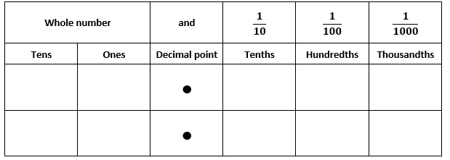

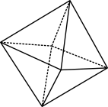

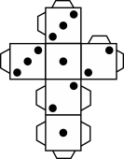
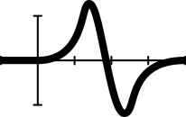


Place value chart
© 2023 Commonwealth of Australia, unless otherwise indicated. Creative Commons Attribution 4.0, unless otherwise indicated.
Notes:
Use this place value chart to record two students’ measurements for an object.
Record using the place value parts for each column.
For example, a book that measured 1 straw and seven smaller parts would be 1 and seven tenths
In the ones column record a one and in the tenths column record 7.
Have students say the number one and seven tenths.

