Slide 1
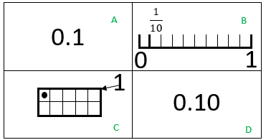
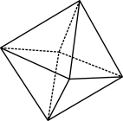
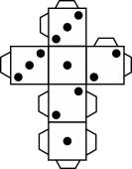
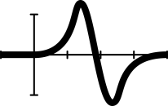
What do you notice?
What is the same and what is different?
© 2023 Commonwealth of Australia, unless otherwise indicated. Creative Commons Attribution 4.0, unless otherwise indicated.
Notes:
Some observations may include
The same number is represented as a fraction one tenth 1/10, as a decimal 0.1 and as one grid shaded in a ten frame.
0.1 and 0.10 are the same
There are different ways to represent the number using a number line or a ten frame.

