Slide 1


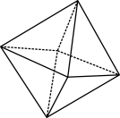

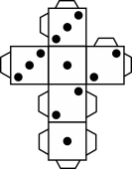
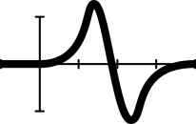


Fruit fractions: Fruit salad Crafty creations

Slide 2

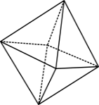


Warm up
Number Talk
$$\frac{2}{4}+\frac{1}{2}=$$
© 2023 Commonwealth of Australia, unless otherwise indicated. Creative Commons Attribution 4.0, unless otherwise indicated.
Notes:
Use the classroom talks strategy in the warm-up activity.

Slide 3
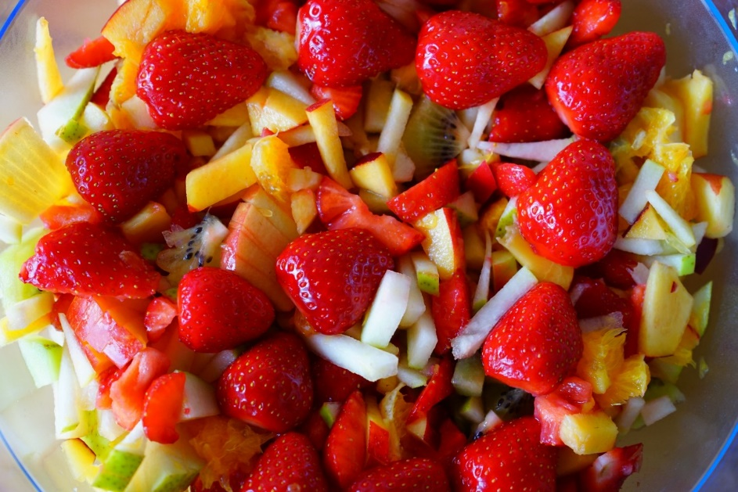
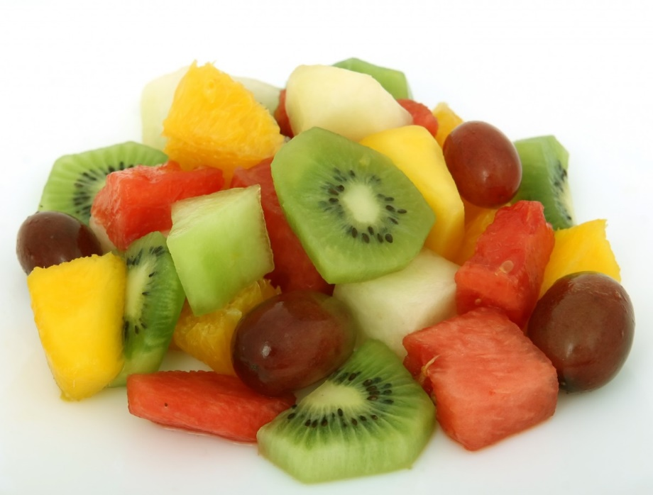
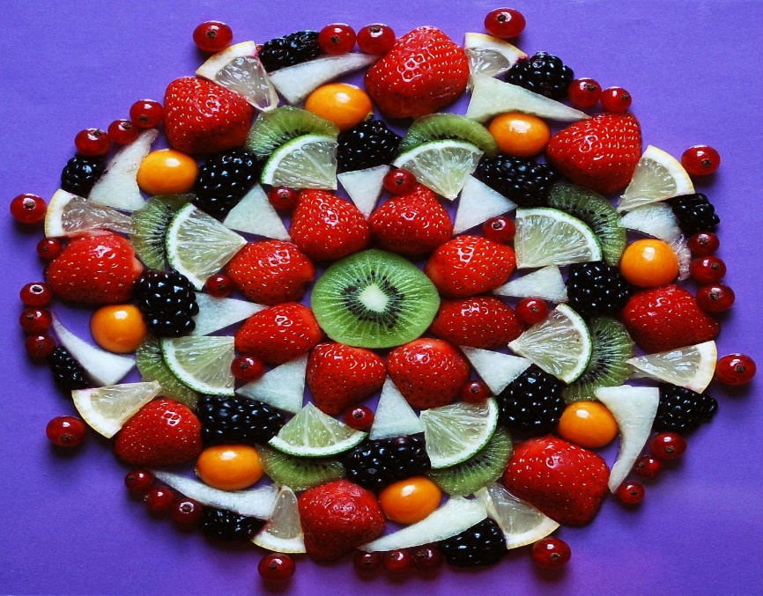
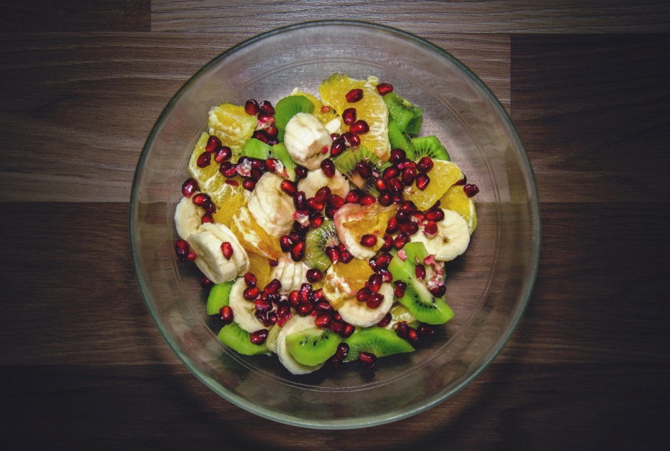
Fruit Salad
Images: CC0 1.0 DEED CC0 1.0 Universal
© 2023 Commonwealth of Australia, unless otherwise indicated. Creative Commons Attribution 4.0, unless otherwise indicated.
Notes:
The images are released free of copyrights under CC0 1.0 DEED CC0 1.0 Universal

Slide 4
Exit ticket
Celebrate with a hands-on fruit feast.
© 2023 Commonwealth of Australia, unless otherwise indicated. Creative Commons Attribution 4.0, unless otherwise indicated.

Slide 5
Teachers’ notes
Sullivan and Lilburn (2015) state that ‘good’ questions are those:
that require more than remembering a fact or reproducing a skill
where students can learn by answering the questions, and the teacher learns about each student from the attempt
where there may be several acceptable answers.
Sullivan, P. & Lilburn, P. (2015). Open-ended maths activities (2nd Ed.). Oxford University Press.
Dan Meyer (2010) gives the following advice:
Use multimedia.
Encourage student intuition.
Ask the shortest question you can.
Let students build the problem.
Be less helpful.
This time should be a safe maths space for students to share potential thoughts/answers without judgement.
Using this information as a general guide, pose this problem to your class and take on the role of facilitating/ posing questions, giving students wait and pause time, allowing students to share their thoughts with others, and differentiating as required for all students to be challenged within their zone of proximal development. Take time at the end of the activity to summarise students’ thoughts, their progress in thinking, and clarify any misconceptions.
Meyer, D. (2010, March). Math class needs a makeover [Video].
© 2023 Commonwealth of Australia, unless otherwise indicated. Creative Commons Attribution 4.0, unless otherwise indicated.

