Slide 1


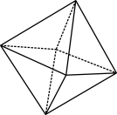

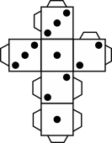
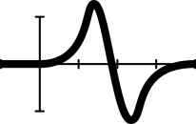


Fruit fractions:
Growing with fruit

Slide 2

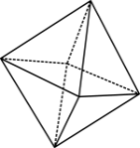

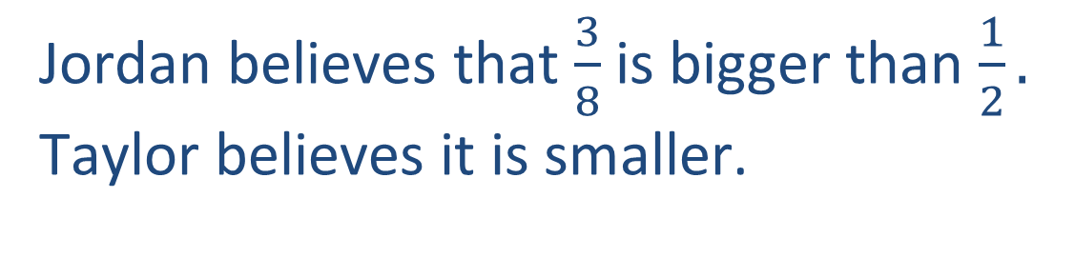
Warm up
Maths battle
Jordan believes that $\frac{3}{8}$ is bigger than $\frac{1}{2}.$
Taylor believes it is smaller.
Who is right?
© 2020 Commonwealth of Australia, unless otherwise indicated. Creative Commons Attribution 4.0, unless otherwise indicated.

Slide 3
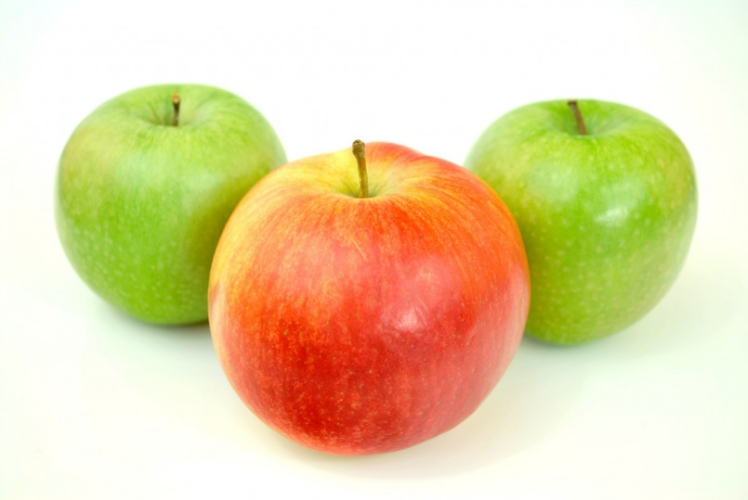
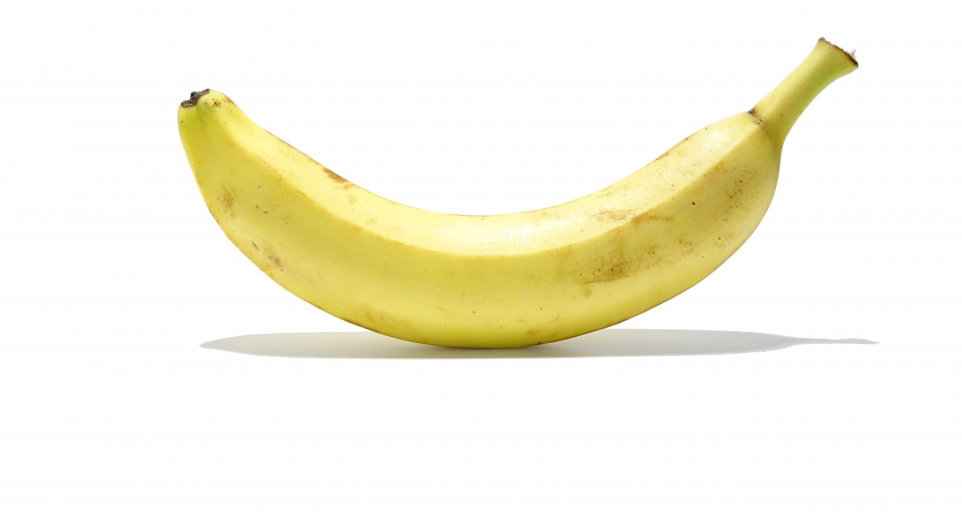
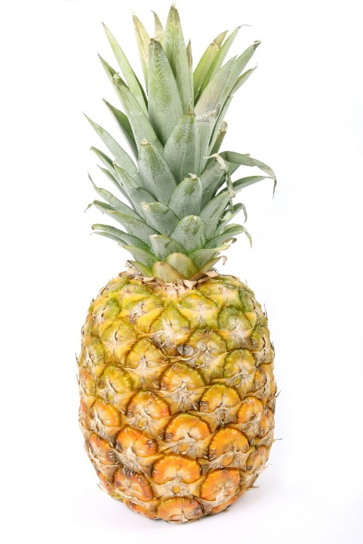
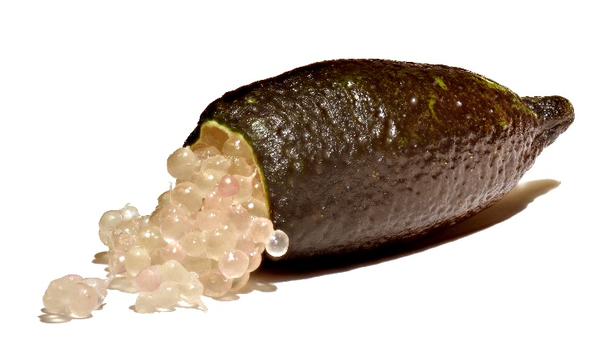
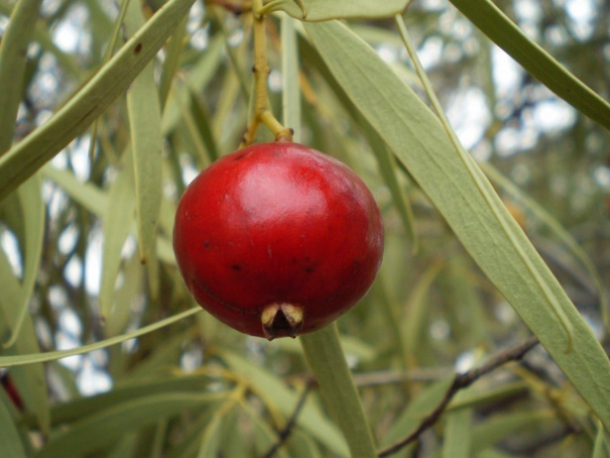
Example fruits
banana
apples
Finger lime
quandong
pineapple
Images: under CC0 1.0 DEED CC0 1.0 Universal
Finger lime: Amada44, CC BY-SA 3.0 via Wikimedia Commons
© 2020 Commonwealth of Australia, unless otherwise indicated. Creative Commons Attribution 4.0, unless otherwise indicated.
Notes:
The image is released free of copyrights under CC0 1.0 DEED CC0 1.0 Universal
Finger lime: Citrus australasica Australian finger lime Amada44, CC BY-SA 3.0 via Wikimedia Commons

Slide 4
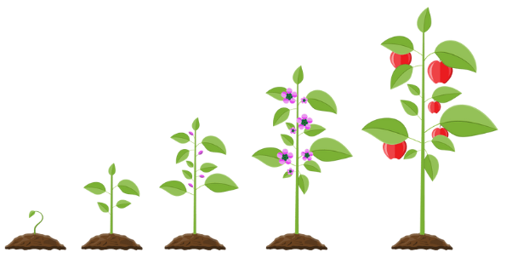
Where does fruit come from?
Images source: Canva
© 2020 Commonwealth of Australia, unless otherwise indicated. Creative Commons Attribution 4.0, unless otherwise indicated.

Slide 5
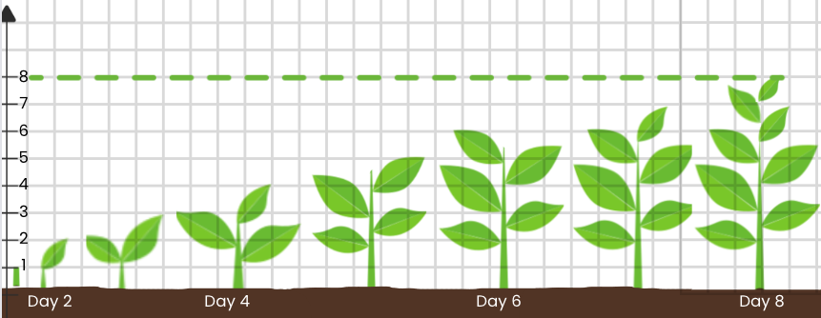
Plant life cycle
Images source: Canva
© 2020 Commonwealth of Australia, unless otherwise indicated. Creative Commons Attribution 4.0, unless otherwise indicated.

Slide 6
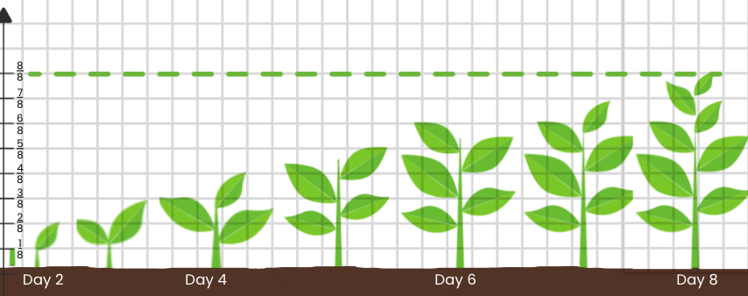
From seed to plant
Images source: Canva
© 2020 Commonwealth of Australia, unless otherwise indicated. Creative Commons Attribution 4.0, unless otherwise indicated.

Slide 7
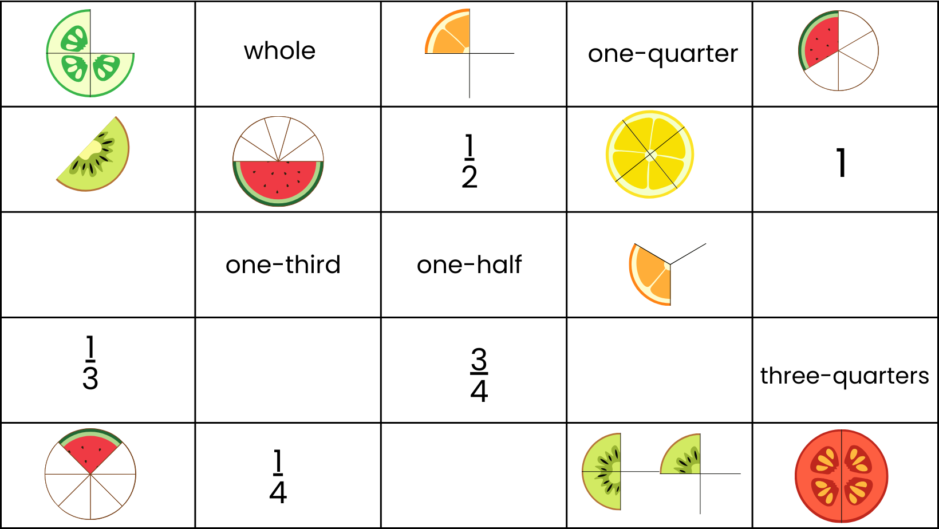
Equivalent fraction matching game – student cards
Images source: Canva
© 2020 Commonwealth of Australia, unless otherwise indicated. Creative Commons Attribution 4.0, unless otherwise indicated.
Notes:
A downloadable version (PDF) is available to print out for your class.

Slide 8
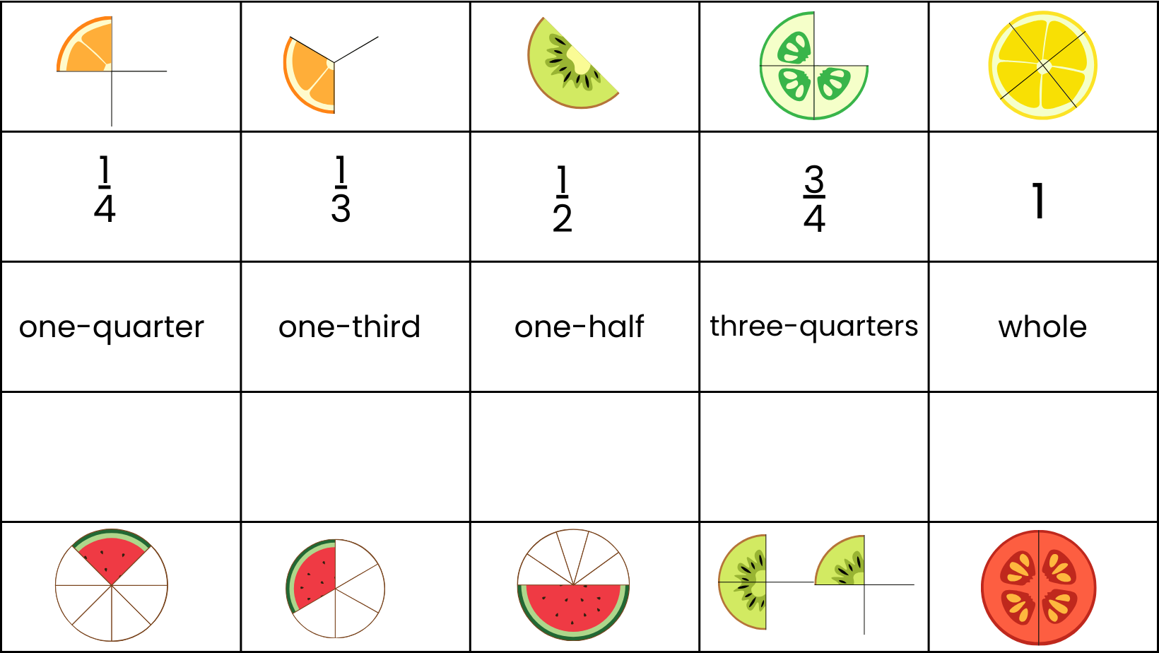
Equivalent fraction matching game – solution
Images source: Canva
© 2020 Commonwealth of Australia, unless otherwise indicated. Creative Commons Attribution 4.0, unless otherwise indicated.

Slide 9
Exit ticket
Act it out
Stand behind your desks and stand on tip-toes with your arms spread out, to represent the ‘whole plant’.
Curl up in a little ball on the floor to represent a seed.
Now you will grow, bit by bit!
© 2020 Commonwealth of Australia, unless otherwise indicated. Creative Commons Attribution 4.0, unless otherwise indicated.
Notes:
To the teacher
Ask students to stand behind their desks and stand on tip-toes with arms spread out, to represent them as a ‘whole plant’.
Then they curl up in a little ball on the floor to represent a seed.
The teacher then gives increments of fractions.
The students follow these increments by ‘growing’ until they are finally a ‘whole’ plant

Slide 10
Teachers’ notes
Sullivan and Lilburn (2015) state that ‘good’ questions are those:
that require more than remembering a fact or reproducing a skill
where students can learn by answering the questions, and the teacher learns about each student from the attempt
where there may be several acceptable answers.
Sullivan, P. & Lilburn, P. (2015). Open-ended maths activities (2nd Ed.). Oxford University Press.
Dan Meyer (2010) gives the following advice:
Use multimedia.
Encourage student intuition.
Ask the shortest question you can.
Let students build the problem.
Be less helpful.
This time should be a safe maths space for students to share potential thoughts/answers without judgement.
Using this information as a general guide, pose this problem to your class and take on the role of facilitating/ posing questions, giving students wait and pause time, allowing students to share their thoughts with others, and differentiating as required for all students to be challenged within their zone of proximal development. Take time at the end of the activity to summarise students’ thoughts, their progress in thinking, and clarify any misconceptions.
Meyer, D. (2010, March). Math class needs a makeover [Video].
© 2020 Commonwealth of Australia, unless otherwise indicated. Creative Commons Attribution 4.0, unless otherwise indicated.

