Slide 1


Flight of the osprey
Bird dimensions

Slide 2
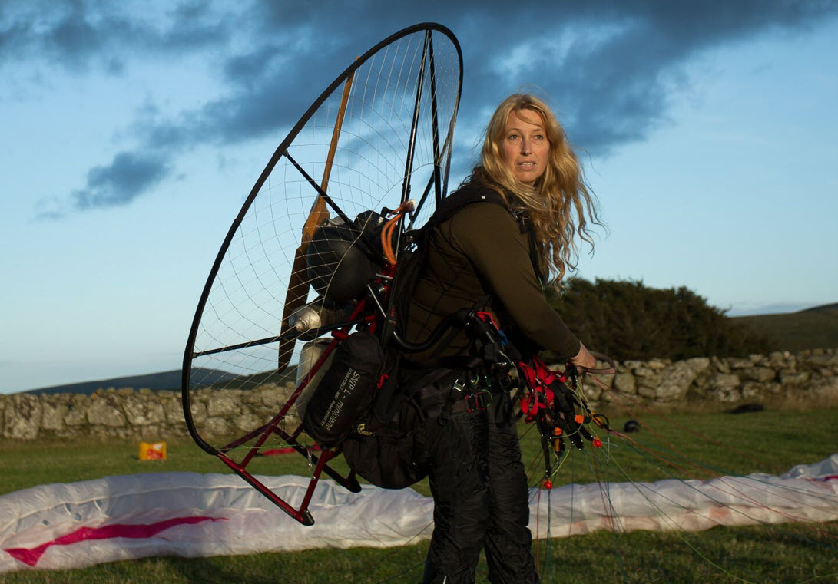
Today’s task
Ready for some more work as a junior researcher?
Image © 2024 Conservation Without Borders. Permission granted.
Notes:
Sacha is the team leader.

Slide 3
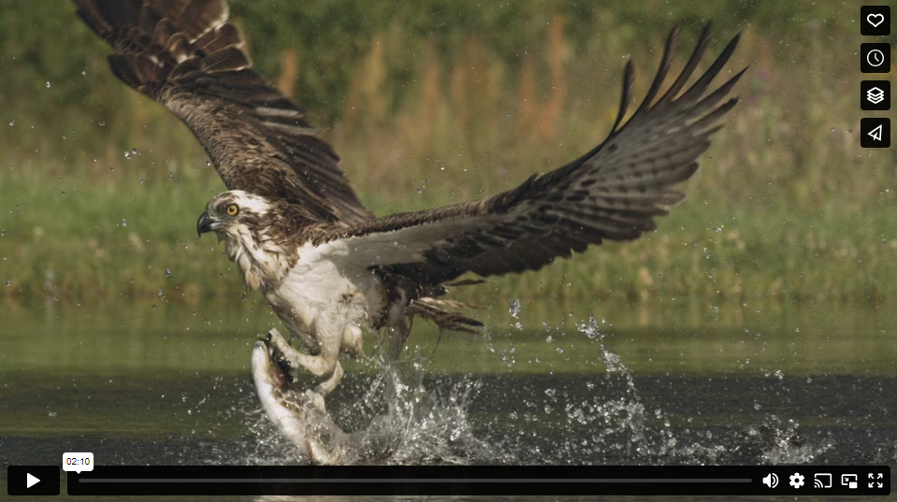
Osprey diet
Ospreys hunt for food – it’s a battle they need to win to survive!
The osprey is a raptor bird and survives on a diet of fish only.
Watch this 2 min video of the Osprey hunting for fish.
As you watch estimate the size of its wings!​

Slide 4
Know your Osprey! A Quick quiz
Osprey – Bird of Prey
About the osprey | Information and measurements
Body length | 55–62 cm
Wingspan | 145–180 cm
Lifespan | 30 years in wild
Weight females (average) | 1.6–2.0 kg
Weight males (average) | 1.2–1.5kg
Colour | Dark brown with white on chests and legs
Diet | Fish 300–400 g a day
Location | All continents except Antarctica
Habitat | Lakes, rivers, estuaries and coastal waterways
Breeding season | March to September in the UK
Young | 2- 4 eggs
1. The difference in maximum average mass between females and males maximum average is:
5 g
50 g
500 g
2. Osprey need 300–400 g of fish in their diet a day. In a week they need:
210 g to 280 g
2.1 kg to 2.8 kg
2100 kg to 2800 kg
Notes:
If students viewed the video, ask them what their estimate was for wingspan.
Discuss the wingspan length of 180 cm in relative terms such as the height of a tall person is 180 cm or nearly two metre rulers put together.
Note: in discussions we often use the term ‘weight’ to describe how heavy something is. Weight is the force exerted on an object due to gravity.
The correct term is ‘mass’ and is commonly measured in grams and kilograms.
Answer for Q 1 is C 500g; Weight females (average) 2.0 kg, Weight males (average) 1.5kg difference 500g or half a kilogram.
Answer for Q 2 is 2.1kg to 2.8kg; 7 days multiplied by 300-400 g a day

Slide 5

Body length versus wingspan
Work in pairs to measure your arm span.
Stretch out your arms. Measure the length of your arms from fingertip to fingertip.
Now measure your height (body length).
Compare your arm span and your height.
Compare these to the Osprey.
Describe your comparisons mathematically.
Image credit Nerida McGeachie
Osprey measurements
Your measurements
Body length | 55–62 cm
Wingspan | 145–180 cm
Body length | ?
Arm span | ?

Slide 6
How big is big?
Look at the size of each of the birds' body length and wingspan.
What do you notice?
Is there a relationship between body length and wingspan?
How can we visualise that data?
Bird | Type | Body length | Wingspan
Andean condor | Raptor | 120–130 cm | 280–320 cm
White-bellied sea eagle | Raptor | 75–85 cm | 180–220 cm
Powerful owl | Raptor | 50–60cm | 120–140 cm
Budgerigar | Parakeet (parrot) | 18–20 cm | 30–35 cm
Notes:
Students may notice:
the wingspan for all four birds is longer than their body length
the raptors have a large wingspan
the longer the body length, the longer the wingspan
the budgerigar has a small wingspan.

Slide 7
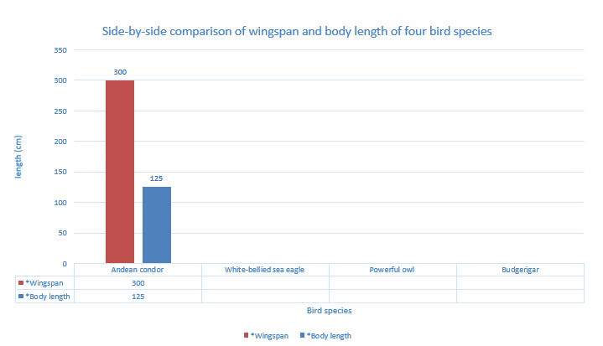
Using a side-by-side column graph
Notes:
Introduce the side-by-side column graph.
You may want to use the Excel spreadsheet provided as a teaching tool and demonstrate how to create a chart.
Explain that the data in the table is provided as a range for example the Andean condor’s body length was on average between 120–130 cm.
For our purposes we chose the middle value of 125 as the body length was between 120–130 cm.
The same process needs to be followed for the remaining data.

Slide 8
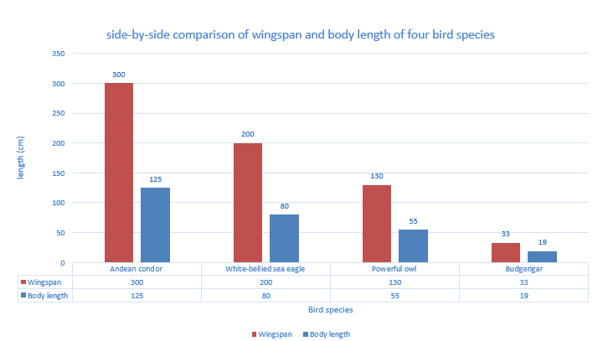
What do you notice?
Notes:
In this visualisation students may suggest that the body length is less than half the wingspan for all four bird species.
Mathematically we can calculate the relationship by dividing the wingspan by the body length
Explain to students that the data in the table was a range for example the Andean condor’s body length was on average between 120 - 130cm.
For our purposes we chose the middle value of 125
The same process was followed for the data given as a range; the middle value was chosen.
side-by-side comparison of wingspan and body length of four bird species. Each bird is represented as two columns with a data label.

Slide 9
Wingspan divided by body length
Bird | Type | Body length (cm) | Wingspan (cm) | Wingspan/body length
Andean condor | Raptor | 125 | 300 | 2.4
White-bellied sea eagle | Raptor | 80 | 200 | 2.5
Powerful owl | Raptor | 55 | 130 | 2.4
Budgerigar | Parakeet (parrot) | 19 | 33 | 1.7
Notes:
Use questioning to prompt students to describe the relationship between body length and wingspan.
Model the Andean condor: 300 divided by 125 is approximately 2.4
The White-bellied sea eagle is 2.5 and the Powerful owl is 2.4
Students may note these are all raptors and are all close to 2.5
The budgerigar, however, is 1.7 and is a parrot and not a raptor.
Interpreting the table of data students may draw conclusions such as:
For Andean condor, White-bellied sea eagle and Powerful owl which are all raptors the wingspan is approximately 2.5 times bigger than the body length.
The budgerigar in comparison the wingspan is approximately 1.7 times bigger than the body length.

Slide 10
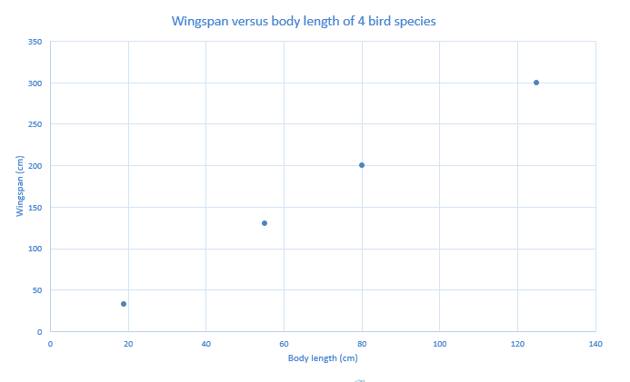
Can you see a relationship between body length and wingspan?
Notes:
Use questioning to prompt students to describe the relationship between body length and wingspan on this graph called a scatter plot.
For Andean condor, White-bellied sea eagle and Powerful owl which are all raptors the wingspan is approximately 2.5 times bigger than the body length.
Students may notice that the 4 points roughly make a straight line.
Ask students to predict if a bird had a body length of 100 what might you expect its wingspan to be? Why? (they may suggest 250cm if it follows the pattern)
What about a bird with a body length of 40? What would you expect its wingspan to be? (Students may suggest about 100 if it follows the same pattern).
Mathematically you could show that as 2.5 x 40 =100

Slide 11

Report your findings on the osprey
What have you discovered about the wingspan and body length of birds?
Provide a brief report for our research team with your conclusions together with any visualisations you have created.
How does the wingspan and body length of an osprey compare to other raptors?
Image © 2024 Conservation Without Borders. Permission granted.

Slide 12
Research complete (for now)
Thanks, you really know some important information from today's research.
My team will need your help again soon.
Image © 2024 Conservation Without Borders. Permission granted.

