Slide 1
Factors bingo!
Prime, composite and square numbers
Notes:
Teacher notes: rationale
‘Research studies show that when students discover mathematical ideas and invent mathematical procedures, they have a stronger conceptual understanding of connections between mathematical ideas’ (Grouws & Cebulla, 2000, p.17).
It is through discovery that students can utilise a wide range of mathematical concepts and skills, as well as reinforce mathematical vocabulary. When students investigate maths, they explore ideas and make discoveries for themselves – discoveries they are more likely to believe in (trust) and remember.
A classroom culture where students feel comfortable asking questions, taking risks, and engaging in mathematical reasoning, fosters deep engagement in learning. It is also important for students to develop their own ideas about conjectures. Students need to be encouraged to formulate and justify their own conjectures based on their observations and investigations. Develop a sense of mathematical curiosity and inspire students to continue exploring and questioning mathematical ideas both within and beyond the classroom.
This activity explores properties of odd and even numbers using discoveries to confirm calculations involving addition, subtraction and multiplication (and division). Students begin by testing conjectures while critically thinking about the various examples provided and are encouraged to make their own conjectures on the topic of odds and evens, exploring patterns and seeking counter examples. If counter examples exist (or students believe they have found a counter example) for the conjecture, take the opportunity to discuss these with the students. Help students to understand why these counter examples disprove the conjecture. Analysing counter examples fosters critical thinking and deepens their understanding of mathematical concepts involved.
Download the tables for this lesson that were designed to afford a systematic approach to their investigations; however, students may wish to take their own creative approach to test conjectures for odd and even numbers. Ensure, however, reasoning is sound. There are other resources on the planning tool that could also be utilised within this part of the lesson or used as inspiration for students to explore. Provide a box of manipulatives of various kinds for students to use to help with their calculations of addition, subtraction, multiplication. Some students may explore division.
Promote collaboration and discussion among students and encourage students to share their findings, discoveries and wonderings with one another.

Slide 2
Learning intention and success criteria
We are learning about the properties of prime, composite and square numbers.
By the end of this lesson, I can:
identify prime, composite and square numbers
use mathematical language to discuss properties of numbers (for example, positive integers, factors, multiples)
apply understanding of prime, composite and square numbers to solve a mathematical problem.

Slide 3
A game of bingo
I was playing Bingo with a friend.
We rolled two 10-sided dice and multiplied the two numbers together to find the product.
8
3
24

Slide 4
Compare bingo cards
Which bingo card would you pick?
Why might that card be the better choice?
My card
My friend's card
B | I | N | G | O
23 | 10 | 72 | 32 | 48
7 | 100 | 11 | 8 | 42
16 | 4 | 18 | 24 | 99
9 | 52 | 12 | 36 | 84
37 | 27 | 80 | 91 | 20
B | I | N | G | O
3 | 10 | 88 | 32 | 48
49 | 4 | 15 | 54 | 42
72 | 28 | 40 | 24 | 45
21 | 36 | 16 | 25 | 20
9 | 27 | 12 | 100 | 18

Slide 5
Hint #1
Have a close look at the numbers on my card.
Which of the numbers will not be called?
How do you know?
My card
B | I | N | G | O
23 | 10 | 72 | 32 | 48
7 | 100 | 11 | 8 | 42
16 | 4 | 18 | 24 | 99
9 | 52 | 12 | 36 | 84
37 | 27 | 80 | 91 | 20

Slide 6
Hint #2
Look at the factors of 12.
When you multiply the factors together you get 12.
List the factors of 16, 24, 19 and 8.
Which of these numbers cannot be rolled with two 10-sided dice?
Factors of 12
1, 12
2, 6
3, 4

Slide 7
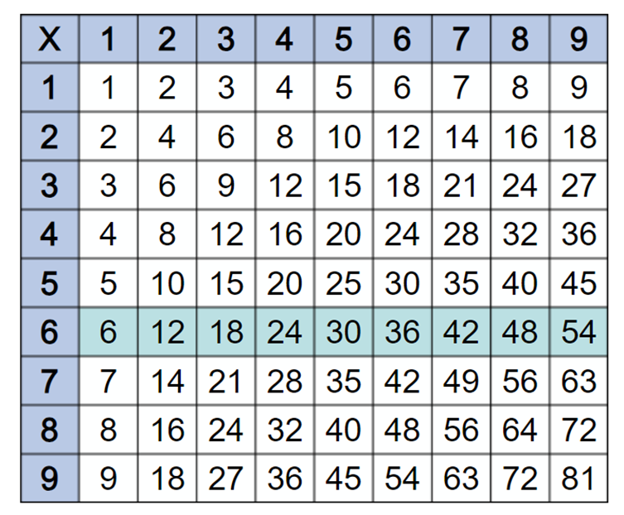
Hint #3
Use a multiplication grid.

Slide 8
Challenge task
Design your own bingo card!
Explain how and why you selected the numbers you did.
Which numbers didn’t you include and why?
B | I | N | G | O

Slide 9

Reflection
Prime: an integer divisible by one and itself
Composite: an integer divisible by smaller positive integers other than one and itself
Square: is the result of multiplying a natural number by itself
Did knowing what prime, composite or square numbers are help you work out the task? If so, how?

Slide 10
Exit ticket
Which of these is prime (P), composite (C) or square (Sq) or none of these (x)?
Write your answer in the box below each number.
27 | 13 | 16 | 32 | 7 | 99 | 54 | 17 | 44 | 25

