Slide 1
Training your Maths Eyes
Notes:
Guide your students’ thinking by facilitating discussion around the following series of Maths Eyes photos or make up your own.

Slide 2
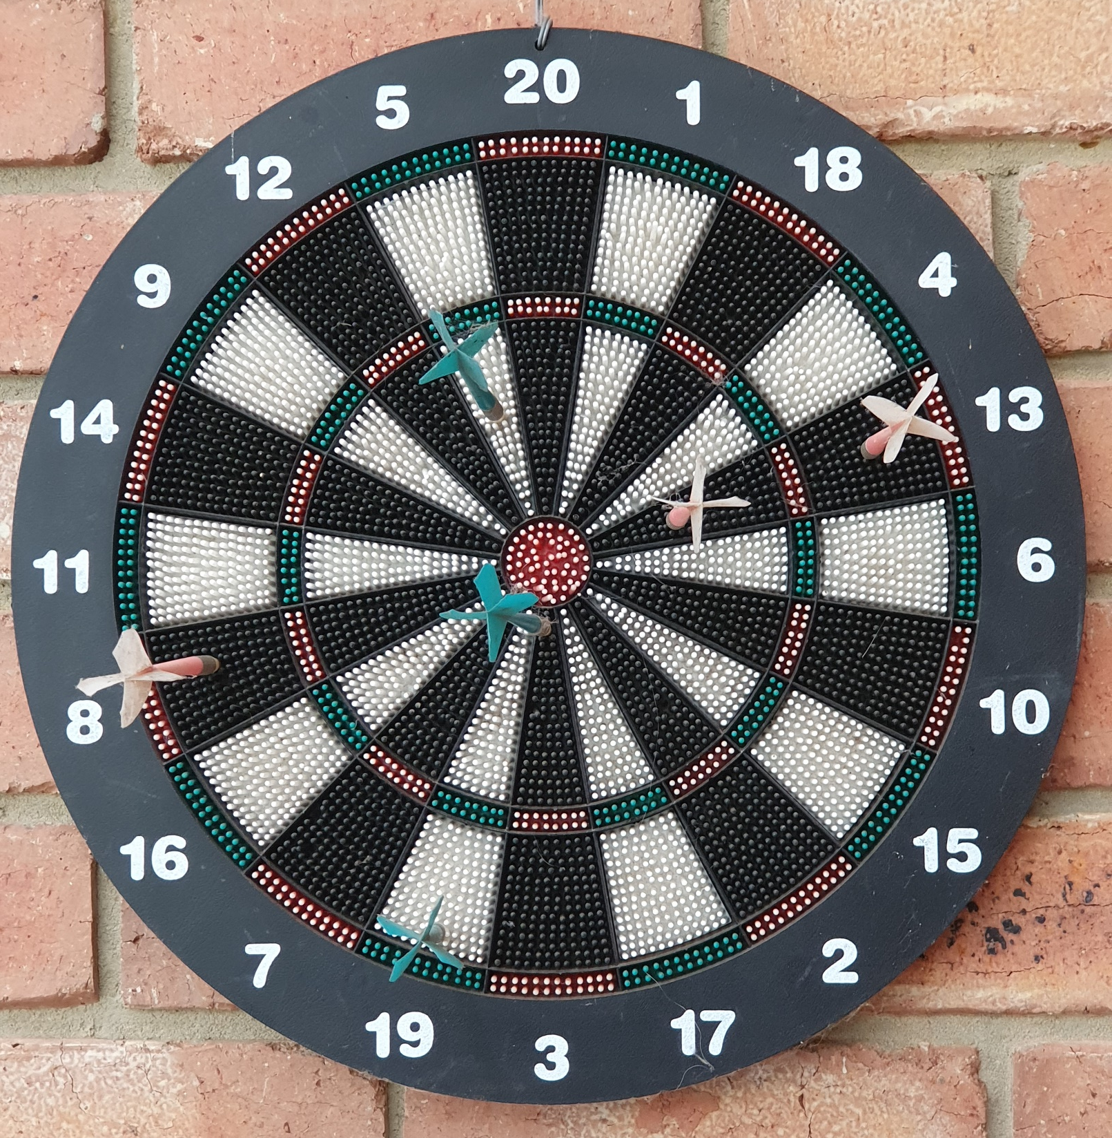
Notes:
Prompt questions - examples
What do you see in this picture?
Where do you think this picture could have been taken?
Can you talk about what is happening in the picture?
Can you think of story to tell about the picture?
Look at the picture with your ‘Maths Eyes’. What can you see?
Can you use any maths words to describe something in the picture?
Can you think up any maths questions for other groups?
Why aren’t the numbers in order around the circle?
What do you notice about the order of the numbers?
Are the wedges triangles?
Scoring in darts is quite complicated. Can you think of a simple scoring system?
Using your simple scoring system, what colour has won?

Slide 3
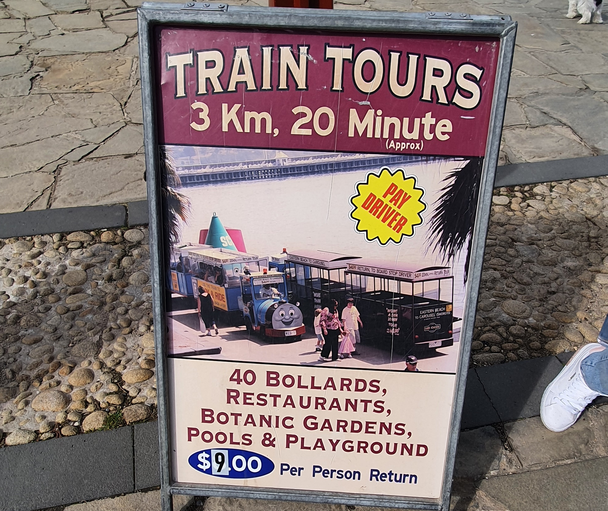
Notes:
Prompt questions - examples
What do you see in this picture?
Where do you think this picture could have been taken?
Can you talk about what is happening in the picture?
Can you think of story to tell about the picture?
Look at the picture with your ‘Maths Eyes’. What can you see?
Can you use any maths words to describe something in the picture?
Can you think up any maths questions for other groups?
How many people can fit in each train?
How much will it costs for the family in the foreground of the banner to all ride on the train?
How much does the trip cost per kilometre? Per minute? Per bollard?

Slide 4
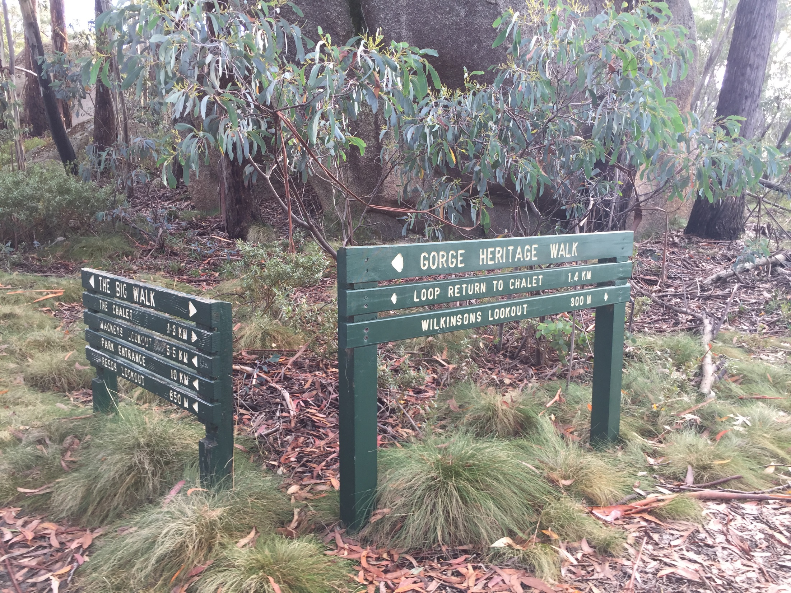
Dart board
Notes:
Prompt questions - examples
What do you see in this picture?
Where do you think this picture could have been taken?
Can you talk about what is happening in the picture?
Can you think of story to tell about the picture?
Look at the picture with your ‘Maths Eyes’. What can you see?
Can you use any maths words to describe something in the picture?
Can you think up any maths questions for other groups?
What does 300 m mean? What does 1.4 km mean?
What do the small triangles show?
Why might some distances be shown in metres and some in kilometres?
You want to walk for about 7 km. What different walks could you do to total about 7 km?

Slide 5
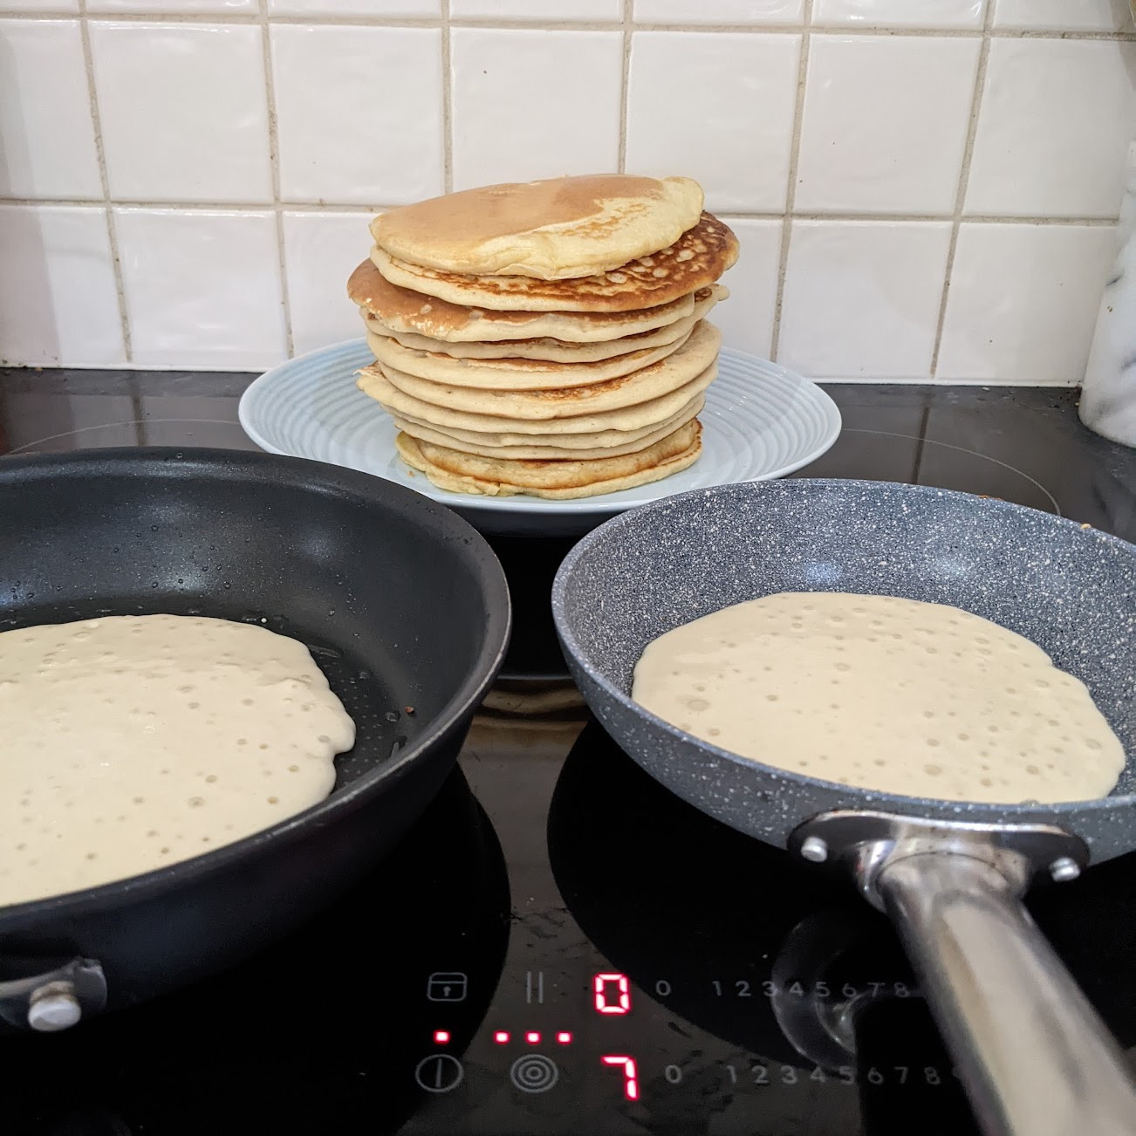
Notes:
Prompt questions - examples
What do you see in this picture?
Where do you think this picture could have been taken?
Can you talk about what is happening in the picture?
Can you think of story to tell about the picture?
Look at the picture with your ‘Maths Eyes’. What can you see?
Can you use any maths words to describe something in the picture?
Can you think up any maths questions for other groups?
How could you make square pancakes? What about other shapes?
What does the zero show? The seven? The three circles inside each other?
How many people might this stack be feeding? Why do you think that?

Slide 6
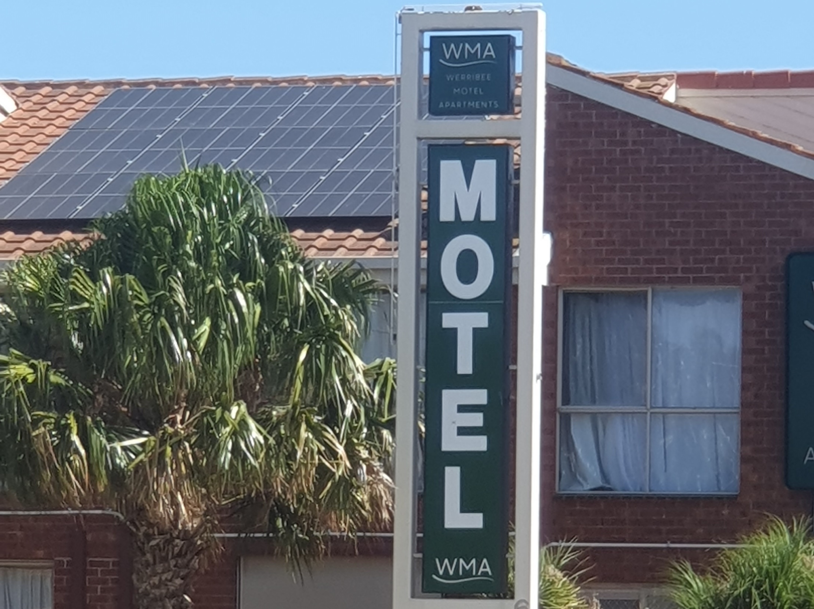
Notes:
Prompt questions - examples
What do you see in this picture?
Where do you think this picture could have been taken?
Can you talk about what is happening in the picture?
Can you think of story to tell about the picture?
Look at the picture with your ‘Maths Eyes’. What can you see?
Can you use any maths words to describe something in the picture?
Can you think up any maths questions for other groups?
Are any letters symmetrical?
How many letters have one axis of symmetry?
Do any have more than one axis of symmetry?
What is the ratio of vowels to consonants?

