Slide 1
Farm fence fractions warm-up
Always, sometimes, never
The numerator is
always / sometimes / never
smaller than the denominator.

Slide 2
Your mission
Morning Farm Crew, I’m Farmer Oz.
Today I need your help to design some paddocks for my animals.
I will need you to design the paddocks and work out how much fence is needed, using your skills with fractions and decimals.

Slide 3
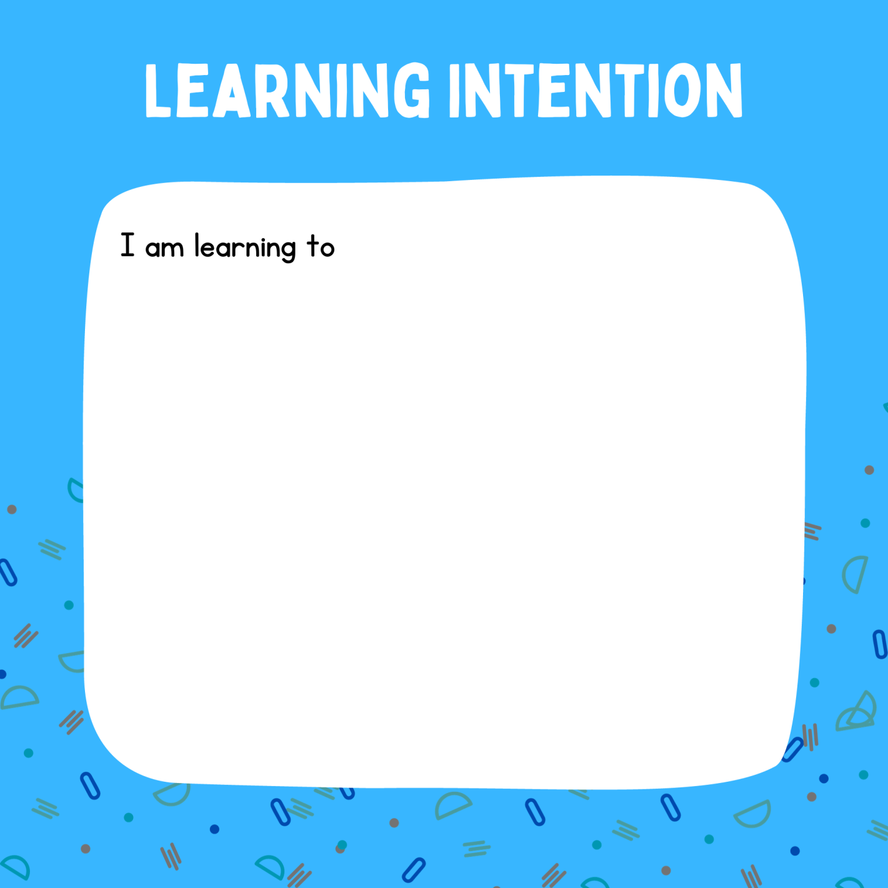
add fractions with the same denominator
understand how to convert fractions as expressed as tenths to decimals
calculate the perimeter of rectangles and composite shapes
add decimals with one decimal place
calculate percentage discounts and increases (extension activity).

Slide 4
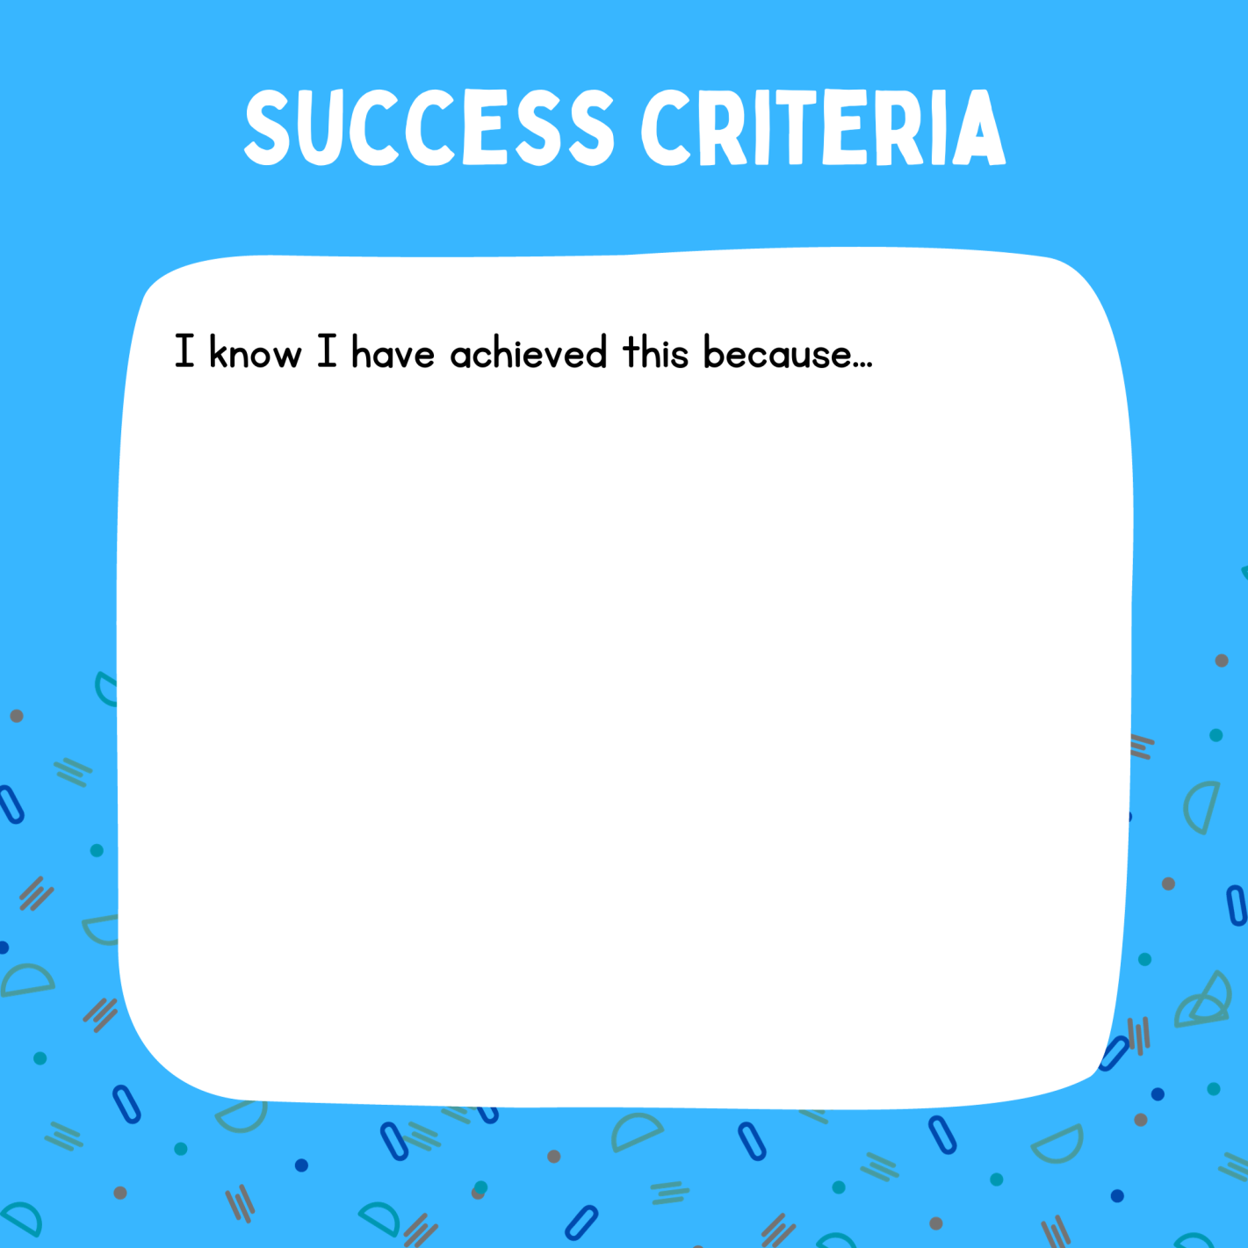
I can add lengths expressed in tenths of a metre to give improper fractions
I can convert these lengths to decimals
I can find the perimeter of rectangular shapes (including composite shapes) by adding decimals to one decimal place
I can calculate a common percentage discount (25%) and decrease/increase an amount by this percentage.

Slide 5
Your groups
You’ll be working in groups of four to help Farmer Oz design the paddocks and work out how much fence is needed, using your skills with fractions and decimals. Each group has these roles and responsibilities:
  Illustrator: making the map visually attractive and creative
  Materials manager: organising the fence supplies for the project and animals
  Timekeeper: allocating tasks and ensuring that the group stays on schedule and on track
  Presenter: preparing and delivering the presentation about the group’s work

Slide 6
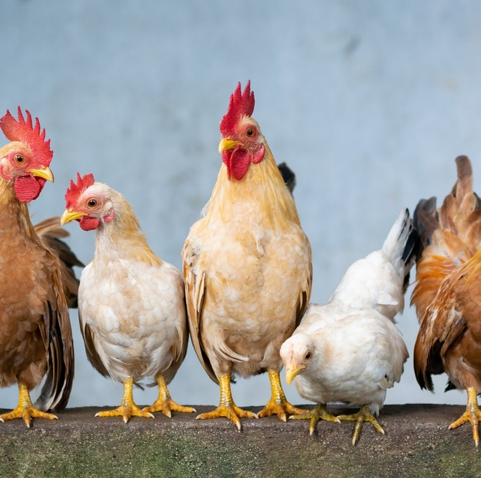
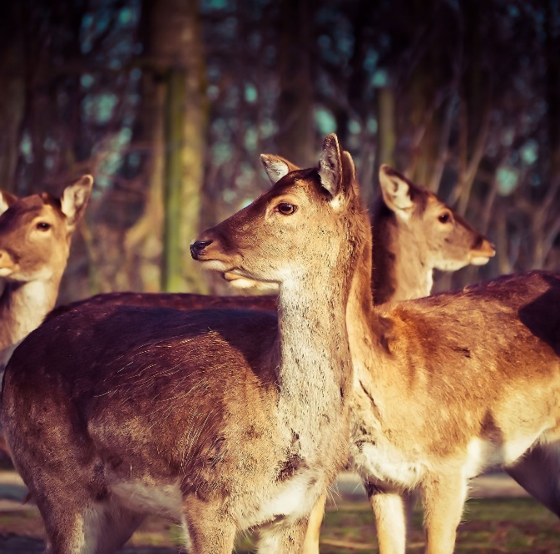
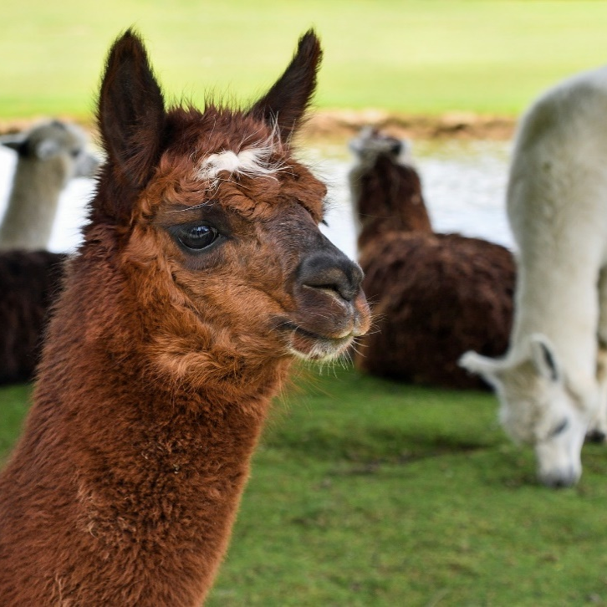
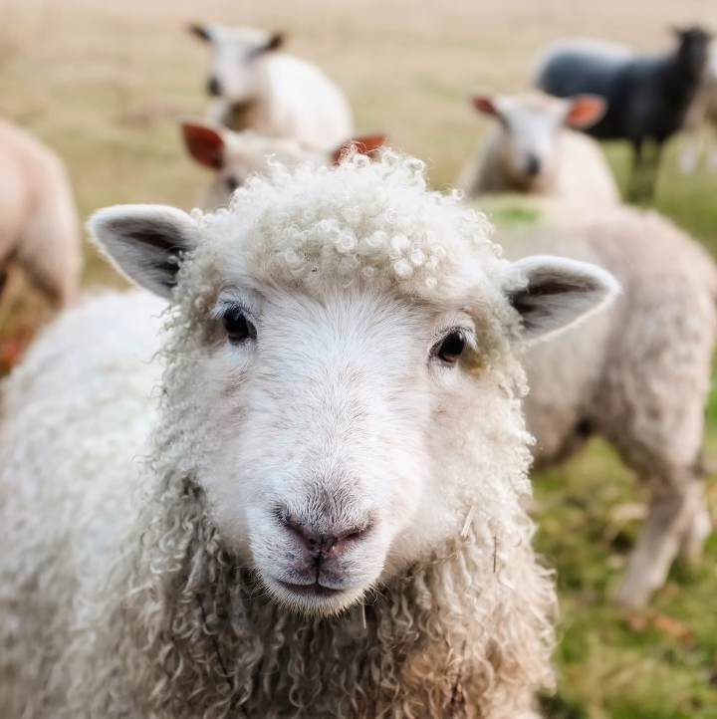
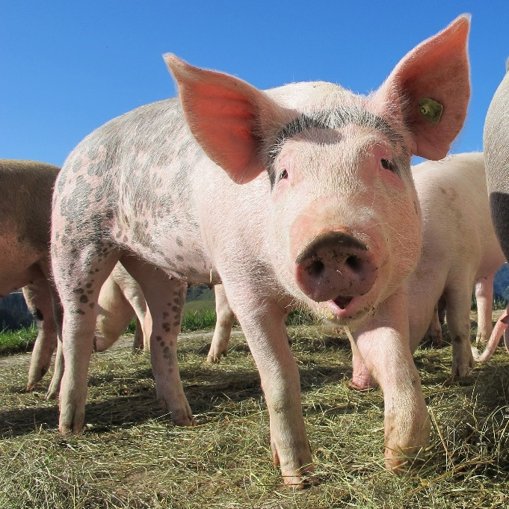
Australian farming
Notes:
Chicken image by Xuân Tuấn Anh Đặng from Pixabay
Deer image by 652234 from Pixabay
Pig image by Marion Streiff from Pixabay
Sheep image by 12019 from Pixabay
Alpaca image by Christel SAGNIEZ from Pixabay

Slide 7





Your animals
x 8
x 4
x 2
x 3
x 4
Notes:
Chicken image by Xuân Tuấn Anh Đặng from Pixabay
Deer image by 652234 from Pixabay
Pig image by Marion Streiff from Pixabay
Sheep image by 12019 from Pixabay
Alpaca image by Christel SAGNIEZ from Pixabay

Slide 8
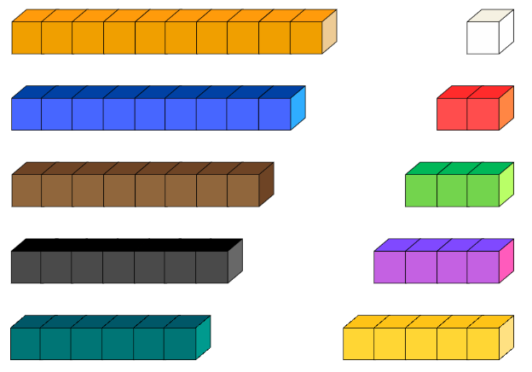
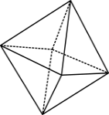
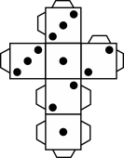

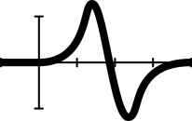

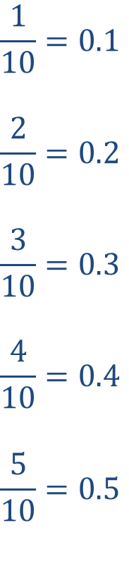
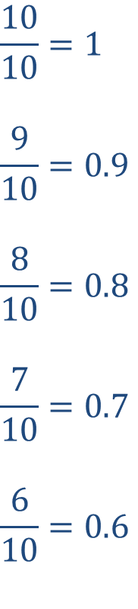
Your fences
$$\frac{10}{10}=1$$
$$\frac{9}{10}=0.9$$
$$\frac{8}{10}=0.8$$
$$\frac{7}{10}=0.7$$
$$\frac{6}{10}=0.6$$
$$\frac{1}{10}=0.1$$
$$\frac{2}{10}=0.2$$
$$\frac{3}{10}=0.3$$
$$\frac{4}{10}=0.4$$
$$\frac{5}{10}=0.5$$
Notes:
Images created using Canva

Slide 9
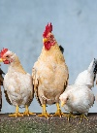
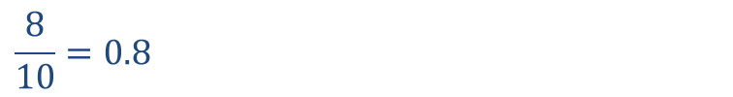
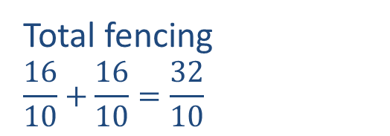
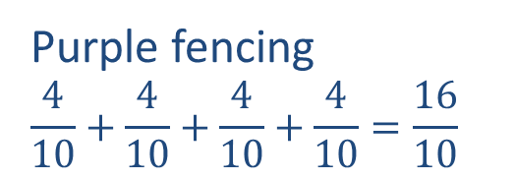
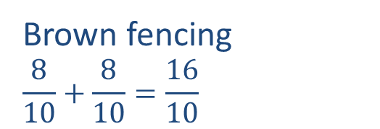
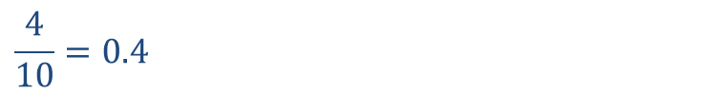
Example: chicken enclosure
$$\frac{8}{10}=0.8$$
Brown fencing
$$\frac{8}{10}+\frac{8}{10}=\frac{16}{10}$$
0.8
0.8
1.6
+
$$\frac{4}{10}=0.4$$
0.4
0.4
0.4
0.4
1.6
Purple fencing
$$\frac{4}{10}+\frac{4}{10}+\frac{4}{10}+\frac{4}{10}=\frac{16}{10}$$
+
Total fencing
$$\frac{16}{10}+\frac{16}{10}=\frac{32}{10}$$
1.6
1.6
3.2
+
Notes:
Chicken image by Xuân Tuấn Anh Đặng from Pixabay

Slide 10

Pricing the fencing (extension)
At the hardware shop, fencing costs $100 per metre. Calculate the total cost of fencing the paddocks.
2) There is a special deal available at the hardware shop and you can choose from two offers:
    Offer A Offer B
    Think of as many reasons as you can why Farmer Oz might choose Offer A or Offer B.
    Which is the best deal?
Notes:
Special offer images created using Canva

Slide 11



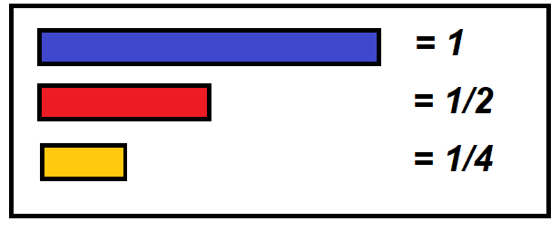
Farm fence fractions exit ticket
Which one of these designs uses the most fencing? Prove your answer.
Design 2.
Design 1.

Slide 12
Teachers’ notes
Sullivan and Lilburn (2015) state that ‘good’ questions are those which:
require more than remembering a fact or reproducing a skill
students can learn by answering the questions, and the teacher learns about each student from the attempt
there may be several acceptable answers.
In his Ted Talk (2010), Dan Meyer gives the following advice:
Use multimedia
Encourage student intuition
Ask the shortest question you can
Let students build the problem
Be less helpful
This time should be a safe maths space for students to share potential thoughts/answers without judgement.
Using this information as a general guide, pose this problem to your class and take on the role of facilitating- posing questions, giving students wait and pause time, allowing students to share their thoughts with others, and differentiating as required for all students to be challenged within their zone of proximal development. Take time at the end of the activity to summarise students’ thoughts, their progress in thinking and clarify any misconceptions.
Meyer, D. (2010, March). Math class needs a makeover [Video]. TEDx.
Sullivan, P. & Lilburn, P. (2015). Open-ended maths activities (2nd Ed). Oxford University Press.

