Slide 1


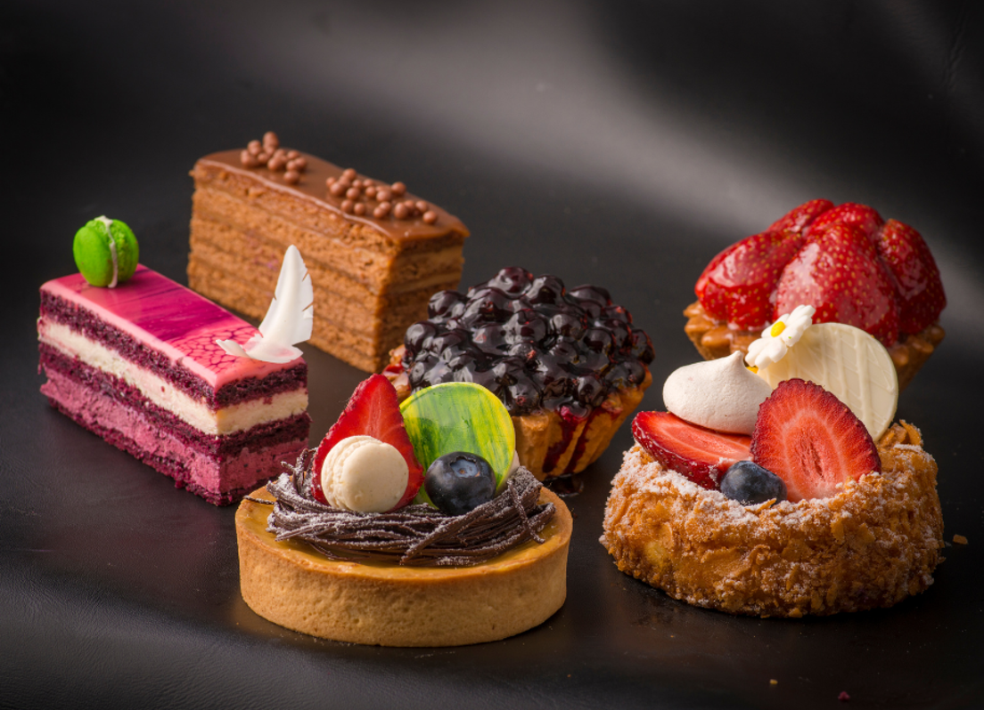
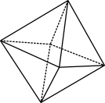

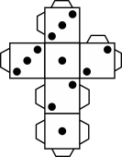
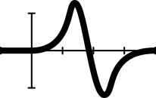


A piece of cake
Notes:
Image: Ruslan Khmelevsky from Pexels
Year 10, Measurement, AC9M10M01 and AC9M10M05
Lesson summary
In this lesson, students build on their skills finding volumes and surface areas of prisms and cylinders, to design a multi-level celebration cake for a party. They use mathematical modelling to vary the size and shape of the component cakes and to calculate how much icing is needed.
Why are we learning about this?
Surface area and volume have many real-world applications, such as calculating how much paint is needed to paint a house or how much chlorine has to be added to a swimming pool. In manufacturing and engineering processes, a detailed understanding of volume and surface area calculations is essential and as most objects are not ‘known solids’, an ability to decompose into separate solids is required.

Slide 2
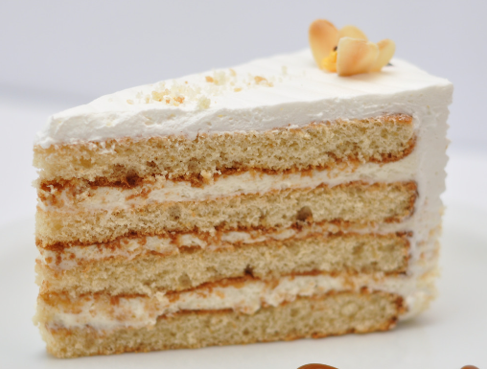
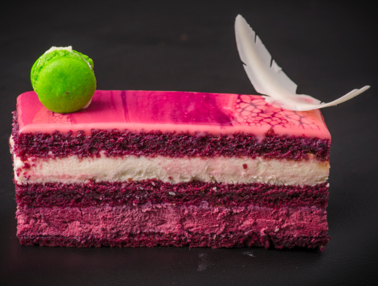
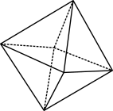

Which is bigger?
What information do you need to know?
Notes:
ASPhotoStudio free image from Canva.com; Ruslan Khmelevsky from Pexels

Slide 3
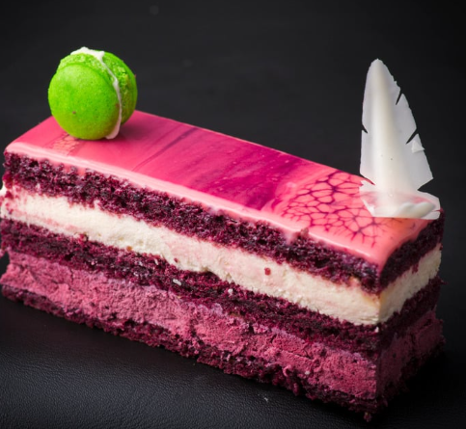

Measurements
40$°$
6cm
5cm
6cm
4cm
8cm
What information do you need to know?
Notes:
ASPhotoStudio free image from Canva.com; Ruslan Khmelevsky from Pexels

Slide 4


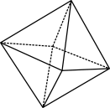

Learning intention
Success criteria
We know how to interpret practical modelling problems involving volume and surface area, understanding how to use decomposition to find volumes and surface areas of composite solids comprised of prisms or cylinders.
Interpret a practical modelling problem, applying their knowledge of 3D solids to meet a design brief.
Use or build a mathematical model in a spreadsheet to generate a set of dimensions for a composite solid to meet minimum volume criteria.
Find the volume and surface area of a composite solid.

Slide 5

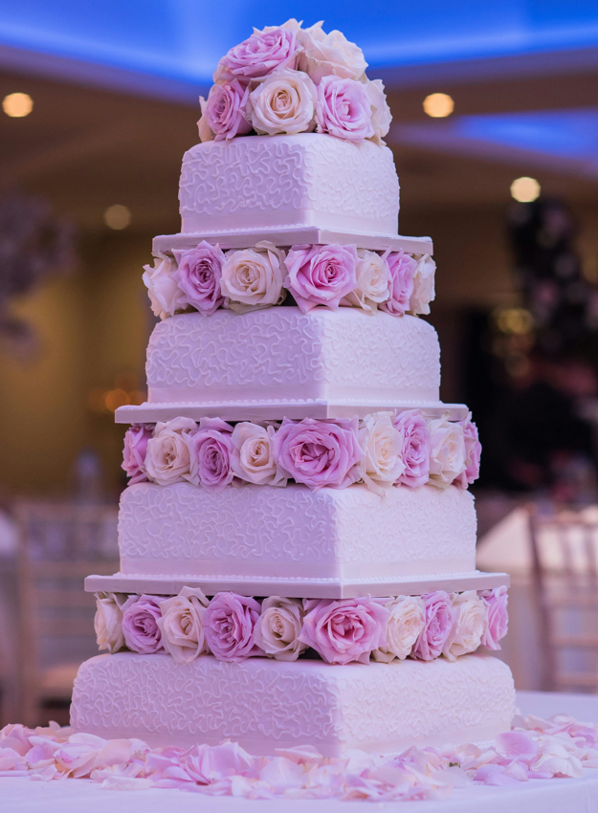
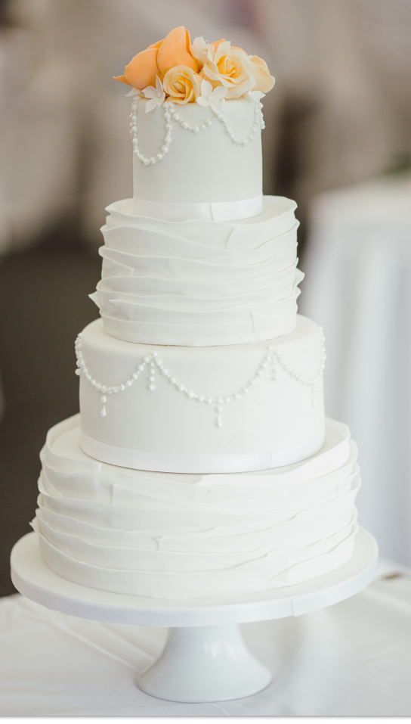
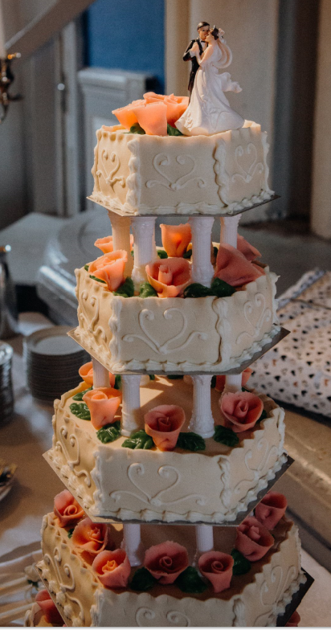
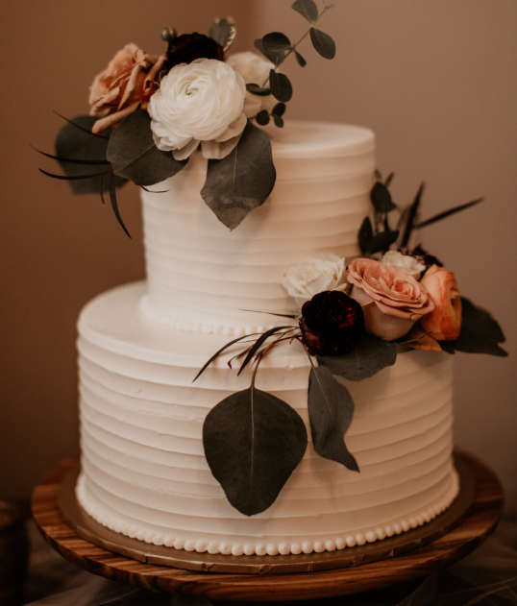
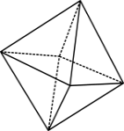
Wedding cakes
Notes:
Images care of Jai Kumar via Pexels; Avonne Stalling via Pexels; Jeremy Wong via Pexels; Rene Asmussen via Pexels

Slide 6
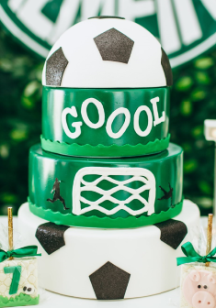
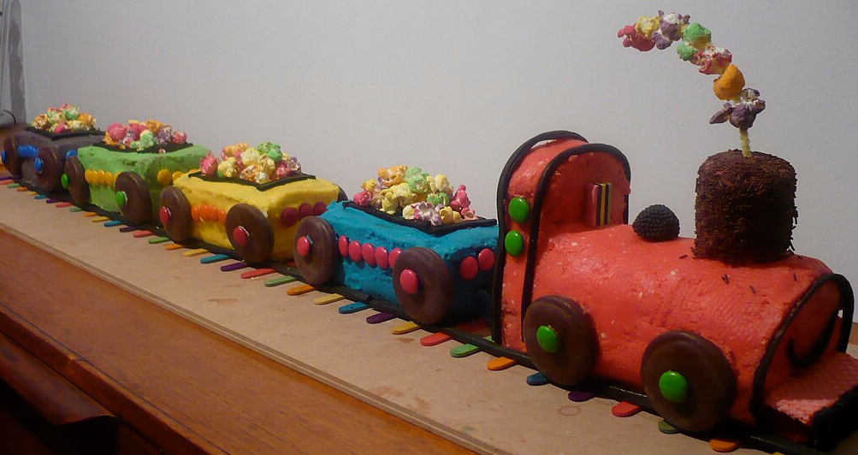
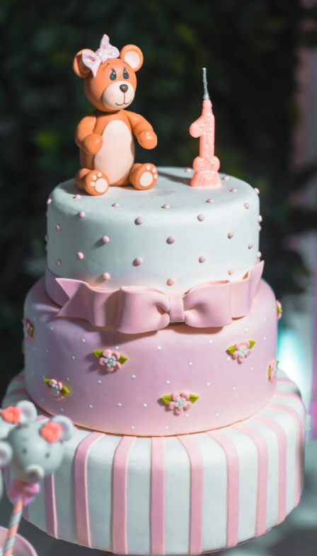
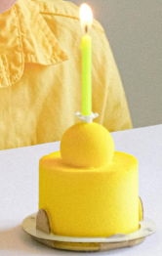
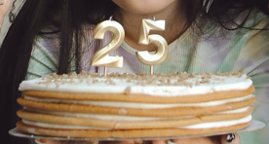
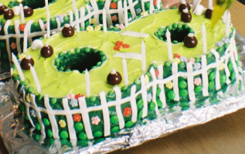
Celebration cakes
Notes:
Images: Helen Lopes via Pexels; Polina Tankilevitch via Pexels; Anna Svetts via Pexels; Rodrigo Souza via Pexels; Jerimah G via Pexels; Ginger Gorman, CC BY-SA 4.0 via Wikimedia Commons

Slide 7
Your mission: design a celebration cake
Choose an occasion: wedding, birthday, baby shower…
Choose the number of party guests who will eat your cake
  (20 to 150).
Your cake design must be a composite solid – made up of at least two separate solids – a stack of cylinders, rectangular prisms or a more complex shape comprising different solids.
Use the portion-size guide to work out the minimum volume of a portion; and hence, the volume your cake needs to be.
Use a spreadsheet model to vary the dimensions of the individual cakes to determine their ideal sizes.
Calculate how many 600 mL tubs of frosting you will need to cover your cake.
Complete the written report explaining your calculations.

Slide 8
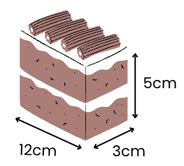
Portion-size guide
This is the ideal size of a piece of cake for one person.
How will you use this information?
Notes:
Image sourced from Canva.com, free from Sketchify Mexico.

Slide 9
Decompose your cake … to find the volume
Find the volume of each individual solid in the cake

Slide 10
Count and calculate surface area
Think about hidden surfaces between cakes and whether they need frosting.
Can you mentally ‘move’ other cakes to fill in odd shapes, making your calculations easier?
Do cakes have frosting underneath?

Slide 11
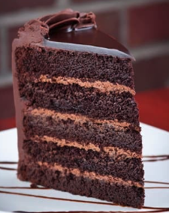
Don’t forget the filling
Think about the filling: a five-layer cakes needs four layers of frosting inside.

Slide 12
Reflection
What did I learn today?
What was tricky today?
How did I approach the problem?
What do I need to remember?

Slide 13
Summary
Composite solids
Be careful …
Split the composite solid into solids you know.
Know your formulae.
Find the volume of each separate solid.
In surface area problems, some sides are hidden and shouldn’t be counted.
‘Move around the shape’ and find each area in turn.
Volume is measured in cm³ and surface area in cm².
Mathematical models
Can be used to solve problems, by changing a range of variables.

