Slide 1


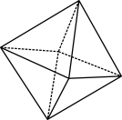

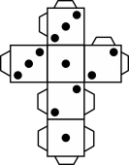
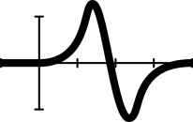


Fruit fractions: Fruit karate

Slide 2

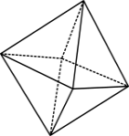

Warm up
True or False? Prove it.
This is half.
© 2020 Commonwealth of Australia, unless otherwise indicated. Creative Commons Attribution 4.0, unless otherwise indicated.
Notes:
Sullivan, P., & Lilburn, P. (2015). Open-Ended Maths Activities (2nd Ed). Oxford University Press. state ‘good’ questions are those which:
Require more than remembering a fact or reproducing a skill
Students can learn by answering the questions, and the teacher learns about each student from the attempt.
There may be several acceptable answers.
Meyer, D. (2010, March). Math Class Needs a Makeover [Video]. TEDx. gives the following advice:
Use multimedia
Encourage student intuition
Ask the shortest question you can.
Let students build the problem.
Be less helpful.
This time should be a safe math space for them to share potential thoughts/answers without judgment.
Using this information as a general guide, pose this problem to your class and take on the role of facilitating- posing questions , giving students wait and pause time, allowing students to share their thoughts with others, and differentiating as required for all students to be challenged within their zone of proximal development. Take time at the end of the activity to summarise students thoughts, their progress in thinking and clarify any misconceptions.

Slide 3
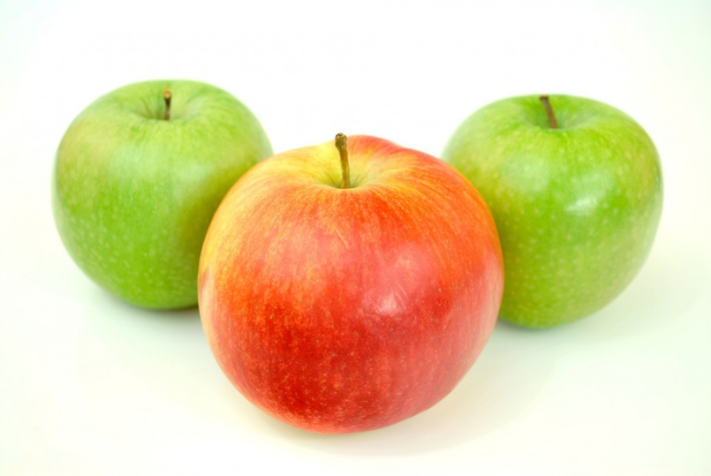
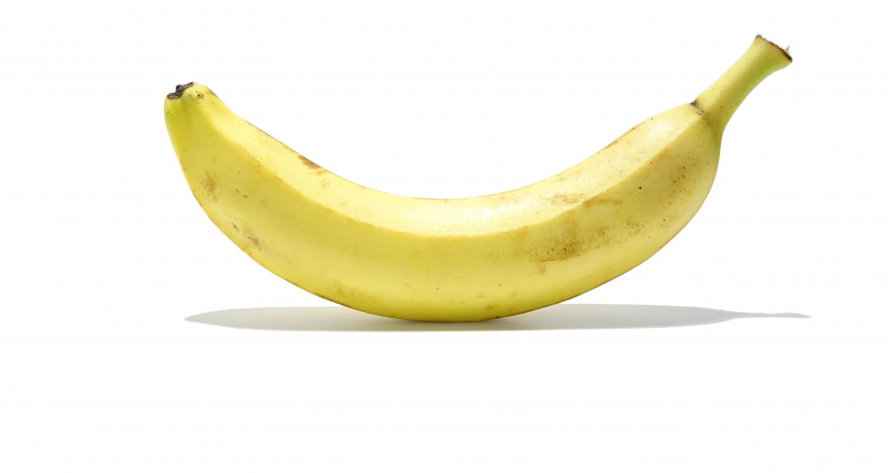
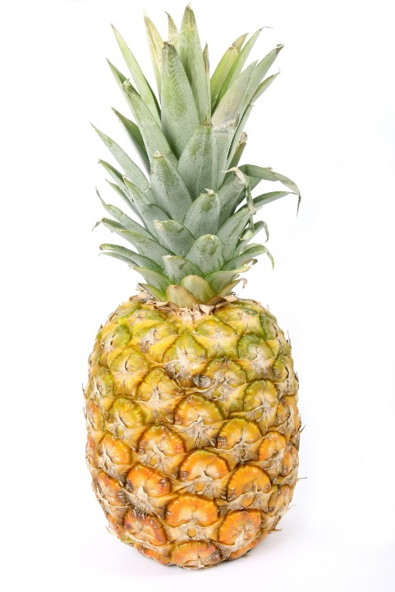
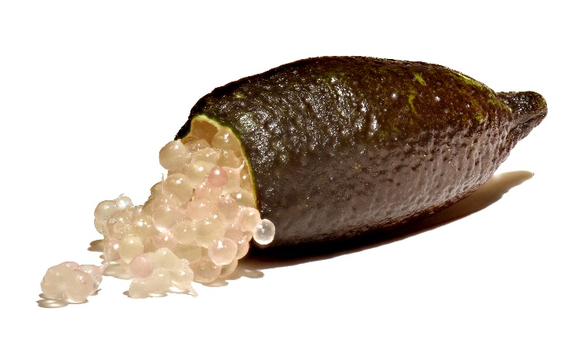
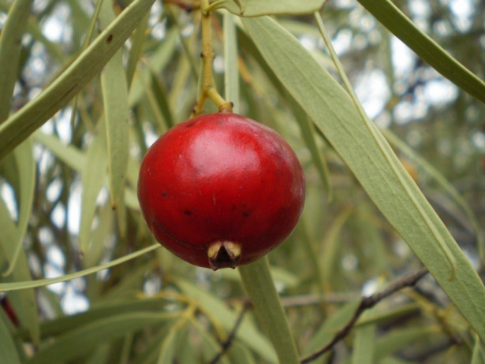
Example fruits
banana
apples
Finger lime
quandong
pineapple
Images: under CC0 1.0 DEED CC0 1.0 Universal
Finger lime: Amada44, CC BY-SA 3.0 via Wikimedia Commons
© 2020 Commonwealth of Australia, unless otherwise indicated. Creative Commons Attribution 4.0, unless otherwise indicated.
Notes:
The images are released free of copyrights under CC0 1.0 DEED CC0 1.0 Universal
Finger lime: Citrus australasica Australian finger lime Amada44, CC BY-SA 3.0 via Wikimedia Commons

Slide 4

Exit ticket
True or False?
Prove it
$\frac{1}{4}$ is bigger than $\frac{1}{2}$
© 2020 Commonwealth of Australia, unless otherwise indicated. Creative Commons Attribution 4.0, unless otherwise indicated.

Slide 5
Teachers’ notes
Sullivan and Lilburn (2015) state that ‘good’ questions are those:
that require more than remembering a fact or reproducing a skill
where students can learn by answering the questions, and the teacher learns about each student from the attempt
where there may be several acceptable answers.
Sullivan, P. & Lilburn, P. (2015). Open-ended maths activities (2nd Ed.). Oxford University Press.
Dan Meyer (2010) gives the following advice:
Use multimedia.
Encourage student intuition.
Ask the shortest question you can.
Let students build the problem.
Be less helpful.
This time should be a safe maths space for students to share potential thoughts/answers without judgement.
Using this information as a general guide, pose this problem to your class and take on the role of facilitating/ posing questions, giving students wait and pause time, allowing students to share their thoughts with others, and differentiating as required for all students to be challenged within their zone of proximal development. Take time at the end of the activity to summarise students’ thoughts, their progress in thinking, and clarify any misconceptions.
Meyer, D. (2010, March). Math class needs a makeover [Video]
© 2020 Commonwealth of Australia, unless otherwise indicated. Creative Commons Attribution 4.0, unless otherwise indicated.

