Slide 1
Angles
Types of angles

Slide 2
Language of angles
Angles are all around us.
Can you recognise angles around you?
Notes:
https://pixabay.com/photos/architecture-building-glass-1839450/

Slide 3
Terms used to describe angles
Have you heard of these terms?
right angle
acute angle
obtuse angle
straight angle
reflex angle
revolution

Slide 4
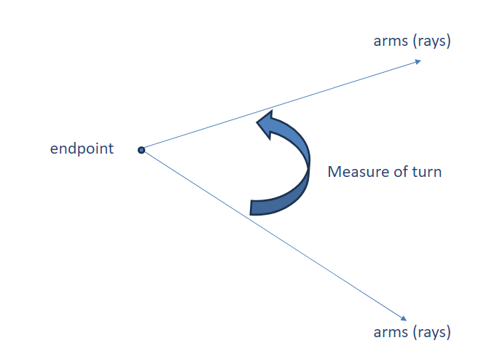
Diagrams of angles
Notes:
Image created in PPT.

Slide 5
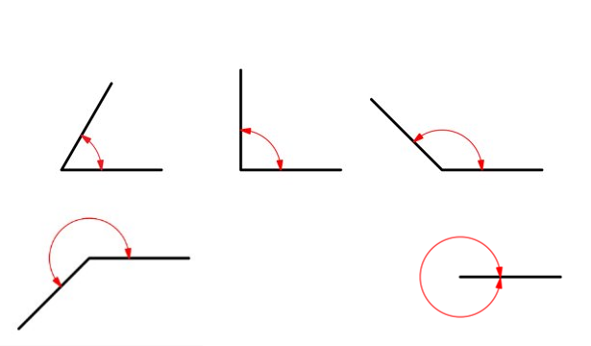
Matching angles
Which type of angle is missing?
Match the diagram with the correct label.
right angle
acute angle
revolution
reflex angle
obtuse angle
straight angle
Image by hannazasimova on Freepik
Notes:
Image by hannazasimova on Freepik
As a class, match the angles on the diagram with the correct label.
Elaborate on each term, as required, to provide a little more information. For example, an acute angle is less than a right angle.
An obtuse angle is more than a right angle but less than a straight angle.
A reflex angle is greater than a straight angle.
The next slide shows the missing angle type.

Slide 6
Missing angle type
Which type of angle is missing?
Match the diagram with the correct label.
acute angle
right angle
obtuse angle
straight angle
reflex angle
revolution
Image by hannazasimova on Freepik
Notes:
Ask students what a straight angle would look like.

Slide 7
Straight angle
Image by hannazasimova on Freepik

Slide 8
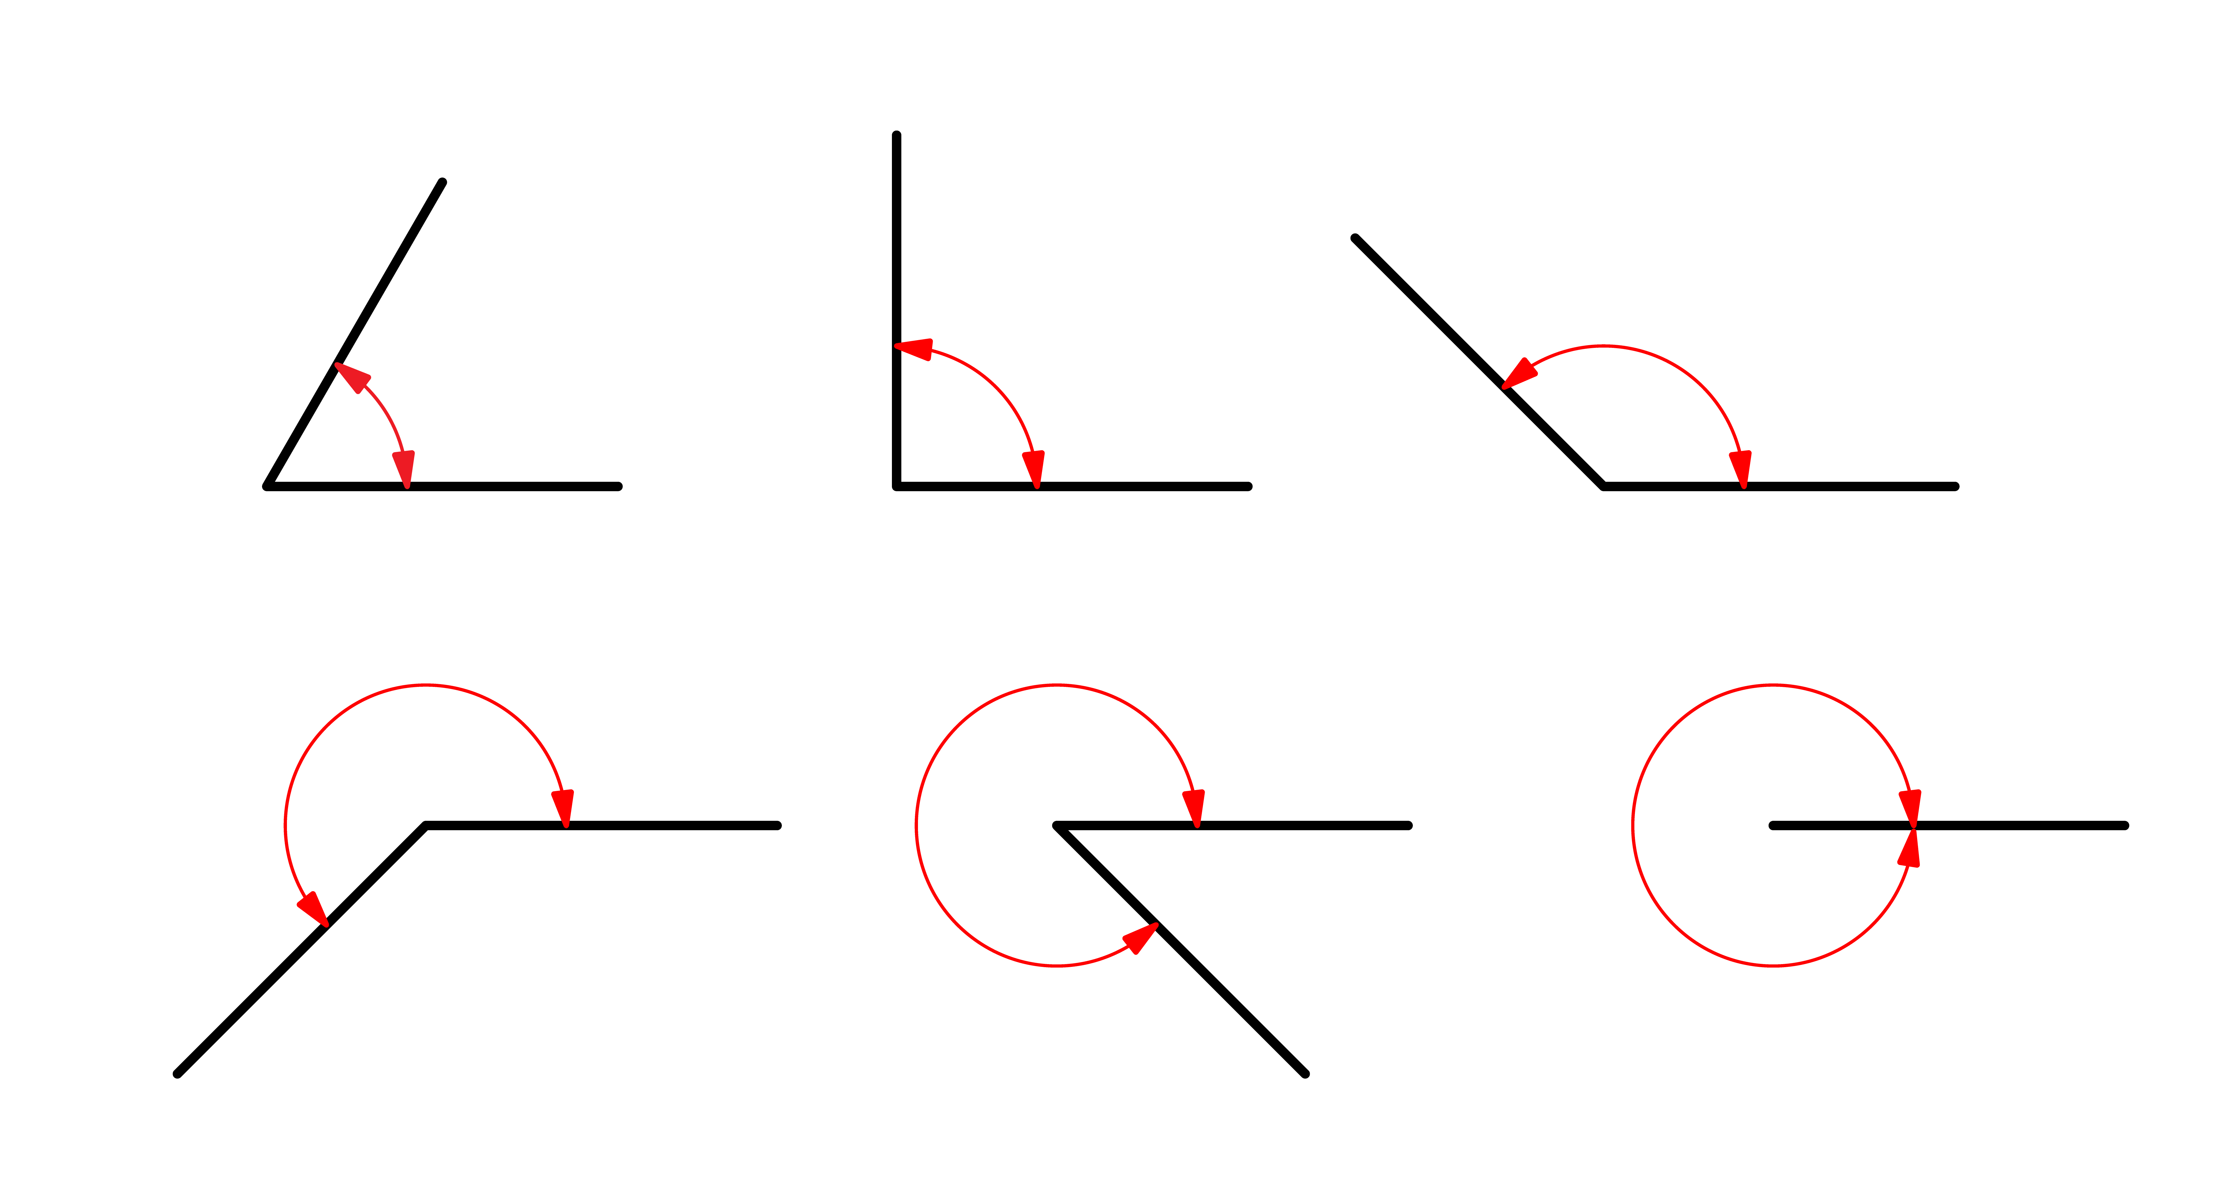
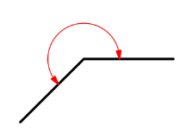
Describe these angles
What is different about each type of angle?
acute angle
right angle
obtuse angle
reflex angle
straight angle
revolution
Image by hannazasimova on Freepik

Slide 9
What do you notice?
Image: pixabay
Notes:
•https://pixabay.com/photos/clock-wall-clock-clock-face-pointer-2634551/
Ask students if they can see:
- an acute angle
- a reflex angle
- an angle that is approximately a right angle.

Slide 10
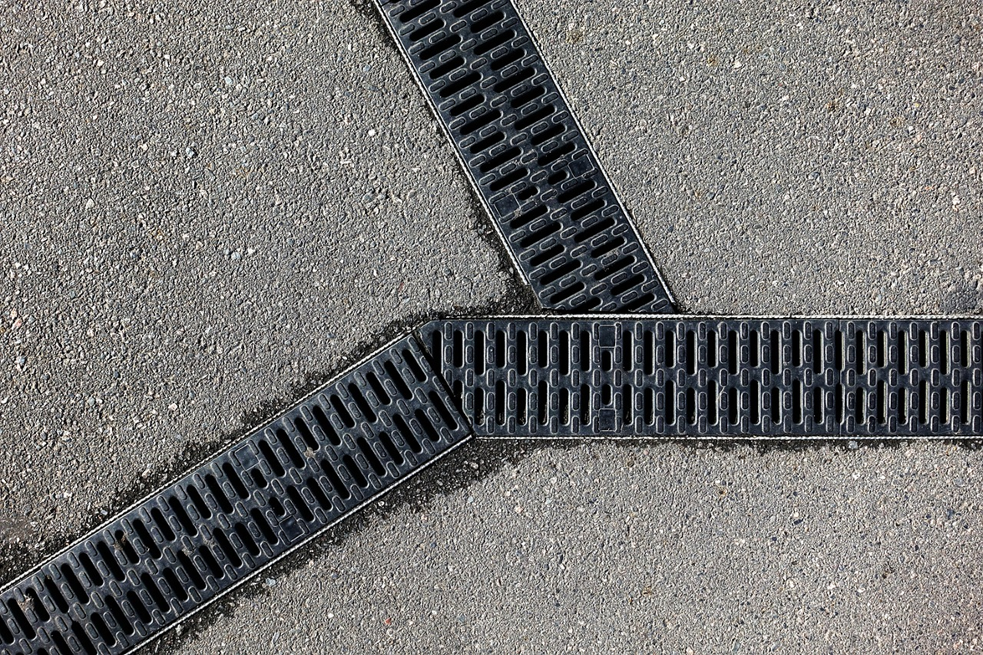
Can you see an acute and obtuse angle?
Image: pixabay
Notes:
•https://pixabay.com/photos/drain-grill-grid-three-pattern-2644484/
Ask students if they can see:
- an acute angle and close to it an obtuse angle?
- how about a reflex angle?

Slide 11
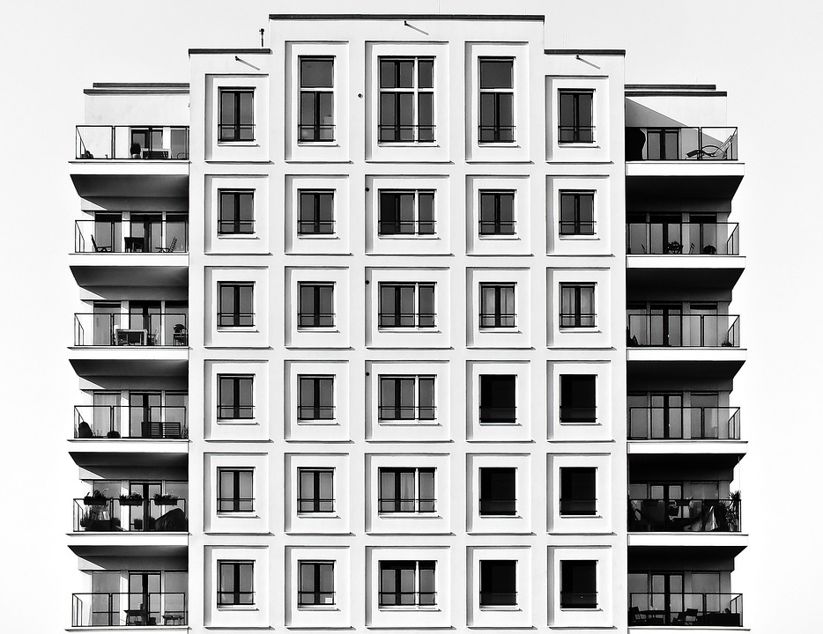
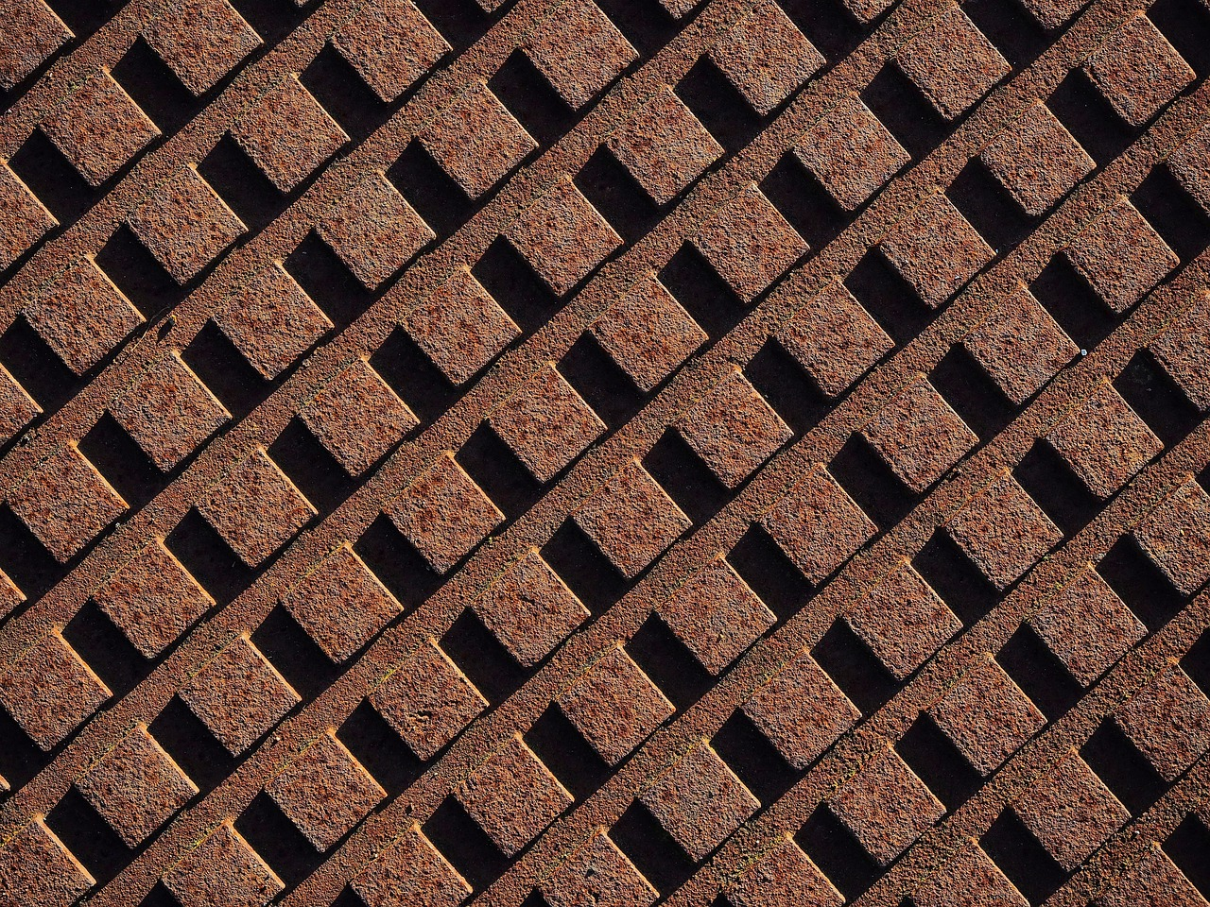
Which is the odd one out? Why?
Images: pixabay
Notes:
https://pixabay.com/photos/rust-rusty-grid-array-pattern-1973251/
https://pixabay.com/photos/architecture-skyscraper-2092849/
https://pixabay.com/photos/black-white-lines-fracture-ice-102549/
https://pixabay.com/photos/structure-acute-angle-urban-4598494/
Ask students if they can see:
- one building mainly made of acute angles; the other images have right angles.
There may be other reasons for an odd one out related to angles.

Slide 12
Angle checker
Make an angle checker with two lengths of card and a split pin fastener.
Image: flickr
Notes:
https://www.flickr.com/photos/oskay/1328635621
Can students use their angle checker to find:
- an acute angle
- an obtuse angle
- a reflex angle
- a right angle.

Slide 13
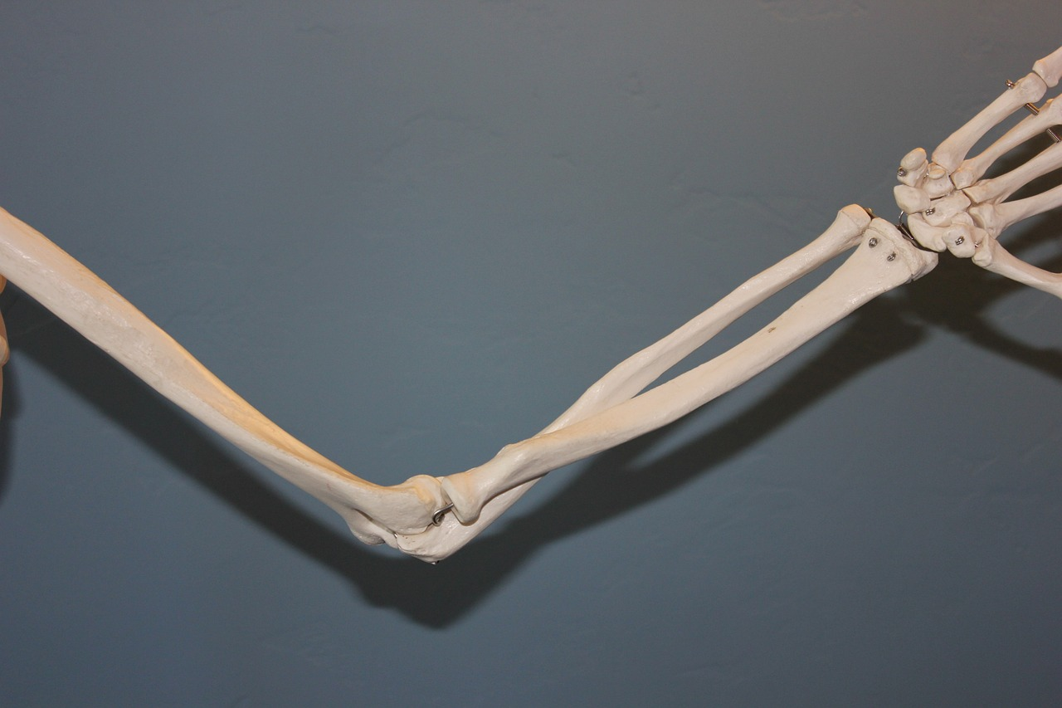
Elbow angles
What angles can you make with your elbow?
Image: pixabay
Notes:
•https://pixabay.com/photos/clock-wall-clock-clock-face-pointer-2634551/
Ask students if they can see:
- an acute angle
- a reflex angle
- an angle which is approximately a right angle.

