Slide 1
How much water does our class use?

Slide 2
Learning intentions
We are learning about identifying important information and devising a plan to solve a practical problem in a real-world context.
We are learning to model a real-world context using approximations to estimate outcomes.
We are learning to read and interpret a household water bill.

Slide 3
Why do I need to know this?
Modelling a real-life context helps us to better understand a context and make informed decisions.
Understanding how much water we use in common household activities helps us become more aware of our consumption, which is critical in a world where water is a finite (limited) resource.
Helping us see the connection between our everyday actions and the larger environmental impact is important for sustainable use of resources.

Slide 4
What uses most water?
Which one of the following do you think uses the most water at home:
Dishwasher
Washing machine
Toilet
Shower
Outdoor
Tap and bath

Slide 5
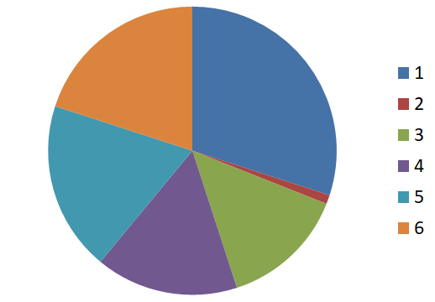
Water usage at home
Activity
Shower
Outdoor
Tap and bath
Washing machine
Toilet
Dishwasher
Notes:
Estimate the percentage of each segment of the pie chart.
Match the segment number and colour to the water usage in the home.

Slide 6
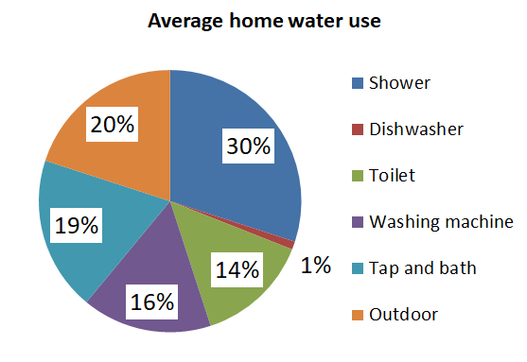
Water usage at home (pie chart %)
Notes:
Data viewed as a pie chart

Slide 7
Water usage at home (table %)
Activity | Home water use
Shower | 30%
Outdoor | 20%
Tap and bath | 19%
Washing machine | 16%
Toilet | 14%
Dishwasher | 1%

Slide 8
How much water does our class use at home?

Slide 9
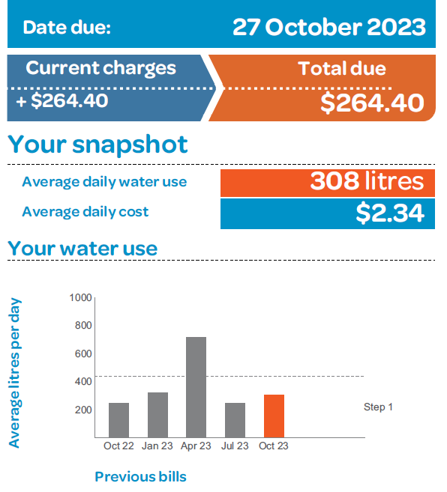
Water bill
This water bill is for a 2-person household.

Slide 10
Summary and reflection
What did you find most surprising about water in the home today?
What units of measure are used when we’re looking at water usage at home?
What steps did you work through to estimate an answer to today’s question?
Why might the amount of water we use a day matter?

