Slide 1


Flight of the osprey
Ranking threats

Slide 2

Quick quiz
In Scotland, ospreys had almost been wiped out in the early 1900s. With conservation efforts, osprey numbers are now increasing.
In the 9 years from 1981 to 1990 the number of birds increased by:
36
72
56
The number of breeding pairs of ospreys in Scotland increased from 26 pairs in 1981 to 62 pairs in 1990.
This increase is:
less than double
double
more than double
Image © 2024 Conservation Without Borders. Permission granted.
In 1981 there were 26 breeding pairs, but by 1990 there were 62 pairs. Of these, 56 pairs successfully laid eggs and 90 young hatched ospreys survived to start their first migration. In 1992 Scotland saw this number climb to 101 of successfully hatched young. In 2001 the number of young raised from the nest in a year was over 200, with 153 pairs of ospreys known to return to Scotland to breed.
Roy Dennis Wildlife Foundation
Working for wildlife
Notes:
Q1.
To calculate the increase in the number of birds from 1981 to 1990, we can find the difference between the total number of breeding pairs in 1990 (62 pairs) and 1981 (26 pairs) and then multiply that difference by 2 (since each pair represents 2 birds):
Increase in number of birds = (Number of pairs in 1990 - Number of pairs in 1981) x 2 Increase in number of birds = (62 - 26) x 2 Increase in number of birds = 36 x 2 Increase in number of birds = 72
Therefore, the number of birds increased by 72 in the 9 years from 1981 to 1990. The correct answer is 72.
The number of breeding pairs of ospreys in Scotland increased from 26 pairs in 1981 to 62 pairs in 1990. This increase is: A) Less than double B) Double C) More than double
Correct Answer: C) More than double
Explanation: Since 62 is greater than double of 26 (which is 52), the increase from 26 pairs to 62 pairs is more than double.

Slide 3
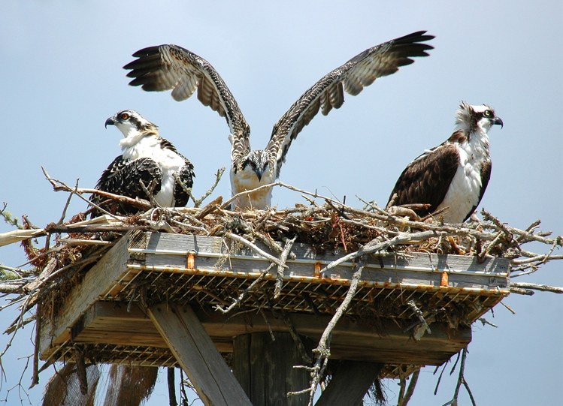
Threats to the osprey
The Conservation without Borders team has seen many of these threats. We would like people to understand what these are and what this means for the osprey, other animal life and us humans.
Research has shown that although osprey are coming back in numbers in the UK, due to protection and conservation, there are still many threats to the osprey as they leave the UK and migrate south.
Image © 2024 Conservation Without Borders. Permission granted.
Image by PublicDomainPictures from Pixabay

Slide 4
Largest threats for migrating osprey
Hunting, trapping and egg collection by humans
We know these are the biggest threats to osprey.
All of them are important and need solutions but we have limited people and funds.
What threat should we tackle first?
Removal of their habitat due to human activities
Collision with power lines and wind turbines
Predators – other predator birds competing for limited food
Pollution of waterways – with plastics and non-biodegradable material
Pesticides and heavy metals – enter the food chain and kill very young osprey
Image © 2024 Conservation Without Borders. Permission granted.

Slide 5
Ranking from 1 to 6
Hunting, trapping and egg collection by humans
As junior researchers we need your input.
List them from 1 to 6, ranking them in order they should be tackled.
Removal of their habitat due to human activities
Collision with power lines and wind turbines
Predators – other predator birds competing for limited food
You may decide to rank them based on their importance, urgency or impact.
Pollution of waterways – with plastics and non-biodegradable material
Image © 2024 Conservation Without Borders. Permission granted.
Pesticides and heavy metals – enter the food chain and kill very young osprey

Slide 6
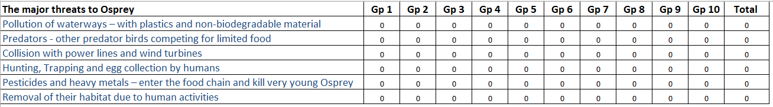
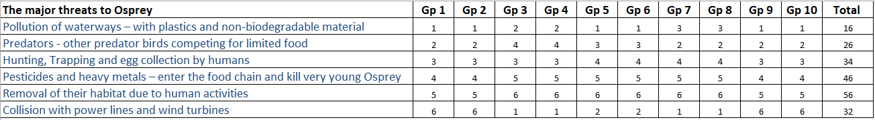
Entering data into a class spreadsheet
Add each group’s ranking to the class spreadsheet
Totals for each group’s ranking is automatically calculated
Notes:
Refer to the bottom table. Point at the total of each row is the sum of each groups ranking for that threat
Point out that the lowest number indicates the highest ranking.
Explain that we can sort this column to show the ranking.
Discuss that the higher number means that is was ranked of lower importance.

Slide 7

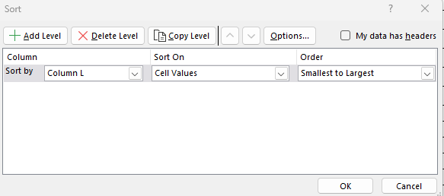
Sort and filter
Next, we need to sort the totals smallest to largest.
Select Sort & Filter from main menu.
Sort smallest to largest.
Notes:
Explain that a spreadsheet can be used to sort information.
We need to sort the totals smallest to largest
Select sort and filter from main menu
Sort smallest to largest

Slide 8
Sorting threats for overall class ranking
An example of a sorted totals for each group’s ranking
The major threats to Osprey | Gp 1 | Gp 2 | Gp 3 | Gp 4 | Gp 5 | Gp 6 | Gp 7 | Gp 8 | Gp 9 | Gp 10 | Total
Pollution of waterways – with plastics and non-biodegradable material | 1 | 1 | 2 | 2 | 1 | 1 | 3 | 3 | 1 | 1 | 16
Predators - other predator birds competing for limited food | 2 | 2 | 4 | 4 | 3 | 3 | 2 | 2 | 2 | 2 | 26
Collision with power lines and wind turbines | 6 | 6 | 1 | 1 | 2 | 2 | 1 | 1 | 6 | 6 | 32
Hunting, Trapping and egg collection by humans | 3 | 3 | 3 | 3 | 4 | 4 | 4 | 4 | 3 | 3 | 34
Pesticides and heavy metals – enter the food chain and kill very young Osprey | 4 | 4 | 5 | 5 | 5 | 5 | 5 | 5 | 4 | 4 | 46
Removal of their habitat due to human activities | 5 | 5 | 6 | 6 | 6 | 6 | 6 | 6 | 5 | 5 | 56
Notes:
Explain that this shows all threats in order sorted based on the total of each group’s ranking.
The lower the number the higher its ranking.

Slide 9
Presenting class results
Chart title: Each group's first ranking
Notes:
Use this chart to describe how we can visualise data (data is a sample only).
Emphasise that this visualisation (pie chart) shows each group's first ranking only.
From this we can see which threat had the highest first ranking.
Can students interpret that the green segment with 27% is largest which relates to the threat removal of their habitat due to human activities?
Which threat is ranked second? (13%) Predators - other predator birds competing for limited food

Slide 10
Reflections
What did you learn about ranking data?
What makes it a useful process to acquire and compare data?
What are some potential problems with this type of data?
Image © 2024 Conservation Without Borders. Permission granted.
Notes:
Ranking is a useful process when acquiring data because it helps to:
Simplify complex data: Ranking allows complex data to be simplified into a more easily understandable form. It provides a clear order of importance or preference among items, making it easier to analyse and interpret.
Facilitate decision-making: Rankings can assist in decision-making processes by highlighting the most important or relevant items. This can be particularly useful when prioritising tasks or resources.
Identify patterns and trends: By ranking data, patterns and trends can emerge more clearly. This can provide valuable insights into relationships between different variables or factors.
Compare and contrast: Ranking allows for direct comparison and contrast between different items. It can help to identify similarities and differences, leading to a deeper understanding of the data.
Communicate Information: Rankings provide a concise and effective way to communicate information. They can be easily understood and shared among different stakeholders.
However, there are also potential problems with using ranking data, including:
Subjectivity: Ranking is often subjective and can be influenced by personal bias or opinion. Different individuals may rank items differently based on their own perspectives and experiences.
Missing information: Ranking data may not provide enough information about the underlying factors that contribute to the rankings. This can make it difficult to understand the reasons behind certain rankings.

Slide 11
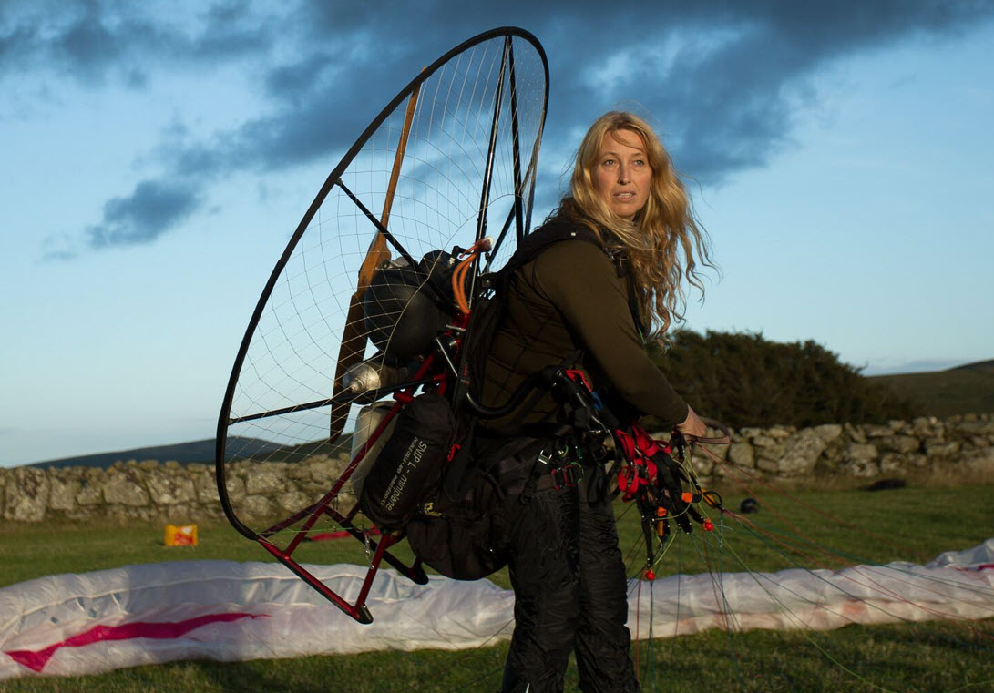
Research complete
Thanks for your help again today!​
I may call on you again.
Image © 2024 Conservation Without Borders. Permission granted.

