Slide 1


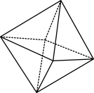

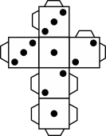
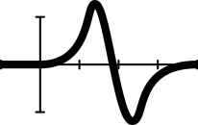


Egg roulette: Part 1
Notes:
Year 9, Probability, 60 mins, AC9M9P01, AC9M9P02 and AC9M9P03
Learning intention
We are learning to understand probability without replacement.
We are learning to analyse compound events visually and numerically.
We are learning to understand the changing probabilities at each stage, including by simulation.
Success criteria
By the end of this lesson, students can:
correctly identify how probabilities change at different stages in a without replacement probability experiment
use an array to find probabilities for two-stage compound events
conduct repeated chance simulations
calculate relative frequencies from collected data to estimate probabilities involving ‘and’ and ‘or’ statements.
Why are we learning about this?
Understanding probability is foundational in mathematics, aiding progression to advanced statistics topics. It intertwines with real-world scenarios, enriching our decision-making and analytical skills. Examples include in genetics, where trait inheritance follows probability patterns, and in games like poker where the odds change with every card drawn. Understanding changing probabilities helps us comprehend the world and make informed decisions.
Key language: compound event with and without replacement, simulation, two-stage compound event, relative frequency, ‘and’ and ‘or’ statements, ‘inclusive or’ and ‘exclusive or’ statements.

Slide 2

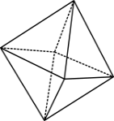

Lavina has tossed a coin four times and got ‘head’, ‘head’, ‘head’, ‘head’.
What do you think the next toss will be?
Explain your answer.
Warm-up question
Notes:
Warm-up question: Gambler’s fallacy
Show the warm-up question in the presentation:
Lavina has tossed a coin 4 times and got Head, Head, Head, Head.
What do you think the next toss will be? Explain your answer
Expected responses include:
‘Heads - because the coin is biased’ - this is a possibility, but there is a $\frac{1}{16}$ of getting 4 heads in a row with a fair coin, which is not that unlikely.
‘Tails – because it’s due’ – which is an example of the Gambler’s Fallacy – this student believes (incorrectly) that a random event (tails) is more likely to happen based on the outcome of the previous series of events, but each toss is independent of the previous ones.
I can’t say – it’s 50/50 between heads and tails – the most correct response.

Slide 3
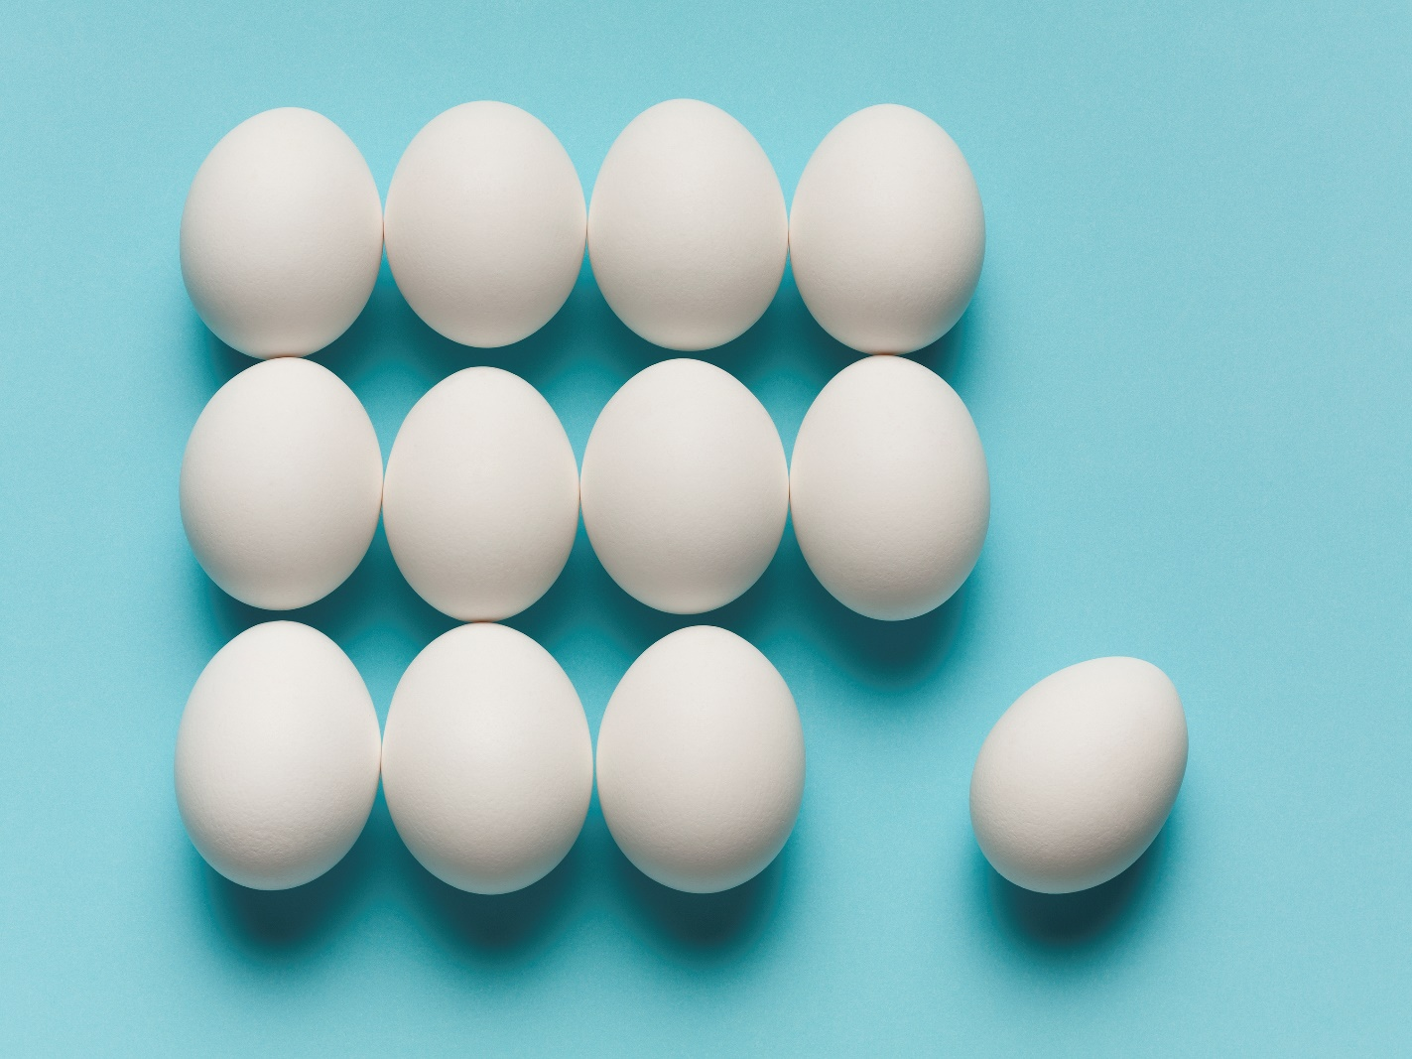
Egg roulette in real life!!
12 eggs:
3 raw
9 cooked
2 teacher’s heads
Notes:
Image: care of Microsoft office
Learning hook: Egg roulette – playing the game
This lesson is based around the game of egg roulette, which is based on a game originally seen in The Tonight Show with Jimmy Fallon. A video has been provided of two teachers playing egg roulette, which can be used as the basis of the lesson. Alternatively, teachers can conduct their own egg roulette in their school (with fellow teachers or possibly with students) or may be able to source videos online from the original TV show with celebrities. The rules of egg roulette are explained in the video, but in essence there are 12 eggs, 3 raw and 9 cooked and the contestants take it in turns to choose an egg and smash it on their head. They are hoping to avoid the 3 raw eggs!

Slide 4
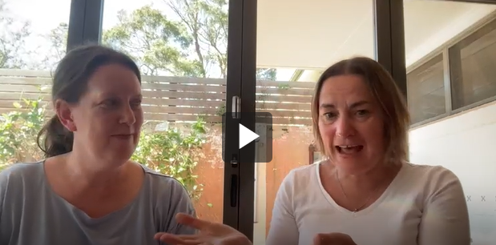
Which teacher will win?
Watch two teachers smash eggs on their heads in the game Egg roulette!
Notes:
Click on the image to bring up the video in your browser. The alternative way to access the video is through the online lesson where the video is embedded in the Learning hook section and a further link provided in the What you need section.
Watch the video and stop at 1min 19s. Ask the students:
‘Can you recap/explain the game to me?’
‘Miriam has chosen to go first. What is the probability that she picks a raw egg? A cooked egg?’ Correct answers: Raw $\frac{3}{12}=\frac{1}{4}$ and Cooked $\frac{9}{12}=\frac{3}{4}$
‘Why might she have chosen to go first? Is that a good idea?’ From a probability point of view, it makes no difference. She may have wanted to get it over with or didn’t want to end up potentially with the last egg and knowing that it had to be raw.
Watch the video and stop at 2min 5s. Ask the students:
‘The first two eggs were cooked. Have they been lucky? Do you think that was the most likely outcome?’ This will be answered in the next activity
‘What do you think is the chance that the next egg (Miriam) is raw? Have her chances of getting a raw egg worsened or improved since the game started? Why?’ Now only 10 eggs remain and 3 are raw so Miriam now has a $\frac{3}{10}$ chance of getting a raw egg versus $\frac{3}{12}$ at the start, so she now has more chance of getting a raw egg
Watch the video and stop at 3min 19s. Ask the students:
‘Miriam says Denise was right not to have a good feeling about that egg. Was Miriam right or was Denise just unlucky? What was the probability that Denise got an egg that go?’ Before Denise chose, 9 eggs remained and 3 were raw so Denise had a $\frac{3}{9}=\frac{1}{3}$ chance of getting a raw egg. Although the chance of picking a raw egg has kept increasing as more and more cooked eggs were gone, she still had a higher chance of choosing a cooked egg than a raw one.
‘Now Denise has got a raw egg how have things changed? What is the chance that Miriam gets a raw egg in her next go?’
Both the number of eggs AND the number of raw eggs have changed. Now 8 eggs remain and 2 are raw so Miriam now has a $\frac{2}{8}=0.25$or $25\%$ chance of getting a raw egg, but the go before she had a $\frac{3}{10}=0.3$or $30\%$ chance of choosing a raw egg. The odds of Miriam picking well have improved now one of the raw eggs is gone.
Watch the video and stop at 3min 47s. Ask the students:
‘Denise says it’s impossible to get two in a row. Miriam says it is possible. Why does Denise think this? Who is correct?’ Denise is falling for the Gambler’s Fallacy and she doesn’t want to pick a raw egg. With 7 eggs remain and 2 are raw, Denise has a $\frac{2}{7}≈29\%$chance of choosing a raw egg, so Miriam is correct, it really is quite possible.’
Watch the video and stop at 4min 19s. Ask the students:
‘After she got two eggs in a row, Denise says that this is not very fair. Is she correct?’ The game is completely fair – there are 12 possible times that a raw egg could be picked and there are 3 raw eggs. They are equally likely to end up in any of the 12 time slots. Denise just doesn’t feel it’s fair because she’s had two in a row, but that is just bad luck.
‘Denise then says Miriam has to get one. Is this correct? What is the chance Miriam now gets a raw egg?’ There are 6 eggs remaining and only one raw egg, so Miriam has a $\frac{1}{6}≈17\%$ chance of choosing raw. This is the best chance she has had all game because there are so few raw eggs remaining. So, Denise is quite wrong – Miriam would be quite unlucky if she chose a raw egg.
Finish watching the video

