Slide 1
Pocket money
Classroom talk

Slide 2
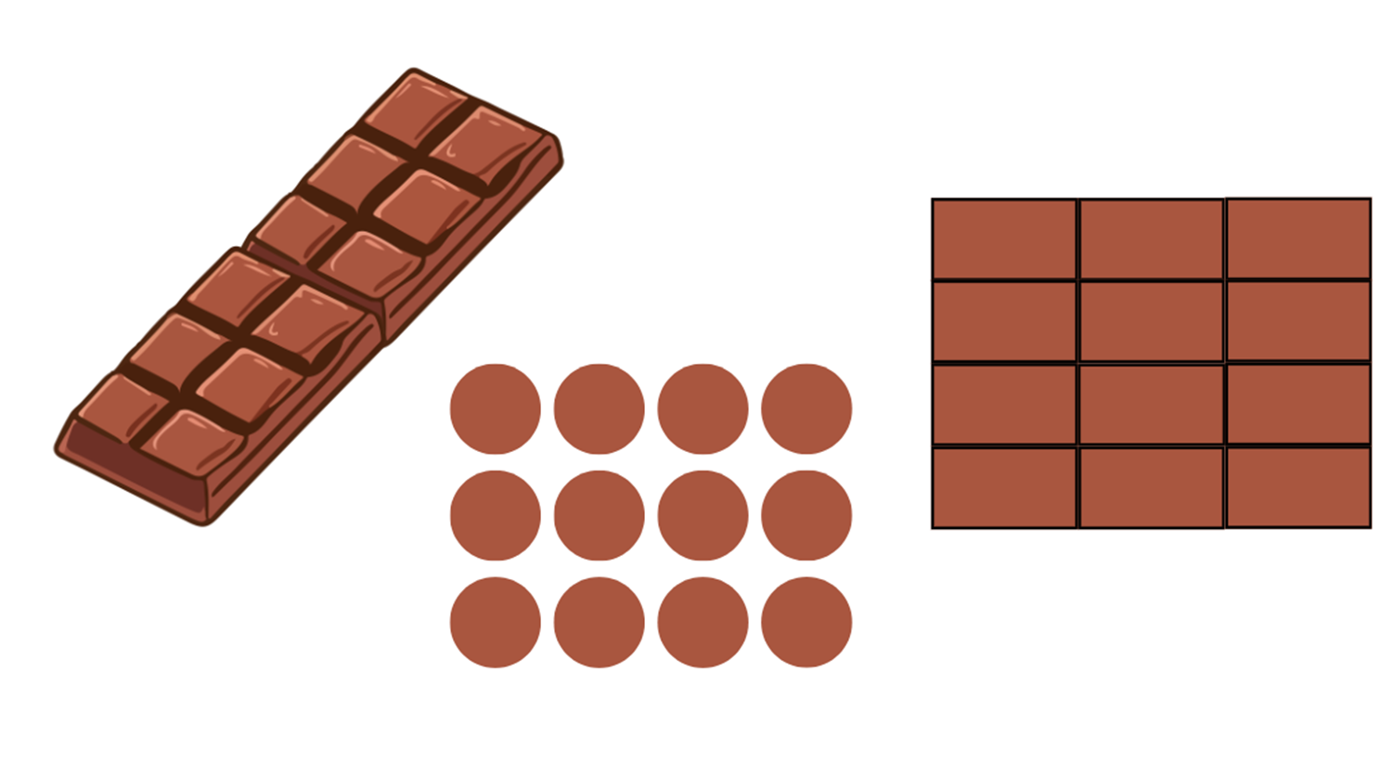
What’s the same? What’s different?
Notes:
Images created in Canva (M.Richards)

Slide 3
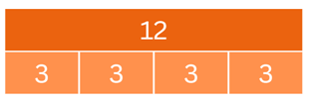
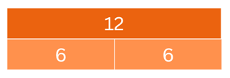
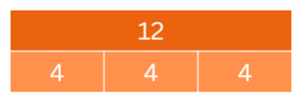
Bar model
Notes:
Images created in Canva (M.Richards)

