Slide 1
Learning number
through First Nations
leaf games and stories

Slide 2
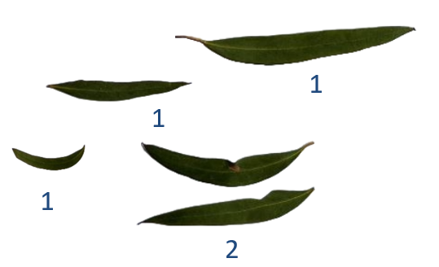
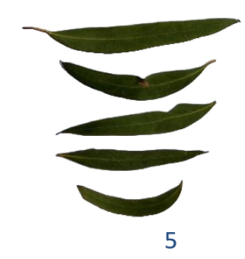
Yuendumu leaf games – 1
What story could you make with these leaves?
Image credit: Caty Morris
Notes:
Show the animation by using mouse clicks to advance the animated leaves.

Slide 3
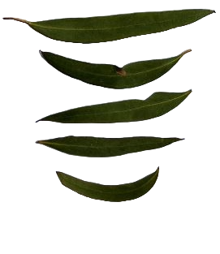



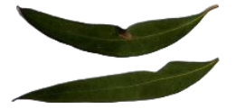
Follow the story
What story could you make with these leaves?
1
1
1
5
2
Image credit: Caty Morris

Slide 4
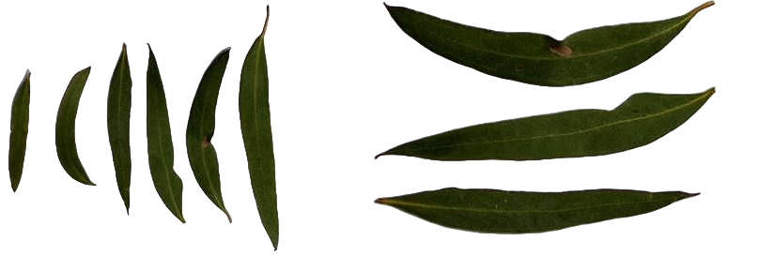
Yuendumu leaf games
What story could you make with these leaves?
3
8
5
Image credit: Caty Morris

Slide 5
Using drawings and numerals
Represent your leaf story with circles and numerals.
3
8
5

