Slide 1
Angles
Chalk designs

Slide 2
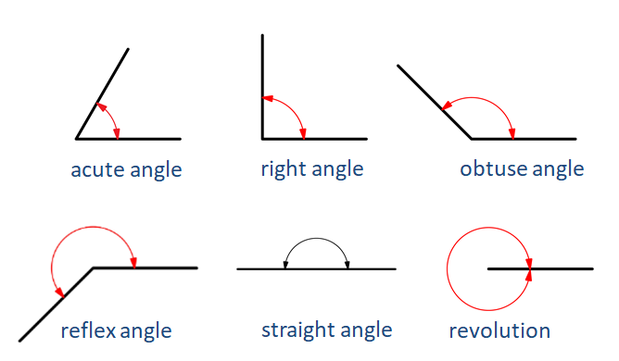
Review of angles
Image by hannazasimova on Freepik

Slide 3
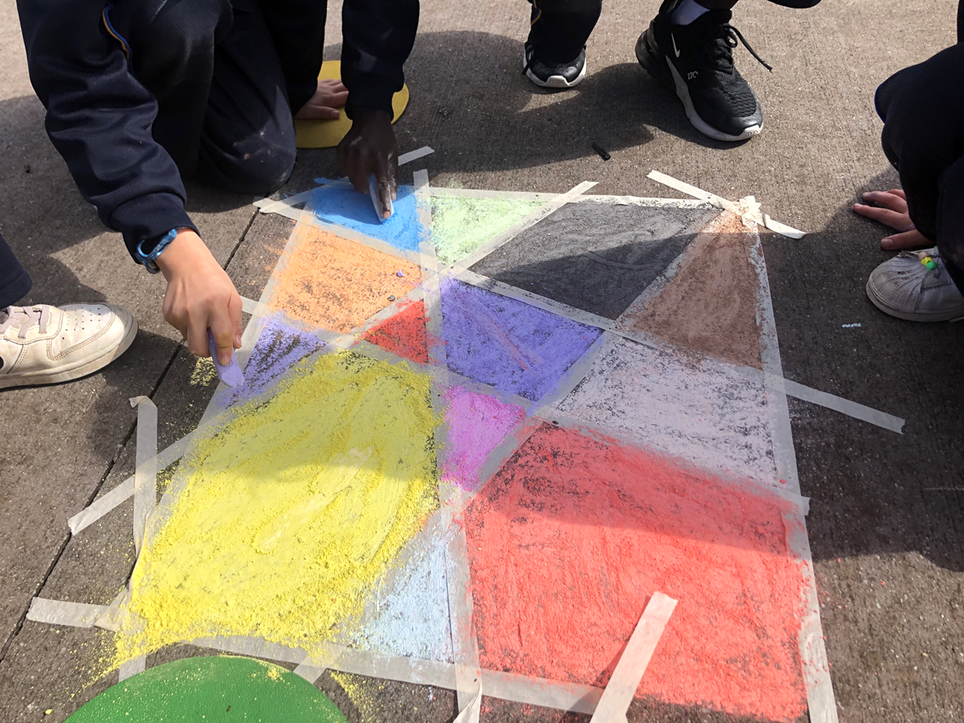
Activity: chalk designs
Images: Cass Lowry

Slide 4
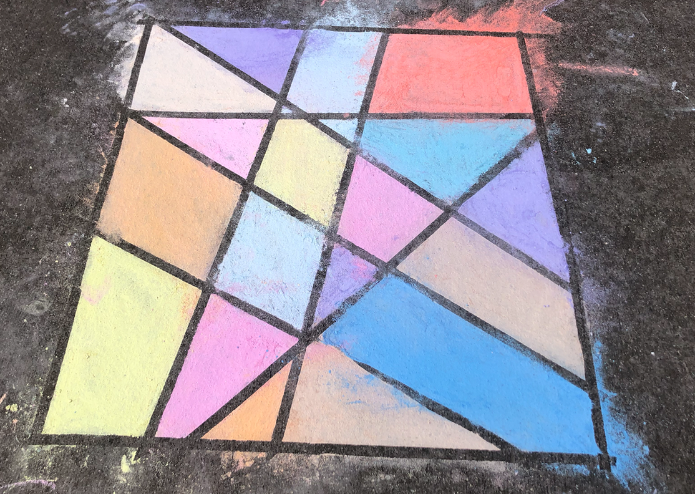
Chalk designs angle hunt
What angles do you notice?
Images: Cass Lowry

