Slide 1


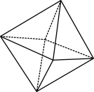

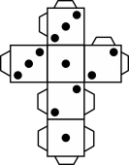
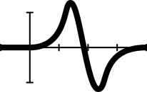


Pythagoras’ theorem two ways
Notes:
Year 9, Measurement, 60 mins,
AC9M9M03: Students learn to solve spatial problems, applying angle properties, scale, similarity, Pythagoras’ theorem and trigonometry in right-angled triangles.
Students can use Pythagoras’ theorem to calculate unknown side lengths in right-angled triangles after undertaking a step-by-step simultaneous method of working through visual and algebraic proofs simultaneously. This approach is designed to help students develop deeper connections between algebra and measurement in a Pythagoras context.
Why are learning about this?
Learning about and using Pythagoras’ theorem as a tool to solve mathematical problems can relate and be applied to an extraordinary number of fields and scenarios, such as design, architecture, building, engineering and computer science to name a few. If you want to get take the shortest distance between two point and get there faster, use Pythagoras’ theorem.

Slide 2

Learning intention
We will use Pythagoras’ theorem to calculate unknown side lengths in right-angled triangles.
We will prove Pythagoras’ theorem using measurement skills and knowledge.
To do this, I will review:
calculating squares and square roots with and without the use of technology.
simplifying surds (extension).
Success criteria
Approaching | At standard | Above
I can correctly label the sides of right-angled triangles with ‘a’, ‘b’ and ‘c’. | I can prove Pythagoras’ theorem by creating a set of three squares. | + I can investigate and recreate an algebraic proof for Pythagoras’ theorem.
I can use Pythagoras’ theorem to calculate unknown side lengths in right-angled triangles. | I can identify the need to use Pythagoras’ theorem as one element of a solution to a broader spatial problem. | + I can apply Pythagoras’ theorem and trigonometry in tandem to solve practical problems.
Notes:
Students can select the LI/SC most appropriate for them and write it in their exercise books underneath the title.
Slides 1 & 2 introduces the learning intention and success criteria for students and prepares students to tap into what they already know about the topic of algebra, linear relationships, number sense.
Note that the lesson plan: Year 8 lesson plans: Pythagoras investigations and applications; Pythagoras: Cartesian coordinate plane and Pythagoras triples are the natural the natural precursor to this lesson and sets up the scaffolding neatly. However, this lesson can be used as a standalone.

Slide 3

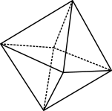

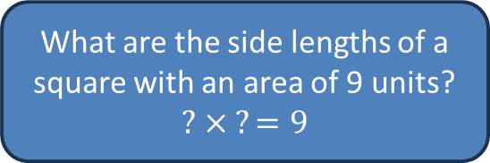
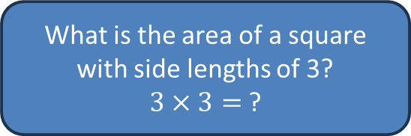


Skill check
Use the image to the left as a prompt to explain to the person sitting next to you what a square number is.
Can you create similar diagrams to illustrate why 25 is a square number, but 24 is not?
$$3^{2}$$
$$\sqrt{9}$$
What is the area of a square with side lengths of 3?
$3×3=$?
What are the side lengths of a square with an area of 9 units?
$$? × ?=9$$
Notes:
Students share the responses of their peers.

Slide 4
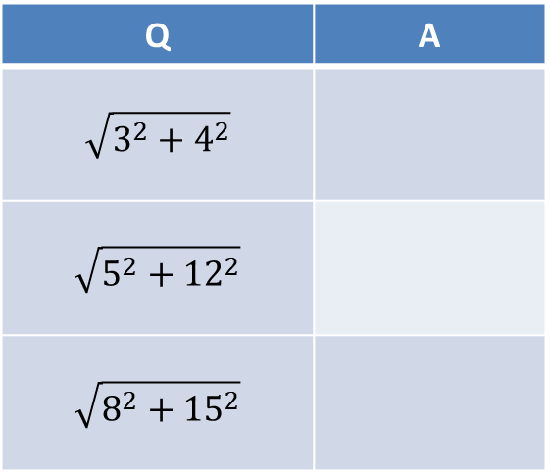
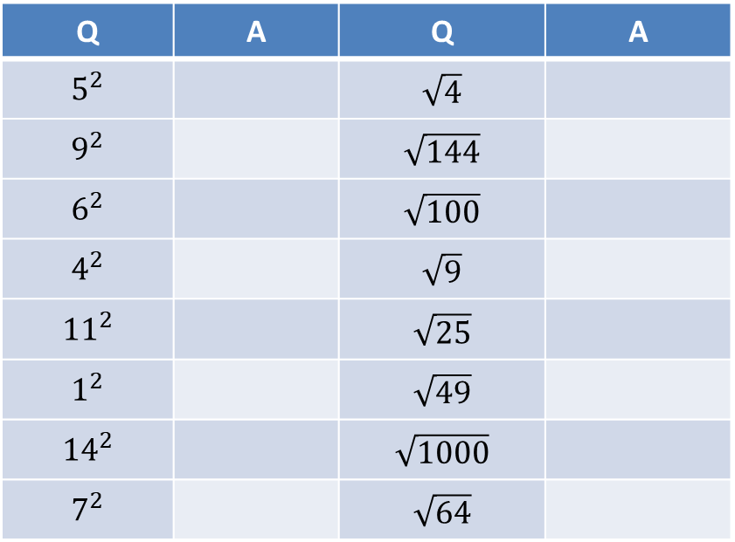
Keep checking!
These calculations should be done without technology!
Q | A | Q | A
$$5^{2}$$ |  | $$\sqrt{4}$$
$$9^{2}$$ |  | $$\sqrt{144}$$
$$6^{2}$$ |  | $$\sqrt{100}$$
$$4^{2}$$ |  | $$\sqrt{9}$$
$${11}^{2}$$ |  | $$\sqrt{25}$$
$$1^{2}$$ |  | $$\sqrt{49}$$
$${14}^{2}$$ |  | $$\sqrt{1000}$$
$$7^{2}$$ |  | $$\sqrt{64}$$
Q | A
$$\sqrt{3^{2}+4^{2}}$$
$$\sqrt{5^{2}+{12}^{2}}$$
$$\sqrt{8^{2}+{15}^{2}}$$
You’ve got this!
Notes:
Students share the responses of their peers.

Slide 5
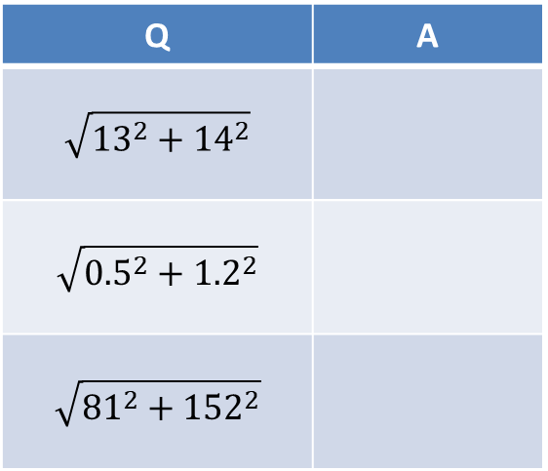
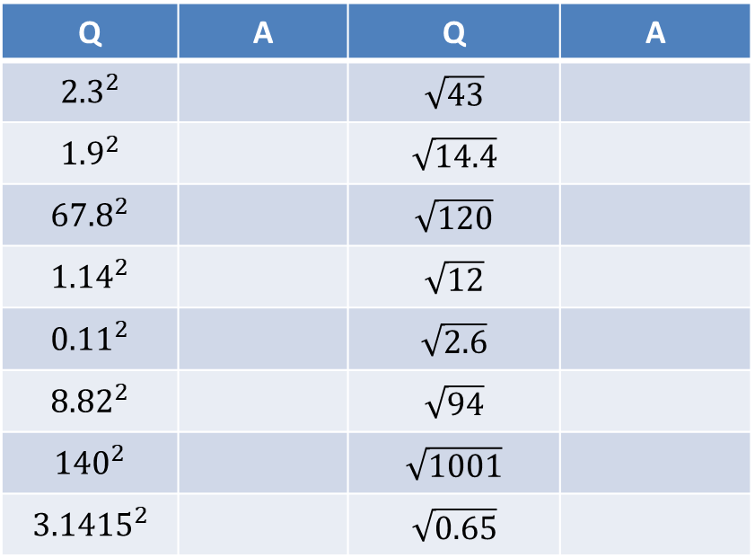
More checking
These calculations can be done with technology! Round your answers to 2 decimal places.
Q | A | Q | A
$${2.3}^{2}$$ |  | $$\sqrt{43}$$
$${1.9}^{2}$$ |  | $$\sqrt{14.4}$$
$${67.8}^{2}$$ |  | $$\sqrt{120}$$
$${1.14}^{2}$$ |  | $$\sqrt{12}$$
$${0.11}^{2}$$ |  | $$\sqrt{2.6}$$
$${8.82}^{2}$$ |  | $$\sqrt{94}$$
$${140}^{2}$$ |  | $$\sqrt{1001}$$
$${3.1415}^{2}$$ |  | $$\sqrt{0.65}$$
Q | A
$$\sqrt{{13}^{2}+{14}^{2}}$$
$$\sqrt{{0.5}^{2}+{1.2}^{2}}$$
$$\sqrt{{81}^{2}+{152}^{2}}$$
You’ve got this!
Notes:
Students share the responses of their peers.

Slide 6
Two truths and a lie
I was the leader of a cult who abstained from many pleasures and were sworn to secrecy.
There is a statue of me in Greece with a giant triangle.
I was the first person to refer to myself as a ‘philosopher’ (lover of wisdom).

Slide 7
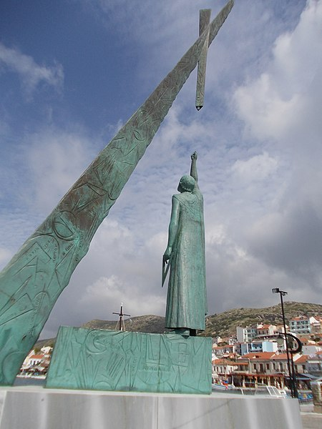
Two truths and a (half) lie
I was the leader of a cult who abstained from many pleasures and were sworn to secrecy.
There is a statue of me in Greece with a giant triangle.
I was the first person to refer to myself as a ‘philosopher’ (lover of wisdom).
Now it’s your turn
Notes:
Image: Cuxfoto, CC BY-SA 4.0 <https://creativecommons.org/licenses/by-sa/4.0>, via Wikimedia Commons
There are many claims and discoveries attributed to Pythagoras but historians are uncertain about how many of them can be directly linked to him, including his claim. He had a number of followers who may have made the discoveries themselves and attributed the credit to Pythagoras to glorify his name.
Students create their own version of ‘two truths and a lie’ about Pythagoras.

Slide 8
Let’s discover the theorem ourselves:
Step 1
a
b
Visual proof
Each student receives a square piece of card. They place the card on a blank piece of paper and trace around the edges to create a second, equal-sized square.
Each side of the square must be split into two unequal lengths. This split must be replicated across all sides. Mark out the point at which these lengths meet on each side.
Label one set of lengths as ‘a’ and the other as ‘b’.
Algebraic proof
Determine an expression for the total area of the square in terms of ‘a’ and ‘b’.
b
a
a
b
b
a
Notes:
Students share the responses of their peers.

Slide 9
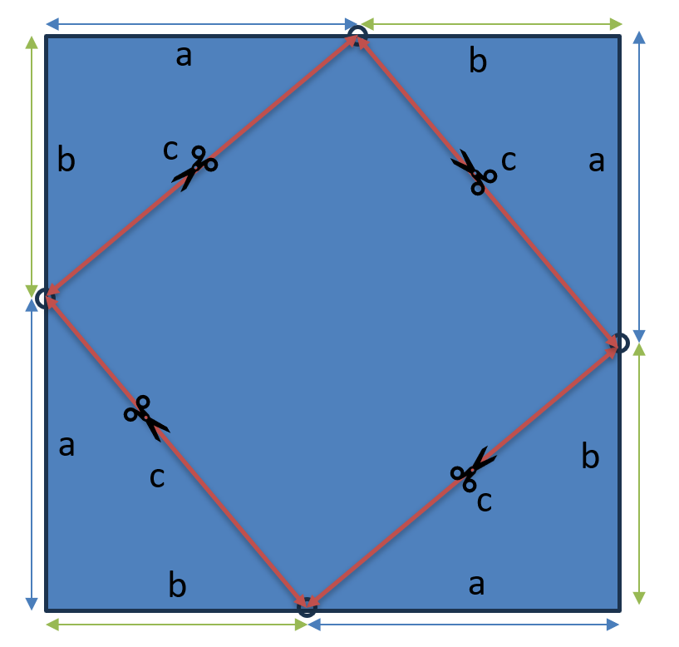
Step 2
Visual proof
Draw an edge between the inner endpoints of each pair of adjacent ‘a’ and ‘b’ lengths.
Label these new lengths as ‘c’ and cut along them to create a set of four triangles and one square.
Algebraic proof
Determine an expression for the area of the four triangles and new, smaller square.
The combined area of these five shapes must be equal to the area of the large square determined in the previous step.
Notes:
Students share the responses of their peers.

Slide 10
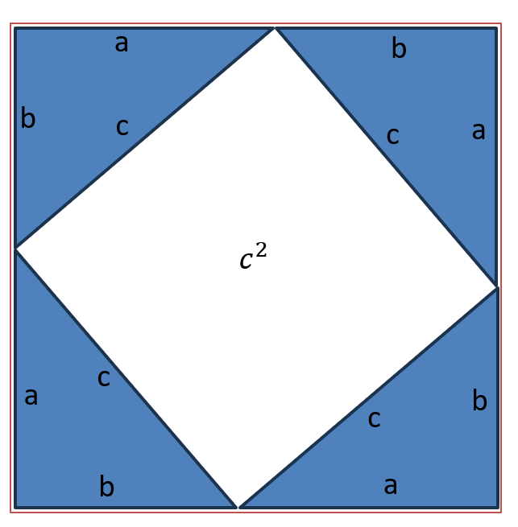

Step 3
Visual proof
Remove the inner square to create a blank space with an area that is equal to $c^{2}$.
Move the four triangles around within the outer square to change the shape of the blank space from a single square to two smaller squares.
Algebraic proof
Equate the two expressions you have determined to create an equation.
Area of outer square = area of four triangles + area of inner square
Simplify the equation.
Notes:
Students share the responses of their peers.

Slide 11
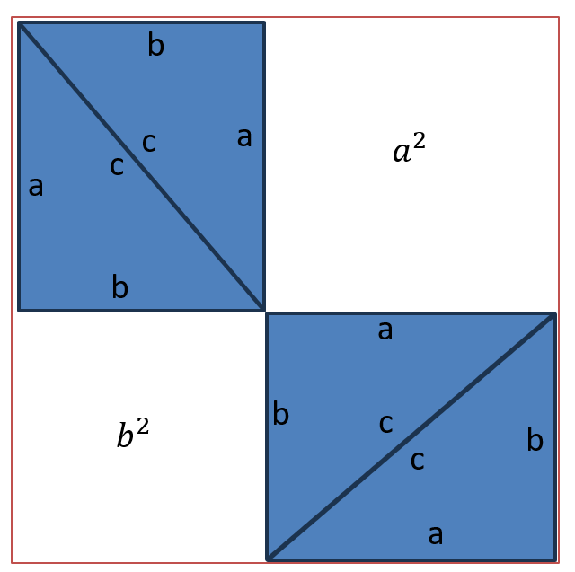

Step 4
Visual proof
The blank space which we already know is equal to $c^{2}$ can be rearranged to also be equal to $a^{2}+b^{2}$. So therefore …
$$a^{2}+b^{2}=c^{2}$$
Algebraic proof
By cancelling out the $2ab$ on each side of the equation you should be left with …
$$a^{2}+b^{2}=c^{2}$$
Congratulations! You have single-handedly proved the famous Pythagoras’ theorem!
Notes:
Students share the responses of their peers or the class.

Slide 12
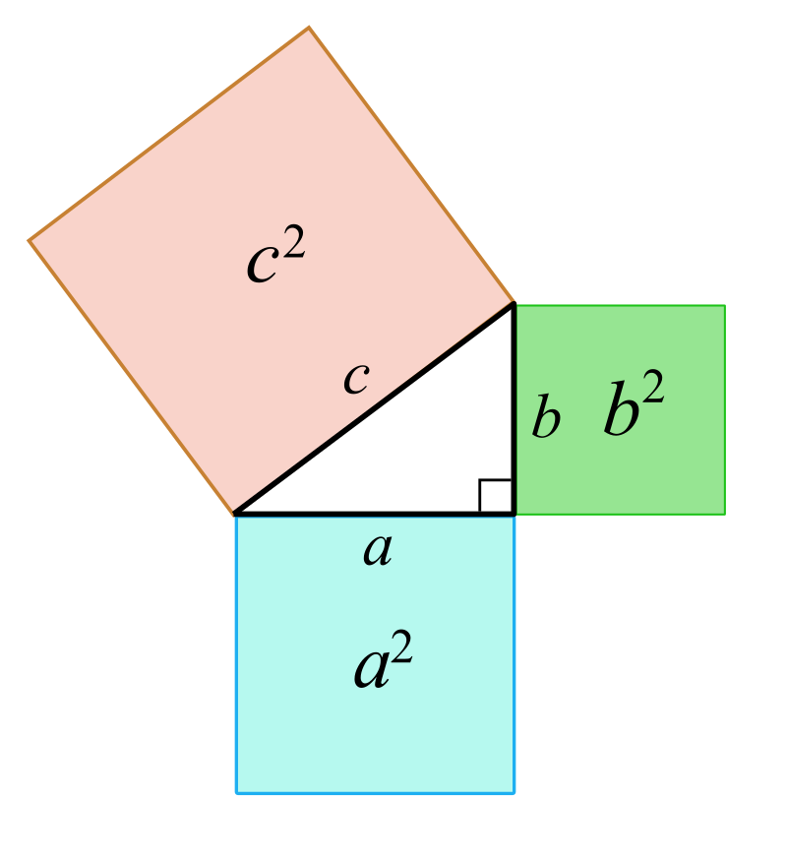

Let’s use the theorem
Equations are mathematical representations of relationships.
Pythagoras’ theorem tells us that there is a relationship between the three sides of right-angled triangles.
We can use this relationship to determine an unknown side length, provided we know the lengths of the other two sides.
We will practise this in two stages.
Finding the hypotenuse (c)
Finding a shorter side (a or b)
$$a^{2}+b^{2}=c^{2}$$

Slide 13








Stage 1 – Finding the hypotenuse
I do
We do
$$a^{2}+b^{2}=c^{2}$$
$${__}^{2}+{__}^{2}=x^{2}$$
$$___+___=x^{2}$$
$____$ $=x^{2}$
$$x= ____$$
$$x$$
$$6 cm$$
$$x$$
$$12 cm$$
$$8 cm$$
$$5 cm$$

Slide 14






You find the hypotenuse
You do
$$x cm$$
$$9 km$$
$$x$$
$$8 cm$$
$$10 cm$$
$$3 km$$
Round your answers to 2 decimal places.

Slide 15







Stage 2 – Finding a shorter side
I do
We do
$$a^{2}=c^{2}−b^{2}$$
$${__}^{2}+{__}^{2}=x^{2}$$
$$___+___=x^{2}$$
$____$ $=x^{2}$
$$x= ____$$
$$5 cm$$
$$x$$
$$17 m$$
$$x$$
$$4 cm$$
$$8 m$$

Slide 16






You find the shorter side
You do
$$34 mm$$
$$10 cm$$
$$33 mm$$
$$x$$
$$7 cm$$
$$x$$

Slide 17




Scale and similarity
$$102 mm$$
$$5 cm$$
$$99 mm$$
$$x$$
$$3.5 cm$$
$$x$$
Notes:
Identifying similar triangles is a key skill at this level and it is worth taking the time now to review this concept, with a particular focus on the RHS test. Then, flick between slides 16 and 17 and ask students if they can spot the relationship between the triangles on each slide. The left triangle has been scaled by a factor of 3 and the right triangle has been scaled by a factor of 0.5 from the previous slide. Since students have already determined the missing side lengths in the previous activity, they can now use their knowledge of similarity to determine the missing lengths of on slide 17, without using the theorem. This is a good opportunity to reinforce that there can be simpler ways to tackle a problem if you already have prior information. While working through Pythagoras will give the same result, it is not necessary to perform these tedious calculations, given we have identified the triangles as similar.
Ask students to draw an additional version of each triangle that has been scaled by a new factor and determine the missing length. These can be shared with the class and listed on the board. This can help to draw out the idea that there are an infinite number of triangles with the same shape and are merely scaled up or down.

Slide 18
Pythagorean triples
a | b | c
3 | 4 | 5
6 | 8 | 10
5 | 12 | 13
9 | 12 | 15
8 | 15 | 17
12 | 16 | 20
15 | 20 | 25
7 | 24 | 25
10 | 24 | 26
20 | 21 | 29
18 | 24 | 30
Notes:
Students should already be familiar with this concept, but a brief review may also be necessary (See the Year 8 lesson, ‘Pythagorean triples’. The core idea is that given there is a relationship between the sides of a triangle, only certain sets of values will fit. These values will also naturally follow the rule that the sum of the square of the two smaller values will equal the square of the largest. When a set of three integers fits this rule we call them a Pythagorean triple. Given that students have now considered scaling, they can spot that these triples also come in scaled versions of one another. Here could be an opportunity for a discussion on how many unique triplets exist, which can go off on lovely tangents about prime numbers and infinity. Students can cement their understanding in this section by generating some scaled versions of other Pythagorean triples from the table shown. The bolded rows are suggested.

Slide 19




One exit ticket two ways
After losing a bet, Yuhas needs to swim across the local river in the middle of winter. It’s 17m wide. After making it to the other side, Yuhas realises that the current has pulled him downstream. He finished 5m away from where his friends were waiting directly across from where he started. How far did Yuhas swim?
Santana is planning to make triangular bandanas for a casual dress day by cutting rectangular piece of fabric along the diagonal. The piece of fabric is 36cm². Determine a possible set of side lengths for the bandanas.
$$16 m$$
$$12 m$$
$$x$$
Determine the length of $x$.

