Slide 1

Pocket money:
Saving for an item
Notes:
Anime Characters images
https://pixabay.com/vectors/purple-hair-girl-young-teenager-312496/
https://pixabay.com/vectors/boy-teenager-teen-brown-hair-35706/
https://pixabay.com/vectors/boy-asian-anime-face-head-23714/

Slide 2

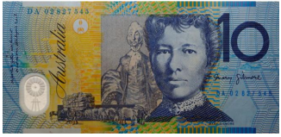
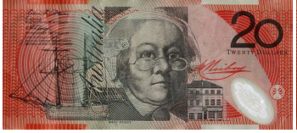
What connections can you make between these images?
$70
$10
$20
$30
Notes:
Headphone image by Sr Verone Ms Designer from Pixabay
Currency image Istock.com/hddigita
Use slides 2–5 to get students thinking about problems involving money calculations and the strategies to solve the problems. Undertake a Classroom talk focused on money calculations.
Invite students to share their thinking.
Explicit teaching: if students do not make links between the money amounts, use questioning and feedback, for example, ‘The first image refers to an item with a total value of $100’ and ‘What connections can you make between the other monetary values and $100?’

Slide 3
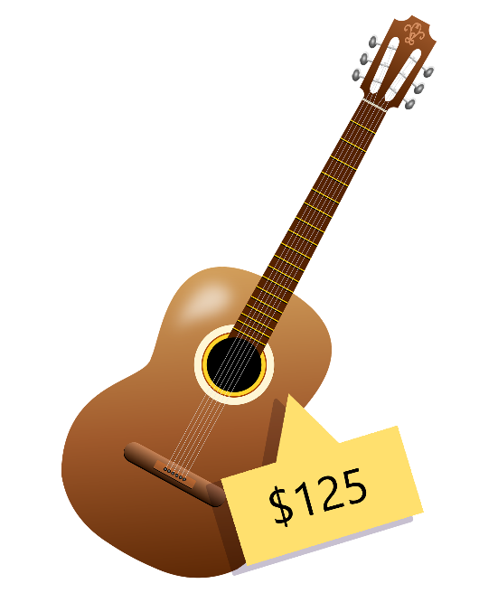

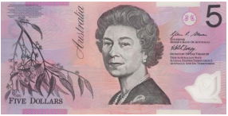
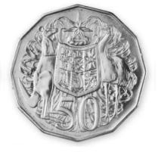
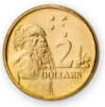
What connections can you make?
$70
Notes:
Guitar image by Almeida from Pixabay
Currency image Istock.com/hddigita
Invite students to share their thinking.
Explicit teaching: if students do not make links between the money amounts, use questioning and feedback, for example, ‘The guitar is worth $125 and ‘What connections can you make between the other monetary values and $70?’

Slide 4
Connections might include:
The sum of $70 and $55 is $125.
If I had $125 and spent $55, I would have $70 left.
If I wanted to buy the item and I already had $55, I would need another $70 before I could pay for it in full.
Notes:
Image by Almeida from Pixabay

Slide 5

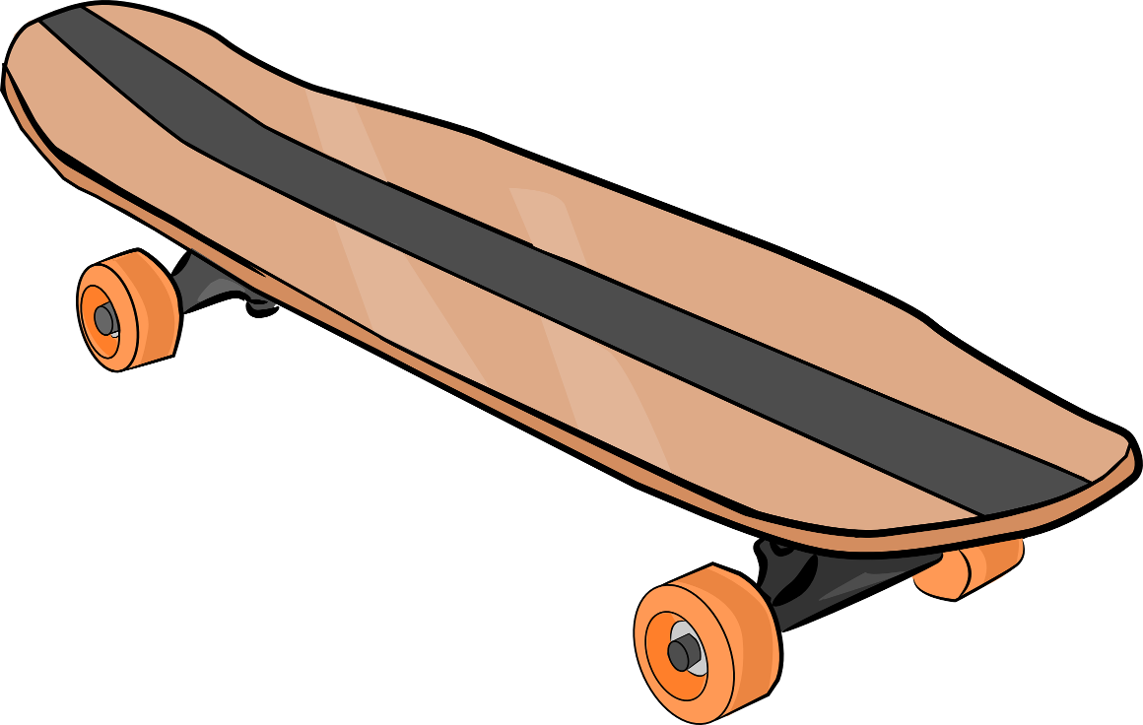



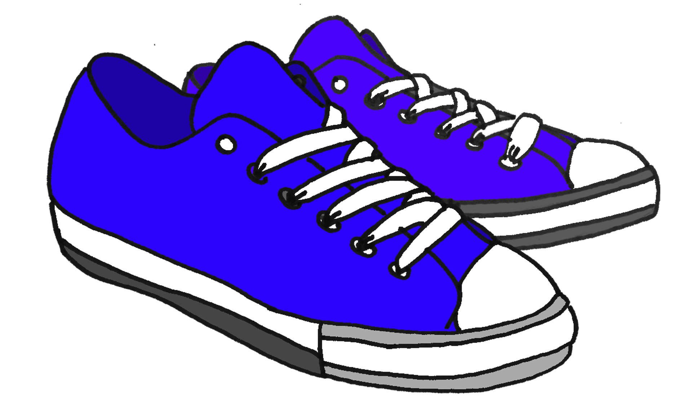
What each child wants
$179 for a sick skateboard
I have always wanted a rescue dog
$125 for new runners
Ralph
I’m only $325
Notes:
Anime Characters images via canva.com
Shoes, skateboard and dog illustrations care of Microsoft Word.

Slide 6



Each child is saving for an item of their choice.
If each child continues to perform the same jobs each week, estimate the number of weeks required for each child to purchase their item.
 | Item they are saving for | Amount saved | Amount earned per week
Maree | New basketball runners ($125) | $65 | $5
Angelo | Skateboard ($179) | $33 | $4.50
Ralph | Buying a rescue dog ($325) | $109 | $5.50

Slide 7
How could you work out the number of weeks each child needs to save to have enough money to buy their item?
Use the 4-step problem solving model.
 | Item they are saving for | Amount saved | Amount earned per week
Maree | New basketball runners ($125) | $65 | $5
Angelo | Skateboard ($179) | $33 | $4.50
Ralph | Buying a rescue dog ($325) | $109 | $5.50
Notes:
Explain that each child has decided to continue to do some jobs around the house to earn pocket money. Each child has different jobs to do so they earn different amounts: Maree saves $5 per week; Angelo saves $4.50 per week and Ralph saves $5.50 a week. Ask the following, ‘If each child continues to earn the same amount of pocket money each week, how long would it take them to save up so they can buy their item of choice?’

Slide 8
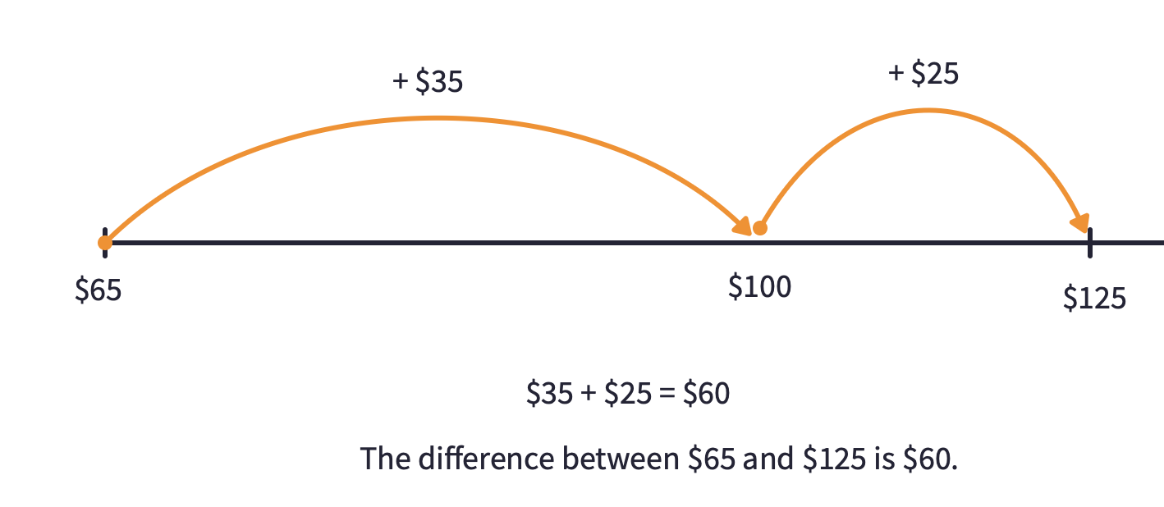
Using a number line to calculate difference

Slide 9

Using a bar model to calculate difference

Slide 10
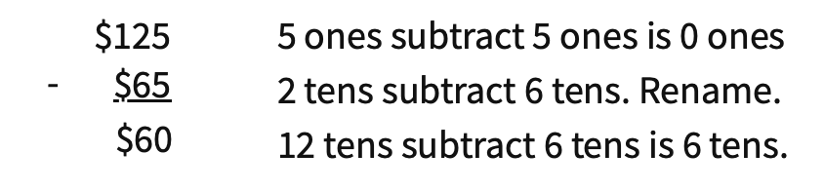
Using a subtraction algorithm to calculate difference

Slide 11
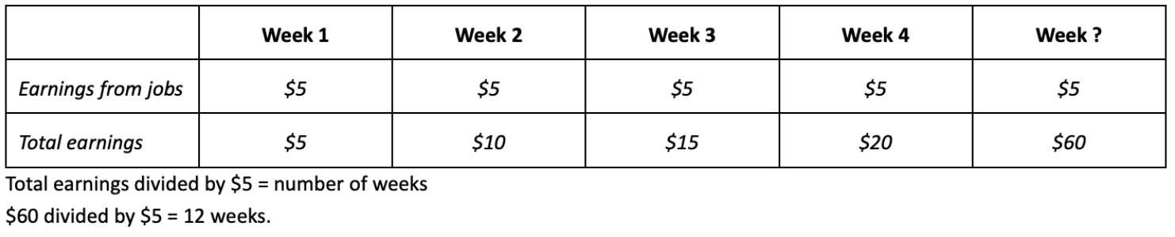
Look for a Pattern/Apply a rule

Slide 12
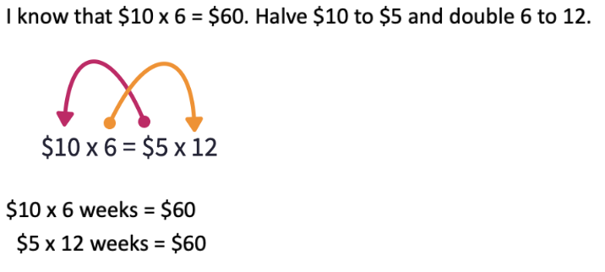
Doubling and halving

Slide 13
Inverse operation
(x and ÷)
$5 x ___ = $60
use division
$60 ÷ $5 = ___ weeks

Slide 14
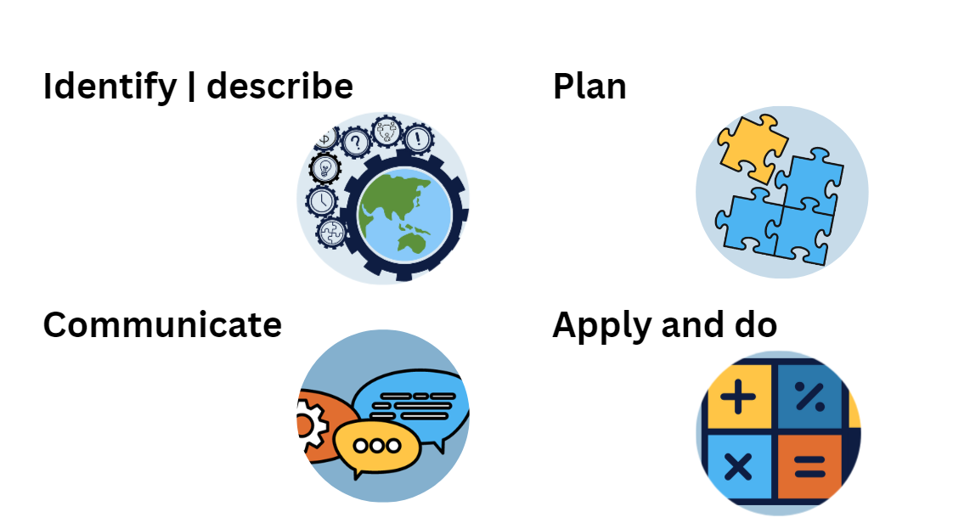
Use the 4-step problem solving model

