Slide 1


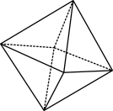

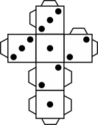
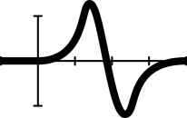


Fruit fractions:
Fruit kebabs!

Slide 2

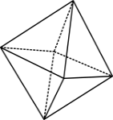

Warm up
Are these quarters?
Prove it
© 2023 Commonwealth of Australia, unless otherwise indicated. Creative Commons Attribution 4.0, unless otherwise indicated.

Slide 3
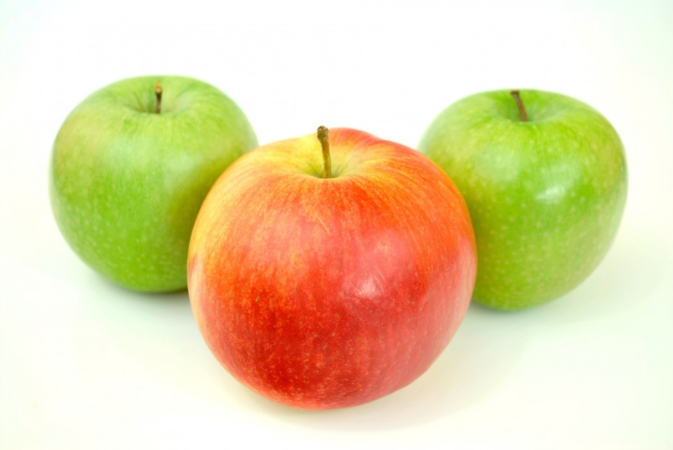
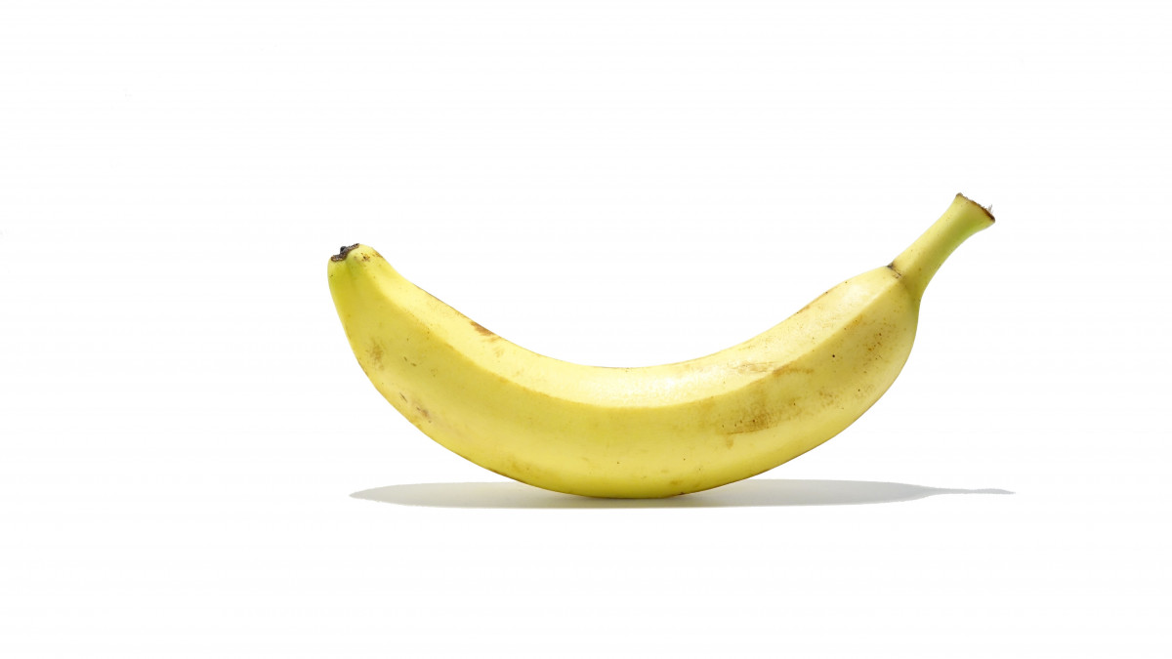
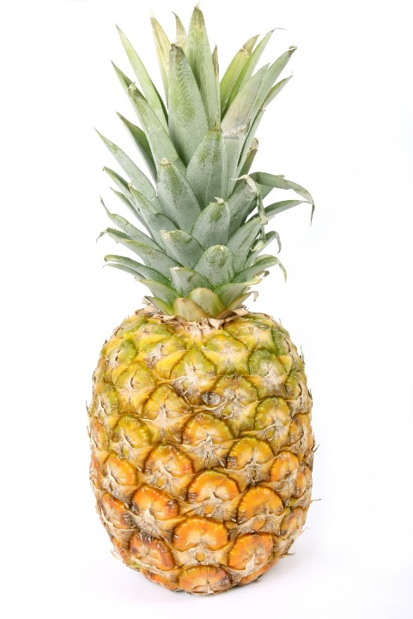
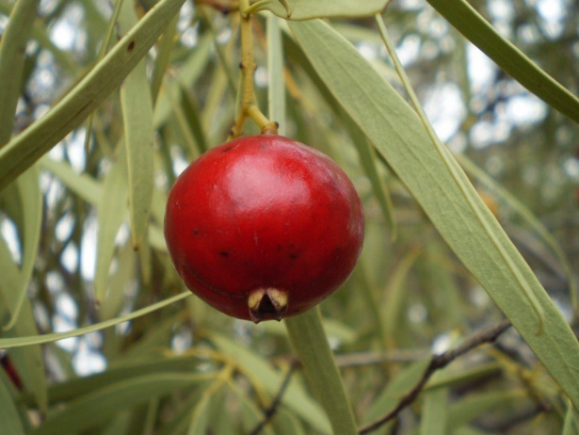
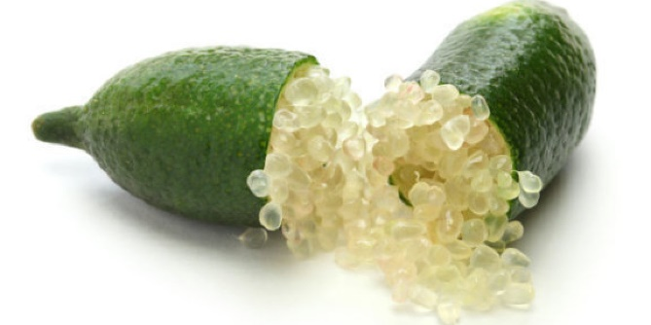
Example fruits
banana
apples
finger lime
quandong
pineapple
Images: under CC0 1.0 DEED CC0 1.0 Universal
Finger lime: Amada44, CC BY-SA 3.0 via Wikimedia Commons
© 2023 Commonwealth of Australia, unless otherwise indicated. Creative Commons Attribution 4.0, unless otherwise indicated.
Notes:
The images are released free of copyrights under CC0 1.0 DEED CC0 1.0 Universal
Finger lime: Citrus australasica Australian finger lime Amada44, CC BY-SA 3.0 via Wikimedia Commons

Slide 4
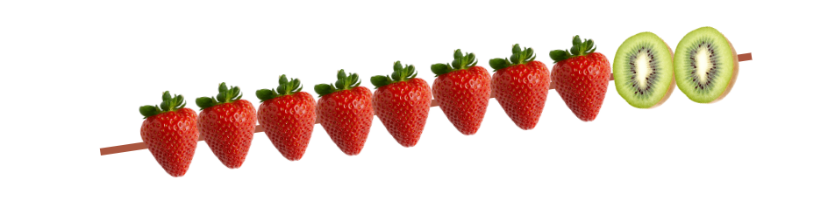
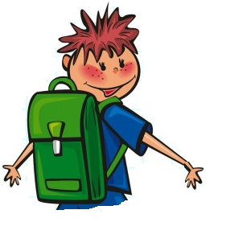
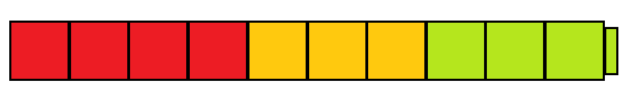

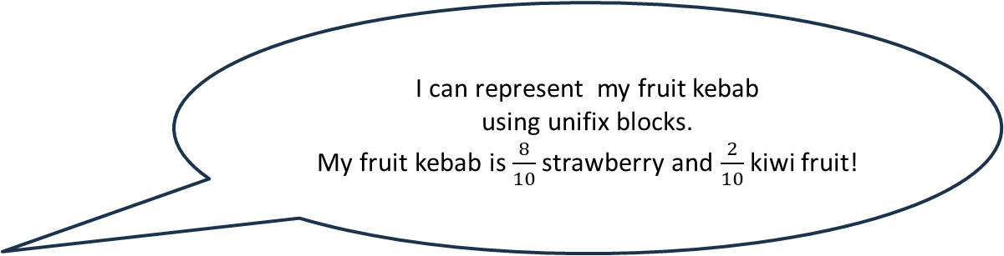
Fruit kebabs
I can represent my fruit kebab
using unifix blocks.
My fruit kebab is $\frac{8}{10}$ strawberry and $\frac{2}{10}$kiwi fruit!
Characters CC0 Public Domain, Images created in Canva
© 2023 Commonwealth of Australia, unless otherwise indicated. Creative Commons Attribution 4.0, unless otherwise indicated.
Notes:
Images of school kid from https://pxhere.com/en/photo/1443557, CC0 Public Domain
Kebab made in Canva by M.Richards

Slide 5

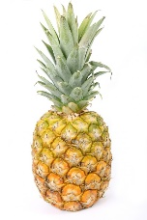
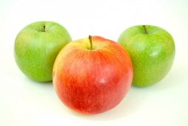
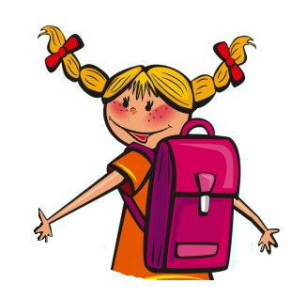
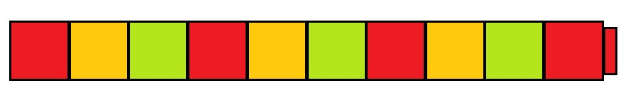
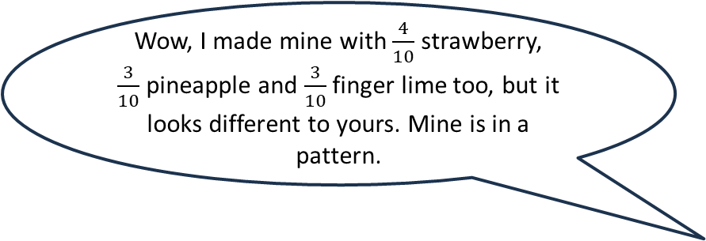
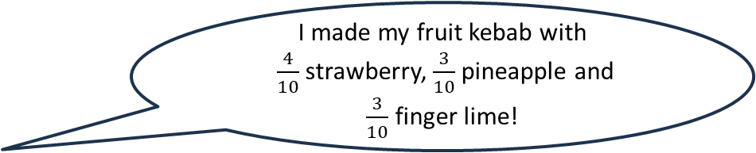
Fruit kebab patterns
I made my fruit kebab with
$\frac{4}{10}$ strawberry, $\frac{3}{10}$ pineapple and
$\frac{3}{10}$ finger lime!
Wow, I made mine with $\frac{4}{10}$ strawberry,
$\frac{3}{10}$ pineapple and $\frac{3}{10}$ finger lime too, but it looks different to yours. Mine is in a pattern.
Characters CC0 Public Domain
© 2023 Commonwealth of Australia, unless otherwise indicated. Creative Commons Attribution 4.0, unless otherwise indicated.
Notes:
Images of school kids from https://pxhere.com/en/photo/1443557, CC0 Public Domain

Slide 6
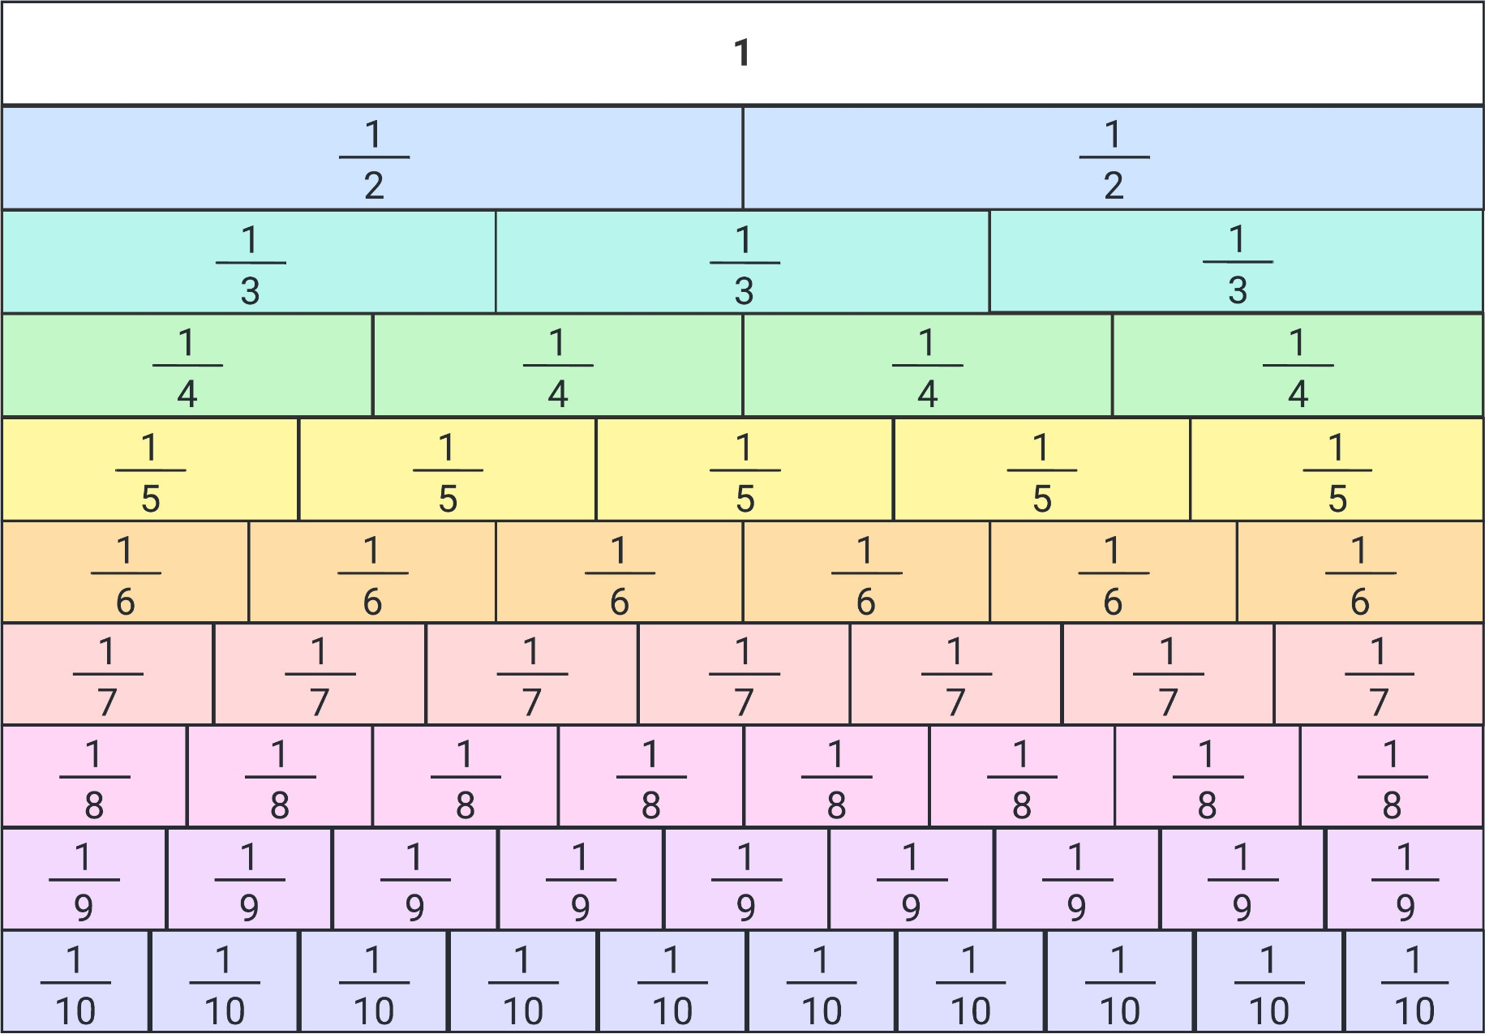
Fraction wall
© 2023 Commonwealth of Australia, unless otherwise indicated. Creative Commons Attribution 4.0, unless otherwise indicated.
Notes:
Fraction wall created in Lucid chart.

Slide 7
Exit ticket
Open-ended question
Create a fruit kebab with 10 pieces that includes 2 quandong, 1 apple, 2 finger limes.
What could it look like?
Share with a partner.
© 2023 Commonwealth of Australia, unless otherwise indicated. Creative Commons Attribution 4.0, unless otherwise indicated.

Slide 8
Teachers’ notes
Sullivan and Lilburn (2015) state that ‘good’ questions are those:
that require more than remembering a fact or reproducing a skill
where students can learn by answering the questions, and the teacher learns about each student from the attempt
where there may be several acceptable answers.
Sullivan, P. & Lilburn, P. (2015). Open-ended maths activities (2nd Ed.). Oxford University Press.
Dan Meyer (2010) gives the following advice:
Use multimedia.
Encourage student intuition.
Ask the shortest question you can.
Let students build the problem.
Be less helpful.
This time should be a safe maths space for students to share potential thoughts/answers without judgement.
Using this information as a general guide, pose this problem to your class and take on the role of facilitating/ posing questions, giving students wait and pause time, allowing students to share their thoughts with others, and differentiating as required for all students to be challenged within their zone of proximal development. Take time at the end of the activity to summarise students’ thoughts, their progress in thinking, and clarify any misconceptions.
Meyer, D. (2010, March). Math class needs a makeover [Video]. TEDx.
© 2023 Commonwealth of Australia, unless otherwise indicated. Creative Commons Attribution 4.0, unless otherwise indicated.

