Slide 1
Pizza problem
Mathematical modelling

Slide 2




What do you notice?
What do you wonder?
Notes:
Use a notice and wonder activity to introduce discussion around pizza size and slices and portions.
Students may notice:
The pizzas on the top row are divided into different numbers of slices (8 and 6), but they are the same size overall.
The bottom row has two pizzas with different-sized slices (quarters and eighths), with one pizza looking like it has larger slices.
One smaller-sized pizza is cut into quarters, and the other small pizza is cut into eighths, so with that one you would get a slice half the size of the quarter pizza slice.
The smaller pizzas appear to be approximately two-thirds the size of the larger pizzas.
Students may wonder:
Why are the pizzas divided into different numbers of slices, and does that change how much pizza each person would get?
Does the number of slices affect how filling each slice might be, even if the pizzas are the same size?
Are there any mathematical relationships between the size of the pizzas, the number of slices, and the amount of pizza each person would get?
https://www.flaticon.com/free-icon/pizza_2094661?related_id=2094661
https://www.flaticon.com/free-icon/pizza_1404945
https://www.flaticon.com/free-icon/pizza_792805?term=pizza&related_id=792805

Slide 3
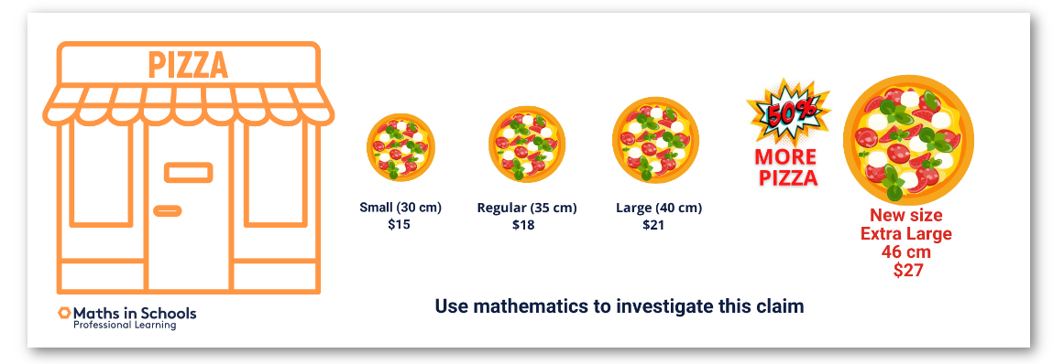
Investigating a claim
A pizza company has advertised a new extra-large pizza.
It is 46 cm in diameter and costs $27.
The company claims the new size gives customers 50% more pizza.
Use mathematics to investigate this claim.
Notes:
Introduce this scenario:
A pizza company has advertised a new extra-large pizza. It is 46 cm in diameter and costs $27.
The company claims the new size gives customers 50% more pizza.
Use mathematics to investigate this claim.
Discuss that the claim is vague in terms of which pizza it is comparing to.
Assume that the claim is made compared to large pizza 40 cm.
Differentiation: Extension
Which pizza is the best value?
Use mathematical modelling to work it out.

Slide 4
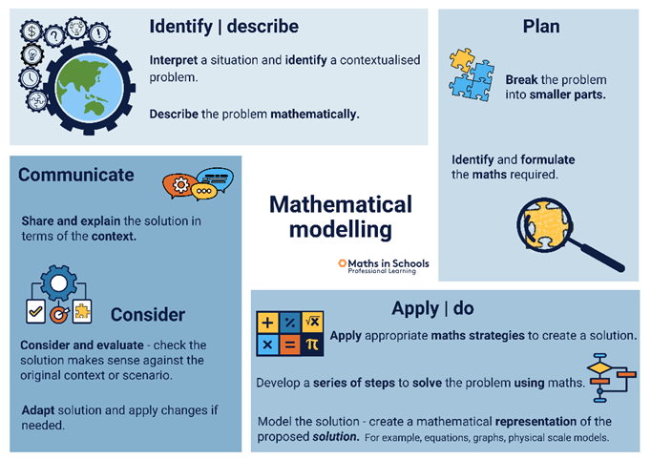
Introducing the
4-STEP PROBLEM-SOLVING MODEL
Notes:
Introduce the 4-step problem-solving model.

Slide 5

Using the 4-STEP PROBLEM-SOLVING MODEL
The company claims the extra-large pizza
gives customers 50% more pizza.
Notes:
We will use a 4-step problem-solving process to investigate the claim and use mathematical modelling.

Slide 6
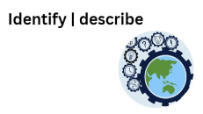
STEP 1
The company claims the extra-large pizza gives customers 50% more pizza.
What numbers or pieces of information
do you need to represent the problem mathematically?
For example, diameter, cost, percentage, area, circumference, ratio, radius, number of slices.
Notes:
Which of these pieces of information is relevant and which is irrelevant?

Slide 7



STEP 2
How might you use these approaches?
Use a formula to calculate the area of a circle, Area = πr² .
Grid paper and pizza cut outs.
A spreadsheet to compare pizza sizes.
Compare the size of pizza slices from each.
Notes:
Suggest some methods that students can use as a springboard as they consider their approach.

Slide 8
STEP 3
Apply calculation strategies:
area formula
percentage
ratio
calculation strategies.
Solve the problem using a series of steps.
How would you start?
What steps will you follow?
Create a representation of your mathematical solution.
Notes:
This is where you apply your maths knowledge.
You may use an area formula for each pizza and then compare area and express as a percentage.
You may prefer to use physical materials, such as grid paper and pizza cut outs for each pizza with their different diameters. Then you could count the grid squares and compare.
If you’re familiar with Excel, Numbers or Google Sheets use a spreadsheet to create formulas to automate the process.
Another method might be to express one pizza as a ratio to another.

Slide 9

STEP 4
Share your solution:
Was the claim accurate? What maths did you use to work out the problem?
Explain why you chose your method of modelling the problem.
Propose an ad campaign for the company with your claim about the size difference between two of their pizzas, for example large and extra-large.
Notes:
Communicate your ideas and represent your mathematical thinking.
What do you need to include in your representation?
What visuals will you use?
What information is important?
How might labelling be useful
This part of the communicate step provides students with the need to justify a claim rather than just respond to one:
Propose an ad campaign for the company with your claim about the size difference between two of their pizzas, for example large and extra-large.
Students may claim that:
Our extra-large pizza is over 30% larger than our large pizza. Give it a try!
Try our family sized extra-large pizza, it is nearly 33% larger than our large pizza.

Slide 10
Reflection
Maths used:
Area formula
Percentage/ratio
Physical materials
Notes:
Summarise some of the approaches and use explicit teaching to demonstrate the maths concepts and relationships.

Slide 11
Answers
Diameter of pizzas (cm) | Area of pizzas (cm²) | How much bigger is the 46 cm pizza? (%)
30 | 706.9 | 135.1%
35 | 962.1 | 72.8%
40 | 1256.6 | 32.3%
46 | 1661.9 | reference size
The 46 cm pizza is 32.3% larger than the 40 cm pizza,
not 50% larger, as claimed.
Notes:
Comparing the 46 cm pizza to the 40 cm pizza:
Percentage increase = (Area of 46 cm pizza − Area of smaller pizza)/(Area of smaller pizza) x 100
Percentage increase = (1661.9 − 1256.6)/1256.6 x 100 = 32.3%
If students wanted to find the diameter of the smaller pizza so that the claim holds true that the 46 cm pizza is 50% larger, then they should find that the smaller pizza would have a diameter of approximately 37.6 cm to make the 46 cm pizza 50% larger in area.

