Slide 1
Developing flowcharts
The halving strategy
Notes:
Summary
In this lesson, Year 4 students will create a flowchart outlining the sequence of steps required when using the halving strategy for division. The process of creating the flowchart consolidates the sequential steps required when solving problems and can be found in other learning areas, such as Design and Technologies and Digital Technologies.
Learning intention
We use flowcharts to provide a visualisation of the steps required to perform mathematical procedures.
We can use a flowchart to model the halving strategy so that we can show the steps involved in solving simple division problems.
We create ways to test the steps of the strategy when solving simple division problems.
We can provide and accept feedback to refine the steps in a flowchart.
Success criteria
By the end of this lesson, students can:
describe the steps when using the halving strategy
create a flowchart representing (or modelling a series of) steps, using graphics
follow an algorithm to show the steps involved in solving division problems
test the validity/accuracy of a flowchart and provide constructive feedback.
Areas of challenge
Some students:
may need further scaffolding with number fact knowledge for multiplicative thinking and division
may have difficulty visualising the flow of the steps without performing the task
may include additional ‘branches’ that hold no purpose to the outcome
may focus on a particular part of the flowchart and ignoring the other aspects
find it difficult to decide what information is necessary and useful to perform the task
may not recognise or make the connection between halving and dividing by two.
Exposure to flowcharts and creating algorithms with a sequence of steps is first introduced at Level 3. At this stage of the lesson, students should be encouraged to access their prior knowledge regarding the protocols for flowcharts. This information can be accessed through the Digital Technologies Learning Hub: https://www.digitaltechnologieshub.edu.au/teach-and-assess/classroom-resources/lesson-ideas/have-fun-with-flowcharts/.
Teaching strategies
Classroom talks: Encourage students to perform the steps in the flowchart (or visualise the steps in sequential order) to support accuracy in results.
Feedback: Create opportunities for peer feedback to ensure there is a logical process outlined in the flowchart.
Questioning: A culture of questioning should be encouraged and students should be comfortable to ask for clarification when they do not understand.

Slide 2
Why are we learning this?
Solving tricky arithmetic by following steps
Can we teach others?
Can we develop our own steps to teach others?
Can we do this using a visual chart? … maybe a flow chart?
Notes:
Teaching note
When developing flowcharts (or algorithms) using branching, students are thinking critically about the precise steps required to achieve an outcome (or to find a given number). By learning how to use branching, students develop skills in logical thinking and decision-making. They can understand how to design algorithms to perform different actions to enable more complex problem-solving. The ability to design algorithms with branching is a transferable skill that can be utilised in other learning areas (for example, Design and Technologies and Digital Technologies).
Suggested intro to students
When solving arithmetic problems involving division, we need to follow a series of steps. What if we were to teach someone else? How could we explain the process and represent it in a visual way for someone else to follow? We can use a flowchart to record the sequence of our steps and branching to help explain the different questions we ask ourselves when finding solutions. Using flowcharts helps to provide a visual pathway to access our understanding and apply it to solving division problems. When we are confident developing and testing our work, we can then use flowcharts or algorithms as tools to solve lots of problems in everyday life.

Slide 3
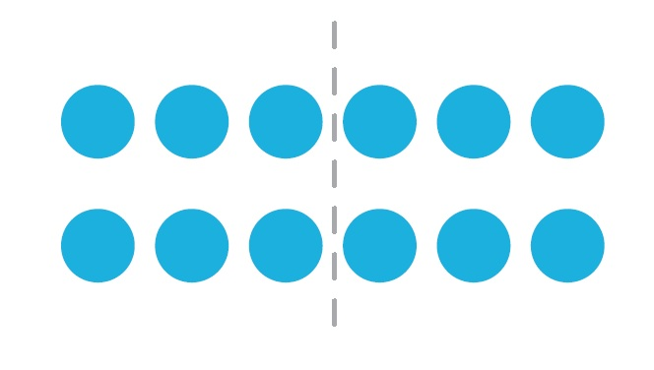
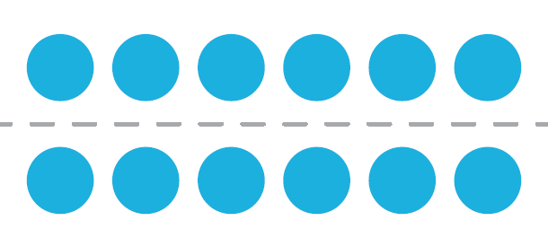
Look at the blue counters.
What is the same?
What is different?
Notes:
Explain to the class that all images show 12 split into 2 equal groups – some horizontally and some vertically. The collections have been halved to represent the connection between halving and dividing by 2.

Slide 4
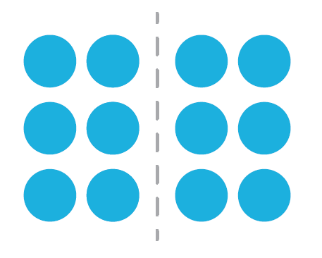
What about these?
What is the same and what is different?

Slide 5
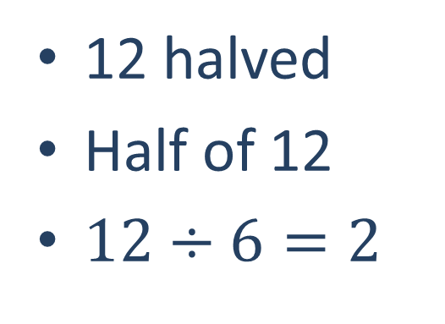
Images can be used to explain number sentences.
12 halved
Half of 12
$12÷6=2$
Notes:
Show that we can represent the connection between all images using number sentences.
These sentences represent how we can use the halving strategy when dividing numbers by 2. For example, all of these sentences are ‘equivalent’.

Slide 6
What steps do we take when we halve something?
…hmm
Can the whole number be divided equally?
Yes
Do the groups make 2 whole numbers?
Yes
How many will each group receive?
6
But what if I start with a different whole number?
What if the answer is ‘No’? What does this mean?
Notes:
The hook
Explain to the class that concepts about division and halving can be represented using a simple flowchart.
But to create any flowchart we need to visualise the anticipated outcomes, sort these and then present choices that can be made.
And to create a flowchart for dividing by 2 (halving), we need to reflect on the series of steps taken to solve division problems.
Ensure you have pre-prepared a bag of counters and perform a ‘think aloud’ for developing a flowchart for dividing by 2 (halving) by modelling the steps required to halve a collection (share between 2). Present 12 counters in your hands to the class (but don’t tell them there are 12) and ask the class:
Can I divide these counters equally between 2, or in other words, is the solution a whole number?
How can we split these counters to model dividing by 2 (halving)?
Model the task by dividing the group of counters into 2 equal groups recording the series of steps on the board. For example, you might say:
When dividing by 2:
Can the whole number be divided equally between 2? Yes.
Do the groups form 2 whole numbers? Yes
How many will each group receive? 6 (solution)
But what if the answer is no? What does this mean?
Explain that if the answer is no then you cannot divide this number by 2 to achieve a whole number solution.

Slide 7


How can we perform a division problem so that it is easier to see?
…hmm
Notes:
Ask the class: how could we present this thinking in a way that is easy to ‘see’?

Slide 8
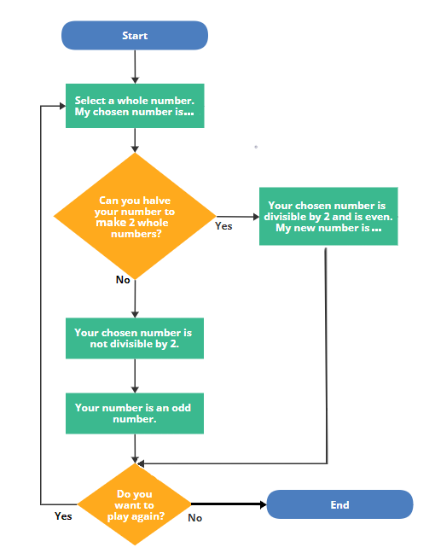
Oh, that’s a flowchart!!
Let’s put in 12.
Notes:
Explain and show the properties of a flowchart and ask or talk about why flowcharts work so well, such as:
that the steps are presented in a logical order to create a path/sequence to follow
you can build a flowchart for just about any purpose
that with a few simple shapes and arrows (branches), you can visualise an idea or action required to achieve an outcome
that a flowchart allows ideas to be presented in a meaningful way
that the visual display breaks down the steps so the process is easier to understand, follow and check
that there is minimal text and creative design used to provide directions.
The words ‘yes’ and ‘no’ are used in this flowchart but you can also use ‘true’ and ‘false’. The branches can represent the students’ own process but emphasise that there needs to be a logical order in the steps. Continue to question the class and ask how would we know if our flowchart is correct? Explain that to check our work, we could ask a peer ‘to check’ the sequencing (flow) and accuracy of the information presented. How do our classmates check our flowchart? Ask students to use the flowchart above to find the solution to the following problems and to ‘Follow the paths and check the mathematics is true’.
Differentiation (alert): Some students might do this in their head at the board, or some students may prefer to write this in their workbooks.
18 divided by 2
15 divided by 2

Slide 9

Can I make one?
A flowchart? Sure! But …
Can you make a flow chart to divide a whole number by 4?
If we can use doubles to multiply by 4 (double, double), can we use halving to divide by 4?
Notes:
Explore (questioning strategy)
Instruct students that they are going to create their own flowcharts that describes the sequence of steps required to divide numbers by 4 either in their workbooks or on some butcher’s paper. However, before they begin, reflect on the thinking involved to divide a number by 2 using halving.
As a group, ask questions to stimulate creative thinking.
How could we use this information to help us divide numbers by 4? For example, if we can use doubles to multiply by 4 (double, double), could we use halving to divide by 4? (To calculate 4 x 15 we can double 15 = 30 and then double 30 = 60. What if we were to find 60 ÷ 4? How could we use the halving strategy to support us with this process?
What connections are there between dividing by 4 and the halving strategy?
What about dividing numbers by 8? What connections can we make between doubling and halving to support this process? For example, if we can use doubles to multiply by 8 (double, double, double) could we use halving to divide by 8?
What actions/steps do you take in your thinking to complete this sequence?
Ask students to think about the sequence of steps required for the intended outcome. How can you present these steps in the form of a flowchart?
I’m using questioning here to encourage students to make connections between doubling and halving, for example, to multiply by 4 we can use the double, double strategy. Could we use the inverse (halve, halve) to divide by 4? Using a flowchart will allow students to investigate this visually following a sequence of steps. It will also encourage students to explore multiple outcomes to an inquiry in numbers divisible by 2 and 4 (8). When constructing flowcharts students may also discover that some numbers are divisible by 2, however are not also divisible by 4, for example, 10. This could be a potential misconception. It could also present as another conjecture that the students form and explore. This could lead to an exploration into factors.

Slide 10
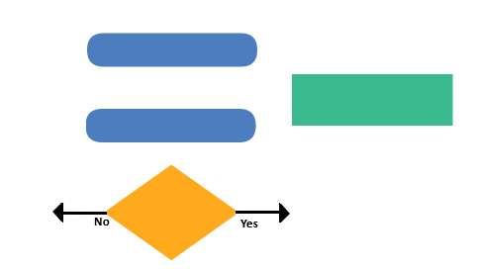
You need to know the rules first!
Start/End
Process step
Yes/No answers
Decision
Notes:
Next describe the rules of the flowchart shapes to students before they begin to make their own. Display this slide for students to refer to. Clarify that colour doesn’t matter, it’s the shapes that count. Discuss how you would use the shapes and symbols to sequence a division problem.
What is a ‘condition’ you use to decide if you can divide a number by 2? Record this condition inside the first shape.
What could the possible responses be? This will help you decide how many branches you will need initially …
Encourage students to be creative with the shape and branch designs. Let them know that everyone thinks differently and that different ideas can still lead to the correct answer. While students are working, ask students to think about the following reflecting question: If numbers are not divisible by 2, 4 (or 8) and have remainders, are they always odd numbers?
Differentiation (enabling): Provide an empty flowchart template or flowchart software program. Include start, end, and close-ended questions that can be answered with true and false.
Once students have created their flowchart, arrange for students to share their chart with a peer to test and provide feedback. Instruct the peers or assessors to give feedback on the sequence and whether the intended outcome was achieved. When students have reviewed a peer’s flowchart, pair them up (or in small groups or as a class) and use ‘questioning’ to help draw out the main concepts in the topic: number sequences, remainders, division.
What patterns can you ‘see’ between the number equations involving dividing by 2, 4 and 8?
What connections can you make between dividing by 2, 4 and 8 and the halving strategy?
What do you notice about the numbers that can be divided equally by 2, 4 and 8 and the ones that can’t (result in remainders)?
What statements can you make about the halving strategy?

Slide 11
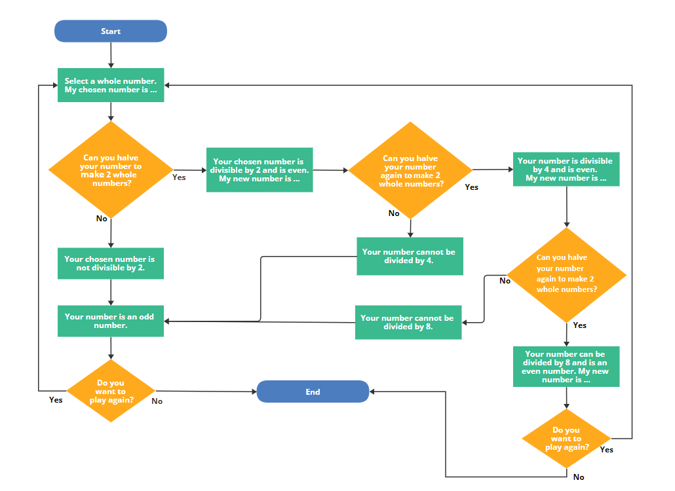
Odd or even?
Notes:
Differentiation (extending)
How could we create a flowchart that combines dividing numbers by 2, 4 and 8 and the connection with the halving strategy?
What conjectures can you make about dividing by 2, 4 and 8 and the halving strategy? Is your conjecture always true? How do you know?

Slide 12
What connections did you make between dividing by 2, 4 (and 8) and the halving strategy?
Can I use this connection to solve division problems with larger numbers?
Why is it important to visualise the steps when developing a flowchart?
What strategies did you use to create your flowchart?
How did the feedback from your peer affect your flowchart?
Notes:
What connections do you make between dividing by 2, 4 and 8 and the halving strategy? How could we use this information to help us solve division problems with larger numbers? For example, 240 divided by 4.
Why is it important to visualise (or record) the steps when developing a flowchart?
What are some of the strategies you used to create your flowchart today?
What impact did the feedback from your peer have on the outcome of your flowchart?

