Slide 1
Word problems
Mathematical modelling

Slide 2
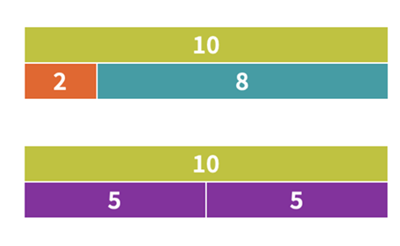
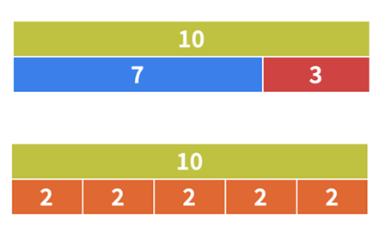
What do you notice? What do you wonder?
Notes:
Run a classroom talk using the ‘What do you notice? What do you wonder?’ strategy.
Students may notice things such as:
They are all bar models (part-part-whole).
The top rectangle is 10 in each bar model (that represents the whole, which is 10).
The parts add up to 10.
The 10 2|8 model can be written as 10 = 2 + 8 or 10 - 8 = 2.
The 10 5|5 model could be 2 times 5 = 10.
The 10 2|2|2|2|2 model could be 5 times 2 = 10 or 10 ÷ 5 = 2.

Slide 3
Number sentences
2 + 8 = 10 or 8 + 2 = 10
10 - 2 = 8 or 10 - 8 = 2
5 + 5 = 10 or 10 - 5 = 5
10 ÷ 2 = 5 or 2 x 5 = 10
Notes:
Note this slide has animated text
Run a classroom talk using the What do you notice? What do you wonder? Strategy.
Now focus on number sentences.
Discuss Commutative Law of Addition
2 + 8 = 10 or 8 + 2 = 10
Discuss inverse relationship
2 + 8 = 10 or 10 - 8 = 2
Discuss multiplicative thinking
The 10 5|5 model could be 2 times 5.
In this case, the bar is divided into two equal parts, each representing 5.The total length of the bar is 10, which we can write as 2 groups of 5 or 2 times 5.
If we divide 10 into 2 equal parts, each part will be 5. We are using division: 10 ÷ 2 = 5.
Repeat for this bar model.
The 10 2|2|2|2|2 model could be 5 times 2.
The 10 5|5 model could be 2 times 5.
The 10 2|2|2|2|2 model could be 5 times 2.

Slide 4

A number story example
There were 10 ice creams,
8 were eaten, and 2 were left.
Which number sentence is correct for this story?
2 + 8 = 10
10 - 8 = 2
10 - 2 = 8
10 ÷ 2 = 8
Notes:
Consider the number story: ‘There were 10 ice creams, 8 were eaten, and 2 were left.’
The total length of the bar represents 10 ice creams.
One part of the bar represents the 8 ice creams that were eaten, and the remaining part represents the 2 ice creams left.
Which number sentence is correct for my story?
2 + 8 = 10
10 - 8 = 2
10 - 2 = 8
10 ÷ 2 = 8
B is correct: 10 - 8 = 2.
Discuss how the number story asks, ‘How many were left?’ This typically signals a subtraction problem. You started with 10, subtracted 8 (the part that was eaten), and were left with 2. The bar model clearly shows the relationship between the whole (10), the part that was subtracted (8), and the remaining part (2).

Slide 5
Number story example 2
Which bar model represents this story?
You have $10, and you spend $2 each week. How many weeks will it take before you have no money left?
A.
B.
C.
D.
Notes:
Each section of the bar represents the amount spent weekly, and by subtracting $2 each time, you get:
Week 1: $10 - $2 = $8
Week 2: $8 - $2 = $6
Week 3: $6 - $2 = $4
Week 4: $4 - $2 = $2
Week 5: $2 - $2 = $0
Animate to reveal answer
In this case, the bar model D shows the concept of repeated subtraction over time, where after 5 weeks, you've spent all your money. This not only demonstrates subtraction but also links to division, as 10 ÷ 2 = 5 weeks of spending.

Slide 6
Write a number story

Slide 7
Represent as a bar model
Problem 1:
Matt and Jessie are combining their coloured pencils into one container. Matt has 12 pencils and Jessie has 9 pencils. How many coloured pencils do they have altogether?
Problem 3:
Three classes of Year 3 students are being seated in the school gym to watch a presentation. There are 90 seats available.
The first class of 29 students is already seated.
The second class of 33 students is seated next.
Will the third class of 29 students all fit in the remaining seats?
Problem 2:
There are 25 books on a shelf. 17 are fiction and the rest are non-fiction. How many non-fiction books are there?
Notes:
Students choose a problem they find that suits their skill level.

Slide 8
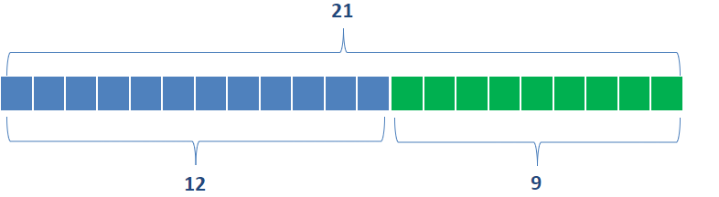
Problem 1 bar model
Problem 1:
Matt and Jessie are combining their coloured pencils into one container. Matt has 12 pencils and Jessie has 9 pencils. How many coloured pencils do they have altogether?
Matt and Jessie have 21 coloured pencils altogether.
Total pencils = Matt’s pencils + Jessie’s pencils
= 12 + 9
= 21
Notes:
Make explicit the need for framing the answer in reference to the context (refer to speech bubble).
Matt and Jessie have 21 coloured pencils altogether.

Slide 9
Problem 2 bar model
There are 8 non-fiction books out of the total of 25 books on the shelf.
Problem 2:
There are 25 books on a shelf. 17 are fiction, and the rest are non-fiction. How many non-fiction books are there?
25
17
8
Notes:
Make explicit the need for framing the answer in reference to the context (refer to speech bubble).
There are 8 non-fiction books out of the total of 25 books on the shelf.

Slide 10
Problem 3 bar model
The 29 students will not all fit there are only 28 seats left after the 62 students are seated.
Problem 3:
Three classes of Year 3 students are being seated in the school gym to watch a presentation.
There are 90 seats available.
The first class of 29 students is already seated.
The second class of 33 students is seated next.
Will the third class of 29 students all fit in the remaining seats?
90
already seated
seated next
seats left
29
33
28
29 + 33 = 62 90 - 62 = 28
Notes:
Make explicit the need for framing the answer in reference to the context (refer to speech bubble).
The 29 students will not all fit there are only 28 seats left after the 62 students are seated.

