Slide 1


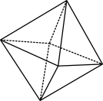

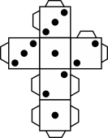
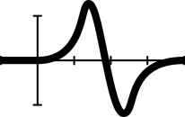


Using algebra tiles to solve equations

Slide 2
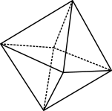

Learning intention
We are learning to:
construct equations for given word problems
substitute values into equations
solve equations involving multiplication and division
use algebra to find unknown lengths and areas for various shapes.
https://solveme.edc.org
© 2023 Commonwealth of Australia, unless otherwise indicated. Creative Commons Attribution 4.0, unless otherwise indicated.
Notes:
Hook students in and let them know that you will play a quick game. But first you need to talk about the learning intention for the lesson.
Success criteria
By the end of the lesson, students can:
solve one-step equations involving addition, subtraction, multiplication and division with and without concrete materials
recognise the algebra required to solve geometric problems for various shapes and can solve them.
Introduction: connect to prior learning
Have students complete mobile puzzles from https://solveme.edc.org/ (select “mobiles”>”play” and start at explorer puzzle #1). Note that you do not need to create a login and can just play the interactive; however, it will not save the results.
Differentiation: Students can complete as many puzzles as they like, allowing for Differentiation. Students can choose more difficult puzzles if needed, rather than beginning at puzzle #1. Allow students to work in pairs if they find the puzzles challenging.
Areas of challenge
Some students may:
consider that the ‘=‘ sign indicates to record an example, rather than expressing an equivalence relationship
think that a particular variable always holds the same value
find identifying inverse integer operations counterintuitive, particularly when negative integers are involved
forget, or not realise they need to do the same thing to both sides of the equation
have trouble neatly recording each step of their working out when solving equations.
A student may pose the question, ‘Why are we learning this?’
Equations are useful in many everyday life scenarios, including representing our wages, or formulas for finding the area of a shape or the density or volume of an object. Substituting values into equations allows us to easily explore a range of phenomena in the real world and solve a wide variety of problems.

Slide 3

Review from last lesson
How might we solve these?
$$x+3 =23$$
$$19=x−2$$
© 2023 Commonwealth of Australia, unless otherwise indicated. Creative Commons Attribution 4.0, unless otherwise indicated.
Notes:
As a whole class, allow students to offer their solutions to each step of the problem. Before going through the solution with the whole class, allow students to think about each question for 1 minute.

Slide 4

Solving algebra equations with
Today we are going to learn how to model and solve equations like:
$\frac{x}{2}=20$
and
$$2x=20$$
© 2023 Commonwealth of Australia, unless otherwise indicated. Creative Commons Attribution 4.0, unless otherwise indicated.
Notes:
Allow students to think-pair-share how these equations might be solved and what the answers might be.

Slide 5
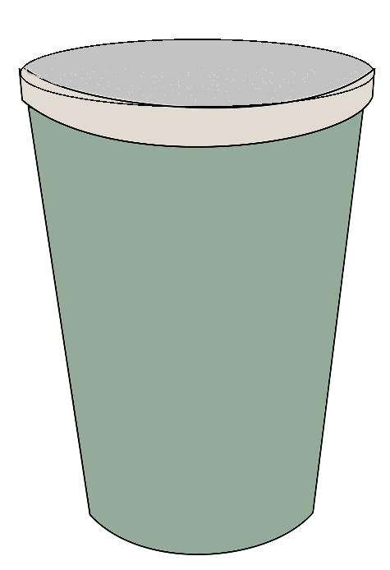


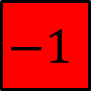

Today
Last lesson we used cups and counters to solve equations.
Today we will be using algebra tiles to solve equations.
$$−x$$
$$x$$
$$1$$
$$−1$$
© 2023 Commonwealth of Australia, unless otherwise indicated. Creative Commons Attribution 4.0, unless otherwise indicated.
Notes:
Introduce students to solving equations using algebra tiles (slides 5–11).
The slides are animated and with each click the next step is revealed as you progressively go through each slide; this allows for explanation, iterations, analogies and further explanations to be had at any time.
Differentiation: Give pairs of students a set of algebra tiles and an equation mat to use so that they can model each example question along with the teacher.
Model solving equations using hands on and/or digital algebra tiles (Digital option: Polypad: https://mathigon.org/polypad#algebra-tiles Tutorial: https://mathigon.org/task/tutorial-algebra)
Model to students how they should structure their written solutions for the question.

Slide 6



















Revision
$$x+5 =−2$$
 | =
$$1$$
$$−1$$
$$−1$$
$$−1$$
$$1$$
$$−1$$
$$−1$$
$$x$$
$$−1$$
$$1$$
$$−1$$
$$−1$$
$$1$$
$$−1$$
$$−1$$
$$1$$
$$−1$$
$$−1$$
$$x =−7$$
© 2023 Commonwealth of Australia, unless otherwise indicated. Creative Commons Attribution 4.0, unless otherwise indicated.
Notes:
x + 5 = $−$2
x + 5 $−$5 = $−$2$−$5 (Show this step to students on a whiteboard if possible.)
x =$−$7

Slide 7



















Solving a new equation with algebra tiles
$$x$$
$$3x=15$$
 | =
$$1$$
$$1$$
$$1$$
$$x$$
$$1$$
$$1$$
$$1$$
$$x$$
$$1$$
$$1$$
$$1$$
$$1$$
$$1$$
$$1$$
$$1$$
$$1$$
$$1$$
© 2023 Commonwealth of Australia, unless otherwise indicated. Creative Commons Attribution 4.0, unless otherwise indicated.
Notes:
As the x tiles have been rotated on this slide, it is worth discussing with students that they have remained the same and are not different tiles.
Explain that this equation is modelling how three x tiles are equal to 15. Remember that to emphasise the idea of balance and equivalence.
Scaffolding questions:
How might we find the value of one x tile?
What is the role of multiplication and division operations?
Why is it necessary to divide both sides of the equation to keep it balanced? (facilitate discussion and reasoning)
Can you think of a real-life example? Answer: Dividing chocolate bars

Slide 8
















$$3x=15$$
$$x$$
 | =
$$x$$
$$1$$
$$1$$
$$1$$
$$1$$
$$1$$
$$x$$
$$1$$
$$1$$
$$1$$
$$1$$
$$1$$
$$1$$
$$1$$
$$1$$
$$1$$
$$1$$
Notes:
3x=15
x=5

Slide 9
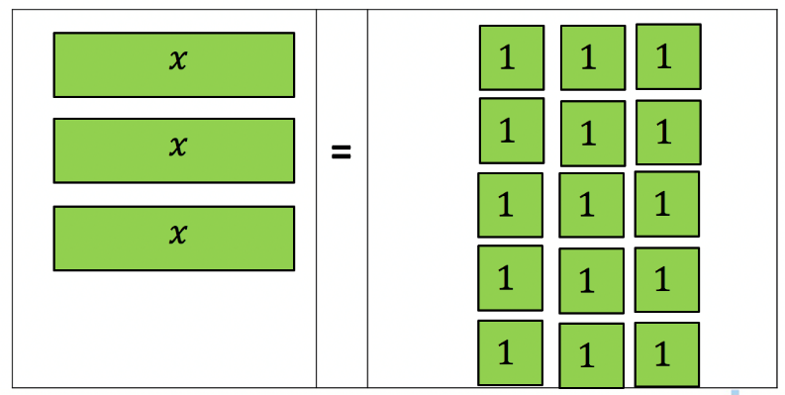
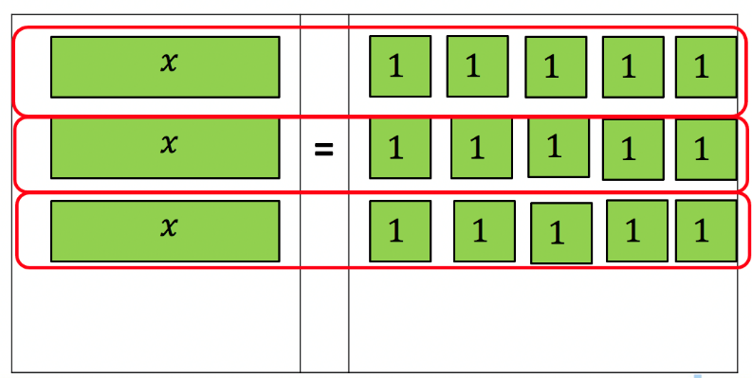
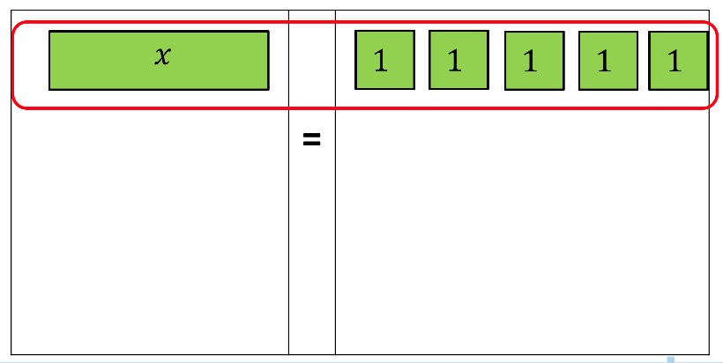

Visualising and manipulating algebra tiles
$$3x=15$$
$$\frac{3x}{3}=\frac{15}{3}$$
$$x=5$$
© 2023 Commonwealth of Australia, unless otherwise indicated. Creative Commons Attribution 4.0, unless otherwise indicated.

Slide 10

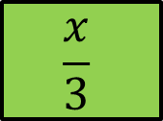









$$\frac{x}{3}=3$$
$$x$$
 | =
$$\frac{x}{3}$$
$$1$$
$$1$$
$$1$$
$$1$$
$$1$$
$$1$$
$$1$$
$$1$$
$$1$$
© 2023 Commonwealth of Australia, unless otherwise indicated. Creative Commons Attribution 4.0, unless otherwise indicated.
Notes:
Explain that on the LHS we don’t have a whole x, we have a third of an x tile.
If we have 1/3 of an x tile, then we need to multiply both sides by 3 to find the value of the whole x tile.

Slide 11
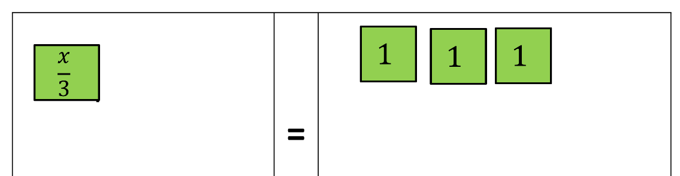
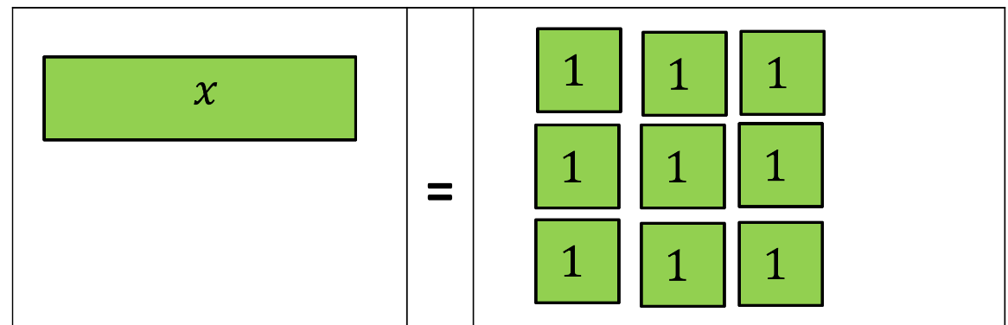

Visualise and manipulate
$$\frac{x}{3}=3$$
$$\frac{x}{3}×3=3×3$$
$$x=9$$
© 2023 Commonwealth of Australia, unless otherwise indicated. Creative Commons Attribution 4.0, unless otherwise indicated.
Notes:
If the cancelling out lines reformat for you, simply click and select and move them onto the number threes that need to be cancelled.

Slide 12
Summarise and reflect
In your books, write a couple of sentences to describe what you have learnt today.
Write areas that remain confusing.
Did you find any other strategies to solve your equations today?
Can you think of real-life scenarios that you can share with the class?
© 2023 Commonwealth of Australia, unless otherwise indicated. Creative Commons Attribution 4.0, unless otherwise indicated.
Notes:
Facilitate discussion on the learning successes.
Try to address misconceptions that may be raised.
Ask whether anyone had any different strategies the used or ways or thinking to solve the problems. Have them come up to the whiteboard to demonstrate.
Note those students who need extra clarification and practise.
Not those students who may wish to expand their learning.
Connect the abstract ideas with real-world examples, have students call out examples.
Create channels for students to come to you individually with confusions.
Hand out the assessment worksheet. (In class or for homework)

Slide 13









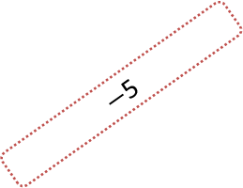








Algebra maze
Start
$$−3=w−2$$
5
$$5=y÷5$$
$$x−4=12$$
16
$$2+A=9$$
11
$−$1
8
1
$−$5
1
7
3
4
$$2=\frac{x}{3}$$
$−$1
$$2−Z=−1$$
5
$$4=−1−k$$
5
$$20=4R$$
6
$−$3
$−$3
4
5
$−$5
$$9P=45$$
0
$$2=n−2$$
4
$$h÷−3=−1$$
3
$$\frac{x}{4}=12$$
End
© 2023 Commonwealth of Australia, unless otherwise indicated. Creative Commons Attribution 4.0, unless otherwise indicated.
Notes:
Assessment task slides. Solutions are on slide 4.
Students solve the maze from start to end by substituting the values that exist either horizontally, vertically or diagonally into the equations to choose the correct pathway.
The next slide shows the solutions.
A handout with the problem and the solutions also exist on the final pages of the Student worksheet: shapes Word document.

Slide 14


Algebra maze: solutions
Start
$$−3=w−2$$
5
$$5=y÷5$$
$$x−4=12$$
16
$$2+A=9$$
11
$−$1
8
1
$−$5
1
7
3
4
$$2=\frac{x}{3}$$
$−$1
$$2−Z=−1$$
5
$$4=−1−k$$
5
$$20=4R$$
6
$−$3
$−$3
4
5
$−$5
$$9P=45$$
0
$$2=n−2$$
4
$$h÷−3=−1$$
3
$$\frac{x}{4}=12$$
End
© 2023 Commonwealth of Australia, unless otherwise indicated. Creative Commons Attribution 4.0, unless otherwise indicated.
Notes:
Teacher only slide or display for students to check answers.

