Slide 1
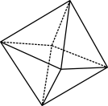
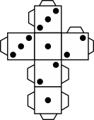
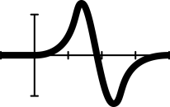
Shooting 3-pointers: Part 1
Notes:
This lesson gives students the opportunity to participate in a real-life problem both in and out of the classroom. Students are guided through the process of formulating a problem that can be solved using a mathematical modelling approach. A professional sporting context allows students to engage in a common basketball scoring move: shooting 3-pointers. Students conduct a statistical investigation, collect and analyse data using percentages, choosing efficient calculations and strategies, that is communicated visually and verbally to the teacher and peers. Students reflect on feedback and consider revisions for the investigation.
Achievement: Students use mathematical modelling to solve practical problems involving ratios, percentages and rates in measurement and financial contexts.
Relevant content descriptions for Part I
AC9M8N05
use mathematical modelling to solve practical problems involving rational numbers and percentages, including financial contexts; formulate problems, choosing efficient calculation strategies and using digital tools where appropriate; interpret and communicate solutions in terms of the situation, reviewing the appropriateness of the model.
AC9M8N04
use the 4 operations with integers and with rational numbers, choosing and using efficient strategies and digital tools where appropriate
Note that students also use what they have learnt in the Statistics strand and combine knowledge and skill in this investigation, this especially important for Part II of the lesson.
AC9M8ST04
plan and conduct statistical investigations involving samples of a population; use ethical and fair methods to make inferences about the population and report findings, acknowledging uncertainty
AC9M8SP02
analyse and report on the distribution of data from primary and secondary sources using random and non-random sampling techniques to select and study samples
AC9M8SP03
compare variations in distributions and proportions obtained from random samples of the same size drawn from a population and recognise the effect of sample size on this variation

Slide 2
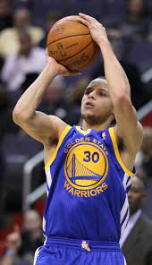
Why do basketballer players shoot so many three-pointers?
Keith Allison/ CC-BY-SA-2.0
Notes:
Image: Keith Allison/ CC-BY-SA-2.0
This lesson is designed to immerse students in the world of professional basketball to directly engage them in a sport that is generally well known across Australia.
Specifically, the types of scoring shots that are employed in basketball is explored.
The hook
You may wish to begin with showing short video clips on professional players scoring 3-pointers in NBA/WNBA or the Australian male and female leagues.
Ask students which shots they like to practise or utilise when they play?
Direct students to the investigative question: why do basketball players shoot so many three-pointers?
Lead the class in discussion questions as students may ask why talking about basketball in maths class.
Can anyone name the player in the picture? – Steph Curry
Why is he so famous? – He revolutionised the NBA by scoring a huge proportion of his points as 3-pointers, with very high accuracy
What kind of shots do you practice the most? – Shots that are beyond the 3-point line receive 3 points while shots within the arc are wroth 2 points.
Do you have a theory that could answer the investigation question? What are your reasons?
Did you know that some professional sports teams employ several mathematicians? – Their job is to conduct the kind of modelling that you are about to do and uncover potential winning strategies to give their players an advantage. It’s no fluke that all NBA players are shooting and practicing more 3-pointers these days. It’s a data-driven decision, as we will soon see for ourselves.
5. The investigation question can be written in students’ exercise books as the title for this lesson sequence.
6. Now connect the learning question directly to the maths investigation. Lead the discussion but allow students to come up with the ideas. At this point, the discussion is general.
Ask how the class could investigate the learning question?
Confirm that data could be collected at various points around the net
Confirm that the class could perform the shots and collect the data
Confirm that students could analyse the data to see if 3-pointers (taken further from the net) can be just as accurate as those shots taken closer to the net.
How could they design the experiment to collect the most data points.
7. Go to the next slide, slide 3

Slide 3
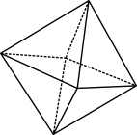
Learning intention / Success criteria
Approaching | At standard | Above
I can perform the calculations involving rational numbers and percentages and explain their connection to the investigation. | I can communicate a reasoned solution to the investigative question and support it with mathematical evidence that I have produced. | + I can formulate an additional question for the investigation and propose the relevant calculation strategies and digital tools that could help answer it.
I have evidence of the data I collected and the calculations I performed. | I produced tabular and graphical representations of the data collected and a presentation to effectively communicate my solution and review the model. | + I collected additional data and performed additional calculations to enhance the model’s effectiveness and communicated these in my presentation.
Notes:
Introduce the learning intention and success criteria. They are described together in this slide; however, the lesson plan gives further descriptions.
Students can select the LI/SC most appropriate for them and write it in their exercise books underneath the title. This is an independent goal set by the student and teacher. A skills check is provided on slide 4 and 5 to perform the calculations using percentages required for the investigation.
If you haven’t already covered this in slide 2, pose more specific questions and prompts related to the LI and SCs, such as:
what sorts of calculations might they perform in their data analysis.
if they had a table full of data on scoring shots, what would they do next?
Lead students to say they could visualise the data, look for trends … but what would they do after that?
Might they ‘compare’ the data? How would you compare the data?
4. Leave the discussion here and go to the next slide 4.

Slide 4
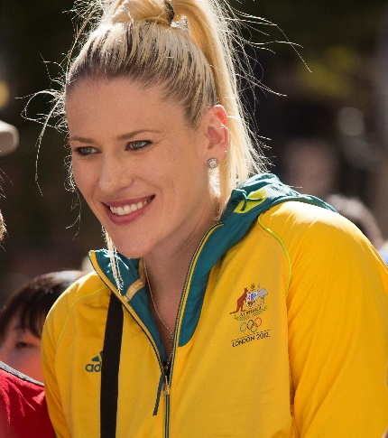
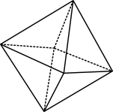
Skills check
Rob Masefield (masey.co) CC BY-NC-ND-NoDerivs 2.0 Generic
By Bidgee, CC BY-SA 3.0 au
Lauren attempted 13 field goals and made 7 of them. Express her accuracy as a percentage.
At the Tokyo Olympics, Patty Mills led Australia to a win over Nigeria by scoring 25 points. He made 5 of 8 from beyond the arc.
What was his three-point shooting percentage?
If he scored the rest of his points as field goals within the arc, and attempted 7 shots from this range, what was his overall shooting percentage?
Notes:
Images: Rob Masefield (masey.co) CC BY-NC-ND-NoDerivs 2.0 Generic; By Bidgee, CC BY-SA 3.0 au
Field goals: is any shot at goal that is not taken from the free-line. Depending where it is taken on the court indicates how many points the goal is worth.
This lesson gives teachers the opportunity to guide students through the mathematical-modelling process. The problem and investigation is pre-determined in this activity; however, students are guided along the path step by step. Teachers are encouraged to take a Classroom dialogue and Questioning teaching approach to have students use critical thinking skills to uncover the reasons for the approach taken. Use the ‘Wh’ and How’ questions to help students suggest the next step and answer why they are taking this step, whether it be construction of the problem or performing a calculation.
Slides 4 and 5 are designed to test prerequisite knowledge, specifically percentages, decimals and proportional reasoning. These are skills taught in Year 7; however, they are important arithmetic skills to consolidate. Ensure you can connect the arithmetic to the investigation, so that students can access deeper mathematical thinking skills. Go through the slide questions as a class where students are expected to provide full sentences within the basketball context in their notes. An extension question is also provided. Answers are provided below, including a fist-to-5 temperature test to identify those students requiring support or extension.
Do these as a class but have students write their answers in their exercise books.
7/13 is approximately equal to 54%.
a) 5/8 is equal to 62.5% b) 25 – (5*3) = 10, therefore Patty scored 10/2 = 5 regular field goals. 5+5 = 10 total made shots and 8+7 = 15 total attempts. 10/15 is approximately equal to 67%.
Students should be expected to present their answers in full sentences that provide context for the solution.
Differentiation (support): Have practice worksheets ready on percentages for those students who require further scaffolding and practise.
Differentiation (extension or expansion): Create a list of the 5 Australian NBA/WNBA players with the highest career 3-point shooting accuracy. Select one of these players and list five possible individual game performances that would closely match their career average. E.g., a player with a career average of 37% may have shot 3-of-8 on a given night.

Slide 5
More warm-up questions
What is 30% of 160?
15% of the 8,000 tickets to a game were sold to tourists. How many tourists are in the crowd?
The Boomers scored 552 out of 600 foul shots at the Olympics while the Opals made 344 out of 400 free throws. Which team had a better percentage?
In a class of 25 students the fail rate for a test was 20%. How many students passed the test?
Vikram achieved 92% of his steps goal on a particular day. On that day he completed 4,600 steps. What was his goal?
Notes:
Provide students with an appropriate amount of time to complete these questions independently. Display a timer to support their time-management skills.
Work through solutions on the board while the students mark their own or a peer’s answers.
Fist-to-5. Ask students to close their eyes and then hold up the same number of fingers as questions answered correctly. This allows you to quickly assess whether the class are proficient in the core skills of the investigation. You may use this data to identify students for additional support or extension.
Worded questions should be answered contextually.
0.3*160=48
0.15*8000=1200
552/600=92% and 344/400=86% therefore the Boomers shot better.
1/5 of 25 = 5 therefore 20 students passed.
4600/x = 0.92 0.92x = 4600 x = 4600/0.92 x = 5000

Slide 6
The task!
As a budding young mathematician and fan, you decide to send a basketball coach an email with a suggested winning strategy. You’ve noticed recently that your team doesn’t shoot many three-pointers, even though most of the players shoot two-pointers with a high degree of accuracy.
Write a convincing email to the coach to persuade him that shooting three-pointers is a good idea. The coach is notoriously skeptical and can only be swayed by strong evidence.
Therefore, your email must include:
data
calculations
graphs
relevant analysis of them.
To submit, send this email to your teacher.
Notes:
Circulate the Shooting three-pointers assessment and the data collection handouts to students. Inform the class they will be working in groups. It is suggested to predetermine groups for this task, given there is a physical and sporting aspect to it, but also to have students collaborate and support their peers who are at different levels of mathematical achievement.
Introduce the task problem from the handout by reading it out to the class.
Remind students that this task is an investigation and one in which they will (with guidance) breakdown the investigative question to formulate a mathematical model to test the conjecture proposed. Students will produce and collect their own data, present the data in an organised matter, correctly use calculations (involving percentages), plot data effectively, provide written analysis that is relevant and accurate, communicate results as a group in a logical manner, support logic with mathematical evidence, consider feedback and compose a persuasive email that identifies both the strengths and weaknesses of the model used.
Since there are a lot of clues in the question, bring up the earlier discussion you may have had with the class before the skill check. Focus on identifying the problem.
What statistical strategies might mathematicians who work for professional basketball teams use to maximise their scores to win games?
5. Go to slide 7

Slide 7
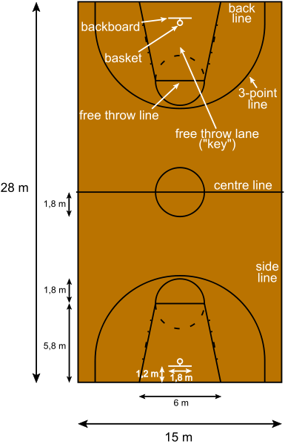
Data collection
Select six locations on the court with the following criteria.
One location must be very close to the basket (‘lay-up’).
Two locations must be beyond the three-point line (> 6.02m).
Hint: three-point shots are shortest when they are perpendicular from the basket and longest when they are straight ahead of the basket. Why is that?
The locations must cover a range of different distances from the basket.
Now draw a half-court diagram displaying your group’s locations and approximate distance from the basket/ring.
NielsF CC BY-SA 3.0 DEED
Notes:
Image: NielsF CC BY-SA 3.0 DEED
The focus on this part of lesson is planning the statistical investigation: AC9M8ST04
Have the kids organised in their groups with their exercise books ready.
Explain the main elements of the basketball court using the language of the game, as shown in the slide, to cover those unfamiliar with the game. You do not need to have any further knowledge of the game rules other than this.
Have the students discuss the problem and what they should do in their groups. Rough ideas here are ok.
Walk around the groups and ask guiding questions about the investigative problem depending on the discussions you here. Suggestions are:
Do you think all shots in basketball have the same accuracy or success rate?
How might the location of the shot on the court influence its value or success rate?
How could we test the success/accuracy rate of shots from different locations on a basketball court?
What would be a good way to ensure our test results are consistent and reliable?
How many times should each shot be attempted to get a good average? Why?
What factors might influence the success rate of each shot, and how can we control for them in our experiment?
After 5 to 10 minutes ask students to stop and listen. Have groups call out some of their ideas.
Click your mouse to bring up the text. (This slide is animated.) Together decide on the number of locations and number of shots that students need to take to collect data. This lesson suggests 6 locations and 10 shots each.
Ask to students to assign each of their locations a name, such as: Lay-up 2, Short 2, Mid 2, Long 2, Short 3, Long 3.
Have students draw a half-court diagram showing locations, labels and approximate distances from the basket/ring.
Go to slide 8.

Slide 8
Data collection example
Notes:
The image won’t show first but ask the class whether in groups have ideas for recording data before clicking the mouse.
From here promote a discussion on considerations of data collection.
Guiding questions:
Ask how should we record the results of our shots?
Talk about data: question students on sampling and the type of data collection best suits this task (random, non-random, qualitative, quantitative)
Discuss the implications and advantages of different ways to collect data for this scenario
Discuss how a team should organise the data so that it is collected meaningfully (should they use a table, spreadsheet, tally)
Could they use digital tech to collect data?
Click the mouse to bring up the image of the spreadsheet. This is a suggestion but edit this slide to suit your group and your intention for this investigation.
Show students how they will collect data. It is suggested to have the actual Excel spreadsheet opened in another window so you can display it on the board. If you class is not using spreadsheet software, have students make recording tables instead.
Demonstrate where they will enter data for their team members and reiterate the language of maths: number of shots will be recorded as a decimal (since they are taking ten shots). Ensure students understand this point. (Talk about ten shots, decimals and percentages if you like.)
Share the spreadsheet with each group, and have the group set-up their spreadsheets, typing in names of each group member in the relevant row.
Ensure students save the spreadsheet to their device to quickly access it the following lesson.
This is a natural end to Part I of the investigation.
OR if there is time
Go to the basketball courts to collect data. This stage is likely to require a good amount of time. It is important to organise the require materials beforehand such as booking the basketball court and collecting cones and balls.
Each group marks out their 6 locations on the school’s basketball court with cones.
All students in the group attempt 10 shots from each location and use spreadsheet software to record the accuracy of the group’s shooting.
Each student should have their spreadsheet verified at the end of the lesson to ensure everyone has collected the required data. Students who were absent during this lesson will be able to transpose the spreadsheet of another group member.

