Slide 1

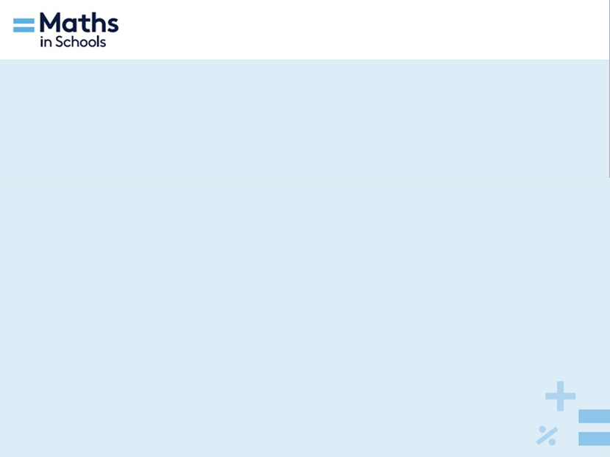
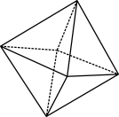

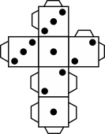
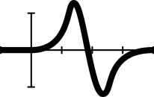


Sleepy statistics:
Stem-and-leaf plots (Part 1)
Notes:
Year 7
Statistics
60 minutes
AC9M7ST02, AC9M7ST03
Summary
Students conduct a sleep audit over two weeks to test hypotheses regarding improving sleep quality. They will represent the data using a back-to-back stem-and-leaf plot and draw conclusions based on statistical analysis. The lesson is divided into two parts and are to be taught sequentially; however, each lesson is designed to stand alone.
Prerequisite knowledge
It is assumed that students have:
a basic understanding of data representation methods such as tables
an ability to calculate time differences, for example, finding the difference between 9.45pm and 6.50am and converting times in hours and minutes to minutes
can calculate mean, median and range for a dataset
an understanding of place and place value.
Areas of challenge
Some students may:
think all forms of data representation can be used interchangeably
find keeping consistent data recording difficult
experience difficulty using digital spreadsheets.
The following interventions are suggested:
Highlight the purpose and effectiveness of different graphical representations – for instance, asking students what kind of data a stem-and-leaf plot could be effectively used for (categorical data, single/double-digit numerical data) and highlighting how other graphs such as pie charts might be a poor choice.
Check in with students each lesson to remind them to update their sleep diaries. Consider emailing parents to remind them to support their children in completing the diary.
Model how to input data into software and generate graphs. Spreadsheets are pre-populated with inbuilt calculations in hidden tabs.

Slide 2

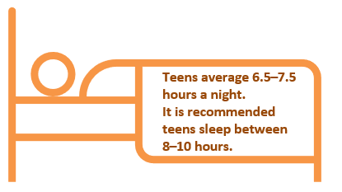
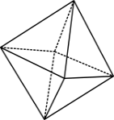

How long did you sleep last night?
How much sleep do you think you should get?
Teens average 6.5–7.5 hours of sleep a night. It is recommended that teens sleep 8–10 hours per night.
Data: Sleep Health Foundation and VicHealth (2018)
© 2023 Commonwealth of Australia, unless otherwise indicated. Creative Commons Attribution 4.0, unless otherwise indicated.
Notes:
Important note: This lesson series can be structured over a two and a half week period to allow for the collection of data. The learning hook below takes about 15 minutes to deliver with the teacher’s slides. Deliver this a week before this lesson is scheduled, so students can collect Week 1 sleep data. At the end of this lesson, you will instruct students to collect Week 2 data, which will have a slight change of instruction.
Iteration: If time is short and to reduce cognitive load, combine lesson with students creating two different stem-and-leaf plots for the two weeks of data (rather than a back-to-back stem-and-leaf plot). Remove the two-column graph created using a spreadsheet.
Learning hook
Hand out sticky notes (or squares of paper) and ask students to write down how long they think they slept last night in hours and minutes.
Ask the students to stand up with their papers or sticky notes and stand in a long line in increasing order. The teacher notes the highest and lowest values on the board and students return to their seats.
Ask students to think for 30 seconds about how much sleep they think they should get each night, and then tell their neighbour.
This slide shows that ‘Adolescents are only getting between 6.5 and 7.5 hours of sleep on school nights’ and lead a discussion about how much sleep students should get, what affects our sleep, and why sleep is important for health.

Slide 3
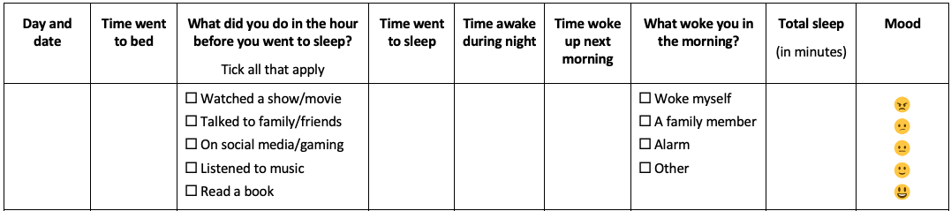
Keeping a sleep diary
Total sleep is the difference between ‘Time woke up next morning’ and ‘Time went to sleep’, less ‘Time awake during night’.
Multiply the hours by 60 to convert to minutes.
You will need to estimate what time you went to sleep.
© 2023 Commonwealth of Australia, unless otherwise indicated. Creative Commons Attribution 4.0, unless otherwise indicated.
Notes:
Distribute the Sleep diary and instructions to students and use slides 3 and 4 to explain how to keep a sleep diary over the next week.
Remind students about filling out the diary each lesson during the week.
If students ask why are they are keeping a sleep diary, show them the learning intentions on slide 5, and make connections with the task in your class discussion.

Slide 4
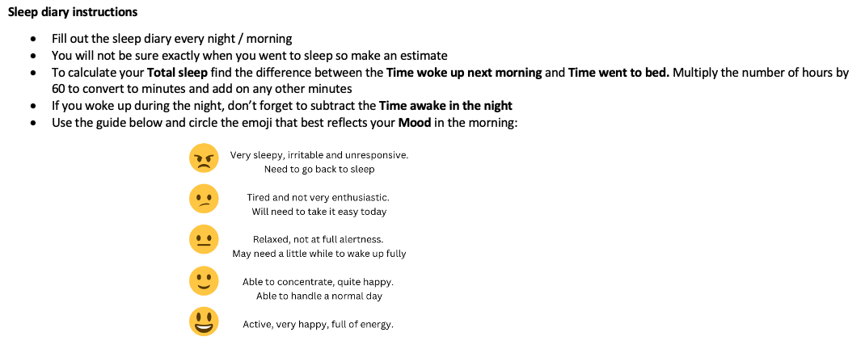
Diary instructions
© 2023 Commonwealth of Australia, unless otherwise indicated. Creative Commons Attribution 4.0, unless otherwise indicated.

Slide 5
Learning intentions
We are learning how to create and interpret a stem-and-leaf plot and a two-column bar chart (using technology).
We will interpret and use data displays to compare datasets.
We will learn how different bedtime behaviours affect the quantity and quality of sleep and learn about the importance of statistical analysis in real-world data representation.
© 2023 Commonwealth of Australia, unless otherwise indicated. Creative Commons Attribution 4.0, unless otherwise indicated.
Notes:
Why are we learning this?
We live in a data-driven world, where statistics are everywhere and graphs are a helpful way to summarise and visualise data. Understanding and interpreting graphs is an important skill allowing us to quickly interpret and analyse information in real-world situations.
Understanding sleep patterns is crucial for health and wellbeing. By statistically analysing personal data, we can make informed decisions on daily habits, promoting healthier lifestyles.
Learning intentions
We will learn how to create and interpret a stem-and-leaf plot
We will interpret and use data displays to compare datasets.
We will learn how different bedtime behaviours affect the quantity and quality of sleep, and understand the importance of statistical analysis in real-world data representation.
Success criteria
By the end of this lesson, students can:
record and organise data in a table
create a stem-and-leaf plot by hand
calculate mean, median and range accurately from a stem-and-leaf plot.

Slide 6

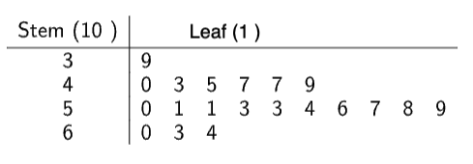

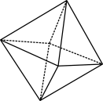

What is a stem-and-leaf plot?
It is a way to display 2- or 3-digit numerical data:
Each number on the right represents an item of data.
Note that the numbers on the right (the leaves) must be in increasing order.
Numbers on leaves are evenly spaced.
© 2023 Commonwealth of Australia, unless otherwise indicated. Creative Commons Attribution 4.0, unless otherwise indicated.
Notes:
Stem-and-leaf plots
Hand out more sticky notes and ask each student to note their date of birth ignoring the month and year, for example, a student born on 17 May writes 17, a student born on 28 February writes 28. Explain that we are going to create a new type of graph showing their birthdates.
Ask students to stick their notes on the whiteboard in rows. Place the notes in groups – 0–9, 10–19, 20–29 and 30–31, but in no order. Ask how the data would be better shown and elicit the idea of ordering the data. Ask a couple of student volunteers to reorder the data.

Slide 7
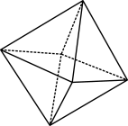
How to create a stem-and-leaf plot
Data set: 15, 21, 67, 72, 28, 25, 25, 32
Stem Leaf
How to place 28 on a stem-and-leaf plot
1
2
3
4
5
6
7
5
1 5 5 8
2
7
2
The stems must have an even scale (no missing numbers, even if there are no data points for that number).
© 2023 Commonwealth of Australia, unless otherwise indicated. Creative Commons Attribution 4.0, unless otherwise indicated.
Notes:
Draw a stem-and-leaf template on the whiteboard with 0 to 3 on the stem and demonstrate, with student assistance, how to add the data to the stem-and-leaf plot.
Explain the use and construction of a stem-and-leaf plot, using slides 6–9 if desired. It is important that the students gain familiarity with a double-digit stem as this will be required for their sleep survey data.
Use questioning to scaffold the students trying to find the range, mean, median and mode from the stem-and-leaf plot created in the Introduction.
Observe students’ work and use questioning/feedback to correct any misunderstandings.

Slide 8
Reading a stem-and-leaf plot
Data set: 15, 21, 67, 72, 28, 25, 25, 32
Stem Leaf
1
2
3
4
5
6
7
5
1 5 5 8
2
7
2
What number in this data is represented by this 7?
© 2023 Commonwealth of Australia, unless otherwise indicated. Creative Commons Attribution 4.0, unless otherwise indicated.

Slide 9
A stem-and-leaf plot
42
43
44
45
46
47
48
49
50
2
0 5 5
9
3
4
What is different about this stem-and-leaf plot?
What number in this data is represented by this 3?
© 2023 Commonwealth of Australia, unless otherwise indicated. Creative Commons Attribution 4.0, unless otherwise indicated.
Notes:
Students complete the downloadable worksheet: Practising stem-and-leaf plots.
Students complete the online interactive Interpreting stem and leaf plots or any further related activities you would like to use.
Summarise the key features of a stem-and-leaf plot.

Slide 10
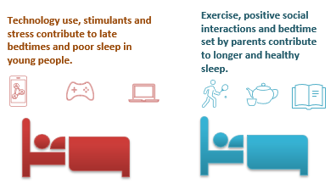
What affects our sleep?
© 2023 Commonwealth of Australia, unless otherwise indicated. Creative Commons Attribution 4.0, unless otherwise indicated.
Notes:
Go through slides 10 to 12, which are about sleep and sleep hygiene
For more information: https://apmha.com.au/wp-content/uploads/Summary-sleep-and-wellbeing-summary-report.pdf

Slide 11
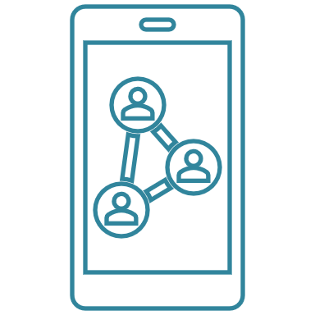
Week 2 instructions
Make one change to follow every night that you think may increase your sleep. You could try:
  turning off screens one hour before bed
  reading in bed
  setting a fixed bedtime
  having a shower at night …
Continue your sleep diary for every night in Week 2.
If teenagers stop using their phones one hour before bed, they will gain 21 minutes sleep each night. That’s one hour and 45 minutes a school week!
Data: Sleep Health Foundation and VicHealth (2018)
© 2023 Commonwealth of Australia, unless otherwise indicated. Creative Commons Attribution 4.0, unless otherwise indicated.
Notes:
Give students the sleep diary instructions for Week 2 where students make one change to their daily sleep practices.
Remind students to record their sleep data every night.

Slide 12
What is sleep hygiene?
Includes | Benefits
Regular bedtime and waketime | Early bedtimes
Relax an hour before bed | Less trouble falling asleep
Avoid stimulants like coffee and technology | Longer sleep times
Create a comfortable sleep environment
Sleep Health Foundation and VicHealth (2018)
© 2023 Commonwealth of Australia, unless otherwise indicated. Creative Commons Attribution 4.0, unless otherwise indicated.
Notes:
Information in table is from Sleep and mental wellbeing: exploring the links
: https://apmha.com.au/wp-content/uploads/Summary-sleep-and-wellbeing-summary-report.pdf

Slide 13

Exit ticket
Sam made 3 mistakes when he created this stem-and-leaf plot.
How many can you find?
1
2
4
5
7
0
3 4 9
2 1 2 7 5
8
5 7 3
© 2023 Commonwealth of Australia, unless otherwise indicated. Creative Commons Attribution 4.0, unless otherwise indicated.
Notes:
Suggestions for marking:
Missing numbers on stem (stems must be a linear scale)
Numbers on leaves not ordered
Inconsistent spacing between numbers on leaves

