Slide 1
Pocket money
Efficient strategies
dice images: Flaticon.com

Slide 2

Jobs around the house
Image source: Pixabay
Notes:
Engage: the students with questions such as:
What types of jobs do you do at home?
Do you believe you should receive pocket money for these jobs? Why/why not?
How much do you think you should receive for the various jobs you help out with?
Do you share the pocket money between your siblings?

Slide 3
Learning intention and success criteria
We are learning to solve problems involving money calculations.
By the end of this lesson, I can:
show different ways to distribute money values
use efficient strategies when solving money problems
use my proficiency with addition and multiplication facts to add and subtract, multiply and divide numbers efficiently.
Notes:
Share learning intentions and success criteria

Slide 4
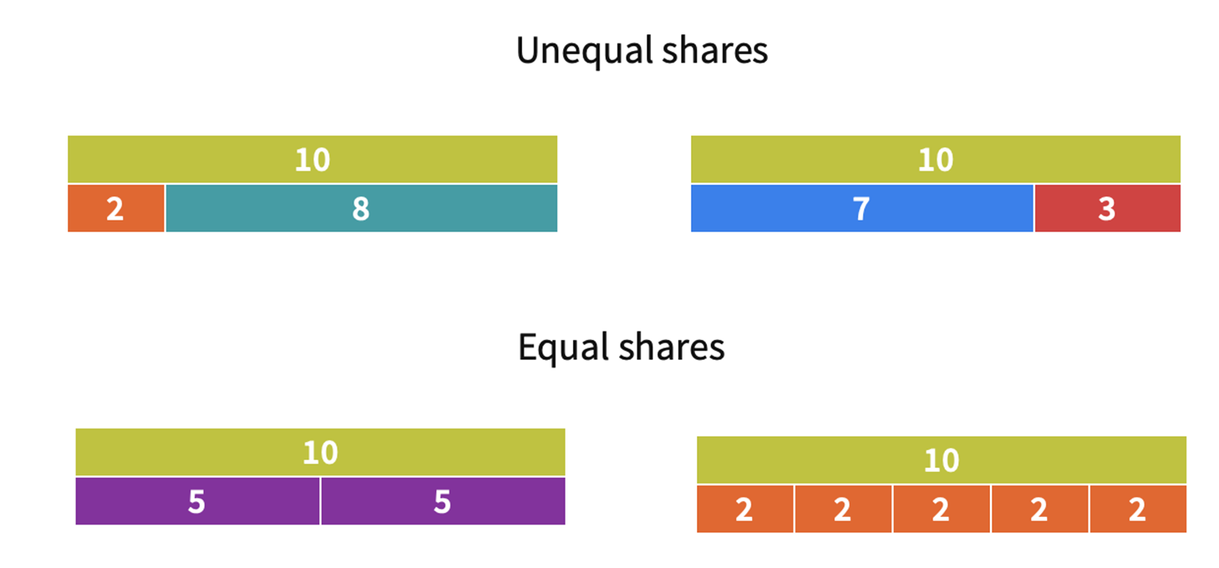
Sharing dollar amounts
Notes:
Explain, sometimes we need to split/partition amounts (collections) into equal groups and sometimes we can make unequal groups. Each action requires the total amount (collection) to be split/partitioned. If we were to put the parts back together again we would have the whole amount/collection again.
Help students interpret the model.
Which model shows $10 shared equally with each child getting $5?
What model shows how $10 is divided equally paying the same amount for 5 jobs.
Which model might show a representation of doing dishes and putting out the bins? Students explain their thinking.

Slide 5

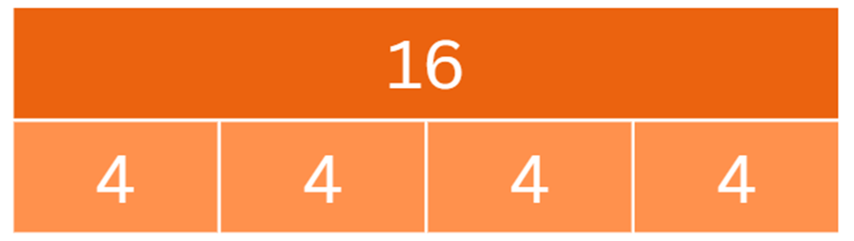
Sharing equal amounts
Notes:
Click to animate answer
This is a bar model and represents the following:
16 shared equally between 4 parts. Each part has a value of 4.
16 ÷ 4 = 4

Slide 6

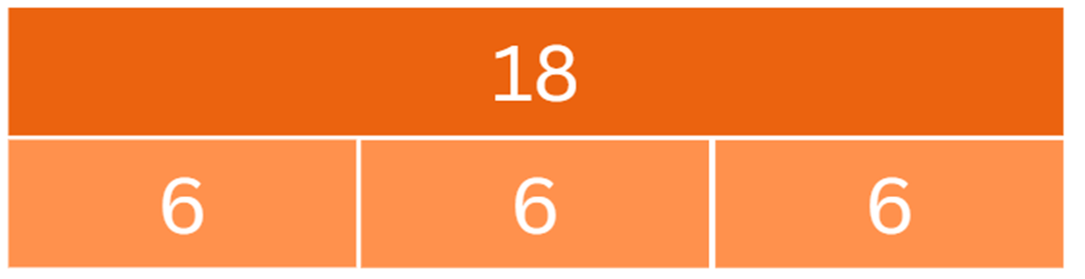
Sharing equal amounts
Notes:
Click to animate answer
We can also use bar models to share money amounts. Let’s explore the number problem 3 children shared $18 equally between them.
$18 does shared equally between 3 parts (children). How much does each part (child) receive?

Slide 7

Sharing with unequal amounts
(using additive thinking)
Think of what this might represent.
Why might one child get more money than the other children?
Why is one child given $9 and the other children much less than this amount?
Notes:
Use an example,
When two children in a family share the jobs one child suggests that ‘It takes me twice as long to clean the bathrooms as it does for my brother to take the rubbish out. I think I should be paid more as my job requires more time and effort.’

Slide 8

Sharing with unequal amounts
Sharing $18
 | Job | Approximate time
Child 1 | Bins | 5 minutes
Child 2 | Dishes | 10 minutes
Child 3 | Washing | 15 minutes
Notes:
Explain this example.
This time we have a total of $18 for the week.
We want to share this amount based on the time and effort put into the following jobs.
Imagine if we shared the money based on the amount of time taken to complete the jobs. e.g. Washing = 15 minutes = $9 etc.

Slide 9
Sharing based on time
Sharing $18
 | Job | Approximate time | Possible way to share the $18
Child 1 | Bins | 5 minutes | $3
Child 2 | Dishes | 10 minutes | $6
Child 3 | Washing | 15 minutes | $9

Slide 10
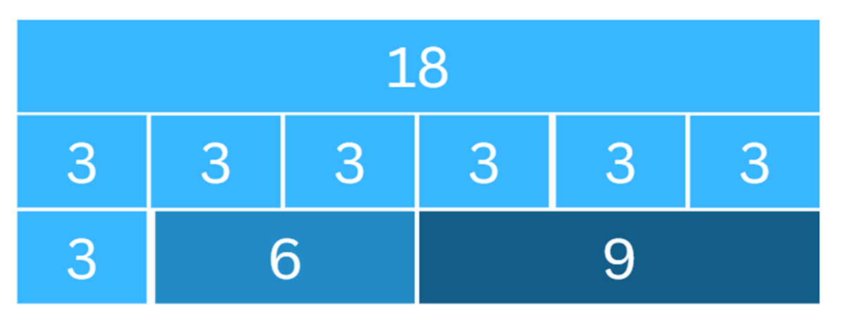
One way to share
Child | Job | Approximate time | $18 shared
Child 1 | Bins | 5 minutes | $3
Child 2 | Dishes | 10 minutes | $6
Child 3 | Washing | 15 minutes | $9

Slide 11
Learning task
What are some ways pocket money could be distributed, based on the jobs completed?
How much pocket money do you suggest should be distributed?
How many people is it shared between?
Will you have an equal/unequal distribution of money amounts?
What type of jobs will you include?
How will you decide how much money is allocated for each job?
Think about how you can present your ideas so it is easy to interpret (read and understand).
Clearly show your working out for each step in the problem.

