Slide 1
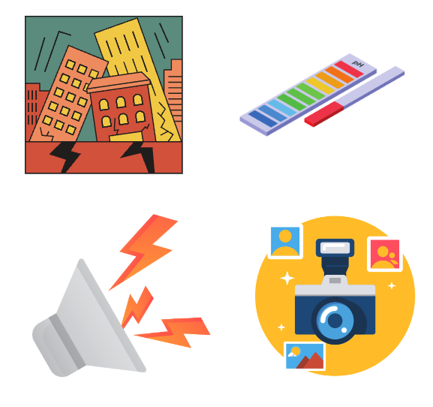
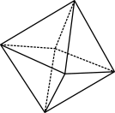
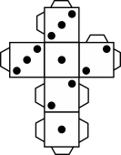
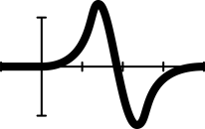
Off the scale
Notes:
Image created in Canva.com
Year 10, Measurement/Statistics, 60 mins, AC9M10M02, AC9M10ST01
Lesson summary
This lesson introduces students to the idea of a log scale, a seemingly perplexing way to present data, by beginning with an exploration of examples when a linear scale is inappropriate and concluding with a plotting activity using authentic data from the COVID-19 pandemic.
Why are we learning this?
Log scales have many real-world applications, being used extensively when analysing or measuring variables that change by significant orders of magnitude, such as for earthquakes (Richter Scale) and pH (acidity). For data analysis they are used when rates of change are of prime interest and by epidemiologists monitoring patterns of disease. Most recently log graphs entered the general public arena when graphs of COVID-19 cases were regularly presented and discussed by governments and in the media. Such graphs can form the basis of models to help predict the future spread of disease, evaluate the impact of interventions and shape health policy.
Learning intention
Students gain knowledge and understanding of what a log scale is.
Students discover how logs are used in the real world.
Students compare how they can represent and analyse data using a log scale, in contrast with the more familiar linear scale.

Slide 2
Log paper
$${10}^{7}$$
$$1 000 000$$
$${10}^{6}$$
The powers increase on a log scale
$$100 000$$
$${10}^{5}$$
$$×10$$
$$10 000$$
$${10}^{4}$$
Which means the numbers multiply by 10
$$1 000$$
$${10}^{3}$$
$$100$$
$${10}^{2}$$
$$10$$
$${10}^{1}$$
$$1$$
$${10}^{0}$$
Notes:
Image created in Canva.com
Note that while this is accurate, it is not very helpful to have a scale marked with 1, 3.2,5.6, 10 if we want to plot points. So instead explain that it would be really useful if we could find the different powers to put onto 10 to get values like 2, 3, 4, 5 … and note that is what mathematicians have done in the creation of log graph paper.

Slide 3
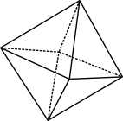
Log paper close-up
The gaps get smaller and smaller
$$10$$
$${10}^{1}$$
10
7
5
4
3
The gaps between numbers are large at first
2
$$1$$
$${10}^{0}$$
1
Log scales start at 1 not 0 !
Notes:
Note that this slide is animated. With each mouse click more information appears.
Explain how the scale operates. Note that technically this is semi-log paper as only half the axes are on a log scale: the vertical axis is a log scale, but the horizontal axis is linear.

Slide 4
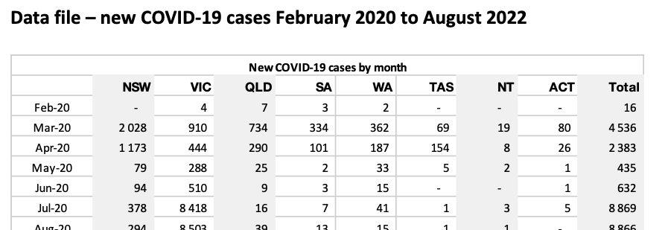
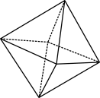
COVID-19 cases
In your pair, you should have two sheets: log graph paper and Data file: new COVID-19 cases.
Mark the vertical scale on your log paper starting at 1, multiplying by 10 for each darker line.
On the horizontal axis mark Feb-20 for the first mark and a different month for each mark up to Aug-22.
Choose a state or territory, or Total (all Australia).
Plot the new COVID-19 cases for that month for your state or territory.
Join your points with a curved (freehand) line.
Write a few sentences explaining what your data shows.
Notes:
Explain that during COVID-19 was the first time that data using a log scale was very widely seen and talked about in the media. New case numbers were reported and monitored daily, by state/territory, national governments, and global bodies like the World Health Organization.
A log scale was often used as some rapid increases were seen and there was a focus on the rate of increase to try and understand how quickly the disease was spreading and whether measures like masks, border closures and lockdowns were working.
While epidemiologists who study patterns of disease regularly use log graphs, many members of the general public (and government) struggled to understand the log graphs presented.
This activity asks students to create their own log graph to try and understand the rate of increase using actual data for the time, but consolidated into months (to reduce the number of data points to a manageable total).
Organise students into pairs and distribute a copy of Log graph and data worksheet one between. The dates have been chosen as they cover the period when daily case number data was being reported in Australia.

Slide 5
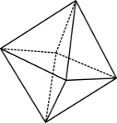
Which scale is best?
Notes:
‘Which scale is easiest to understand?’- expect answers such as ‘The linear graph is easier to understand, because we are used to seeing scales like that and it goes up evenly’
‘Which graph gives more helpful information about the first year of the pandemic?’- ‘It’s hard to see what is happening in the first year on the linear graph because the numbers are so small, so the log graph might be better’
‘Which graph would be more likely to convince you that masks, vaccinations etc. are a good idea?’- On the log graph, the initial numbers appear bigger so that might make you more likely to support measures to stop the spread’
‘How are the graphs different?’ and ‘How do they tell a different story?’ – ‘On the log graph, it looks like numbers are pretty flat towards the end period, but on the linear graph they seem to be coming down so this is a bit inconsistent / confusing’ or ‘The log graph seems to show a generally steady increase, then flattening at the end, whereas the linear graph shows nothing for the first 1.5 years and then massive numbers’
‘How might the different graphs be used?’- ‘epidemiologists need to study the rate of increase so would definitely use a log graph, but perhaps they are too confusing for non-specialists to understand’ or ‘data is always used for a specific purpose so you have to be careful what the person or body showing you the graph believes and wants you to believe as that could influence how they present the data’
Note that current sources of public information on case numbers such as the World Health Organization’s Coronavirus Dashboard and the Australian non for profit Fairfacts Data have reverted to using a linear scale, most probably because of a lack of understanding of log scales among the public.

Slide 6
When logs are used
Notes:
Explain that log scales are not just used for data for epidemics. When something is being measured that increases by significant orders of magnitude, a log scale is used. Ask students if they can guess these log scales from the images.
Examples include earthquakes, which are measured on the logarithmic Richter Scale, pH or the acidity / basicity of a chemical, the loudness of sound, which is measured on a log scale in decibels, and in measuring photography light exposure.

Slide 7
Exit ticket
Imagine you are tasked with explaining today's lesson to a friend who missed class. How would you summarise the key points in three bullet points?
Notes:
Ask students to imagine they are tasked with explaining today's lesson to a friend who missed class. How would they summarise the key points in three bullet points.
Note that you can print and download the exit ticket from the What you need section from the online section, or students can answer in their exercise books.

