Slide 1


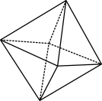

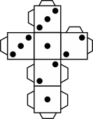
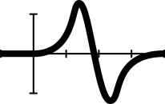


Mathletes in motion
Exploring sporty and rational numbers on a number line
Notes:
Year 7/Number/Number sequences
45–60 mins
(AC9M7N04) Find equivalent representations of rational numbers and represent rational numbers on a number line
Lesson summary
In this lesson, students use mathematical modelling in measurement (comparing and evaluating sports results) to explain equivalence between fractions, decimals and percentages, and represent rational numbers on a number line.
Resources required for lesson
Mathletes in motion lesson plan
Blu Tack
Vertical whiteboards or A3 blank paper
Springboard maths concepts – Decimals fractions
Mix and match order game card templates printed on A4 card and cut out to make 4 unique card sets of 8 rational numbers (It is recommended to laminate these to use again.)
1 x each Number line printed on A3 paper
Exploring sporty rational numbers worksheet
Prerequisite student knowledge and language
Compares and orders fractions and represents these on a number line
Orders numbers with more than one decimal place
Connects familiar percentages and fractions to their decimal equivalent
Locates integers on a number line

Slide 2

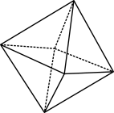

Learning intention
We compare, justify and represent equivalent rational numbers on a number line.
We can use knowledge of place value to partition numbers in different ways.
We can collaborate to investigate equivalence between fractions, decimals and percentages.
We use and apply equivalence to solve practical problems from real life to enhance and communicate understanding in an engaging way.
Notes:
Success criteria
By the end of this lesson, students can:
justify the location of a rational number on a number line
model the comparison of rational numbers in practical problems
use knowledge of place value to partition numbers in different ways
communicate equivalence between different representations of rational numbers.

Slide 3

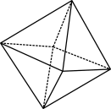

Why are we learning about this?
In this lesson, we will compare quantities and probabilities in sporting contexts.
Why?
helps us to make decisions about sporting data,
make same comparisons that can be used for other real-life problems:
dividing up different-sized easter eggs between friends or siblings
comparing supermarket pricing.
Notes:
Why are we learning about this?
In this lesson, we will compare quantities and probabilities in sporting contexts. Learning about this not only helps us to make decisions about sporting records, but the same comparisons could be used in other types of problems, for example, dividing up different-sized easter eggs between friends or comparing supermarket pricing.

Slide 4

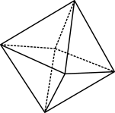
Quick review!
The role of zero
Three students looked on the board in the next classroom and saw: 0.5, 0.05 and 0.50.
Student 1: ‘Those three numbers all mean exactly the same!’
Students 2: ‘No they don’t! Only two are the same and the other is something really different.’
Student 3: ‘I think you’re both wrong. They all must mean something different; they can’t be the same amount!’
Who do you think is right?
Notes:
The role of zero
Verbal prompt: Three students looked on the board in the next classroom and saw: 0.5, 0.05 and 0.50. Write these numbers on the board
Student 1: ‘Those three numbers all mean exactly the same!’
Students 2: ‘No they don’t! Only two are the same and the other is something really different.’
Student 3: ‘I think you’re both wrong. They all have to mean something different, they can’t be the same amount!’
Who do you think is right?
Ask students to give their answers. Explain or review what the numbers mean and say how they are the same or different. Use a diagram to help explain.
How would you write these decimal numbers as fractions?
Number sequences
Ask students to enter a decimal number or fractional number between 1 and 30 on their calculators. Ask each group to order themselves from the greatest number displayed to the lowest number.
Then have two groups combine and repeat the process. Combine groups again and repeat. When two large groups remain, ask one group to read its sequence.
Ask students in the second group to think about where their numbers will fit in the sequence, before combining the groups in one sequence.
More than, less than
Ask students to work with a partner to compare their explanations about the order of numbers and then decide whether they are correct.
Invite students to explain what is wrong with explanations, such as these: 0.038 > 0.2 because 38 is more than 2; 8.05257 > 8.514 because it has more places; 17.353 < 17.35 because when you change them into fractions is bigger than $\frac{355}{1000}$ .

Slide 5
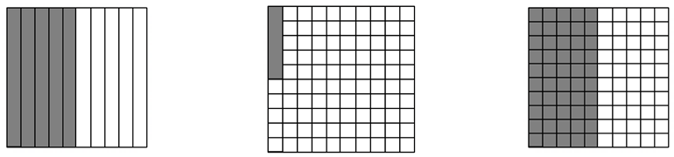
Quick review again!
The role of zero
Three students looked on the board in the next classroom and saw: 0.5, 0.05 and 0.50.
How would you write these decimal numbers as fractions?
Notes:
Explain or review what the numbers mean and say how they are the same or different. Use a diagram to help explain.
How would you write these decimal numbers as fractions?
Note: Slides 5-7 are optional and are designed to clear up the common misconceptions before this progression level.
You may wish to skip these slides and go straight to slide 8.
Alternatively, use these quick reviews as a way of knowing more about your students so you can provide scaffolding for the lesson ahead.

Slide 6
Number sequence game
Form a small group and enter a decimal number between 1 and 30 on your calculator.
Order your numbers from largest to smallest.
Combine with another group and reorder yourselves as one.
Combine and reorder until there is only one ordered group next.
Can you do it without help?
Notes:
Number sequences (optional)
Ask students to enter a decimal number or fractional number between 1 and 30 on their calculators.
Ask each group to order themselves from the greatest number displayed to the lowest number.
Then have two groups combine and repeat the process. Combine groups again and repeat.
When two large groups remain, ask one group to read its sequence.
Ask students in the second group to think about where their numbers will fit in the sequence, before combining the groups in one sequence.

Slide 7

Why are these explanations wrong?
0.038 > 2, because 38 is more than 2.
8.05257 > 8.514, because it has more decimal places.
17.353 < 17.35, because when you change them into fractions, $\frac{35}{100}$ is bigger than $\frac{353}{1000}$.
Notes:
More than, less than (optional)
Ask students to work with a partner to compare their explanations about the order of numbers and then decide whether they are correct.
Invite students to explain what is wrong with explanations, such as these:
0.038 > 0.2 because 38 is more than 2
8.05257 > 8.514 because it has more places
17.353 < 17.35 because when you change them into fractions $\frac{35}{100}$ is bigger than $\frac{353}{1000}$ .

Slide 8
Sporty numbers
Numbers can be very large or very small.
Sometimes we estimate, sometimes we need to be very exact!
Sometimes they are fractions of a fraction of fraction.
Sometimes they are decimals with many decimal places,
Sometimes they are percentages.
And sometimes they are all mixed up and we need to put them in order.
In sport or in our hobbies, when do we use numbers other than whole numbers?
Notes:
The hook (5 to 10 minutes)
Instructions to students
We are going to compare quantities in four different sporting contexts.
Ask students, ‘When would we use numbers other than whole numbers in sports or hobbies?’
Students select a card from the templates provided: swimming, AFL, rugby, netball (4 X 8 rational numbers – 32 students).
Differentiation (support all abilities):
Note that the cards are differentiated into levels of difficulty. Pre-arrange cards to match the learning needs of students in your class, or simply allow students to choose the sport of their choice to boost engagement in the game, no matter the level of challenge.
Level 1 – Rugby players bench lift weights
Level 2 – AFL Development Squad Premiership Teams – probability of a winning a grand final
Level 3 – Netball vertical jump tests (uses mm)
Level 4 – Swim times 200 m (times include conversions of decimals of minutes to seconds, or vice versa)

Slide 9
Mathletes
Find your fellow ‘mathletes’ in groups of about four.
They will have similar measurements on their cards.
Now put yourselves in numerical order.
Remember, do not lose your card, you need it later … and your teacher needs it back!
Notes:
Students gather into groups of four with others that have the same type of measurement, and then organise themselves in numerical order of the numbers stated on their cards.
(Measurement is highlighted so that kids are encouraged to compare by the numbers rather than the pictures on the cards, though this does help for differentiation support.)
After this, the teacher asks one student from each group to share one of the strategies they used to justify their choice to the class.
In the course of discussion, question students to understand their thinking at this moment, ‘Why do you think I asked you to do this task?’
Students keep their card to use in the next section.
Differentiation (monitor):
Was this task easy or was it difficult? Notice students’ engagement and ability with the game while they are working, and those who have communicated how they found the task. Use this to gauge whether the next section should be modified.

Slide 10
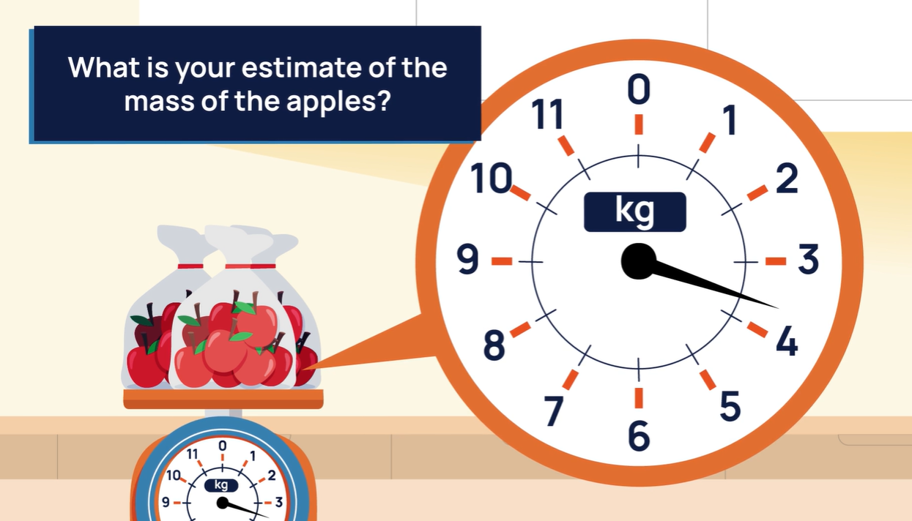
Decimals and fractions
Notes:
Note to teacher: Pre-prepare by printing the downloadable number lines for this task for the different sporting groups. You may wish to laminate these to be used again in the future. Blue Tack them to the walls in the classroom around the room.
Have a tab open and link to: ESA Maths Hub Springboard maths concepts video: Decimals fractions.
Pause at 0:23: ‘What is your estimate of the mass of the apples?’ Students are encouraged to think about (not call out) their estimate.
Now play the video to view the tenths example. Pause at 0:49, ‘Were your estimates close?’
Play video and pause at 1:17: ‘What is your estimate of the length of the long jump?’ Students are encouraged to think about (not call out) their estimate.
Play the video to view the hundredths decimal place example and pause at the 5 and 35 hundredths example (1:59). Explicitly demonstrate on the board (this could be written down before the start of the lesson) how 5 35/100 can also be written as 5 7/20 using cancelling.
Play video and pause at 2:18. Discuss with your partner (group), ‘Who has the winning jump? ‘
Play the video to view example on how to choose the winning jump. Common decimal misconceptions are highlighted.

Slide 11
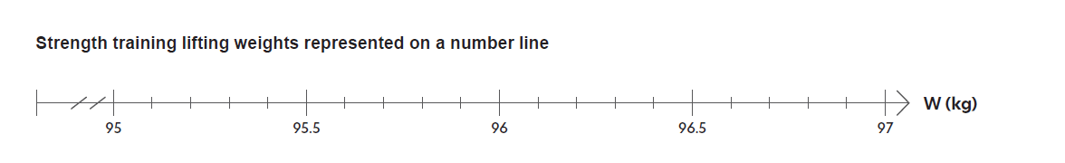
Sporty number lines
96.0 kg
Notes:
Instruct students to combine with the other group that has cards from the measurement and have them arrange themselves in numerical order.
Using Blu Tack, students collaborate to place their card number on their respective number line (printed on A3 paper) with an arrow clearly pointing to its place on the number line. An example is above shown.

Slide 12
Sporty reflection …hmm…
What is similar/different about the numbers in each group? Is there a number type that we haven’t used? Why are there no arrows on the AFL number line?
Can we combine all these measures on one number line?
What would you expect the numerical probabilities on the eight AFL Premiership chances to add up to? Can you check with and without a calculator they add up to 1? Why do they add up to 1?
Could you make up a set of eight numbers that includes negatives? Percentages? What context would you use?
Can you think of a time in life when we need to know negative fractions on a number line?
Paradox statement: ‘Between each two points on a number line is an infinite number of points.’
Notes:
Provide solutions to one member of each sport group so students can check their placement of the rational numbers on the number line. Encourage students to use reasoning to justify their answers against the solutions, especially if answers are incorrectly placed.
Students then complete a gallery walk of the other number lines. Ask students the following prompt questions for reflection and extension of the task.
What is similar/different about the numbers in each group? Is there a number type that we haven’t used? Why are there no arrows on the AFL number line?
Can we combine all these measures on one number line? (Leading to a discussion that comparisons are only possible with same measures.)
What would you expect the numerical probabilities on the eight AFL Premiership chances to add up to? Can you check with and without a calculator they add up to 1? Why do they add up to 1?
Could you make up a set of eight numbers that includes negatives? Percentages? What context would you use?
Can you think of a time in life when we need to know negative fractions on a number line?
And, for a paradox statement: ‘Between each two points on a number line is an infinite number of points.’

