Slide 1





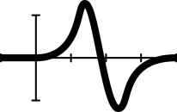


Graphs: formulas and variables
Notes:
This lesson follows Patterns, rules and graphs, but both lessons can be used in isolation.

Slide 2




Learning intention/ Success criteria
Review
I can identify the gradient and initial value of a linear rule.
Approaching | At standard | Above
I can experiment with different values of variables and make observations of the changes. | I can describe the effect of varying the values of variables in linear equations to determine the better job offer. | +I can solve a linear equation to determine when the job offers are equivalent.
I can enter data into spreadsheet software. | I can manipulate formulas on spreadsheet software.
Notes:
Introduce the learning intention and success criteria for students and taps into what they already know about algebra, graphing, linear relationships, number sense.
Students can select the LI/SC most appropriate for them and write it in their exercise books underneath the title.
The important concept to review for this lesson is suggested to directly to students. This helps prime students for what is to come.
I can identify the gradient and initial value of a linear rule.
Other important pre-requisite concepts and skills are taken from the progression levels.
Students have been exposed to and should be able to:
create and identify algebraic equations from word problems involving one or more operations
identify and justify equivalent algebraic expressions
interpret a table of values to plot points on a graph
analyse and visualise data using a range of digital tools to identify patterns and make predictions
select and use the core features of digital tools to efficiently complete tasks.

Slide 3




Which job will get me that new phone faster?
Mediamodifier via Pixabay
Notes:
Image of smart phone by Mediamodifier via Pixabay
Lesson hook
This lesson is designed to engage students by using the context of a common want/goal of students at this age, using a mathematical modelling approach to reach that goal.
Feel free to use a different ‘want/goal’, as suits your class.
Iteration: Poll the class on the desired ‘goal or want’ of the lesson beforehand and surprise the class by editing the slides and materials to suit the most popular goal.

Slide 4

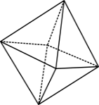

But first … skill check
Prompt A visual pattern involving small circles increases according to the linear rule: $y=2x+4$.
How many small circles are in Figure 0? That is, what is the initial value of the rule?
How many small circles are added in each subsequent figure?
Extension
Describe how your answers to the questions above might change if the rule was adjusted to be non-linear: $y=2x^{2}+4$
Notes:
Introduction (15 mins)
This slide takes students through a check required to revise or address the skills needed to progress through this lesson at a deeper level. If you have delivered the previous lesson (Patterns, rules and graphs), this skill check contextually frames linear relationships in patterns with the algebraic rules.
Use this opportunity to note those students who require support or possibly a more complex task (extension); listen for any challenges or misconceptions any students may hold.
For this slide, challenges and misconceptions may include:
understanding coordinate pairs correctly in relation to a linear rule and that x represents any input number, and y is the output; students may also confuse which figure to plug in
understanding the concept behind linear relationships and that the rule represents a rate of change (In this example, students may mistakenly believe that rate of change is 4 and not 2x.)
forgetting the meaning of c as a constant and that it represents the y intercept, and that y can be 0
finding solving for unknowns, or rearranging equations difficult
being uncomfortable with substituting into equations.
For extension and expansion, try these prompts/hints:
Compare the differences between the linear rule to the adjust rule (non-linear). What do you notice? What do you think the change means?
Suggest various ways to explore the meaning: creating a table of values and noticing the patterns of change and comparing what this means to a table of values in a linear relationship. (What happens to y?)
Suggest to graph a table of values and compare to a linear relationships using similar inputs.
If students have time to graph the equation, ask them to think about what a parabola represents. What would it mean in terms of geometric circles? What would the pattern of circles look like?

Slide 5
Consider your options
The newest model of your favourite phone is about to be released and you’re desperate to own it.
Your parents will not buy it for you because your current phone isn’t that old, so you decide to either start a car-washing business or babysit for friends of the family.
School keeps you busy so your parents say you can only select one job. The phone is calling you!
Which job should you begin?
Notes:
This slide introduces the main investigation.
Note that the context has changed from patterns formed from shapes to patterns and relationships in a financial scenario. This context is much more abstract, but it shows students how relationships are abstract too and problems can be investigated using a mathematical modelling process to provide knowledge on relationships and, in this case, to make predictions.

Slide 6
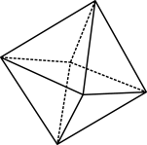
Which job?
You know your neighbours will pay more to have their car washed every so often, but you also know you will get ongoing babysitting jobs.
Job option #1 – Car-washing business
$36 per car to book a time slot, plus $18 per hour worked
Job option #2 – Babysitting
$21 per hour
Notes:
Set the scenario for the mathematical investigation.
Allow the class to mull over the problem.
It is suggested to use this time to create a classroom dialogue to launch this activity, engage the students and to inspire creative- and critical-thinking skills.
Use questions that allow students to interpret the concept and the problem, prompting students to generate possible approaches to tackle the problem.
Remind students about what has been just covered in the skills check: tables, graphs, linear relationships, particularly for those students who feel lost in the question.
Move to the next slide, which progressively scaffolds students through the problem.

Slide 7
Spot the pattern
Instead of squares or circles, these patterns are best represented by dollars.
Car washing: $36 + $18 p/h
Babysitting: $21 p/h
Can you identify the initial value for each ‘pattern’? That is, how many dollars would be in received in hour 0? This is the y-intercept value of the graph.
How many additional dollars will you receive each hour? This is the gradient value of the graph.
Notes:
Explain to students that these job offers can be thought of as a linear pattern/relationship, similar the ones we have been studying.
Note to teacher
Investigations such as these are complex in nature. Below is a list of possible misconceptions or challenges students may experience when tackling the problem, even with a scaffolded approach.
Students may:
feel overwhelmed by the problem and have difficulty starting
be unable to define the variables
question and consider what needs to be considered (for example, time it takes to wash a car; or frequency of doing one job at a time; washing one car or doing one babysitting job)
define the goal to answer the question ‘how much a phone would cost?’ to find a solution to the problem.
Other factors that might influence students’ thinking:
initial costs required to set up the business and whether this is a consideration
profit, loss and revenue
consistency of work (perhaps set some thought boundaries)
job enjoyment or safety - do they find it hard to imagine themselves doing these jobs and therefore this thinking acts to block thinking
may think the hourly rate for a car-washing job is $54 p/h rather than two different elements of the one-off fee + the hourly rate.

Slide 8
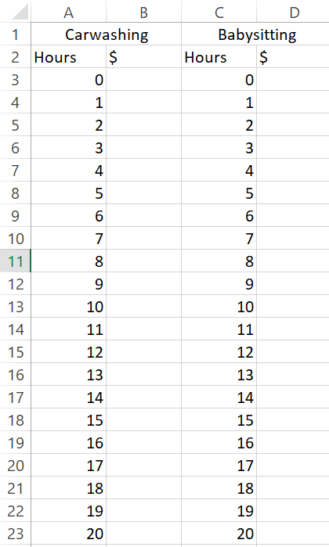


Using tech
We can use technology to tabulate the pattern of each wage offer, because filling in a table of values by hand can be burdensome, and we may make unintentional mistakes. Complete the tables below so you can compare them with our spreadsheet results.
Car washing: $36 + $18 p/h
Babysitting: $21 p/h
Hrs | 0 | 1 | 2 | 3
$ | 36 | 54
Hrs | 0 | 1 | 2 | 3
$ | 0 | 18
Notes:
Introduce a spreadsheet to create tables of values for each equation. Explain that if we insert our equations, the spreadsheet functionality can fill the table.
Demonstrate the spreadsheet software used in your school on the board, explicitly showing how to input equations into cells to create an automatic table of values.
Iteration: have students create a table of values by hand using fewer inputs.
Excel instructions:
Use the ‘merge & centre’ tool in the alignment panel to make the job titles cover two cells.
Enter the first few hour vales (0, 1, 2) and then highlight those cells and drag down the small square from the bottom right corner of the highlighting. This will continue the pattern as far as you drag.
Repeat this process for the second job.
Enter a formula into cell B3 to represent the linear rule for car washing. Explain to students that hitting the “=“ button informs Excel that you are giving it instructions to perform a particular calculation. The formula should be “=36+18*A3”. The * represents multiplication in Excel.
Highlight cell B3 and drag down with the small square. This will replicate the formula in all covered cells. Excel will know to use the correct cell from column A. If we would have included a $ in our formula, for example, “=36+18*A$3”, this would instruct Excel to always use the value from A3 rather than moving on to the cell below.
Repeat this process for babysitting. The correct formula is “=21*C3”.
After the table of values is completed, ask students to compare the results and to consider the original learning question.
Outline the benefits of using a digital spreadsheet: accuracy, time factor, automation.

Slide 9
Reflect
Based on the spreadsheet you have created, which type of job offer would work best for you? (There might not be a straightforward answer to this question!)
How many hours of work per week would lead to the jobs being identical?
How many hours of work per week would lead to the babysitting job being superior?
How many hours of work per week would lead to washing cars being superior?
Your family friends are very keen to hire you as a babysitter on an ongoing basis. They know you were thinking about other ideas and so they want to sweeten the deal. Would you rather they double the retainer payment or increase the hourly wage by $3? Explain your decision because there are logical reasons for each!
There are six weeks until the new phone is released, and it is rumored to cost $1399. Choose one job and set out a plan for how many hours you will need to work per week so that you can afford the phone when it is released.
Notes:
Slide 9 provides you with a series of questions to show students to aid reflection at this point in the investigation. The questions aim to develop deeper level of understanding and the thinking leads to the end of the activity on the following slides. Allow sufficient time for students to answer the questions.
Guiding hints or questioning include:
Defining the goal; or what is your version of ‘best’.
Asking where might ‘earnings’ be equal for both scenarios?
If you have found a point of equality, consider which scenario works best beyond that point.
Consider the booking fee and the hourly rate. If you were to wash many cars, what could you say now about this scenario compared to babysitting?
Consider two different scenarios for babysitting: adding a retainer or increasing the hourly rate. Which works better?
How could we break down the problem when we have new information (question 6). Now that you have worked out the skills to work out different scenarios, how could you apply that logic to this new problem? What steps might you take to answer this problem now?

Slide 10

Investigation
Use the Pay Calculator tool on the following website to find out the minimum wage you are entitled to: https://calculate.fairwork.gov.au/
Fill in the table below:
Most Australians earn a simple hourly wage. Fortunately, this makes it much easier to determine the linear rule!
$$Wage=hourly rate×number of hours$$
In maths notation, we would write this as $y=mx$. The hourly rate represents the gradient of the straight-line graph.
Time | Hourly rate
Regular wage
Saturday
Sunday
Public holiday
Evening – Monday to Friday – 7pm to midnight
Night work – Monday to Friday – midnight to 7am
Notes:
Slide 10 offers a further expansion into the problem. Students are taught about financial literacy and policy using the ‘fairwork’ online calculator on the government website.
https://calculate.fairwork.gov.au/
Students investigate the minimum wage using the online digital tool. Students use the simple equation of ‘wage = hourly rate multiplied by hours worked’.
If you were to ask students whether this rule is linear, students should be able to quickly understand that it is, without making calculations.
Optional (all abilities): ask students to consider the minimum wage for when they begin their first job. Ask students to think about whether they could live off this wage if they were to support themselves.

Slide 11
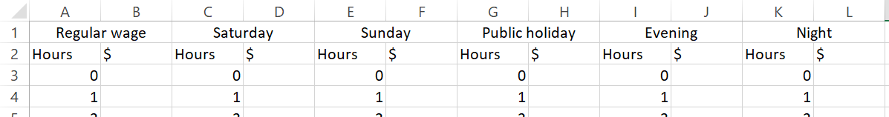
Investigation continued …
You now have 5 linear rules – one for each of the different hourly rates.
Create a new spreadsheet and input each hourly rate as a formula as done previously.
Calculate how many hours of work it would take at each rate to save up the money for your new phone.
In your first job, you may work a combination of different shifts. Create 3 new and different work schedules that would earn you enough money to purchase your phone on its launch date.
Notes:
Explain to students that they have five new linear rules to consider. It should be obvious that the highest hourly rate will earn the most money.
Differentiation (support): Demonstrate numerically if students cannot understand this.
Explain it is a bit trickier to try to determine how much extra money you could make if you were applying the original goal of saving for an expensive phone.
Students have three more tasks as shown on the slides
Ask students to create a new spreadsheet for each new rule and input the new hourly rate.
Have students work out the hours of work it would take to reach their goal savings.
Explain that it is likely in their first job, they will work various hours (weekends, public holidays etc.). Task students with creating 3 new and different work schedules that would earn you enough money to buy the new phone.
Iteration: questions could be given as an assessment or homework task, whereby Slide 12 (the exit ticket) could be a class reflection.

Slide 12
Exit Ticket
Aren’t you glad we measure temperature in degrees Celsius!? Have you ever wondered how temperatures in America can be more than 100 degrees (Fahrenheit)!?
Did you know that there is a linear relationship between Celsius and Fahrenheit?
Let’s see if you can figure out the rule!
The Celsius scale was designed so that 0°C is the freezing temperature of water and 100°C is the boiling temperature of water. For some strange reason, the Fahrenheit scale was designed so that 0°F is the freezing temperature of a mixture of water, ice and salt.
Weird, right?
In Fahrenheit, the freezing temperature of water is 32°F and boiling point is 212°F.
SPICY CHALLENGE
Can you create a linear rule that converts a temperature in Celsius to Fahrenheit? Hint: use the freezing temperature of water to find the initial value (y-intercept).
MILD CHALLENGE
Ask your teacher for the linear rule and then convert 20°C and 30°C into Fahrenheit.
Notes:
Linear rule: F = 32 +1.8C
SPICY CHALLENGE
Can you create a linear rule that converts a temperature in Celsius to Fahrenheit? Hint: use the freezing temperature of water to find the initial value (y-intercept).
MILD CHALLENGE
Ask your teacher for the linear rule and then convert 20°C and 30°C into Fahrenheit.

