Slide 1


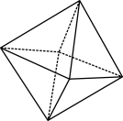

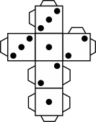
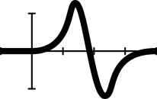


Sleepy statistics: Analysis (Part 2)

Slide 2
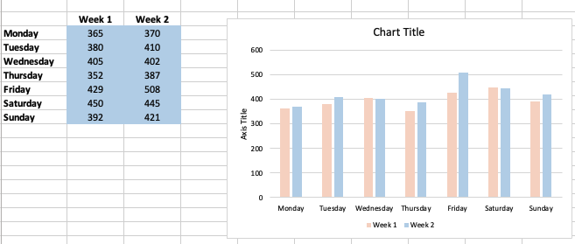
Using a spreadsheet to create a bar graph
1. Insert your data in minutes in the blue cells.
2. Double-click to change the titles for the graph and vertical axis.
3. What patterns does your graph show?
Notes:
This lesson follows Sleepy statistics (Part 1). You can conduct this lesson as a standalone with your changes to suit your class.
Comparing data
Begin by asking students to give a thumbs up/down/sideways if they think they got more/less/same sleep in Week 2. Ask them to get out their sleep diaries and explain that they will create two different types of graphs to analyse their data, starting with using a spreadsheet to create a two-column bar graph.
Email or assign the Excel bar graph template and demonstrate to students how to enter their data and to answer the question ‘What patterns does your graph show?’ You can demonstrate this using slide 2 from the teacher’s slides.
Have students enter their data from their sleep diaries into the spreadsheet. They should now have two weeks’ worth. Ensure they save their file, or have them take a screenshot to save and submit later.

Slide 3

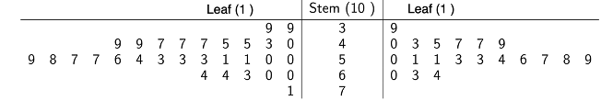
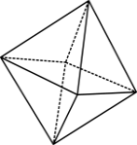

A back-to-back stem-and-leaf plot
What is the same as the stem-and-leaf plot we saw before?
What is different to the stem-and-leaf plot we saw before?
Data: Chiu, A. (n.d.)
Notes:
Explain that the second graph type they
Show the students the example of a back-to-back stem-and-leaf plot and ask them what is different and what is similar to the stem-and-leaf plot we saw before.
Key points to elicit from the discussion are that:
each side shows a different dataset, so a back-to-back stem-and-leaf is used to compare two similar datasets
the numbers always increase from the centre outwards.
will use is called a back-to-back stem-and-leaf plot.

Slide 4
Analysing your data
Use your:
bar graph
back-to-back stem-and-leaf plot
calculations of mean, median and range for Week 1 and Week 2.
With this information, write a few sentences answering these questions:
  How does your sleep pattern vary across the days of the week?
  How did you sleep patterns change between Weeks 1 and 2?
Notes:
Have students once again use their data from Week 1 and Week 2 to produce a back-to back stem-and-leaf plot (on paper), and to calculate the mean, median and range for Week 2 (or for both weeks if they haven’t already done this for Week 1). They will need to compare the Week 2 measures with those from Week 1 and answer these questions (slide 4):
How does your sleep patterns vary across the days of the week?
How did you sleep patterns change between Weeks 1 and 2?
Have students share their findings in pairs and then conduct a group discussion about the students’ sleep patterns. Expected findings might include that students sleep more on weekend versus weekday nights and that there has been some (modest?) improvement in sleep in Week 2.

Slide 5
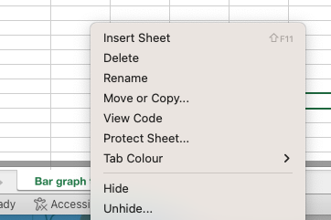
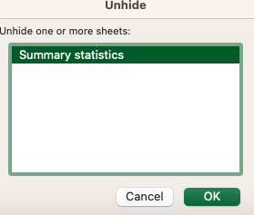
Checking your calculations (Excel)
1. Right click on the tab at the bottom.
3. Choose Summary statistics and click OK.
2. Select Unhide…
Notes:
Next, students find the summary stats calculations in the spreadsheet (slides 5–7) by right clicking on the tab, selecting Unhide and choosing the Summary statistics tab. They should now see the mean, median and range calculations and be able to verify their Week 1 and Week 2 calculations. The teacher can choose to explore the underlying Excel commands with the students by clicking on the pink cells.

Slide 6
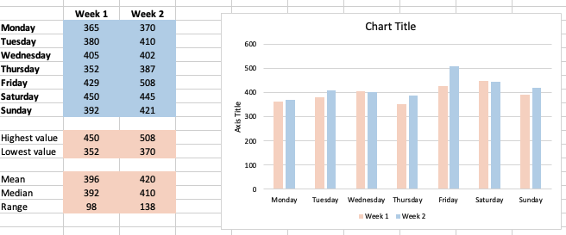
Calculating summary stats
1. Your data should appear here.
2. The software automatically updates these pink calculations and the graph.

Slide 7
Analysing the class data
Use the unordered back-to-back stem-and-leaf plot for the whole class for their Week 1 and Week 2 average (mean) sleep to create an ordered back-to-back stem-and-leaf plot.
Write a few sentences answering these questions:
  Ruby says, ‘there is a lot of variety in the amount of sleep people in our class get.’ State whether you agree or disagree, explaining your answer with supporting summary statistics.
  2. Khalid says, ‘we are not getting enough sleep, but we can improve it.’ State whether you agree or disagree, explaining your answer with supporting summary statistics.
Notes:
Explain that the class will prepare another back-to-back stem-and-leaf plot for the whole-class average (mean) for Week 1 and Week 2 (slide 8). Elicit the highest and lowest values of the whole class (to help decide the scale for the stems). Create a template of the stem on the whiteboard and have students come and write their averages for Weeks 1 and 2 in an unordered back-to-back stem-and-leaf plot.
Students create an ordered back-to-back stem-and-leaf plot for the whole-class data in their exercise books and answer the following questions:
1. Ruby says, ‘there is a lot of variety in the amount of sleep people in our class get.’ State whether you agree or disagree, explaining your answer with supporting summary statistics.
2. Khalid says, ‘We are not getting enough sleep but we can improve it.’ State whether you agree or disagree, explaining your answer with supporting summary statistics.

