Slide 1
What do you notice? What do you wonder?

Slide 2
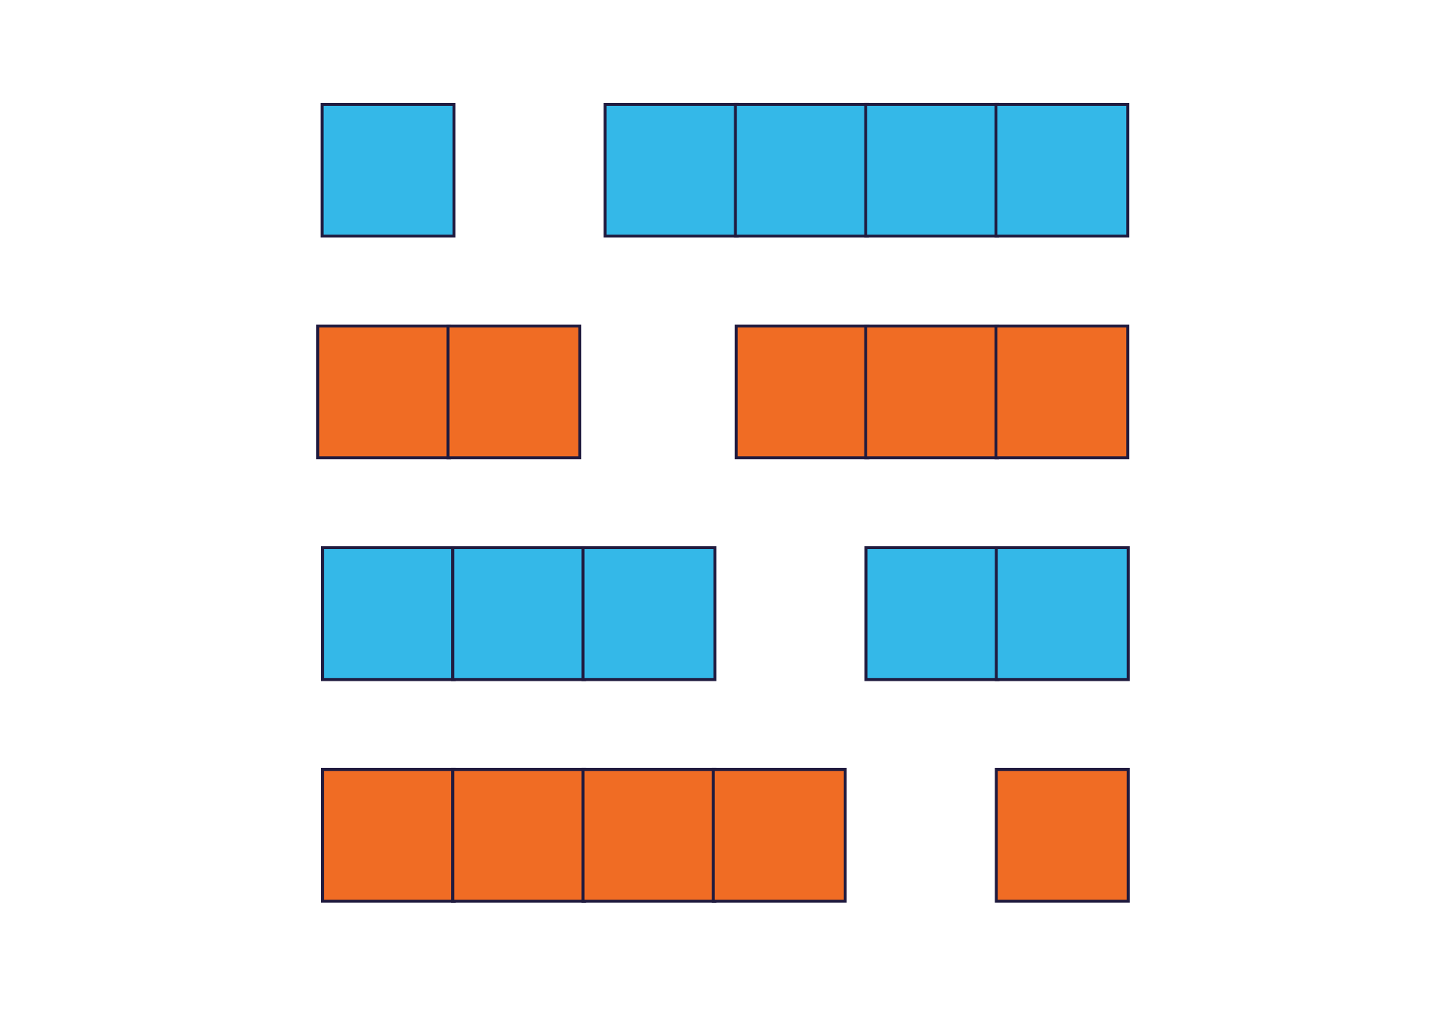
What do you notice? What do you wonder?

Slide 3
What do you notice? What do you wonder?
I + I
I + 2
2 + I
I + 3
3 + I

Slide 4
How are they the same? How are they different?
Notes:
What’s the same?
What’s different?

Slide 5
How are they the same? How are they different?
Notes:
What’s the same?
What’s different?

Slide 6
How are they the same? How are they different?
Notes:
What’s the same?
What’s different?

Slide 7
How are they the same? How are they different?
3 and 4
4 + 3

Slide 8
How are they the same? How are they different?
4 + 5
4 + 4 + I

Slide 9
How are they the same? How are they different?
3 + I + 3
I0 - 3

Slide 10
How many beads are on the left?

Slide 11
How many beads are on the left?

Slide 12
How many beads are on the left?

Slide 13
How many beads are on the left?

