Slide 1
Where is the mankarr (bilby)?
Notes:
This unit of learning/lessons are developed through the kind permission of Kanyirninpa Judurrpa and Martu and who are the Intellectual Property and copyright owners.

Slide 2
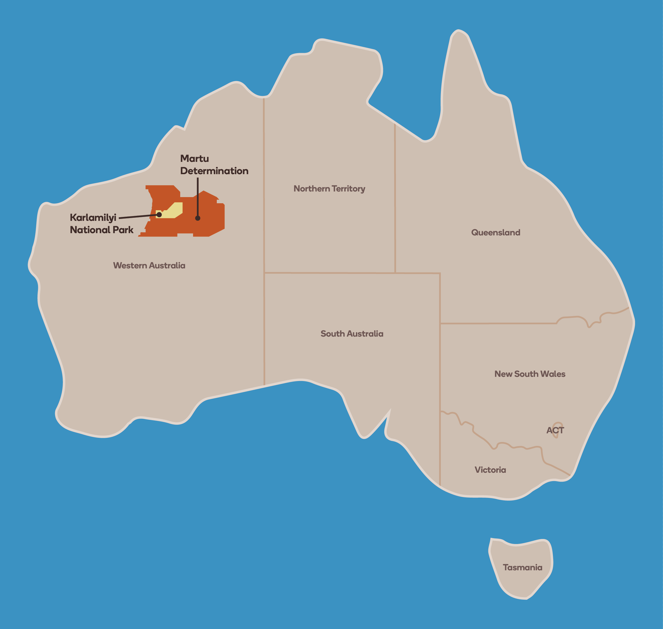
Meet the Martu
The Martu are the traditional owners of a large part of central Western Australia which extends from the Great Sandy Desert in the north to around Wiluna in the south.
Image source: https://www.kj.org.au/meet-the-martu

Slide 3
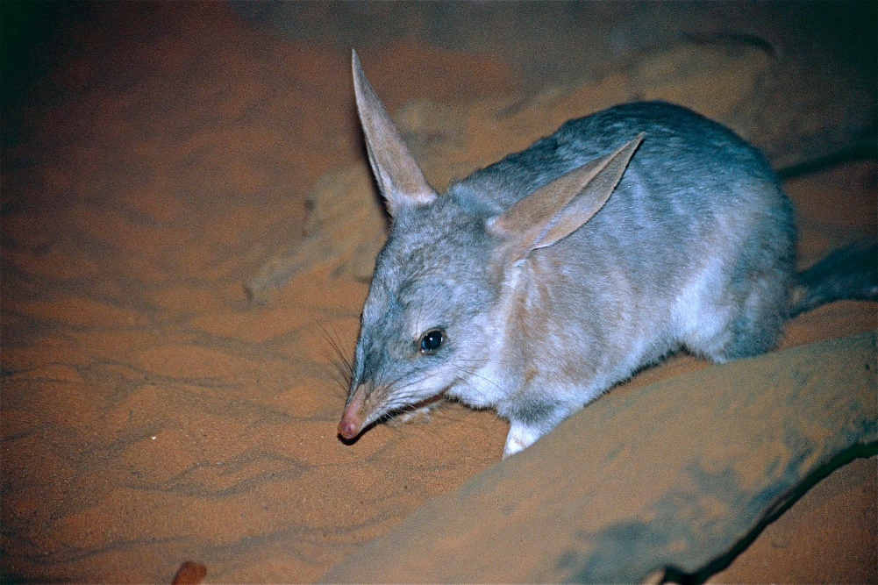
Meet the bilby (mankarr)
Martu rangers work with Kanyirninpa Jukurrpa, a Martu organisation that aims to build strong, sustainable communities.
Together they look after Country and protect endangered species such as the bilby.
In Martu language, mankarr means bilby.
Notes:
Image https://www.flickr.com/photos/berniedup/9996143106/in/photostream/

Slide 4
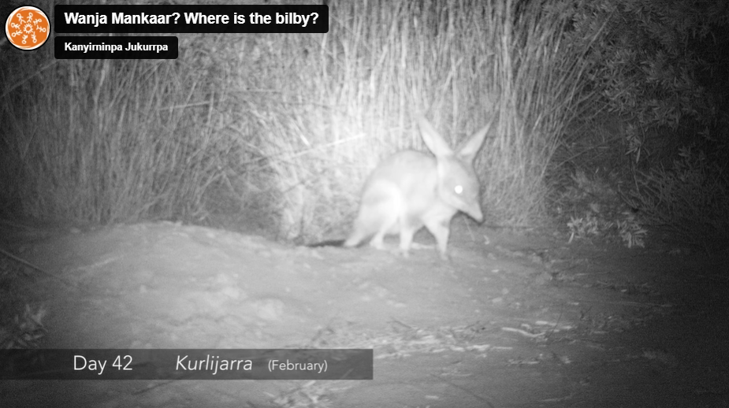
Wanyja Mankarr: Where is the bilby?
Martu rangers put a remote sensor camera outside of a bilby burrow to capture some of the life of a bilby.
What might the video show?
Wanyja Mankarr: Where is the bilby
Notes:
Use this video for students to watch the video to acquire and record data about animal observations

Slide 5
The purpose of data
Watch the video.
What observations can you make and record?
What is the purpose of collecting this data?
Wanyja Mankarr: Where is the bilby
Notes:
Use this video for students to watch the video to acquire and record data about animal observations
Why is the data being collected?
Why is it important to collect the data?
What might the data inform the rangers and us about?
How can the data be used?

Slide 6
Martu Language
mankarr | bilby
jina | tracks
ngurra/pirti | burrow
yuwinji | A grass that provides seeds that Martu and bilby eat
yirna | male
wanti | female
kalirtura | young or baby
paki | no/none
uwa | yes
wiya | not much/small amount
Notes:
These terms are relevant when viewing the video

Slide 7
Martu Language for seasons
kurlijara | January
kurlijara | February
kurlijara | March
wantajarra | April
wantajarra | May
wantajarra | June
tulpura | July
tulpura | August
Notes:
Review the seasons featured during in the video

Slide 8
Martu Language for animals found on Country
mankarr | bilby
pujikatu | wild cat
parnajarrpa | sand goanna
kamalpa | camel
turru | button quail
warnapari | dingo
Notes:
Review the animals featured in the video

Slide 9
Find out more about Martu Country
Traditional Knowledge Helps Monitor Threatened Bilbies on Martu Country
Notes:
Image https://www.flickr.com/photos/berniedup/9996143106/in/photostream/

