Slide 1


Odd and evens
dice images: Flaticon.com
Notes:
Teacher notes: rationale
‘Research studies show that when students discover mathematical ideas and invent mathematical procedures, they have a stronger conceptual understanding of connections between mathematical ideas’ (Grouws & Cebulla, 2000, p.17).
It is through discovery that students can utilise a wide range of mathematical concepts and skills, as well as reinforce mathematical vocabulary. When students investigate maths, they explore ideas and make discoveries for themselves – discoveries they are more likely to believe in (trust) and remember.
A classroom culture where students feel comfortable asking questions, taking risks, and engaging in mathematical reasoning, fosters deep engagement in learning. It is also important for students to develop their own ideas about conjectures. Students need to be encouraged to formulate and justify their own conjectures based on their observations and investigations. Develop a sense of mathematical curiosity and inspire students to continue exploring and questioning mathematical ideas both within and beyond the classroom.
This activity explores properties of odd and even numbers using discoveries to confirm calculations involving addition, subtraction and multiplication (and division). Students begin by testing conjectures while critically thinking about the various examples provided and are encouraged to make their own conjectures on the topic of odds and evens, exploring patterns and seeking counter examples. If counter examples exist (or students believe they have found a counter example) for the conjecture, take the opportunity to discuss these with the students. Help students to understand why these counter examples disprove the conjecture. Analysing counter examples fosters critical thinking and deepens their understanding of mathematical concepts involved.
Download the tables for this lesson that were designed to afford a systematic approach to their investigations; however, students may wish to take their own creative approach to test conjectures for odd and even numbers. Ensure, however, reasoning is sound. There are other resources on the planning tool that could also be utilised within this part of the lesson or used as inspiration for students to explore. Provide a box of manipulatives of various kinds for students to use to help with their calculations of addition, subtraction, multiplication. Some students may explore division.
Promote collaboration and discussion among students and encourage students to share their findings, discoveries and wonderings with one another.

Slide 2
Introduction
Mathematics is all around us.
We use maths in everyday life.
But is it always true?
Have you heard of the word conjecture?
Notes:
Teacher notes: introduction
The introductions asks students to questioning and make conjectures to investigate the properties of Odd and Even numbers. The examples given begins with non-maths contexts to allow students to understand the idea of questioning conjectures to think critically. The lesson then uses maths contexts covered in the Year 4 maths curriculum, specifically: Area and Perimeter (AC9M4M02) and Probability (AC9M4P01). Modify these examples to suit your class or combine with these topics to further explore the curriculum.
Suggestions for introducing this lesson are as follows:
Explain - Today you will be encouraged to think critically when conducting investigations into odd and even numbers. You will explore and test conjectures about these types of numbers.
Say - Mathematics is all around us. We use maths in everyday life from the moment we wake all throughout our day. Sometimes we learn mathematics from others and sometimes we make our own discoveries.
Sometimes we are given information about mathematics however we may question if it is true. Have you ever heard of the word conjecture?

Slide 3
Learning intention
We test conjectures involving odd and even numbers to identify and explain patterns that emerge when odd and even numbers are used in computation problems.

Slide 4
Success criteria
I can …
test conjectures involving odd and even numbers
identify and explain patterns that emerge when odd and even numbers are used in computation problems to explain the properties of odd and even numbers when adding, subtracting, multiplying whole numbers.

Slide 5
Why do I need to know this?
When we have knowledge of the properties of odd and even numbers, we can use this information to check our calculations when we solve mathematical problems.
This supports our ability and confidence for solving number problems and helps us to develop critical thinking skills. This knowledge also leads us to understand other areas of maths. For instance, it helps us to make connections with fractional parts – links remainders to fractional parts and that odd and even numbers are closely related to divisibility.
Knowing properties of odd and even numbers is also useful when performing mathematics involving the identification of multiples, factorisation and simplifying fractions.

Slide 6


Conjectures and counterexamples
A conjecture is an educated guess that is based on known information.
Counter examples question conjectures.
evidence
observations
Image source: Microsoft Office clipart
Notes:
Explain to students that a conjecture is an educated guess that is based on known information.
We use conjectures in daily life when we make unproven statements or have ideas that are believed to be true based on evidence and observations. However, we sometimes find examples that go against the conjecture: these are called counter examples.

Slide 7
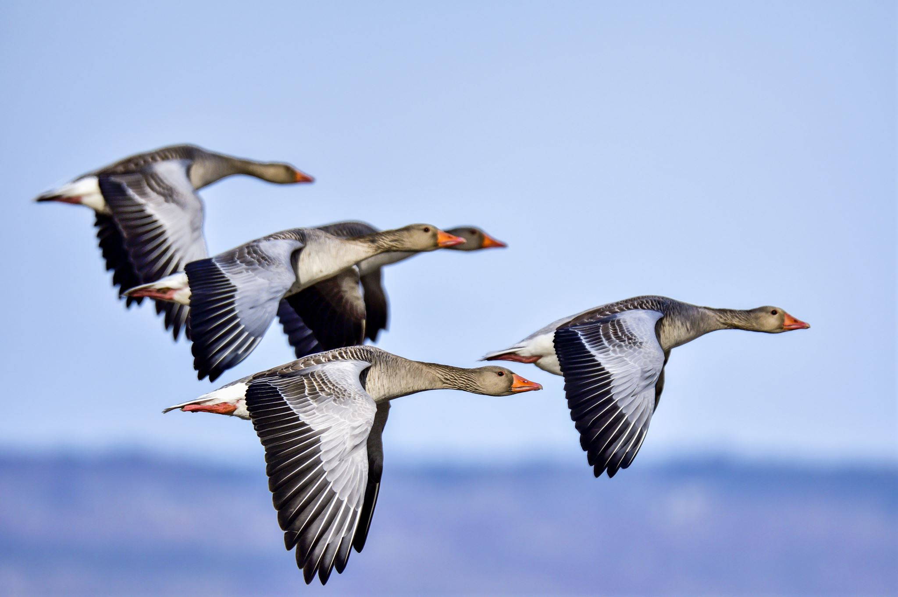
Let’s start!
Conjecture: ‘All birds can fly.’
Are there counter examples?
Image source: Microsoft Office clipart
Notes:
Start with Non-maths examples
Example 1
Conjecture: ‘All birds can fly.’
Can you think of a counter example? (An example of a bird that cannot fly).

Slide 8
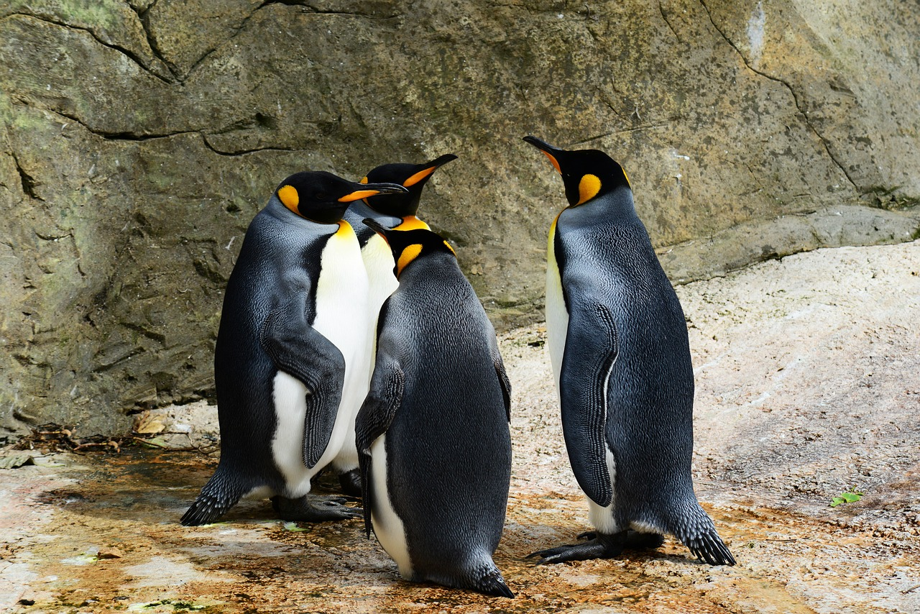
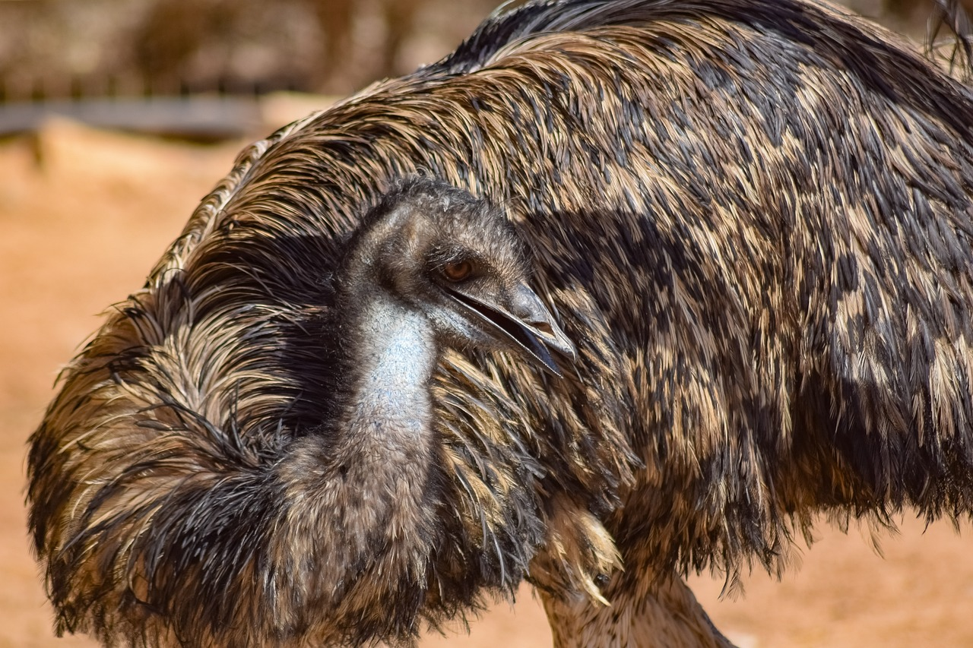
Counter examples
Here are two counter examples.
Image source: Pixabay
Notes:
Emus and penguins are birds but do not fly
https://pixabay.com/photos/king-penguins-birds-animals-384252/
https://pixabay.com/photos/emu-bird-animal-nature-ornithology-3714415/

Slide 9
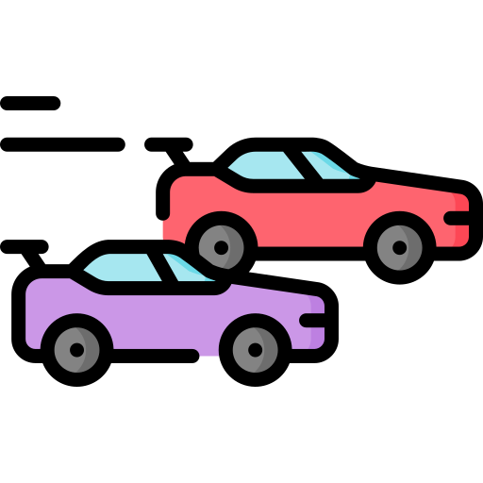
Another example
Conjecture: ‘All red cars are fast.’
Are there counter examples?
Image source: Flaticon
Notes:
Non-maths examples
Example 2
Conjecture: ‘All red cars are fast.’
Why might I say this? Is it because there a lot of racing cars that are red?
Is there a counter example?

Slide 10


Two counter examples
Conjecture: ‘All red cars are fast.’
Counter examples: This car is red but it is slow!
This is a white car and it is fast.
Image source: Pexels
Notes:
Can you see that if we ask questions, we can look at statements in different ways and think about whether the statement is really true or not.
Can you think of a counter example?
This car is red but it’s slow!!
And this white car is fast.

Slide 11
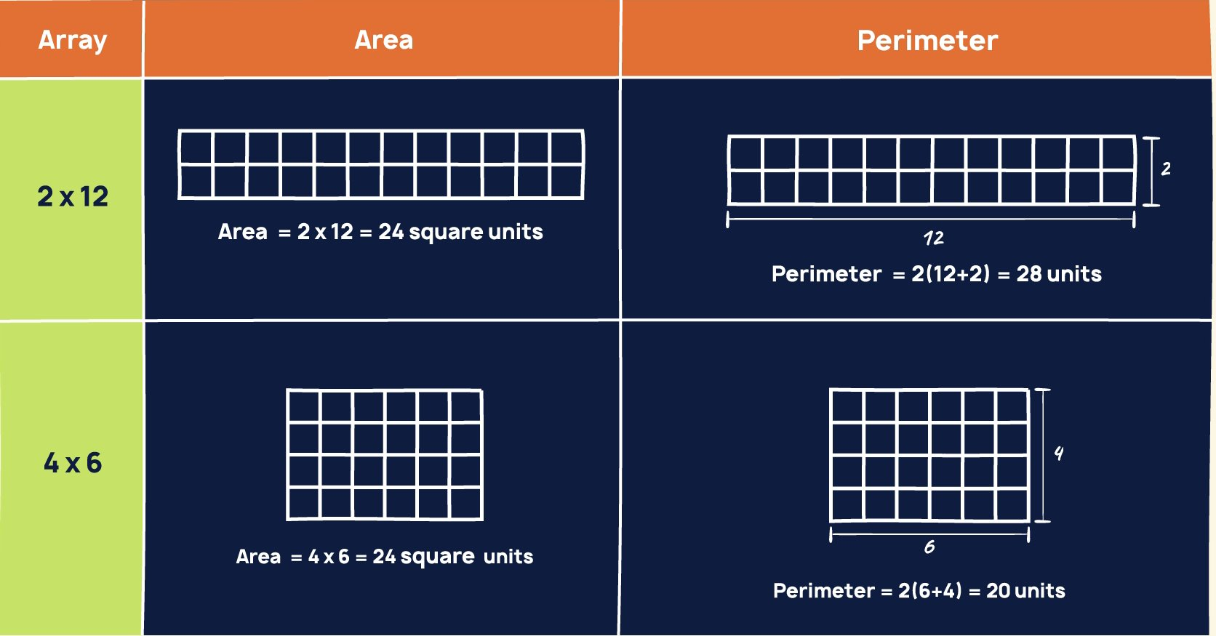
Example: area and perimeter
Conjecture: ‘The area of a shape is not equal to its perimeter. ’
Image source: Maths hub:
Notes:
Can you think of another counter example?

Slide 12
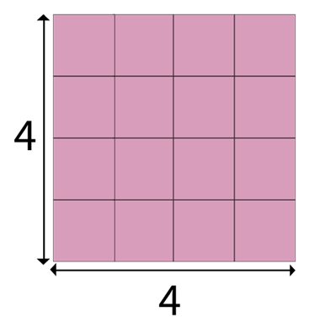
Counter example: area and perimeter
Conjecture: ‘The area of a shape is not equal to its perimeter. ’
Counter example:
Perimeter = 4 + 4 + 4 + 4 = 16 units.
Area = 4 x 4 = 16 square units.
Image source: Created in PowerPoint
Notes:
What about counter examples in maths.
Let’s think about what we know about measurement.
Conjecture: ‘The area of a shape is not equal to its perimeter. ’
Is there a counter example? (An example of a square that has the same perimeter as its area)
Yes: 4 x 4 square. Perimeter = 4 + 4 + 4 + 4 = 16 units. Area = 4 x 4 = 16 square units.

Slide 13
Example: probability
Conjecture: 'You are more likely to roll a 6 than any other number'
How can you gather evidence?
Image source: Flaticon
Notes:
Conjecture (probability): when rolling a 6-sided dice, you are more likely to roll a 6 than any other number.’
As a class, test this example and have students explain why this is based on incomplete information.

Slide 14

Millie’s conjectures: odd and even
Millie noticed an interesting pattern when exploring numbers.
Millie suggests that:
‘When you add two odd numbers together the answer will be an even number.’
‘When you multiply an odd and an even number together, the answer will always be even’
Image source: Microsoft clipart

Slide 15
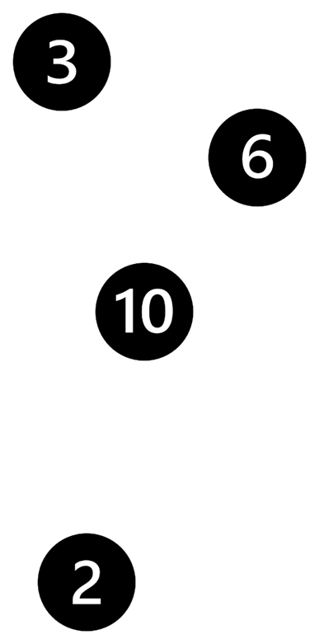
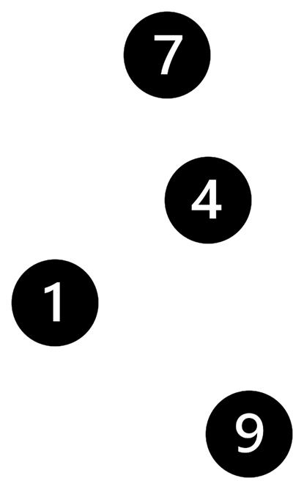


Millie’s conjectures
odd + odd = even
odd × even = even
Can you find a counter example?
Image source: Microsoft clipart

Slide 16
Work systematically
‘When you add two odd numbers together the answer will be an even number.’
Number | Operation + × | Number | Equals | Answer | Even or odd
3 | + | 7 | = | 10 | Even
Image source: Microsoft clipart

Slide 17
Test another conjecture
‘When you multiply an even and an odd number together, the answer will always be even’
Number | Operation + × | Number | Equals | Answer | Even or odd
3 | x | 4 | = | 12 | Even
Image source: Microsoft clipart

Slide 18

Summary and reflection
Odd/even | + × ̶ ÷ | Odd/even | equals | true | not true | Sometimes true
odd | + | odd | = even
even | + | even | = even
even | + | odd | = even
odd | + | even | = even
odd | × | odd | = even
even | × | even | = even
even | × | odd | = even
odd | × | even | = even
Notes:
Summary and reflection
This table may be used to facilitate a class discussion on learnings and discoveries. Each group or individual may have investigated different conjectures.
The slide is animated and with every mouse click the ticks will light up as you discuss the different conjectures.

