Slide 1
Recording additive patterns

Slide 2
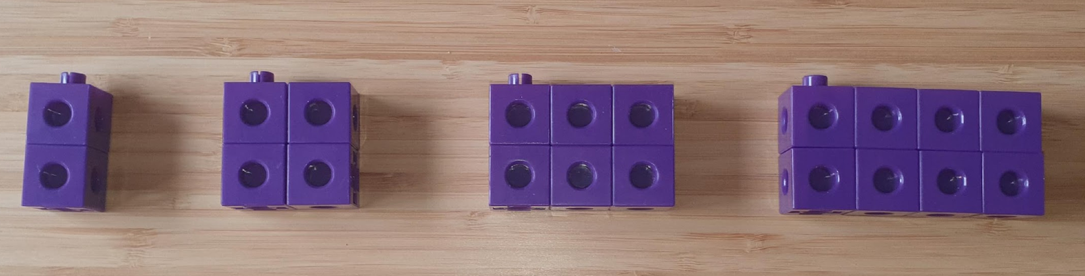




What do you notice? What do you wonder?
Notes:
Run a classroom talk using the ‘What do you notice? What do you wonder?’ strategy.
Students may notice things such as:
There are four blocks.
The blocks get bigger.
Each shape is made up of blocks.
Each set of blocks is labelled with a number
Each set of blocks is a rectangle shape. The second set is also a square.
Each shape is made up of two more than the one before it.
There are 20 blocks altogether.
I can make a pattern, 2, 4, 6, 8 using the sets of blocks.
Students may wonder:
I wonder if the next block would be 10?
I wonder how long the pattern goes on for?
How far can you go if you had 100 blocks?

Slide 3
Can you see a pattern?
How does the pattern change at each step?
What will the next step look like?

Slide 4



What comes next?
Position | 1 | 2 | 3 | 4 | 5 | 6
Number of blocks | 2 | 4 | 6 | 8
Drawing
Notes:
First, ask students to observe the pattern between the position and the number of blocks in the given positions 1 to 4.
Ask students to predict what number of blocks would be in positions 5 and 6.
Based on the data provided:
Position 1: 2 blocks
Position 2: 4 blocks
Position 3: 6 blocks
Position 4: 8 blocks
Position 5: 10 blocks
Position 6: 12 blocks

Slide 5
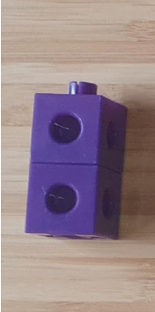
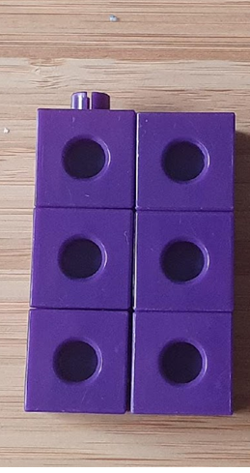
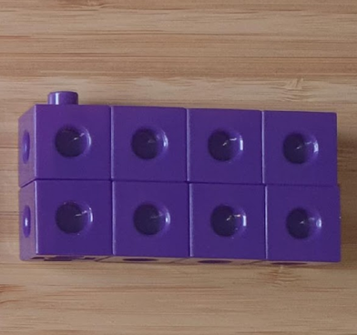


What is the pattern?
Position | 1 | 2 | 3 | 4 | 5 | 6
Number of blocks | 2 | 4 | 6 | 8
Drawing
Notes:
Ask what is the pattern?
They should observe that the number of blocks increases by 2 each time.
Based on the data provided:
Position 1: 2 blocks
Position 2: 4 blocks
Position 3: 6 blocks
Position 4: 8 blocks
Position 5: 10 blocks
Position 6: 12 blocks

Slide 6
Look at the table
Position | 1 | 2 | 3 | 4 | 5 | 6
Number of blocks | 2 | 4 | 6 | 8 | 10 | 12
Drawing
Notes:
Look at the table and ask students to share what they observe.
They should observe that the number of blocks increases by 2 each time.
Based on the data provided:
Position 1: 2 blocks
Position 2: 4 blocks
Position 3: 6 blocks
Position 4: 8 blocks
Position 5: 10 blocks
Position 6: 12 blocks

Slide 7
Use the pattern
How many blocks at position 10?
Draw the block shape.
Position | 1 | 2 | 3 | 4 | 5 | 6 | 7 | 8 | 9 | 10
Number of blocks | 2 | 4 | 6 | 8 | 10 | 12
Drawing
Notes:
From the previous slide, they should observe that the number of blocks increases by 2 each time.
Ask students to extend the pattern:
Position 7: 14 blocks
Position 8: 16 blocks
Position 9: 18 blocks
Position 10: 20 blocks
After filling in the table, they should be able to conclude that at position 10, there are 20 blocks.

Slide 8
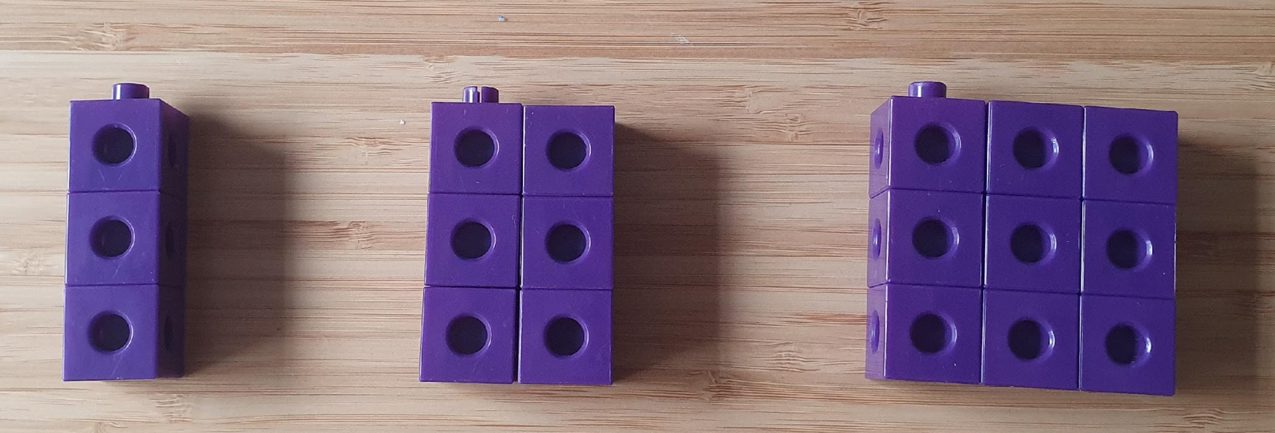
Now, what do you notice? Now, what do you wonder?
Notes:
Run a classroom talk using the ‘What do you notice? What do you wonder?’ strategy.
Students may notice things such as:
There are three blocks.
The blocks get bigger.
Each shape is made up of blocks.
Each shape is made up of three more than the one before it.
They may wonder
I wonder if the next block would be 12?

Slide 9
What comes next for 4, 5 and 6?
Position | 1 | 2 | 3 | 4 | 5 | 6
Number of blocks | 3 | 6 | 9
Drawing
Notes:
First, ask students to observe the pattern between the position and the number of blocks in the given positions 1 to 3.
Ask students to predict what number of blocks would be in positions 4, 5 and 6.
Based on the data provided:
Position 1: 3 blocks
Position 2: 6 blocks
Position 3: 9 blocks
Position 4: 12 blocks
Position 5: 15 blocks
Position 6: 18 blocks

Slide 10
Use this new pattern
How many blocks at position 10?
Draw the block shape.
Position | 1 | 2 | 3 | 4 | 5 | 6 | 7 | 8 | 9 | 10
Number of blocks | 3 | 6 | 9
Drawing
Notes:
From the previous slide, they should observe that the number of blocks increases by 3 each time.
Ask students to extend the pattern:
Position 7: 21 blocks
Position 8: 24 blocks
Position 9: 27 blocks
Position 10: 30 blocks
After filling in the table, they should be able to conclude that at position 10, there are 30 blocks.

