Slide 1
Flight of the osprey infographic
Using data to communicate effectively

Slide 2
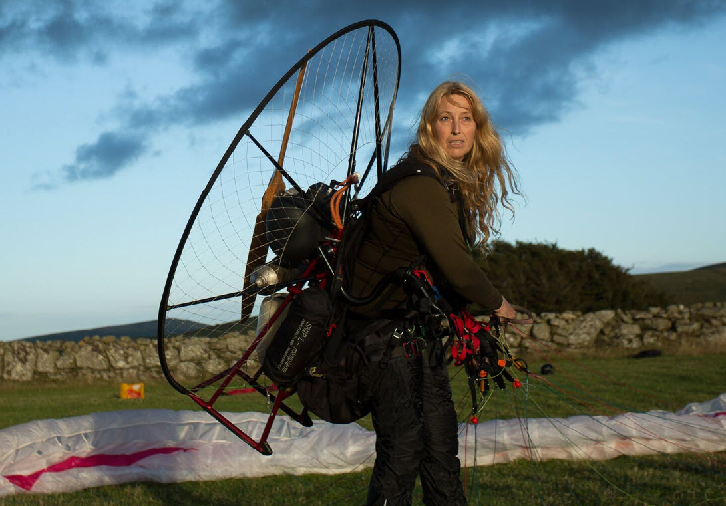
Our task
Looks like we might need some help to spread the word to protect the osprey. I am calling you to action!
Your final task is to design an infographic.
Remember you have learned many facts, and an infographic can tell the important migration story of the osprey.
Image © 2024 Conservation Without Borders. Permission granted.

Slide 3
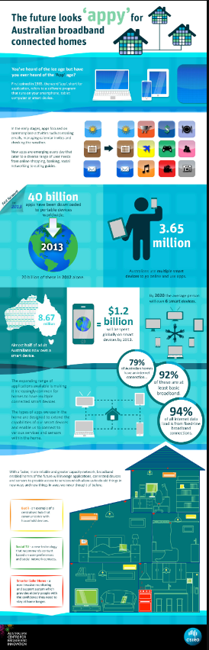
Infographics
An infographic provides information using graphs, diagrams and charts.
Let’s look at this one as an example to explore ways to convey a message.
Notes:
https://upload.wikimedia.org/wikipedia/commons/2/26/CSIRO_ScienceImage_1506_Infographic_explaining_what_a_broadband_app_is_and_how_they_may_be_used_in_our_homes.jpg
Use an example to look at ways data can be used to tell a story in the form of an infographic.

Slide 4

Infographics: introduction
An infographic often has a ‘catchy’ introductory paragraph setting the scene.
Notes:
https://upload.wikimedia.org/wikipedia/commons/2/26/CSIRO_ScienceImage_1506_Infographic_explaining_what_a_broadband_app_is_and_how_they_may_be_used_in_our_homes.jpg

Slide 5
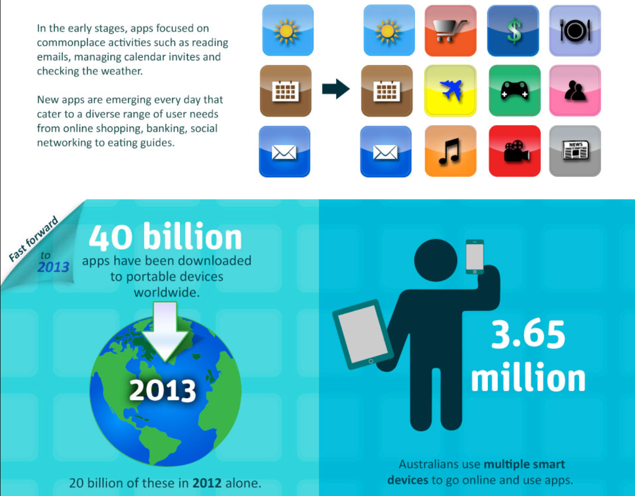
Using numbers
Numbers can be used to convey who or what number are impacted.
Notes:
https://upload.wikimedia.org/wikipedia/commons/2/26/CSIRO_ScienceImage_1506_Infographic_explaining_what_a_broadband_app_is_and_how_they_may_be_used_in_our_homes.jpg

Slide 6
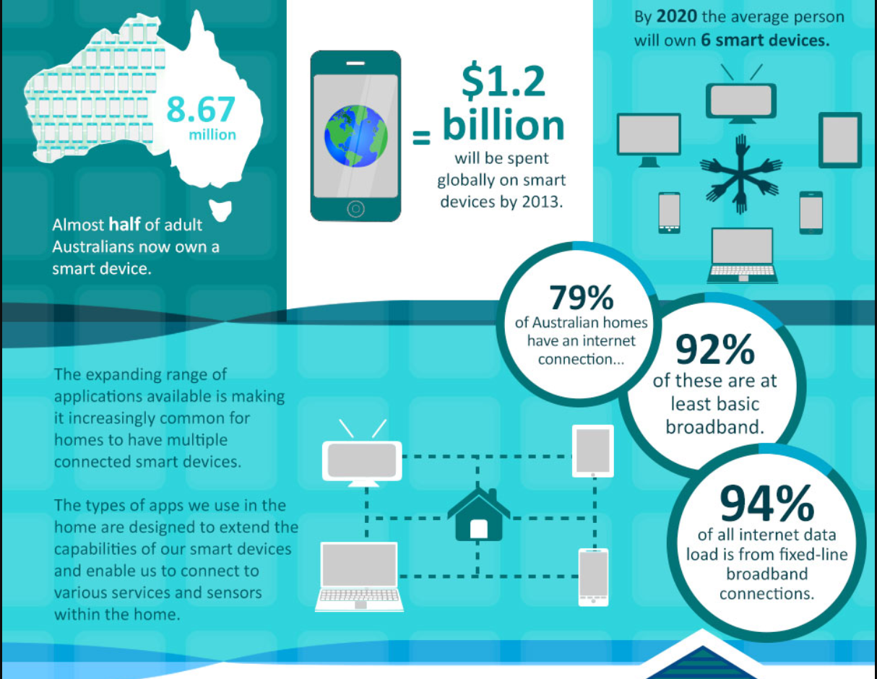
Percentages
Percentages provide clear and concise comparisons, making complex data more accessible and engaging for the audience.
Notes:
https://upload.wikimedia.org/wikipedia/commons/2/26/CSIRO_ScienceImage_1506_Infographic_explaining_what_a_broadband_app_is_and_how_they_may_be_used_in_our_homes.jpg

Slide 7
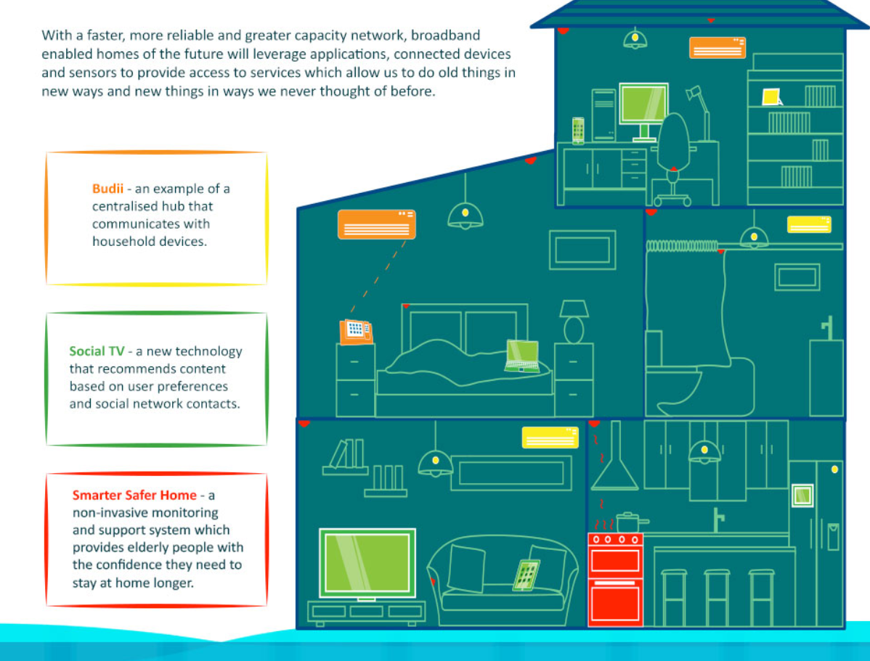
Infographics: summary
The last section of an infographic is typically a summary to reinforce key points and provide a quick overview of the most important information.
Notes:
https://upload.wikimedia.org/wikipedia/commons/2/26/CSIRO_ScienceImage_1506_Infographic_explaining_what_a_broadband_app_is_and_how_they_may_be_used_in_our_homes.jpg
The last section of an infographic is typically a summary to reinforce key points and provide a quick overview of the most important information. This helps viewers remember the main takeaways and understand the significance of the data presented.

Slide 8





How can we best educate people about the osprey?
Use the information you have learned from being a junior researcher to create your infographic.
Your infographic can include tables, charts and diagrams to show the data clearly to make the information easier for the reader to understand.
You can even include maps to show location or travel routes.
Notes:
Images sourced from clip art MS Office 365

Slide 9
The work must continue
Let’s find out what is happening at home in Australia.
Where are osprey found in Australia?
Do they migrate to other countries?
Are their numbers declining?
Search online for the ‘Friends of the Osprey’ in Australia.
What do you notice?​
What do you wonder? ​
You have done well as a junior researcher helping us explore the data about the osprey migration from the UK to Africa. Our research shows only 30% of the osprey that migrate from the UK to Africa survive but what is happening with the osprey in Australia?
Image © 2024 Conservation Without Borders. Permission granted.

Slide 10
Thank you
Thank you and good luck with your research in Australia!
​
Image © 2024 Conservation Without Borders. Permission granted.

