Slide 1
Map masterpiece

Slide 2
Where? What? When?
Source: Pixabay
Notes:
Image source https://pixabay.com/illustrations/percent-discount-issuing-statistics-1176967/
Ask students where and when they may have seen signs like this, and what they mean, to gain insight into their understanding of percentages. Expect answers such as, ‘in shops’, ‘at sale times’ and possibly ‘in banks’. Students may know that in shops, percentages often indicate a discount and may or may not recognise that a ‘50% discount’ is the same as a ‘half-price’ sale.

Slide 3
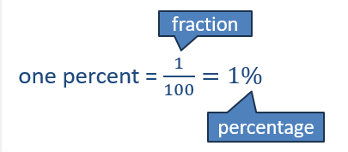
Percentages and fractions
This grid measures 10 squares across and 10 squares down.
Altogether, there are 100 small squares in the grid.
Each small square is one percent of the grid.
‘Percent’ means ‘for each hundred’.

Slide 4
Grid shading
How many squares are shaded?
What would this be as a fraction of the whole grid?
What percentage of the grid is shaded?
Can you think of a different way to express this as a fraction?
Remember each square is: one per cent = $\frac{1}{100}=1\%$

Slide 5
Grid shading – example 2
How many squares are shaded?
What % of the grid is shaded?
What fraction of the grid is shaded?
Each square is: one per cent = $\frac{1}{100}=1\%$

Slide 6
Grid shading – example 3
What fraction of the grid is shaded?
What percentage of the grid is shaded?
Does it matter that the squares are not all connected?
Remember each square is: one per cent = $\frac{1}{100}=1\%$

Slide 7
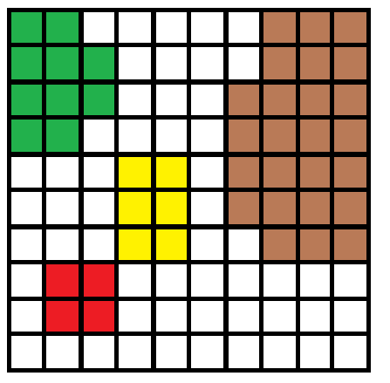
Map masterpiece exit ticket
Work out the fraction of the coloured areas.
List them as common fractions and percentages.

