Slide 1
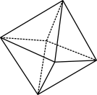
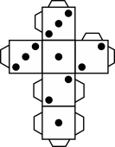
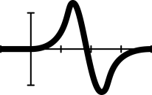
Fruit fractions: Gardeners of fractions

Slide 2
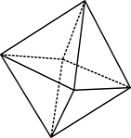
The warm-up
Always, sometimes, never
The numerator is always / sometimes / never
smaller than the denominator.
© 2020 Commonwealth of Australia, unless otherwise indicated. Creative Commons Attribution 4.0, unless otherwise indicated.

Slide 3
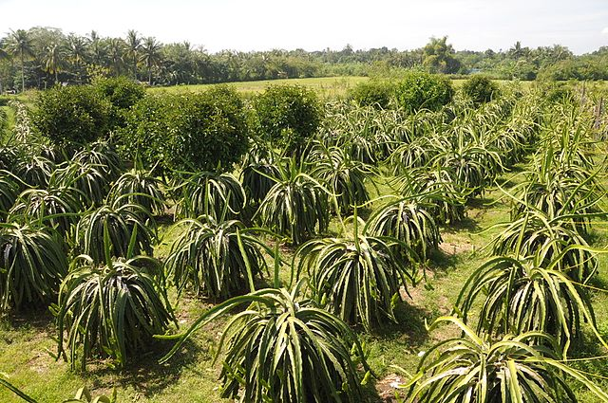
Planting Asian fruit trees
© 2020 Commonwealth of Australia, unless otherwise indicated. Creative Commons Attribution 4.0, unless otherwise indicated.
Notes:
Thanh long Vĩnh Huy (dragon fruit) - panoramio (2).jpg File:Thanh long Vĩnh Huy (dragon fruit) - panoramio (2).jpg - Wikimedia Commons

Slide 4
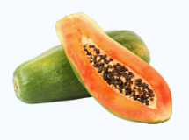
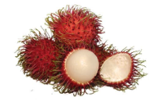
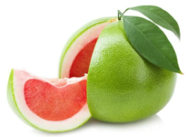
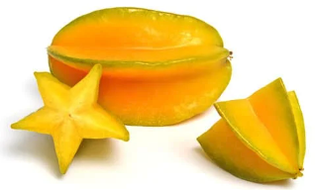
Fruits of Asia
rambutan
papaya
pomelo
star fruit
Tailorpham © via Canva.com; Thunyakon © via Canva.com Maraqu © via Canva.com Jfanchin © via Canva.com
© 2020 Commonwealth of Australia, unless otherwise indicated. Creative Commons Attribution 4.0, unless otherwise indicated.
Notes:
Images:
Papaya: Free to use, Tailorpham © via Canva.com
Rambutan: One-design use licence, Thunyakon © via Canva.com
Pomelo: One-design use licence, Maraqu © via Canva.com
Star fruit: One-design use licence, Jfanchin © via Canva.com

Slide 5
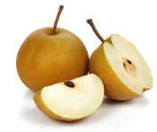
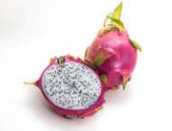
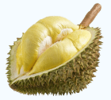
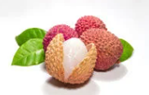
More fruits of Asia
nashi pear
dragon fruit
lychee
durian
Sirichai_asawalapsakul © via Canva.com, Puripat1981 © via Canva.com; aleksandra85foto from Pixabay; ; qqdigitalart © via Canva.com
;
© 2020 Commonwealth of Australia, unless otherwise indicated. Creative Commons Attribution 4.0, unless otherwise indicated.
Notes:
Nashi pear: One-design use licence, Sirichai_asawalapsakul © via Canva.com
Dragon fruit: One-design use licence, Puripat1981 © via Canva.com
Lychee: aleksandra85foto from Pixabay
Durian: One-design use licence, qqdigitalart © via Canva.com

Slide 6
Exit ticket
Dice fraction game
Play a dice fraction game and match fruit fractions to their garden beds.
State the fruit
Roll a 10-sided dice
Colour that number of tenths to represent that fraction
© 2020 Commonwealth of Australia, unless otherwise indicated. Creative Commons Attribution 4.0, unless otherwise indicated.
Notes:
Distribute a 10 square grid (2x5) or grid paper (or regular paper) and students create a 10 square grid.
Roll the dice
Students colour that number of tenths in their own grid to represent that fraction.

Slide 7
Teachers’ notes
Sullivan and Lilburn (2015) state that ‘good’ questions are those:
that require more than remembering a fact or reproducing a skill
where students can learn by answering the questions, and the teacher learns about each student from the attempt
where there may be several acceptable answers.
Sullivan, P. & Lilburn, P. (2015). Open-ended maths activities (2nd Ed.). Oxford University Press.
Dan Meyer (2010) gives the following advice:
Use multimedia.
Encourage student intuition.
Ask the shortest question you can.
Let students build the problem.
Be less helpful.
This time should be a safe maths space for students to share potential thoughts/answers without judgement.
Using this information as a general guide, pose this problem to your class and take on the role of facilitating/ posing questions, giving students wait and pause time, allowing students to share their thoughts with others, and differentiating as required for all students to be challenged within their zone of proximal development. Take time at the end of the activity to summarise students’ thoughts, their progress in thinking, and clarify any misconceptions.
Meyer, D. (2010, March). Math class needs a makeover [Video]. TEDx.
© 2020 Commonwealth of Australia, unless otherwise indicated. Creative Commons Attribution 4.0, unless otherwise indicated.

