Slide 1
Let’s go shopping
Percentage discounts

Slide 2
Learning intention and success criteria
We are learning to calculate percentage discounts.
We are working out the value of discounts commonly offered by stores.
By the end of this lesson, I can:
convert percentages to a fraction
calculate percentages involving money problems
determine the value of a discount
calculate the best offer and justify my choice.

Slide 3

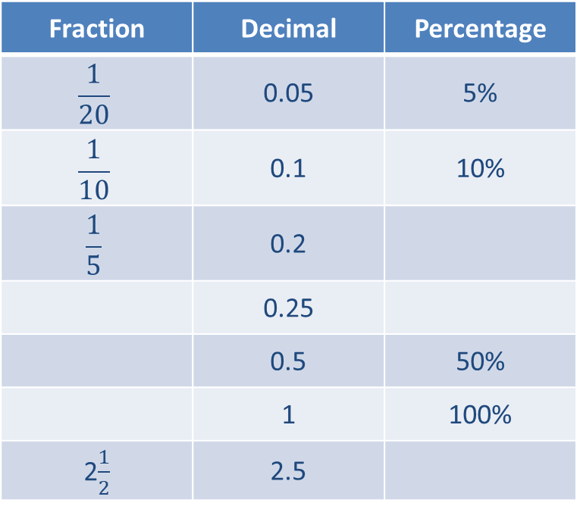
Fractions, decimals and percentages
What do you notice about the values?
Find the missing information.
Fraction | Decimal | Percentage
$$\frac{1}{20}$$ | 0.05 | 5%
$$\frac{1}{10}$$ | 0.1 | 10%
$$\frac{1}{5}$$ | 0.2
 | 0.25
 | 0.5 | 50%
 | 1 | 100%
2$\frac{1}{2}$ | 2.5

Slide 4
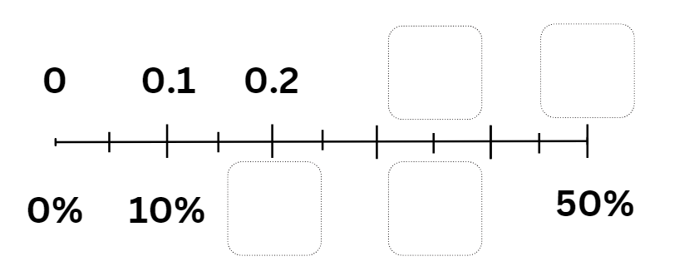
Using a number line
What do you notice about the values?
Find the missing information.
Notes:
Image created in Canva

Slide 5

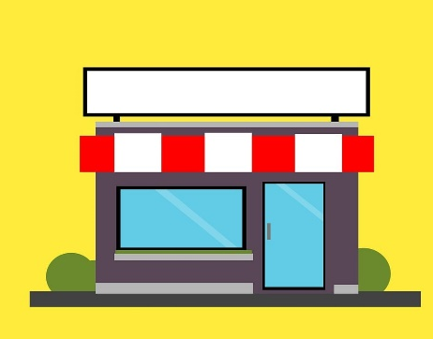

Shopping
In my local town there are three supermarkets:
  Sam’s Sales
  Henry’s Wholesalers
  Fiona’s Foods.
Each store has a different deal, but is it worth the ‘savings’?
Notes:
https://pixabay.com/illustrations/store-retail-shop-supermarket-4315394/

Slide 6
Shopping deals
Sam’s Sales
Check out the sales! Prices reduced.
Henry’s Wholesalers
Discounts on our party items! 10-30% off
Fiona’s Foods
Buy one get one free!
Notes:
https://pixabay.com/illustrations/store-retail-shop-supermarket-4315394/

Slide 7

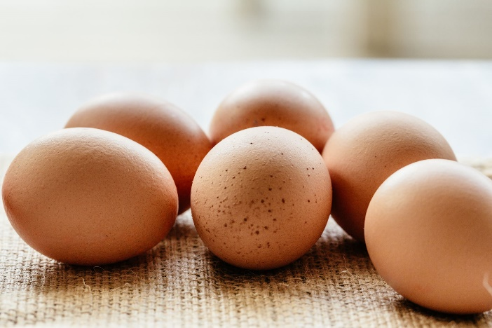
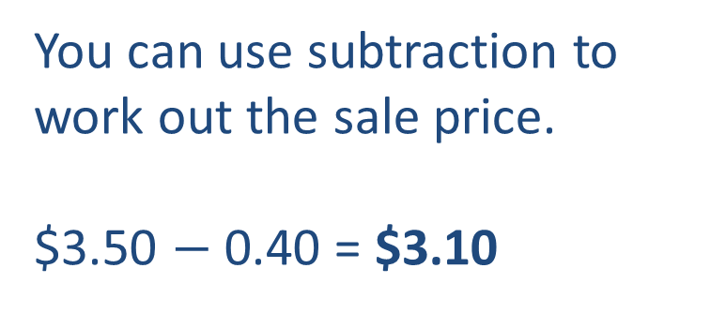
Calculations: ‘cents off’
Sam’s Sales
Check out the sales! Prices reduced.
usually $3.50
40 cents off
You can use subtraction to work out the sale price.
$3.50 $−$ 0.40 = $3.10
Egg image: Microsoft Clipart
Notes:
Use this slide to explicitly teach the calculation process

Slide 8

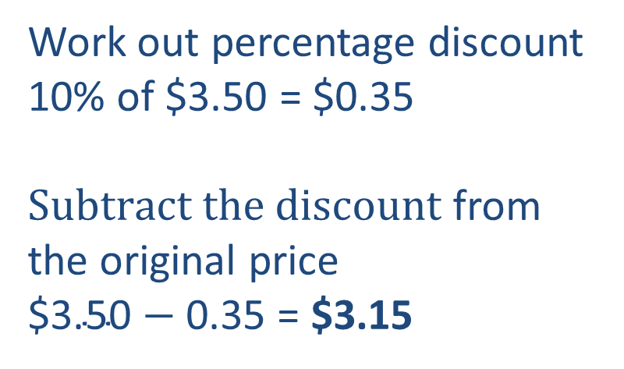
Calculations: ‘percentage off’
Henry’s Wholesalers
Discounts on our party items! 10-30% off
usually $3.50
Now 10% off
Work out percentage discount
10% of $3.50 = $0.35
$Subtract the discount$ from the original price
$\text{\$3.50}−$ 0.35 = $3.15
Notes:
Use this slide to explicitly teach the calculation process

Slide 9

Calculations: ‘Buy one get one free’
Fiona’s Foods
Buy one get one free!
usually $5.80
Buy one get one free.
Use halving strategy
We know half of 58 is 29
So, half of $5.80 = $2.90
The unit cost is $2.90
but we end up with two items
Notes:
Use this slide to explicitly teach the calculation process

Slide 10

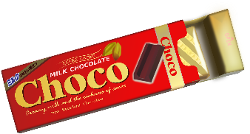
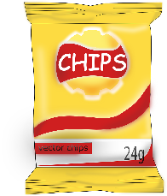

Compare deals
Notes:
https://pixabay.com/illustrations/store-retail-shop-supermarket-4315394/
https://pixabay.com/vectors/local-store-store-local-retail-5762254/
https://pixabay.com/vectors/store-shopping-shop-supermarket-5240992/
https://pixabay.com/vectors/chips-food-yummy-tasty-junk-food-160417/
https://pixabay.com/vectors/food-junk-food-pack-package-2029493/
https://pixabay.com/vectors/choco-chocolate-bar-sweets-146230/
https://pixabay.com/vectors/juice-fruit-apple-box-beverage-31728/

Slide 11


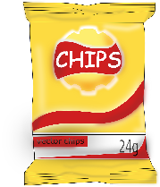



What is the cost at each store?
usually $0.94
40 cents off
usually $3.10
60 cents off
usually $0.55
5 cents off
usually $3.45
40 cents off
usually $0.50
now 10% off
usually $3.00
now 20% off
usually $0.65
now 20% off
usually $3.90
now 30% off
$0.80 Buy one get one free
$5.00 Buy one get one free
$5.10 Buy one get one free
$1.10 Buy one get one free

Slide 12

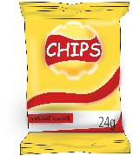

Challenge 1
If you bought all the items on our shopping list from the same store, which store is cheapest?
Shopping list:
1 chocolate bar
1 packet of chips
2 apple fruit drinks
4 packets of sausages
What is the best way to shop so that you spend the least amount of money?
Notes:
Consider differentiation strategies for this task. See lesson for advice.
https://pixabay.com/vectors/chips-food-yummy-tasty-junk-food-160417/
https://pixabay.com/vectors/food-junk-food-pack-package-2029493/
https://pixabay.com/vectors/choco-chocolate-bar-sweets-146230/
https://pixabay.com/vectors/juice-fruit-apple-box-beverage-31728/

Slide 13
Challenge 2
You have $30.00 to buy these items on the shopping list.
Can you do this without going over your budget?
Shopping list:
2 chocolate bars
2 packet of chips
4 apple fruit drinks
2 packets of sausages
Notes:
https://pixabay.com/vectors/chips-food-yummy-tasty-junk-food-160417/
https://pixabay.com/vectors/food-junk-food-pack-package-2029493/
https://pixabay.com/vectors/choco-chocolate-bar-sweets-146230/
https://pixabay.com/vectors/juice-fruit-apple-box-beverage-31728/

Slide 14
Challenge 3
You are planning a party for you and 9 friends. You need to purchase enough food and drink for everyone to enjoy.
Shopping list:
? chocolate bars
? packet of chips
? apple fruit drinks
? packets of sausages or vegan variety
Notes:
https://pixabay.com/vectors/chips-food-yummy-tasty-junk-food-160417/
https://pixabay.com/vectors/food-junk-food-pack-package-2029493/
https://pixabay.com/vectors/choco-chocolate-bar-sweets-146230/
https://pixabay.com/vectors/juice-fruit-apple-box-beverage-31728/

Slide 15
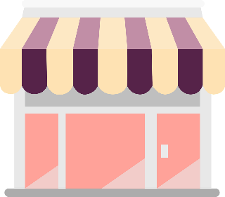

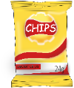




Challenge: calculations check
Cost | Discount | Cost price
$ 0.94 | $ 0.40 | $ 0.54
$ 3.10 | $ 0.60 | $ 2.50
$ 0.55 | $ 0.05 | $ 0.50
$ 3.45 | $ 0.40 | $ 3.05
Cost | Percentage | Discount | Cost price
$ 0.50 | $ 0.10 | $ 0.05 | $ 0.45
$ 3.00 | $ 0.20 | $ 0.60 | $ 2.40
$ 0.65 | $ 0.20 | $ 0.13 | $ 0.52
$ 3.90 | $ 0.30 | $ 1.17 | $ 2.73
Price for two | Unit cost
$ 0.80 | $ 0.40
$ 5.10 | $ 2.55
$ 1.10 | $ 0.55
$ 5.00 | $ 2.50
Notes:
https://pixabay.com/vectors/chips-food-yummy-tasty-junk-food-160417/
https://pixabay.com/vectors/food-junk-food-pack-package-2029493/
https://pixabay.com/vectors/choco-chocolate-bar-sweets-146230/
https://pixabay.com/vectors/juice-fruit-apple-box-beverage-31728/

