Slide 1
Reconciliation in Australia
Investigating data in a national report

Slide 2
What is reconciliation?
At its heart, reconciliation is about strengthening relationships between Aboriginal and Torres Strait Islander peoples and non-Indigenous peoples, for the benefit of all Australians.
Reconciliation is an ongoing journey that reminds us that while generations of Australians have fought hard for meaningful change, future gains are likely to take just as much, if not more, effort.
Reconciliation Australia website
Notes:
Quotes extracted from Reconciliation Australia website, (https://www.reconciliation.org.au/reconciliation/what-is-reconciliation/) on 05/02/2024
Introduce to students to the meaning behind reconciliation in Australia, to set the scene and the context for the teaching/learning process.
This slide is animated. The definitions offered will appear on mouse click.

Slide 3
Why is reconciliation important?
Why is reconciliation is considered important for Australia?
Why is reconciliation considered a ‘journey’?
Does reconciliation look and feel different to different people?
Where do you think Australia (or your community) is in the reconciliation journey?
Notes:
Encourage students to share their responses to do these questions.

Slide 4
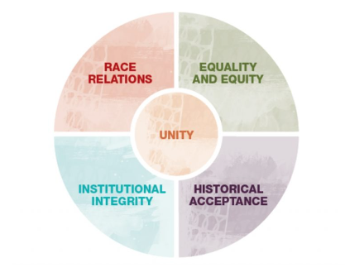
The Australian Reconciliation Barometer
The Australian Reconciliation Barometer (ARB) measures attitudes towards reconciliation using survey data.
The survey measures the progress of reconciliation between Aboriginal and Torres Strait Islander people and non-Indigenous Australians.
Data is collected against 5 dimensions of reconciliation
Image source: Reconciliation Australia
Notes:
●Explain to students that they are going to do a statistical investigation into Australia’s reconciliation journey and progress made, by comparing data from the 2014 and 2022 Reconciliation Barometer reports, published by Reconciliation Australia, an independent not-for profit organisation and lead body for reconciliation in Australia. Give an explanation on what the intention behind the report is? Ask students why you might be looking at these reports in a maths statistics class. Other questions might be:
Why would groups and governments want to collect opinions?
Why do groups and governments want to collect data on what people think about reconciliation and how it is progressing in Australia?
How could we effectively measure opinions on reconciliation – is it more than a word? Does it have facets?
How would defining dimensions be useful when conducting, analysing and comparing survey results?
What considerations would a statistician have to consider to be able to design an opinion survey so that conclusions can be made that are authentic, representative and true.

Slide 5
The 5 dimensions of reconciliation
Race relations: All Australians understand and value Aboriginal and Torres Strait Islander and non-Indigenous cultures, rights and experiences, which results in stronger relationships based on trust and respect that are free of racism.
Equality and equity: Aboriginal and Torres Strait Islander peoples participate equally in a range of life opportunities and the unique rights of Aboriginal and Torres Strait Islander peoples are recognised and upheld.
Unity: An Australian society that values and recognises Aboriginal and Torres Strait Islander cultures and heritage as a proud part of a shared identity.
Institutional integrity: The active support of reconciliation by the nation’s political, business and community structures.
Historical acceptance: All Australians understand and accept the wrongs of the past and their impact on Aboriginal and Torres Strait Islander peoples. Australia makes amends for past policies and practices and ensures these wrongs are never repeated.
Source: Reconciliation Australia
Notes:
●Explain to students that they are going to do a statistical investigation into Australia’s reconciliation journey and progress made, by comparing data from the 2014 and 2022 Reconciliation Barometer reports, published by Reconciliation Australia, an independent not-for profit organisation and lead body for reconciliation in Australia. Give an explanation on what the intention behind the report is? Ask students why you might be looking at these reports in a maths statistics class. Other questions might be:
Why would groups and governments want to collect opinions?
Why do groups and governments want to collect data on what people think about reconciliation and how it is progressing in Australia?
How could we effectively measure opinions on reconciliation – is it more than a word? Does it have facets?
How would defining dimensions be useful when conducting, analysing and comparing survey results?
What considerations would a statistician have to consider to be able to design an opinion survey so that conclusions can be made that are authentic, representative and true.

Slide 6
Your inquiry question
Has progress been made on reconciliation in Australia?
To help answer the question you will need to review the Australian Reconciliation Barometer (ARB) 2022 report.
Let's go through some ways data is visualised in the report so you are familiar with the types of charts and the types of data used to create them.
Notes:
Report https://www.reconciliation.org.au/wp-content/uploads/2022/11/2022-Australian-Reconciliation-Barometer-FULL-Report.pdf

Slide 7
Race relations
An element of 'Race relations' is trust.
A question asked about the level of trust that other Australians have for Aboriginal and Torres Strait Islander people.
First Nations respondents' data for 2014, 2016, 2018 was as follows:
 | Very low | Fairly low | Don't know | Fairly high | Very high | %
2014 | 23 | 36 | 7 | 21 | 13 | 100
2016 | 23 | 35 | 7 | 20 | 15 | 100
2018 | 21 | 33 | 6 | 25 | 15 | 100
Notes:
Report https://www.reconciliation.org.au/wp-content/uploads/2022/11/2022-Australian-Reconciliation-Barometer-FULL-Report.pdf
Data on this slide relates to Perceptions of shared trust 2014-18, page 52.
This question is about the level of trust that other Australians have for Aboriginal and Torres Strait Islander people.
Of the participants surveyed the First Nations respondents' data is shown.
This is the perception First Nations respondents have about the level of trust that other Australians have for Aboriginal and Torres Strait Islander people.
Is it very low, fairly low, don't know, fairly high or very high?
Ask students how they might visualise the data in a table. They may say a side by side column graph or even separate pie charts for each year.
On the next slide we show a type of visualisation called a 100% stacked chart.

Slide 8
Data visualised as a 100% stacked bar chart
Notes:
Report https://www.reconciliation.org.au/wp-content/uploads/2022/11/2022-Australian-Reconciliation-Barometer-FULL-Report.pdf
Data on this slide relates to Perceptions of shared trust 2014-18, page 52.
Flip between the data on previous slide (Slide 7) and this slide
Discuss what the visualisation shows.
What conclusions can be drawn?
If students need prompting suggest this conclusion. Do they agree?
First Nations people believe that other Australians had high trust for them (40%, up from 34%), from 2014 to 2018

Slide 9
Equality and equity
A component of equality and equity is the importance of First Nations people to have a Voice.
In 2020 the general community across Australia responded as follows:
 | Not important at all | Fairly unimportant | Fairly important | Very important | %
NT | 0 | 4 | 36 | 60 | 100
ACT | 1 | 4 | 30 | 66 | 100
TAS | 2 | 7 | 36 | 55 | 100
SA | 3 | 4 | 32 | 61 | 100
WA | 5 | 5 | 32 | 58 | 100
QLD | 2 | 2 | 36 | 59 | 100
VIC | 2 | 5 | 32 | 61 | 100
NSW | 2 | 3 | 33 | 62 | 100
Notes:
Report https://www.reconciliation.org.au/wp-content/uploads/2022/11/2022-Australian-Reconciliation-Barometer-FULL-Report.pdf
Data on slides 9 and 10 is from Most people in all States/Territories believe it is very important for First Nations peoples to have a Voice, page 99.
Explain that the Voice in Australia, in the context of reconciliation, refers to a proposed advisory body known as the Indigenous Voice to Parliament. This body would provide a formal mechanism for Aboriginal and Torres Strait Islander peoples to give advice and have a say in policies and laws that affect their communities. It aims to promote greater involvement and representation of Indigenous Australians in decision-making processes, contributing to reconciliation by acknowledging their perspectives and working towards addressing historical and ongoing injustices. Refer to page 13 of the report for more information.
Ask students how they might visualise the data in a table. They may say a side by side column graph or even separate pie charts for each year.
On the next slide we show a type of visualisation called a 100% stacked chart.

Slide 10
Data as a 100% stacked bar chart
Notes:
Report https://www.reconciliation.org.au/wp-content/uploads/2022/11/2022-Australian-Reconciliation-Barometer-FULL-Report.pdf
Data on slides 9 and 10 is from Most people in all States/Territories believe it is very important for First Nations peoples to have a Voice, page 99.
Flip between the data on previous slide (Slide 9) and this slide
Discuss what the visualisation shows.
What conclusions can be drawn?
If students need prompting suggest this conclusion. Do they agree?
In 2022, the general community in ACT (66%) mostly believe that it’s very important for Aboriginal and Torres Strait Islander peoples to have a say in matters that affect them. Conversely, only 55% of people in Tasmania think this is very important.

Slide 11
Unity
A component of unity is pride in our First Nations cultures.
Data over time enables us to see trends.
% Agree/strongly agree I feel proud of our First Nations cultures:
Year | First Nations respondents | General Community
2014 | 84 | 56
2016 | 91 | 60
2018 | 87 | 62
2020 | 87 | 64
2022 | 83 | 59
Notes:
Report https://www.reconciliation.org.au/wp-content/uploads/2022/11/2022-Australian-Reconciliation-Barometer-FULL-Report.pdf
Data on slides 11 and 12 are from ARB tracking: Pride in our First Nations cultures page 133
Ask students how they might visualise the data in a table. They may say a side by side column graph
On the next slide we show how a line graph can be used to shows trends
Make it explicit that the values include two groups of respondents (agree and strongly agree).
Discuss why and how this type of data is used.

Slide 12
View trends using a line graph
Notes:
Report https://www.reconciliation.org.au/wp-content/uploads/2022/11/2022-Australian-Reconciliation-Barometer-FULL-Report.pdf
Data on slides 11 and 12 are from ARB tracking: Pride in our First Nations cultures page 133
Flip between the data on previous slide (Slide 11) and this slide
Discuss what the visualisation shows.
What conclusions can be drawn?
If students need prompting suggest this conclusion. Do they agree?
Since 2014, pride in Aboriginal and Torres Strait Islander cultures has remained considerably higher within First Nations communities (long term average of 86%).
Notably, this sentiment had steadily increased within the general public (long term average of 60%).
However, there has been a sharp decrease in the general public since 2020.

Slide 13
Institutional integrity
A component of institutional integrity relates to the way the media portrays First Nations people.
In this data a three-point scale has been used.
Respondent | Usually negative | Usually positive | Balanced | %
General community | 33 | 18 | 49 | 100
First Nations respondents | 33 | 19 | 48 | 100
Notes:
Report https://www.reconciliation.org.au/wp-content/uploads/2022/11/2022-Australian-Reconciliation-Barometer-FULL-Report.pdf
Data on slides 13 and 14 are from We mostly believe the media usually portrays First Nations people in a balanced way page 151
Ask students how they might visualise the data in a table. They may say a side by side column graph
On the next slide we show how a line graph can be used to shows trends
Make it explicit that the values include two groups of respondents (agree and strongly agree).
Discuss why and how this type of data is used.

Slide 14
Column or 100% stacked bar chart?
Notes:
Report https://www.reconciliation.org.au/wp-content/uploads/2022/11/2022-Australian-Reconciliation-Barometer-FULL-Report.pdf
Data on slides 13 and 14 are from We mostly believe the media usually portrays First Nations people in a balanced way page 151
Flip between the data on previous slide (Slide 13) and this slide
Discuss what the two visualisations show.
Is one more preferable to the other? Ask students to justify their answers.
What conclusions can be drawn?
If students need prompting suggest this conclusion. Do they agree?
Both the general community (49%) and First Nations respondents (48%) widely believe the media usually portrays Aboriginal and Torres Strait Islander people in a balanced way.

Slide 15
Historical acceptance
A component of historical acceptance is that First Nations people are disadvantaged today because of past race-based policies and colonial legacy.
General community
 | Strongly disagree | Disagree | Neither agree nor disagree | Agree | Strongly agree
2022 | 8 | 14 | 23 | 29 | 25
2020 | 7 | 16 | 25 | 30 | 22
First Nations respondents
 | Strongly disagree | Disagree | Neither agree nor disagree | Agree | Strongly agree
2022 | 3 | 11 | 22 | 29 | 35
2020 | 4 | 10 | 19 | 29 | 38
Notes:
Report https://www.reconciliation.org.au/wp-content/uploads/2022/11/2022-Australian-Reconciliation-Barometer-FULL-Report.pdf
Data on slides 15 and 16 are from We agree that many First Nations people are disadvantaged today because of past race-based policies and colonial legacy page 175.
Ask students how they might visualise the data in a table. They may say a side-by-side column graph
On the next slide we show how a line graph can be used to shows trends
Make it explicit that the values include two groups of respondents (agree and strongly agree).
Discuss why and how this type of data is used.

Slide 16
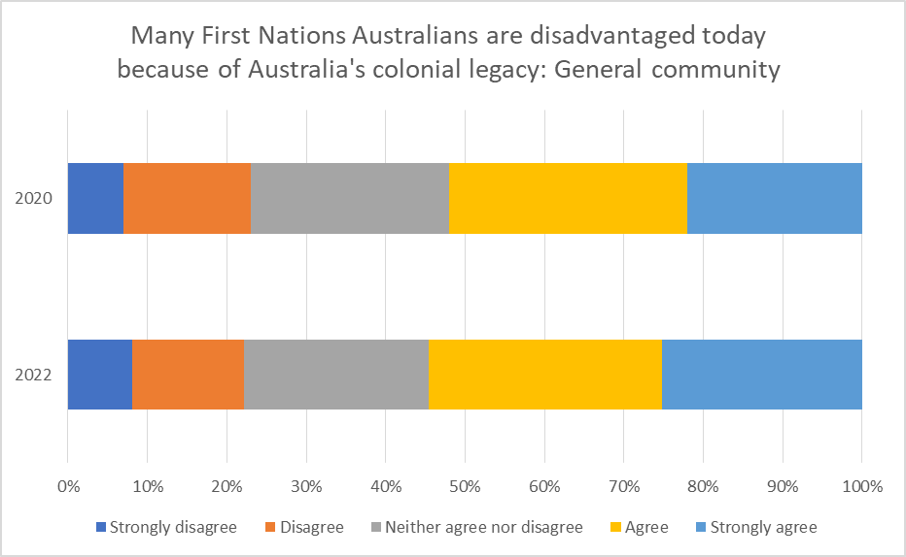
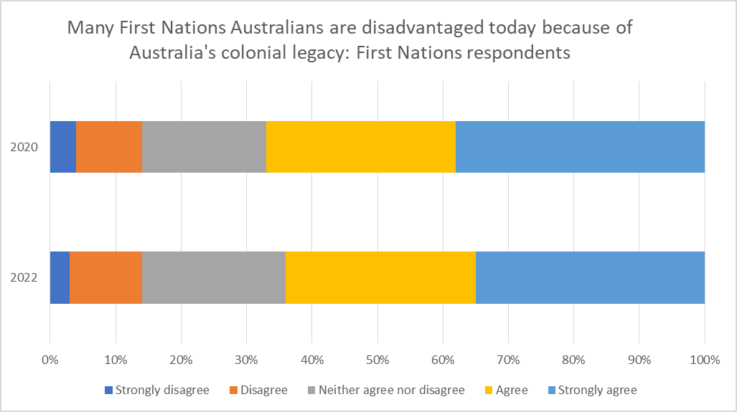
Compare First Nations respondents and General community views
Notes:
Report https://www.reconciliation.org.au/wp-content/uploads/2022/11/2022-Australian-Reconciliation-Barometer-FULL-Report.pdf
Data on slides 15 and 16 are from We agree that many First Nations people are disadvantaged today because of past race-based policies and colonial legacy page 175.
Flip between the data on previous slide (Slide 15) and this slide
Discuss what the visualisation shows.
What conclusions can be drawn?
Do students agree with the following statement?
The majority of both the general community and First Nations respondents continue to agree that many Aboriginal and Torres Strait Islander people are disadvantaged today because of past race-based policies and Australia’s colonial legacy.

Slide 17
Statistical investigation
Has progress been made on reconciliation in Australia?
Use the 2022 Australian Reconciliation Barometer (ARB) to select data to use as evidence towards answering the inquiry question.
If possible, use spreadsheeting software to create your own visualisations and charts.
Create an infographic that provides information and statistics to back up your claim.
Notes:
Report https://www.reconciliation.org.au/wp-content/uploads/2022/11/2022-Australian-Reconciliation-Barometer-FULL-Report.pdf
Review the inquiry question.
Provide guidance on completing the statistical investigation.

