Slide 1
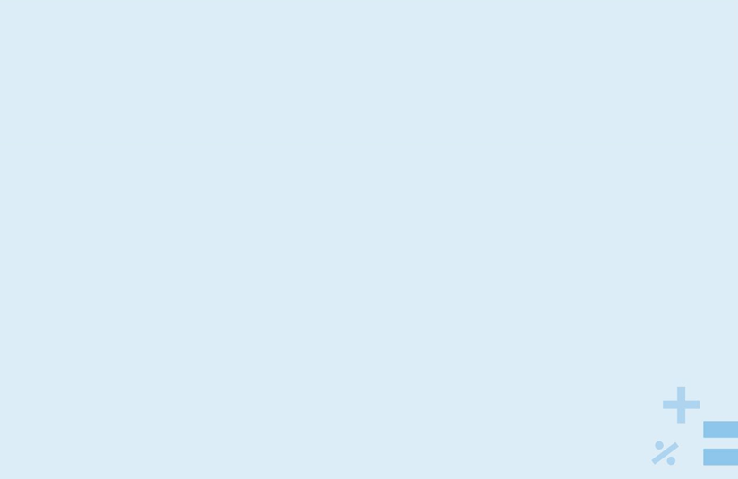
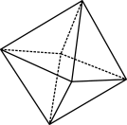
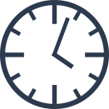
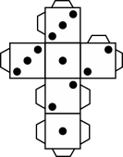
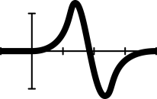
How wrong?

Slide 2
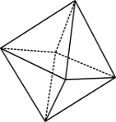
How long is the coastline of Australia?
Write your best guess in km on your post-it note.
Notes:
Image free from Canva.com

Slide 3
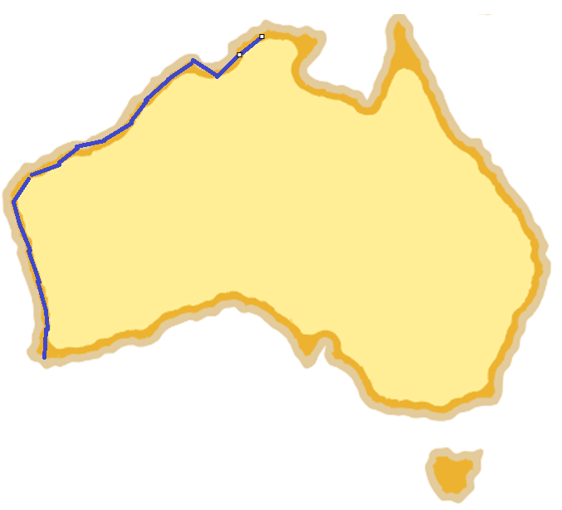
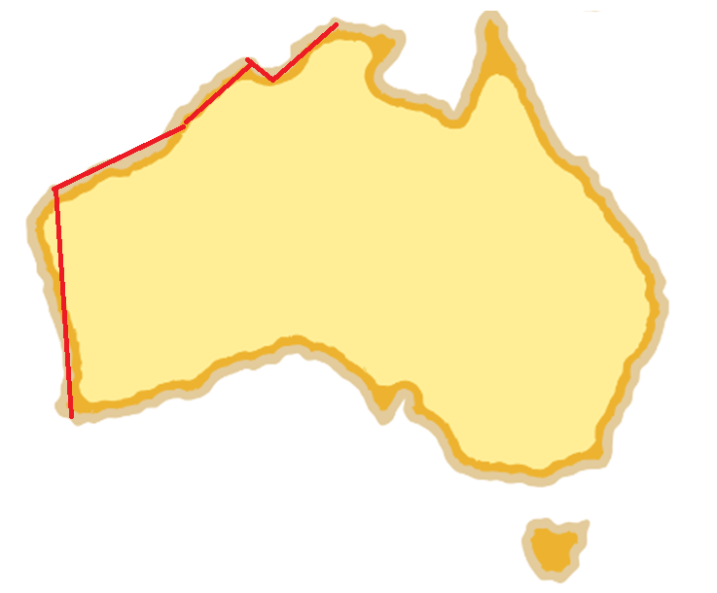
How do you measure it?

Slide 4
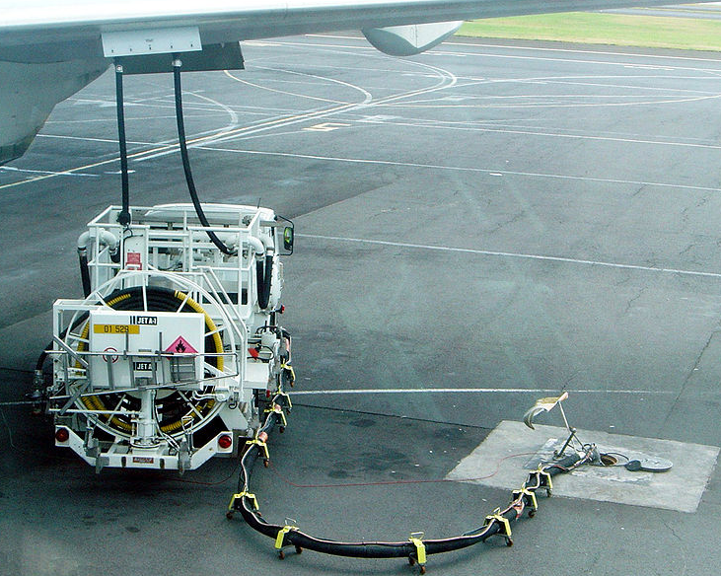
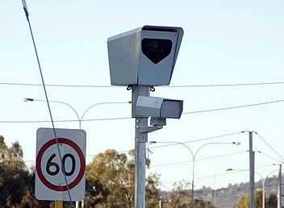
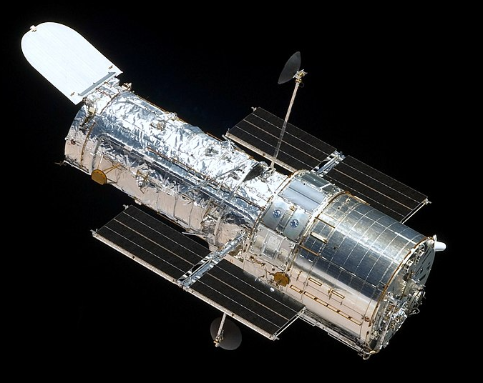
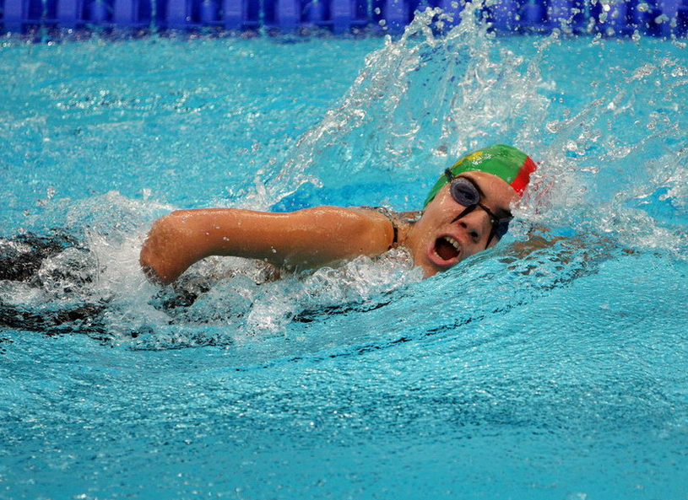
Why does it matter?
How might very accurate measurement matter in these examples?
Notes:
Aeroplane fuel
Fuel requirements are carefully calculated and measured in aeroplanes as aviation fuel adds significant mass and therefore cost to flights. Inaccuracies in measurements can mean planes carry too much fuel costing too much or, far worse, run out of fuel. In a famous case known as the Gimli Glider, an Air Canada flight had to make an emergency landing as they had run out of fuel, owing to issues converting between metric and imperial measurements.
Speed cameras
Speed cameras with significant fines and potential loss of licence, the measurement accuracy of speed cameras and car speedometers (which motorists rely on to judge their speed) is of interest to motorists, the police and governments. Different states apparently give a ‘margin for error’ which is the subject of some controversy.
Sports
In 2008, swimmer Michael Phelps finished the 100 m butterfly one one-hundredth of a second before competitor Milorad Cavic, which was confirmed by a camera recording 100 frames a second. These days, finish line cameras can take 10,000 photos per second. With medals, world records and million-dollar sponsorship deals at stake, these tiny differences really do matter to athletes.
Hubble Space Telescope
The Hubble Space Telescope was found to be slightly out of shape, (a 1.3mm lens shape error) meaning that the images it sent back were blurry. The ultimate cost to fix this tiny measurement error? USD $50 million.
Defence
Another story comes from the Gulf War in 1992, where a Scud missile attack on a US army base killed 28 people. The missile air-defence system recorded time in deciseconds (0.1 sec) but then stored it as an integer (to the nearest second). Over time the effects of these roundings compounded meaning that after 20 hours of operation the system could not intercept missiles and in this case was ‘looking in the wrong part of the sky’ when a missile struck the base.
Fuelling aeroplane: David Monniaux, CC BY-SA 3.0 via Wikimedia Commons
Speed camera: Nachoman-au, CC BY-SA 3.0 via Wikimedia Commons
Olympic para-swimmer: 王伟00715, CC BY 2.5 CN via Wikimedia Commons
Hubble telescope: Ruffnax (Crew of STS-125), Public domain, via Wikimedia Commons

Slide 5
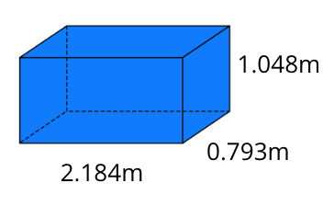
Calculating measurement error: Question 1: a to d
WORKED EXAMPLE
Question 1
Find the volume of the prism using the given measurements on the diagram.
Find the volume of the prism rounding the measurements to two decimal places.
Calculate the error in parts 1.a. and 1.b. (difference between the volume).
Express your answer to 1.c. as a percentage of the original volume found using the most accurate measurements.
$$V=lwh$$
$$V=2.184×0.793×1.048$$
$$V=1.81504378m^{3}$$
V= lwh
V= 2.18 x 0.79 x 1.05
V= 1.80831m³
Error = $1.81504378−1.80831{=0.0067m}^{3}$
% error = $\frac{0.0067}{1.81504378}×100=0.37\%$
Notes:
Image created in Canva.com
Note this slide is animated. The answers will appear after each mouse click.

Slide 6
Calculating measurement error Question 2 and 3
WORKED EXAMPLE
Repeat parts 1.a.–d. using the original measurements with the measurements rounded to one decimal place.
Repeat parts 1.a.–d. using the original measurements with the measurements rounded to the nearest whole number.
$V=2.2×0.8×1.0$ $=1.76m^{3}$
Error = $1.81504378−1.76{=0.0550m}^{3}$
% error $=\frac{0.0550}{1.81504378}×100=3.03\%$
$V=2×1×1$ $=2m^{3}$
Error = $1.81504378−2$ ${=−0.1850m}^{3}$
Differences are always expressed as a positive number ${=0.1850m}^{3}$.
% error $=\frac{0.1850}{1.81504378}×100=10.19\%$
Notes:
Image created in Canva.com
Note this slide is animated. The answers will appear after each mouse click.

Slide 7
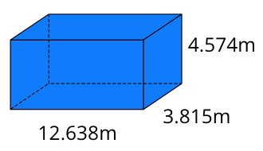
If we accurately calculate the volume of this rectangular prism …
… will we get the biggest error when we round to two decimal places, one decimal place or to the nearest whole number?
Notes:
Image created in Canva.com

Slide 8
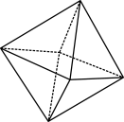
Solution
1.a. $V=lwh$
$V=12.638×3.815×4.574$
$V=220.530699m^{3}$
b. $V=12.64×3.82×4.57$
$V=220.661536m^{3}$
c. $220.661536−220.530699$ ${=0.1308m}^{3}$
d. $\frac{0.1308}{220.530699}×100=0.06\%$
2. $V=12.6×3.8×4.6$
$V=220.248m^{3}$
Error = $220.530699−220.248m^{3}$= $0.282699$
% error = $\frac{0.282699}{220.530699}×100=$ 0.13% (2 decimal places)
$V=13×4×5$
$$V=2{60m}^{3}$$
Error $=260−220.530699$ $=39.469301$
% error = $\frac{39.469301}{220.530699}×100= 7.9\%$
Rounding to the nearest whole number because the numbers change significantly, for example, $4.574≈5$. You would expect this as the more you round a number the less accurate it becomes.
Notes:
Image created in Canva.com

Slide 9
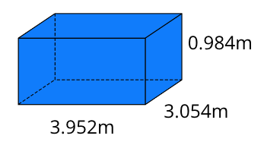
An unexpected result …
How do the errors change when we round the measurements for this rectangular prism?
Length | Width | Height | Volume | Error | Error as a %
3.952 | 3.054 | 0.984 | 11.8762975
3.95 | 3.05 | 0.98 | 11.80655 | 0.0697 | 0.59%
4.0 | 3.1 | 1.0 | 12.4 | 0.5237 | 4.41%
4 | 3 | 1 | 12 | 0.1237 | 1.04%
Notes:
Image created in Canva.com

Slide 10
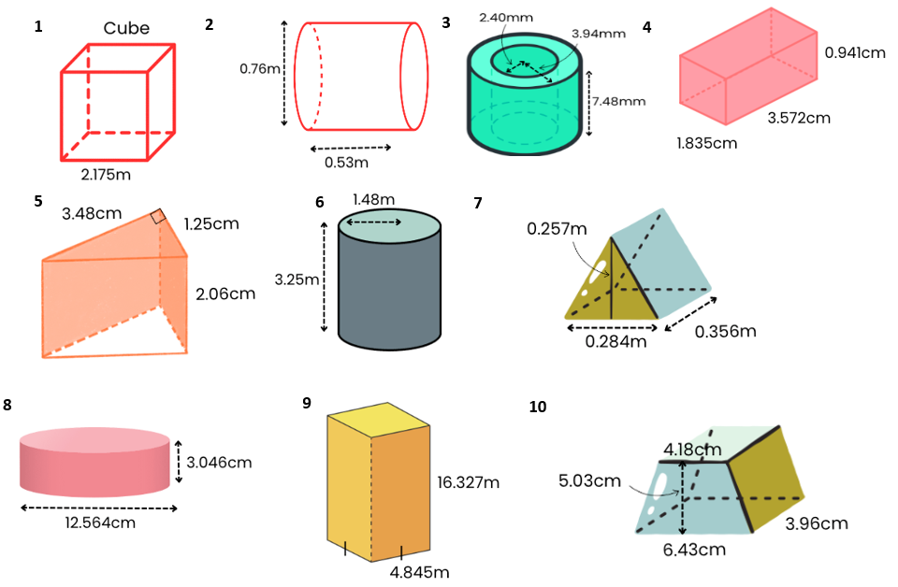
Independent work: choose…at least 3 solids
In pairs, find the volume, then round and calculate the % error caused by rounding.
Notes:
Images created in Canva.com
Differentiation (support)
Provide these formulas for students that require support and guidance.
Cube: $V=s^{3}$or $V=lwh$, where $l, w$ and $h$ are equal
Rectangular prism: $V=lwh$
Triangular prism: find the area of the triangle using $A=\frac{1}{2}bh$ then volume using $V=Ah$
Trapezoidal prism: find the area of the trapezium using $A=\frac{1}{2}(a+b)h$ then volume using $V=Ah$
Cylinder: $V=πr^{2}h$ (remind students to be careful of discriminating between radius and diameter)
Annular cylinder: find the area of the annulus using $A=πR^{2}−πr^{2}$ then volume using $V=Ah$

Slide 11
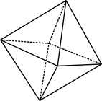
What did we learn today?

