Slide 1
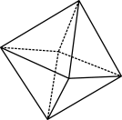
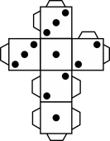
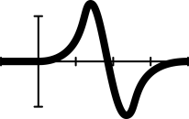
Shooting 3-pointers: Part 2 Coach needs your help!
Notes:
This lesson gives students the opportunity to participate in a real-life problem both in and out of the classroom. Students are guided through the process of formulating a problem that can be solved using a mathematical modelling approach. A professional sporting context allows students to engage in a common basketball scoring move: shooting 3-pointers. Students conduct a statistical investigation, collect and analyse data using percentages, choosing efficient calculations and strategies, that is communicated visually and verbally to the teacher and peers. Students reflect on feedback and consider revisions for the investigation.
Achievement: Students use mathematical modelling to solve practical problems involving ratios, percentages and rates in measurement and financial contexts.
Relevant content descriptions for Shooting 3-pointers: Part I
AC9M8N05
use mathematical modelling to solve practical problems involving rational numbers and percentages, including financial contexts; formulate problems, choosing efficient calculation strategies and using digital tools where appropriate; interpret and communicate solutions in terms of the situation, reviewing the appropriateness of the model.
AC9M8N04
use the 4 operations with integers and with rational numbers, choosing and using efficient strategies and digital tools where appropriate
Note that students also use what they have learnt in the Statistics strand and combine knowledge and skill in this investigation, this especially important for this lesson.
AC9M8ST04
plan and conduct statistical investigations involving samples of a population; use ethical and fair methods to make inferences about the population and report findings, acknowledging uncertainty
AC9M8SP02
analyse and report on the distribution of data from primary and secondary sources using random and non-random sampling techniques to select and study samples
AC9M8SP03
compare variations in distributions and proportions obtained from random samples of the same size drawn from a population and recognise the effect of sample size on this variation

Slide 2
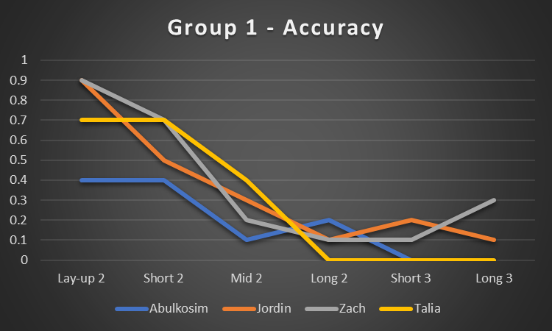
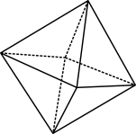
Data analysis
Step 1 – Produce a line graph of the accuracy percentage for the group members at each location. Describe what you observe in the graph.
All four members of our group were more accurate at the closer locations, but the accuracy decreased most between the first few shots. There was not much of a drop in accuracy once the group passed the Mid 2 location. The data from the longest shot might not be as reliable because there was more luck involved with those shots as we were shooting the ball with less technique.
Notes:
Students sit in their groups and bring up their spreadsheet.
Do not bring up the content of the slide before allowing for a class discussion. Student should call out possible ways to analyse their data before the actual first step is given. Guiding prompts are suggested below.
(Should your class require more scaffolding you can be more explicit and go through the steps together, explaining as you go.)
Use the mouse to bring up the first instruction, then the graph and then the example descriptive text. Remember that everyone’s graph will be different and may not show the same trends. That’s ok.
The data, graphs and calculations that students make/do will be used in their presentation. It is worth reminding students of this to incentivise them to complete each stage of the investigation. A teacher demonstration may be required for this step. Students should be shown how to customise their graph so they can produce something unique.
Discussion prompts
What would be an effective way to visualise and compare our results?
Does your data match the expectations/predictions you had before collecting it?
Did any group collect data that shows a different trend to the example shown? Why might that be?
Is there any difference between the line graphs of students who play basketball regularly and those who don’t?
Does anyone spend a lot of time practicing 3-point shots? What do you notice in your data compared to others?
How can we ensure our data is representative and not just based on one person's shooting ability?
Differentiation (support): Reiterate the revision facts with the what is being demonstrated on the graph. For example, expression percentage from 0 to 1 on the y axis, which is the same as saying 0 to 100 % on the scale, that is they are two different ways of expressing a number as a fraction out of 100 (70% / 100% = 0.7). From here reiterate that by expressing numbers of data out of 100 you allow comparisons between numbers and data sets. It could be that one person in the group only actually did 8 shots instead of 10 shots at a particular location. By expressing this as a percentage, 6 shots from a total of 8 multiplied by 100, you can then compare the success rate against someone else who took ten shots at the same location and not 8.

Slide 3
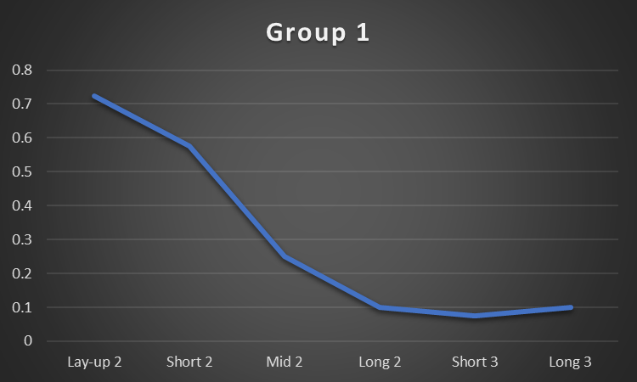
Average percentage of group
Step 2 – Calculate the average accuracy percentage of your group at each location and produce the associated line graph. Describe your observations of this data and graph.
Notes:
Note that this slide is animated.
Ask: Can we simplify our data in a way that it's still informative but less overwhelming?
Click the mouse to bring up Step 2 and have students perform this step in their spreadsheet.

Slide 4
Use spreadsheet to record data
Step 3 – Gather the data of all groups and add it to your spreadsheet.
Step 4 – Add an additional row for the ‘Class average’ and calculate the average accuracy of all groups for each location.
Notes:
Note that this slide is animated
Ask again, how can we ensure our data is representative and not just based on one person’s or any one group’s shooting ability?
Have students complete steps 3 and 4. Ask questions and guide students as you go.
Ask: Explain why these averages are the most reliable values to base our findings on.

Slide 5
Data calculations
Step 4 – Calculate the average points per shot at each location. This value tells us how many points on average the team can expect for a shot taken at each of the locations.
Average points per shot = % accuracy $×$ number of points scored when shot is made
Example
Class average accuracy for lay-up 2 = 0.835
Number of points scored when a lay-up is made = 2
Average points per shot = 0.835 $×$ 2 = 1.67 pt/shot
This means that on average the team will score 1.67 points for each lay-up attempted by a player. If the team attempts 12 lay-ups during a game, they can expect to score 20 points from those 12 shots (12 $×$ 1.67 = 20.04).
Notes:
Prompt: How can we use our data further so that it adds more value to the conjecture we are trying to investigate.
Use Step 4 to guide students through the next step. Allow time for calculations and ask questions to ensure students understand the value of the step they are taking.
Prompt – Is it possible to score 1.67 points per shot? It is important to clarify that 1.67 points is not a possible value in context, but that it still represents a valid statistic. It refers to the long-run expected value.
Differentiations (extension) – students can calculate the pt/shot for both the class accuracy data and their own group data.

Slide 6
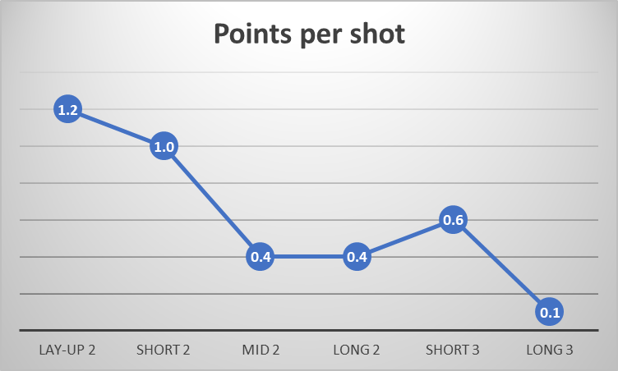
Whole-class data
Step 5 – Produce a line graph to display the average points per shot at each of the six location types for the whole-class data.
List the locations that provide the highest average points per shot in descending order. Does this list align with or differ from the order of accuracy for locations?
Notes:
Students will notice a spike in the graph where the number of points per shot transitions from 2 to 3, as the accuracy barely decreases between these locations while the value of the shot increases. It becomes clear that if a team is unable to attempt a close shot because that area is heavily guarded, the next best option is a 3-pointer; that is, make the connection from what the data is showing us about the actual real-world problem, and that by using data collection and analysis, we have been able to make predictions and give advice that can be potentially be beneficial, and in this case, increase scoring opportunities.
Discussion prompts
Does this graph provide an answer to our initial investigation question?
What recommendation would you to provide to basketball coaches regarding the types of shots their players should practice?
How might this graph change if the coach followed your advice?
Why might it be valuable for a sports team to hire mathematicians?

Slide 7
Review of the model
SWOT
Strengths
Weaknesses
Opportunities
Threats
Notes:
This is your reflection time with the students. And is the point where you suggest iterations to the investigations that would refine it. Allow a good 10 minutes for this discussion.
Encourage students to note the discussion down, as they may find this useful for the end assessment task.
A SWOT analysis can be completed in several ways such as class brainstorm or think/pair/share.
Suggested responses
Strengths – When the class data was combined it created a sizeable sample. Groups selected a range of locations so the model is not limited to a single 3-point location.
Weaknesses – The class is not a reliable sample to draw conclusions about a professional sports team. To provide coaches with appropriate advice this model would need to be recreated for a sample that better represents their team.
Opportunities – Additional data could be collected that focuses on which type of 3-point shots are most efficient. Groups would shoot from a range of 3-point locations.
Threats – Luck/variance could be playing a significant role in this model.

Slide 8
Coach needs your help!
It’s play-off (finals) time and coach is looking for an edge. The opposition team have won the past five encounters between these teams.
As a budding young mathematician and fan, you decide to send the coach an email with a suggested winning strategy. You’ve noticed that the team doesn’t shoot many three-pointers.
Your task
Write a convincing email to the coach to persuade him that shooting three-pointers is a good idea. Coach is a rational thinker and will only be open to a suggestion that is supported by mathematical evidence. Your email must include data, calculations and graphs, and relevant analysis of them. Submission: send the email to your teacher before the due date.
Notes:
Assessment
Revisit the problem as a class.
Ensure students understand what they need to do and set a due date.
Make refinements for classes and individual students where needed.
Revisit the learning intention and success criteria. Each student had set their own goals.

