Slide 1


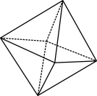

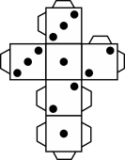
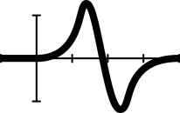


Expressions, formulas and substitution
Notes:
Summary:
In the Formulating algebraic expressions, students were introduced to variables and forming algebraic expressions. In this lesson, students continue to develop these skills and will explore substituting values into familiar and unfamiliar formulas to determine an unknown.
To ensure students’ experiences with formal algebra are founded on a strong sense of the importance of algebraic concepts in the real-world, students explore substitution in a range of authentic contexts.
This lesson can standalone if desired. Though practise and fluency could with forming algebraic expressions could be developed prior to this lesson.
AC9M7A01: Recognise and use variables to represent everyday formulas algebraically and substitute values into formulas to determine an unknown
AC9M7A02: Formulate algebraic expressions using constants, variables, operations and brackets
Prior knowledge
Prior to this lesson, it is assumed that students have knowledge of:
the concept of variables
constructing algebraic expressions from word problems
conventions associated with the order of operations for integers
knowledge of algebraic conventions (covered in prior lesson)
how “=” indicates an equivalence statement
what is meant by an expression (from prior lesson)
how to measure length accurately using rulers (to the mm)
how to use formula to find the area of a triangle and rectangle
decimal notation and rounding decimals
using calculators to carry simple calculations
how to measure mass in grams
Materials needed
You will need: stacking cups, two different coloured counters (per group), rulers, calculators, warm-up worksheet, workstation worksheet, kitchen scale (one is sufficient).
As this lesson uses two different coloured counters to denote +1 and –1, it is important that prior to this lesson students have practised completing integer calculations using these concrete tools.
Teaching strategies
In this lesson, the teacher explicitly introduces new algebraic concepts to students using the concrete-representational-abstract teaching sequence. Typically, a child will start by experiencing a new concept in a concrete, action-based form. They move to making a representation of the idea, in pictures or more sophisticated diagrams, and then to using abstract, symbolic notation. When using manipulatives, it is important that the connections to the mathematics being learnt are made clear, as well as providing clear instructions on how to use the manipulative. Therefore, in this lesson the teacher will set the scene in terms of the learning intention for the lesson, model the use of the concrete materials, and allow students to familiarise themselves with the materials through collaborative learning experiences. The activities where students use concrete materials will also support them to connect the concrete modelling to the abstract algebraic expressions that they will construct.

Slide 2

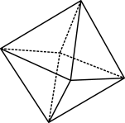

Learning intentions
We are learning to:
match word problems to their algebraic expression
understand the difference between an expression and a formula
understand algebra terminology such as constant, coefficient, variable and operator
substitute values into equations in a range of scenarios.
© 2023 Commonwealth of Australia, unless otherwise indicated. Creative Commons Attribution 4.0, unless otherwise indicated.
Notes:
Students use algebraic expressions to represent situations, describe the relationships between variables from authentic data and substitute values into formulas to determine unknown values.
By the end of the lesson, students can:
explain the difference between a variable and an expression
identity a variable, coefficient, constant, and operator
substitute values into a range of equations in a range of scenarios.
Learning hook
Introduce students to the learning intentions of the lesson. Remind them to think back on the previous lesson and what was learnt about constructing algebraic expressions. (See part 1 in the sequence.) Explicitly explain we will be continuing to construct algebraic expressions and will be working with algebraic equations and substituting values to find and unknown.
To answer the question, ‘Why are we learning this?’, a suggested response is, ‘Equations are useful in many everyday life scenarios, including representing our wages, or formulas for finding the area of a shape or the density or volume of an object. Substituting values into equations allows us to easily explore a range of phenomena in the real world and solve a wide variety of problems.’
Areas of challenge
Some students may:
consider that the “=” sign indicates to record an example, rather than expressing an equivalence relationship
think that a variable represents the count for the number of objects (e.g., 3a means 3 apples)
have difficulties understanding the lack of multiplication signs in algebraic expressions, such as $3×a=3a$
have difficulties with different decimal and fraction representations in algebraic expressions, such as $0.5a=\frac{1}{2}a=\frac{a}{2}$
think that a particular variable always holds the same value
think that the same variable in an expression can hold different values, such as thinking that t could be 2 and 4 in the expression $t+t=6$.

Slide 3
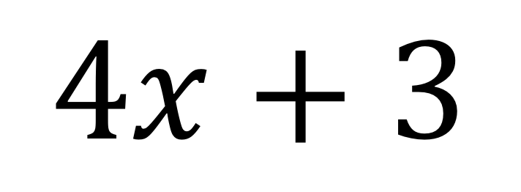
Mathematical expression
A mathematical sentence has numbers, variables and operators.
$$4x+3$$
© 2023 Commonwealth of Australia, unless otherwise indicated. Creative Commons Attribution 4.0, unless otherwise indicated.
Notes:
Slides 3–5 As the terminology equation is being introduced, explain to students the difference between equations and expressions, and discuss key terminology associated with expressions.
The aim for these slides is to create a strong foundation from which students can build from by breaking down complex concepts into simpler, understandable parts
Use this time to:
be clear in explaining algebraic language, terminologies and concepts
link new algebraic concepts to prior knowledge to facilitate understanding
prepare analogies or comparisons to make new information more accessible (see part 1)
remind students that we are learning algebra step by step rather than rushing as it can be complicated quickly
encourage students to visualise expressions and/or think about them as word problems to better understand them.

Slide 4

Parts of an expression
variable
$$4x+3$$
constant
coefficient
operator
© 2023 Commonwealth of Australia, unless otherwise indicated. Creative Commons Attribution 4.0, unless otherwise indicated.
Notes:
This slide is animated. Click the mouse to reveal the names of the different parts of the expression.

Slide 5

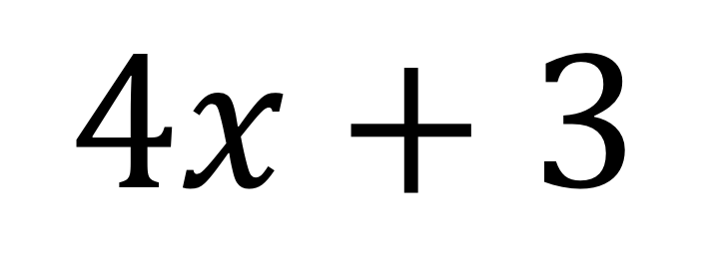
A mathematical equation …
… is a mathematical statement that says two things are equal.
$$4x+3$$
$$=12$$
© 2023 Commonwealth of Australia, unless otherwise indicated. Creative Commons Attribution 4.0, unless otherwise indicated.
Notes:
This slide is animated. Click the mouse to reveal the equation.
Connect to prior learning here (particularly from part 1).
Remind students of the concept of equivalence and ‘balance’. Remind students that the x represents an unknown value and that using ‘what we know’ and modelling the relationships as a mathematical equation can help us to find the unknown value, even if the is a fraction. Use analogies here if necessary; however, the next slide helps to contextualise this equation.

Slide 6


Construct an expression
Mark gets $3 less pocket money a week than his older brother Sam.
Construct an expression to show how much pocket money Mark gets.
Sam’s pocket money
Mark’s pocket money =
$$M=S−3$$
© 2023 Commonwealth of Australia, unless otherwise indicated. Creative Commons Attribution 4.0, unless otherwise indicated.
Notes:
Note that this slide is animated with mouse clicks, so as not to reveal the answer too soon.
Allow students to take in the context: Mark gets $3 less pocket money a week compared to his older brother Sam.
With the class, construct an equation that represents the scenario and use real cups and counters to model this equation.
Note: one red counter represents –1.

Slide 7



Substitute
Mark gets $3 less pocket money a week than his older brother Sam.
Sam gets $5 each week.
How much does Mark get?
Mark’s pocket money =
Sam’s pocket money
$$M=S−3$$
$$M=5−3$$
Mark gets $2!
$$M=2$$
© 2023 Commonwealth of Australia, unless otherwise indicated. Creative Commons Attribution 4.0, unless otherwise indicated.
Notes:
Note that this slide is animated. Also note that the green counters represent +1
Explain to students that if we have an algebraic equation and we are told the value of an unknown, we can substitute this value into the equation.
Use the example from above, substituting in that Sam earns $5 each week.
Model the process of substituting in $5 for S by filling the cup with 5 counters.
Show students how the value of the counters in the cup (+5) and the –3 equate to an answer of $2.
Explain to students that in the question we have substituted S for 5.
Explain that in algebra substitution means replacing a variable with a particular value.

Slide 8
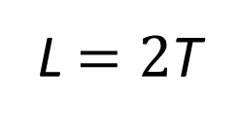
Construct the expression
Taj has several books. Lulu has twice as many.
Construct an expression to show how many books Lulu has.
Taj’s
books
Taj’s
books
Lulu’s books =
L$=2$T
© 2023 Commonwealth of Australia, unless otherwise indicated. Creative Commons Attribution 4.0, unless otherwise indicated.
Notes:
Note that this slide is animated.
Conduct another whole class example of substitution using cups and counters using the question, ‘Taj has a number of books. Lulu has twice as much. Construct and expression to show how many books Lulu has. If Fred has 6 books, how many does Lulu have?’

Slide 9
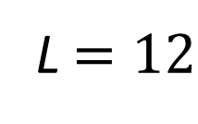
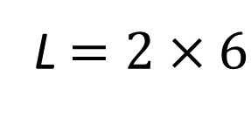
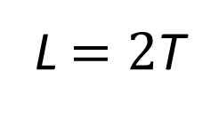
You’ve got this!
Taj has several books. Lulu has twice as many.
If Taj has 6 books, how many books does Lulu have?
Lulu’s books =
L$=2$T
Taj’s
books
Taj’s
books
L $=2×6$
L $=12$
Lulu has 12 books!
© 2023 Commonwealth of Australia, unless otherwise indicated. Creative Commons Attribution 4.0, unless otherwise indicated.
Notes:
Note that this slide is animated.
Conduct another whole class example of substitution using cups and counters using the question, ‘Taj has a number of books. Lulu has twice as much. Construct and expression to show how many books Lulu has. If Fred has 6 books, how many does Lulu have?’

Slide 10
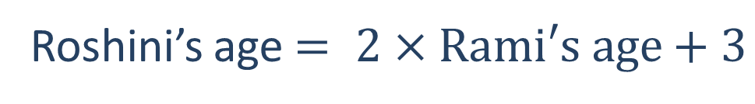
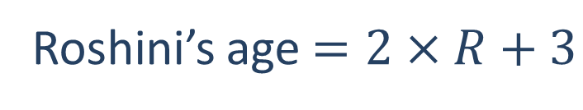
Your turn!
Roshini has a little brother, Rami. If you double Rami’s age and add 3 years, you will know Roshini’s age.
Construct an expression for Roshini’s age.
Roshini’s age $= 2×Rami′s age+3$
Roshini’s age $=2×R+3$
© 2023 Commonwealth of Australia, unless otherwise indicated. Creative Commons Attribution 4.0, unless otherwise indicated.
Notes:
Use the stacking cups and counters to demonstrate this problem.
Roshini has a little brother Rami. If you double Rami’s age and add 3 years, you will know Roshini’s age.
Construct and expression for Roshini’s age.

Slide 11
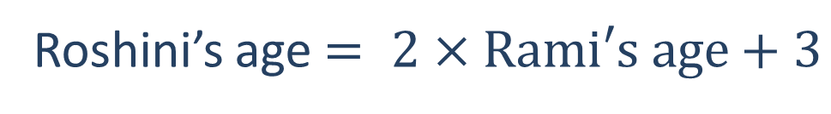


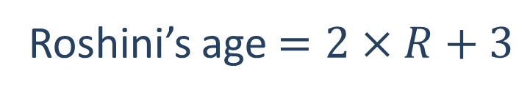
What did you get?
Roshini has a little brother, Rami. If you double Rami’s age and add 3 years, you will know Roshini’s age.
If Rami is 3, how old is Roshini?
Roshini’s age $= 2×Rami′s age+3$
Roshini’s age $=2×R+3$
$$=2×3+3$$
Roshini is 9!
$$=9$$
© 2023 Commonwealth of Australia, unless otherwise indicated. Creative Commons Attribution 4.0, unless otherwise indicated.
Notes:
Use the stacking cups and counters to demonstrate this problem.
Roshini has a little brother Rami. If you double Rami’s age and add 3 years, you will know Roshini’s age.
Construct an expression for Roshini’s age.

Slide 12
Exit ticket
If x = 2, find the value of 2x – 9
Label the parts of this expression: 3x – 2
In your own words, what is the difference between an expression and an equation?
© 2023 Commonwealth of Australia, unless otherwise indicated. Creative Commons Attribution 4.0, unless otherwise indicated.
Notes:
Evaluate students’ responses to the exit ticket questions to determine what concepts and skills are grasped, and what they require further practice in.
Consider students’ confidence levels in engaging with the mild/medium/spicy activities at each workstation.
You may wish to reflect on the success of the lesson to help you evaluate the difficulty of the tasks, student engagement, timing, practicalities, and differentiation for students.

