Slide 1
Flight of the osprey
Position and location

Slide 2
Introduction
I need some help today locating exactly where our osprey are flying.
To help describe position, let’s start with the Cartesian plane.
Image © 2024 Conservation Without Borders. Permission granted.

Slide 3
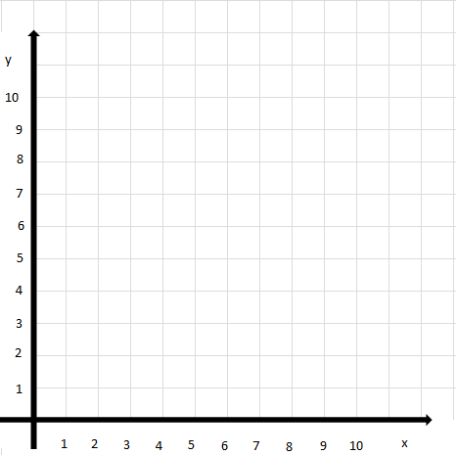
Cartesian plane: locating points
The location of points on a Cartesian plane are given in paired coordinates (x) and (y).
The x coordinate in the pair is always first, y is next.
Locate these objects using their coordinates.
The osprey
The nest
Electrical tower
Wind turbines
The birdwatcher (with binoculars)
Notes:
Binoculars https://www.flaticon.com/free-icon/binoculars_69125
Nest https://www.flaticon.com/free-icon/nest_10132462?term=nest&page=1&position=75&origin=tag&related_id=10132462
Osprey https://www.flaticon.com/free-icon/bird-osprey-shape_47324
Electrical tower: Microsoft Office clip art
Wind turbines: Microsoft Office clip art

Slide 4
Cartesian plane: plotting points
Plot points for the location of these objects on the Cartesian plane:
Osprey (3, 4)
Electrical tower (8, 9)
Wind turbine (10,3)
Nest (10, 6)
Birdwatcher (6, 4)
Plot a pathway for the osprey to safely reach the nest.
Notes:
Binoculars https://www.flaticon.com/free-icon/binoculars_69125
Nest https://www.flaticon.com/free-icon/nest_10132462?term=nest&page=1&position=75&origin=tag&related_id=10132462
Osprey https://www.flaticon.com/free-icon/bird-osprey-shape_47324
Electrical tower: Microsoft Office clip art
Wind turbines: Microsoft Office clip art

Slide 5
Plotting a global position
Do you remember this table?
The osprey Glen was learning to fly and stayed close to the nest.
What information helps us know that?
Now Glen and his siblings have left the nest, we need to know where they are flying​.
Osprey tag number (Glen) | Date | Latitude | Longitude | Maximum altitude in metres
224458 | 8/07/2022 | 55°N | 3°W | 115m
224458 | 9/07/2022 | 55°N | 3°W | 120m
224458 | 10/07/2022 | 55°N | 3°W | 120m
224458 | 11/07/2022 | 55°N | 3°W | 241m
224458 | 12/07/2022 | 55°N | 3°W | 415m
224458 | 13/07/2022 | 55°N | 3°W | 373m
224458 | 14/07/2022 | 55°N | 3°W | 386m
Notes:
Students may suggest altitude data helps us know the height above the nest which is correct.
Use questioning and feedback to prompt students if required to understand that latitude and longitude pinpoints an object on Earth.
Mouse click to reveal an animation (highlighted latitude and longitude columns of data)
Point out that the latitude and longitude, plot a global position on the Earth.
Students may be familiar with GPS, a global positioning system which uses latitude and longitude.
Note: for simplicity we have simplified latitude and longitude numbers in our table to whole numbers.
More accurate measures are used, for example, on the 8/07/2022 at a time of 23:45:00 the osprey Glen was at a latitude of 55.242561 and longitude -3.399452
We have used north (N) and west (W) to indicate the position.

Slide 6
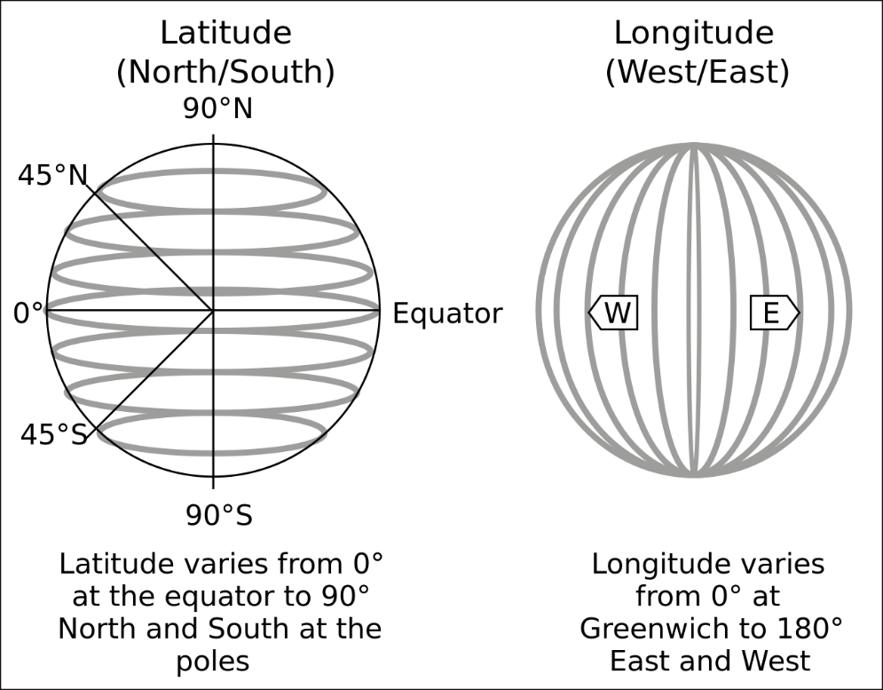
Latitude and longitude
Image © 2024 Conservation Without Borders. Permission granted.
To follow the birds as they migrate, we need to track their location along the flightpath using GPS.
GPS, a global positioning system, uses latitude and longitude.
Latitude is shown by lines drawn on a map running around the globe in an east-west direction (sideways).
The equator is halfway between the north and south pole at 0°.
Longitude is shown by lines drawn on a map running in a north-south direction (up and down).
Image: wikipedia
Notes:
https://upload.wikimedia.org/wikipedia/commons/thumb/e/ef/FedStats_Lat_long.svg/1280px-FedStats_Lat_long.svg.png
Explain position and location in simple terms:
latitude is east and west (sideways)
and longitude is north and south (up and down)
the equator is the imaginary line that divides northern and southern hemispheres
north is above the equator and south is below the equator.

Slide 7
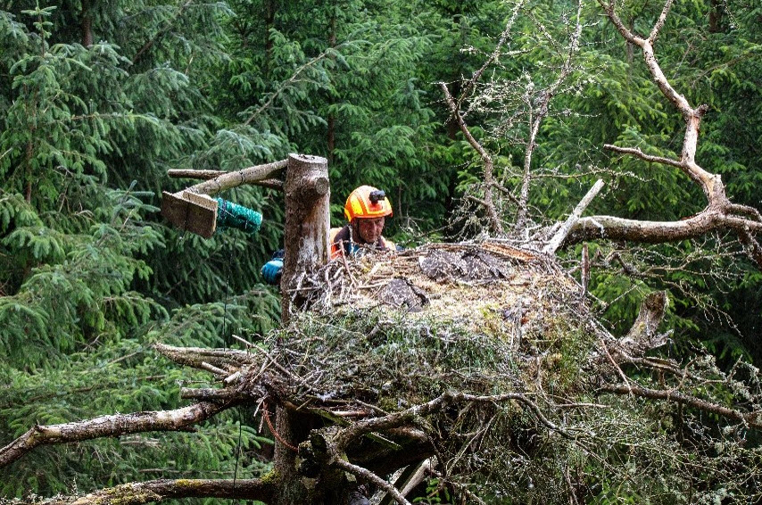
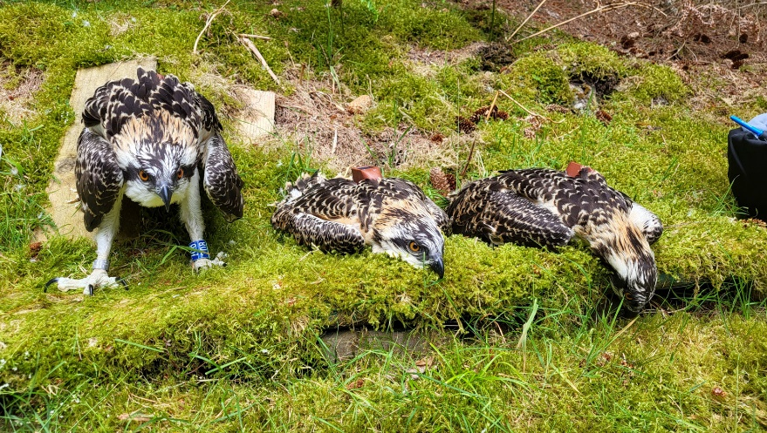
Latitude and longitude and GPS
We use GPS tracking devices to locate and plot the osprey’s flightpath.
The GPS devices (global positioning system) uses a network of satellites to determine the location of ospreys as they migrate between different areas.
The GPS receivers provide the location of each tagged bird with latitude, longitude, and altitude data. They also provide the accurate time.
The device is attached to the bird’s back by a lightweight harness, like a tiny backpack, and is programmed to take GPS readings at regular intervals.
Images © 2024 Conservation Without Borders. Permission granted.

Slide 8
Today’s task
Our three young ospreys have all taken flight and are migrating south on their epic journey. As junior researcher we need you to plot their journey using the GPS data.
Image © 2024 Conservation Without Borders. Permission granted.
Mystery bird 1 | Date | Latitude | Longitude
MB1 | 8/09/2022 | 55° N | 3° W
MB1 | 9/09/2022 | 52° N | 3° W
MB1 | 10/09/2022 | 50° N | 5° W
MB1 | 12/09/2022 | 45° N | 8° W
MB1 | 9/10/2022 | 43° N | 8° W
MB1 | 23/11/2022 | 41° N | 8° W
MB1 | 24/11/2022 | 40° N | 8° W
MB1 | 25/11/2022 | 34° N | 12° W
MB1 | 6/12/2022 | 27° N | 12° W
MB1 | 31/12/2022 | 27° N | 13° W
Mystery bird 2 | Date | Latitude | Longitude
MB2 | 26/08/2022 | 53° N | 2° W
MB2 | 27/08/2022 | 50° N | 3° W
MB2 | 29/08/2022 | 52° N | 8° W
MB2 | 30/08/2022 | 51° N | 10° W
MB2 | 31/08/2022 | 51° N | 9° W
MB2 | 1/09/2022 | 52° N | 10° W
MB2 | 25/08/2022 | 55° N | 3° W
MB2 | 28/08/2022 | 49° N | 9° W
MB2 | 4/09/2022 | 52° N | 9° W
Image © 2024 Conservation Without Boders. Permission granted.
Mystery bird 3 | Date | Latitude | Longitude
MB3 | 24/08/2022 | 55° N | 3° W
MB3 | 25/08/2022 | 52° N | 2° W
MB3 | 26/08/2022 | 51° N | 3° W
MB3 | 27/08/2022 | 46° N | 9° W
MB3 | 28/08/2022 | 40° N | 9° W
MB3 | 29/08/2022 | 40° N | 8° W
MB3 | 1/09/2022 | 41° N | 8° W
Notes:
Select a mystery bird to plot the pathway and work out where it started, its pathway and where it finished.

Slide 9
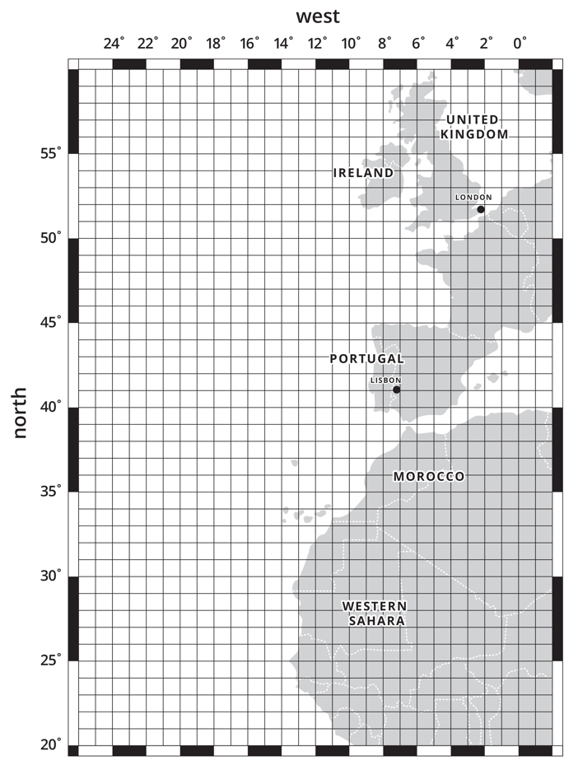
Mystery bird
The tables show the migration paths of three ospreys.
Where do they fly?
Where does each bird end their migration journey?
Choose a mystery bird.
Plot its pathway on the map using the latitude and longitude.

Slide 10
Complete the task
Warning: answer is on next slide

Slide 11
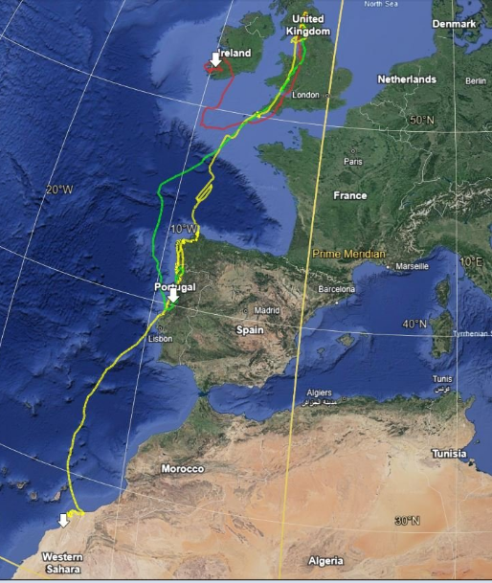
Match bird to flight path
Which colour pathway matched your mystery bird?
Glen ended in Western Sahara, Africa.
Kirk ended in Ireland.
Tweed ended in Portugal.
Which mystery bird did you have?
Source: Google My maps

Slide 12
Research complete (for now)
Thanks for your help today!​
I may call on you again.
Image © 2024 Conservation Without Borders. Permission granted.

