Slide 1
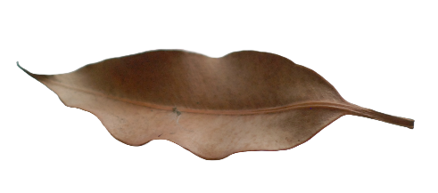
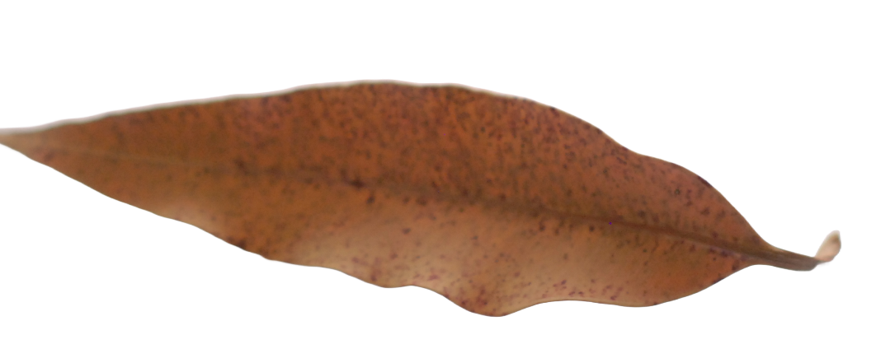
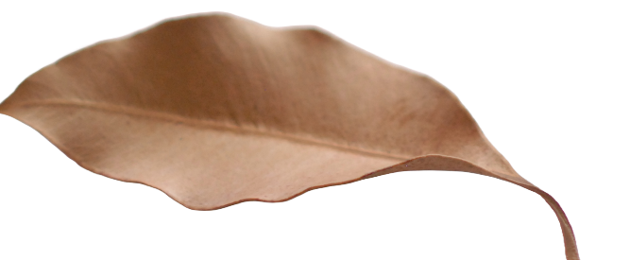

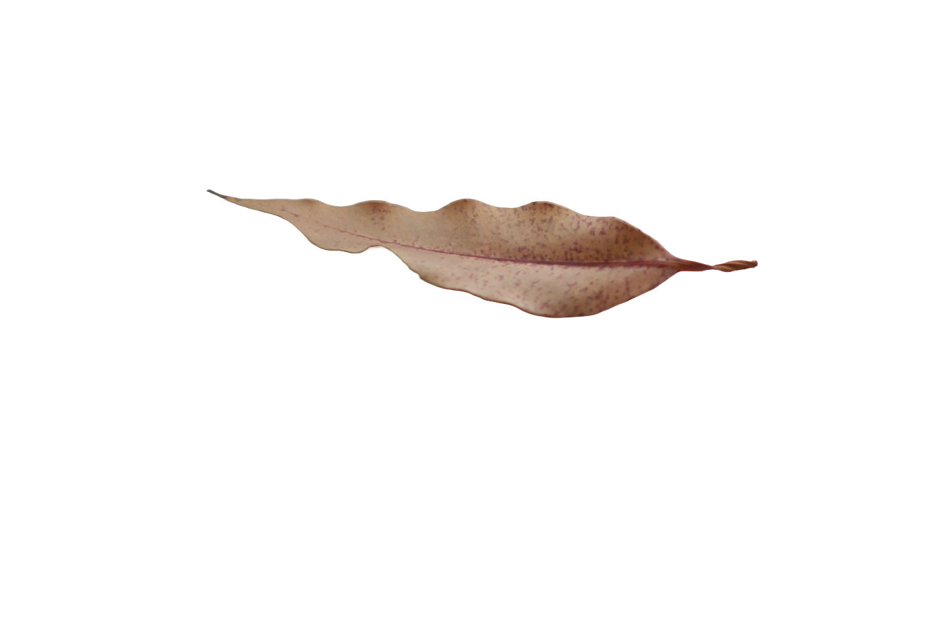
Learning number
through First Nations
leaf games and stories
Image credit: Martin Richards

Slide 2


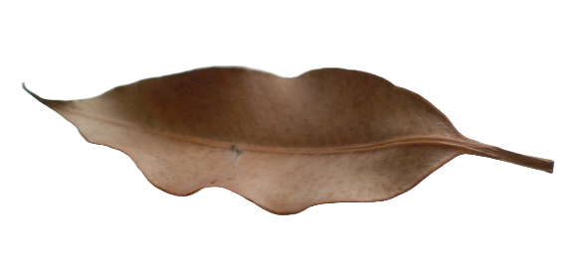
What do you notice?
What could each of the leaves represent?
Image credit: Martin Richards
Notes:
The leaves in these pictures represent different people from a Warlpiri family in a place called Yuendumu. Yuendumu is in the desert in the Northern Territory.
Here are the people in this picture:
•the longest leaf is the father
•the shorter leaf is the mother, who is pregnant
•the third-largest leaf is the child
•and the smallest leaf is the baby.
https://australian.museum/learn/cultures/atsi-collection/aboriginal-toys/leaf-game/
The original concept of the Yuendumu leaf game was developed by Kumanjayi Nangala. Permission has kindly been granted for use in this resource.

Slide 3




Yuendumu (NT)
The leaves in this picture represent different people from a Warlpiri family in a place called Yuendumu.
Yuendumu is in the desert in the Northern Territory.
Image credit: Martin Richards
Notes:
The leaves in these pictures represent different people from a Warlpiri family in a place called Yuendumu. Yuendumu is in the desert in the Northern Territory.
Here are the people in this picture:
•the longest leaf is the father
•the shorter leaf is the mother, who is pregnant
•the third-largest leaf is the child
•and the smallest leaf is the baby.
https://australian.museum/learn/cultures/atsi-collection/aboriginal-toys/leaf-game/

Slide 4
Warlpiri family
The leaves in this picture represent different people from a Warlpiri family.
The longest leaf is the father.
The shorter leaf is the mother, who is pregnant.
The third-longest leaf is the child.
The smallest leaf is the baby.
Image credit: Martin Richards
Notes:
The leaves in these pictures represent different people from a Warlpiri family in a place called Yuendumu. Yuendumu is in the desert in the Northern Territory.
Here are the people in this picture:
•the longest leaf is the father
•the shorter leaf is the mother, who is pregnant
•the third-largest leaf is the child
•and the smallest leaf is the baby.
https://australian.museum/learn/cultures/atsi-collection/aboriginal-toys/leaf-game/

Slide 5


Why leaves?
Leaves have been used traditionally to teach girls about kinship relationships, where groups of people are located within the camp and in Dreamtime stories.
What could these 5 leaves represent? Can you think of a story about them?
Image credit: Martin Richards

Slide 6


Yuendumu leaf games – 1
The patterns/groupings of the leaves can be continually changed to relate to the daily occurrences within the camp.
Here, three young boys left the camp to look for fish.
Image credit: Martin Richards

Slide 7





Yuendumu leaf games – 2
When the men went hunting, the long leaves were removed from the sand, leaving the women and children behind.
Image credit: Martin Richards

Slide 8
Men go hunting
Image credit: Martin Richards

Slide 9
Women and children are left
Image credit: Martin Richards

