Slide 1
Recognising and comparing decimal numbers
Using models

Slide 2
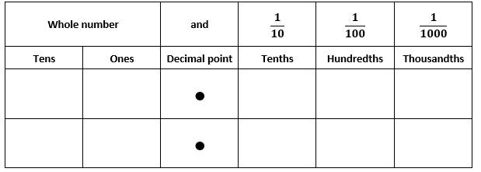
Place value chart
Notes:
Model reading each decimal number using place value language, for example, 0.4 is read as four-tenths and 0.26 is read as twenty-six hundredths.
Model how to represent a number such as 1.26
One in the ones column, 2 in the tenths column and 6 in the hundredths column.

Slide 3
Decimat: one whole divided into tenths
Notes:
Introduce the decimat model dividing one into ten parts (tenths)
On mouse click, one whole divides into 10 parts

Slide 4
How many tenths are shaded?
Notes:
Introduce the decimat model by dividing one into ten parts (tenths).
On mouse click, three tenths are shaded one by one.
Write three-tenths, 3/10 and 0.3.

Slide 5
Now divide tenths into 10 parts
Notes:
Model dividing tenths each into 10 parts (hundredths).
Now show that each rectangle is representing a hundredth.
On mouse click, the animation reveals the grid divided into hundredths.

Slide 6
How many hundredths are shaded?
Notes:
Now show that each rectangle is representing a hundredth.
Click the mouse to advance the animation to reveal the shaded grid.
Write eleven-hundredths, 11/100 and 0.11.

Slide 7
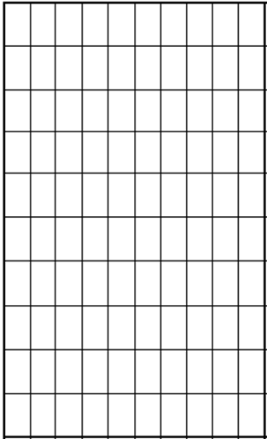
Now divide hundredths into 10 parts
Notes:
Now show that each hundredth grid is representing in thousandths.
Click the mouse to advance the animation to reveal the shaded grid.

Slide 8
How many thousandths are shaded?
Notes:
Each hundredth grid is representing in thousandths.
Click the mouse to advance the animation to reveal the shaded grid.
Write five-thousandths, 5/1000 and 0.005.

Slide 9
Decimat (tenths, hundredths, thousandths)
Notes:
Explain that this is a decimat and used to model decimal numbers.
Make the connections to tenths, hundredths and thousandths.

Slide 10
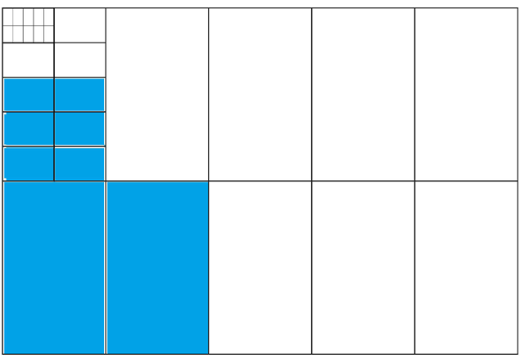
What number is represented?
Notes:
Count how many tenths (2).
Count how many hundredths (6).
Count how many thousandths (0).
The number is 0.26, 26/100, twenty-six hundredths.

Slide 11
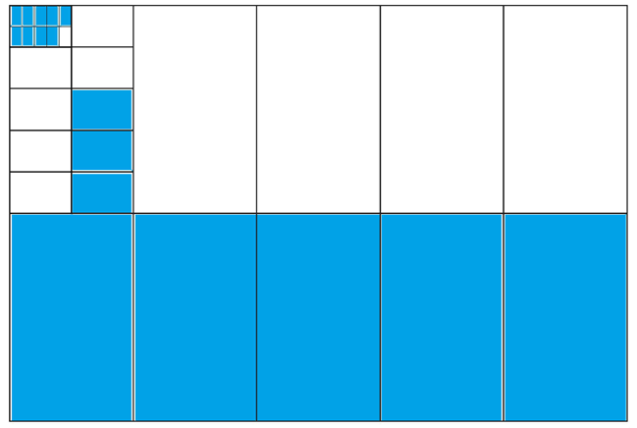
This number includes thousandths. What is it?
Notes:
Count how many tenths (5).
Count how many hundredths (3).
Count how many thousandths (9).
The number is 0.539, 539/1000, five hundred and thirty-nine thousandths.

