Slide 1


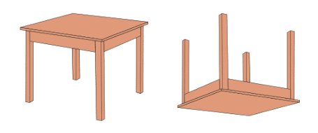
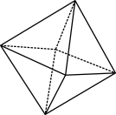

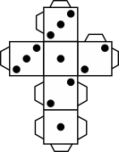
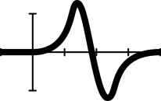


Would you rather …?
and two-way tables
Notes:
Image created in Canva.com
Year 10, Statistics, 60 mins,
Students construct two-way tables and discuss possible relationship between categorical variables, AC9M10ST04
Lesson summary
In this lesson, students collect data, creating and analysing two-way tables, by playing the popular game ‘Would you rather…?’ And you get to find out if your students would rather be in a Marvel or DC movie: With great power, comes great responsibility!
Prerequisite student knowledge and language
It is assumed that students have:
knowledge of tally charts and frequency tables
an understanding of how to change a fraction to a percentage is beneficial (although this is recapped)
previous knowledge of two-way tables – this is tested via a pre-assessment activity.
Areas of challenge
Some students may:
struggle to differentiate between AND and OR statements and inclusive / exclusive OR statements
find difficulties creating and selecting ‘Would you rather …?’ questions or choosing inappropriate questions (Perform a Google search of ‘Would you rather’ and offer a list for students to choose from and employ proactive classroom management strategies.)
experience time management during student-led task – use a visible timer to help keep students on task and progressing through the activity.

Slide 2

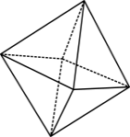

What do you know about two-way tables?
Would you rather … ? | … be too hot? | … be too cold? | Total
… live at the beach? | 25 |  | 60
… live in the bush? |  | 10
Total | 55 |  | 100
How many students would rather live in the bush?
How many students would rather be too cold?
How many students would rather live in the bush AND be too cold?
How many students would rather live in the bush OR be too cold?
How many students were they altogether?
Notes:
Explain that we are going to play a game called ‘Would you rather …?’ Students will choose from one of two options, and they MUST choose one, even if both are unappealing. Have students answer by standing/sitting or hands on heads/bottoms for the respective options.

Slide 3
What about fractions and percentages?
Would you rather … ? | … be too hot? | … be too cold? | Total
… live at the beach? | 25 |  | 60
… live in the bush? |  | 10
Total | 55 |  | 100
What FRACTION of the students would rather live in the bush?
What PERCENTAGE of the students would rather be too cold?
What FRACTION of the students would rather live in the bush AND be too cold?
What PERCENTAGE of the students would rather live in the bush OR be too cold?

Slide 4
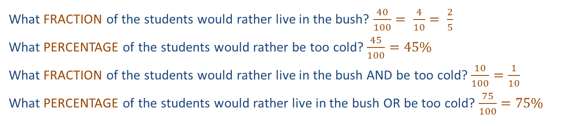
Answers
Would you rather … ? | … be too hot? | … be too cold? | Total
… live at the beach? | 25 | 35 | 60
… live in the bush? | 30 | 10 | 40
Total | 55 | 45 | 100
How many students would rather live in the bush? 40
How many students would rather be too cold? 45
How many students would rather live in the bush AND be too cold? 10
How many students would rather live in the bush OR be too cold? 30 + 10 + 35 = 75 or 100 – 25 = 75
How many students were they altogether? 100
What FRACTION of the students would rather live in the bush? $\frac{40}{100}= \frac{4}{10}= \frac{2}{5}$
What PERCENTAGE of the students would rather be too cold? $\frac{45}{100}=45\%$
What FRACTION of the students would rather live in the bush AND be too cold? $\frac{10}{100}=\frac{1}{10}$
What PERCENTAGE of the students would rather live in the bush OR be too cold? $\frac{75}{100}=75\%$

Slide 5
Would you rather …?
  Would you rather … have $1,000,000 now or $10,000 a month for the rest of your life?
  Would you rather … spend all day chilling or being active?
  Would you rather … star in a Marvel or DC movie?
  Would you rather … be the best athlete who ever lived or the best singer?
  Would you rather … spend a day without people or without your phone?
  Would you rather … eat steak every day or ice-cream every day?
  Would you rather … be rich and working in a job you hate or be poor and working in a job you love?
  Would you rather … be on Survivor or on The Voice?
  Would you rather … live at the beach or in the bush?
Which questions do you think might be linked?
Notes:
Explain that we are going to play a game called ‘Would you rather…?’ Students choose from one of two options, and they must choose one even if they are both unappealing. Have students answer by standing or sitting (for example, option A stand, option B sit) or hands on heads or hips.
Ask the students if they think any pairs of questions and answers are related, similar groups of people might give the same answers to the questions. For instance:
perhaps people who want to live in the bush are more active, while beach people would rather spend all day chilling?
perhaps people who want to be the best athlete would rather be on Survivor, while those who want to be the best singer would rather be on The Voice.
Explain that displaying the answers to two questions in a two-way table can help identify associations and commonalities between two different variables.

Slide 6
A two-way table
 | Theme park | Zoo | TOTAL
Spring
Summer
TOTAL
How many students would rather own a theme park?
What fraction of the students would rather own a theme park?
What percentage of students would rather own a theme park?
Notes:
Note that this slide is animated. The first mouse click brings up the arrows as indicated in the text below, and further clicks bring up the conditional probability questions one by one.
Two-way tables
Distribute small squares of paper or post-it notes to students and explain you are going to ask them two ‘Would you rather …?’ questions. They need to write the answers to BOTH questions on the same square paper.
The questions need to be closed with two possible answers, for example:
Would you rather … own your own theme park or zoo? Students write theme park or zoo.
Would you rather … have six months of spring or six months of summer? Students write spring or summer.
Ask the students if they would expect to find any association between these two variables (probably not).
Now ask the students to form into four groups dependent on students’ answers; that is, each member of the group should have the SAME answers to BOTH questions. Separate group to a different corner of the room. (From here, the lesson can be condensed or explored in more depth based on the findings of the pre-assessment activity to suit your class. Students collaborate to help each other answer the following exploration questions.)
Display a two-way table with the appropriate headings on the whiteboard (or refer to slide 7) and ask each group in turn:
‘How many in your group?’
‘Where should I write that number in the table?’
Explain that two-way tables sometimes contain a total row and column, and if not, it’s always a good idea to add them.
Click the mouse so that the arrows appear and demonstrate how the totals of the rows and columns are calculated by adding down and adding across, including the opportunity to double check calculations by referring to the bottom right corner (i.e. adding down is the same total as adding across).
Start by asking a variety of questions to ensure that students understand how to extract the relevant data from the table to answer questions including: how many, what fraction, what percentage. Questions could include:
1: ‘HOW MANY students would rather own a theme park?’
2: ‘WHAT FRACTION of the students would rather own a theme park?’
Ensure that you explicitly teach the difference between questions that ask, ‘how many’ (answer is a whole number) versus ‘what fraction’ (answer is a fraction out of a total).
Fraction questions have two steps:
finding the whole number (the ‘how many’) to include in the numerator
finding the right total to include in the denominator, which is especially relevant when students study conditional probability.
3: ‘WHAT PERCENTAGE of the students would rather own a theme park?’
Emphasise that to turn a fraction to a percentage you multiply by 100.
Continue this line of question for the other groups including AND and OR questions on the next slide.

Slide 7
A two-way table: ‘AND’ and ‘OR’
 | Theme park | Zoo | TOTAL
Spring
Summer
TOTAL
What fraction of the students would rather own a theme park AND six months of summer?
What fraction OF the students would rather own a theme park OR six months of summer.
What fraction of the students would rather have a theme park OR summer, BUT NOT BOTH?
Notes:
4. ‘What fraction of the students would rather have a theme park AND six months of summer?’
Emphasise that an ‘AND’ question means that we are interested in the people who have done BOTH, so we need to look at only one cell in the table to find the numerator of their fraction.
5. ‘What fraction of the students would rather have a theme park OR six months of summer’?’
Emphasise that an OR question means that we are interested in the people who have done ONE of the things. By convention, when we say OR it is assumed to be inclusive, that is, we also include people who have done BOTH. In a $2×2$ two-way table we need to sum three different cells to find the correct numerator.
6. ‘What fraction of the students would rather have a theme park OR summer BUT NOT BOTH?’
An ‘OR’ question needs to clearly state NOT BOTH to be exclusive. For a $2×2$ two-way table this means that they will need to sum two different cells to find the correct numerator.
Now ask students to review their pre-assessment answers and change their answers, if necessary, before reviewing the answers as a whole class.
Repeat the activity with a different set of two ‘Would you rather…’ questions if you feel that your students need more practise creating and extracting data from two-way tables.

Slide 8
Changing up the words to go deeper
Conditional probability
What is the probability that a student chosen at random would rather own a theme park, GIVEN that they prefer spring?
What fraction OF those students who would rather spring, would rather own a theme park?
What is the probability that a student chosen at random prefers spring, GIVEN that they would rather own a theme park?
Notes:
Differentiation (extension)
The following slide can be used for a class or student to think further still, especially when syntax comes into play. Students must identify what the questions is asking them in order to answer them correctly.

Slide 9

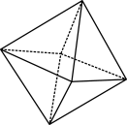

Summary and recap
How many?
What fraction?
What percentage?
… AND …
… OR …
… OR … BUT NOT BOTH
What have you noticed about the type of data?
What data best suits a two-way table?
Notes:
Ask students to think what the words and phrases mean, how they are different, and to make notes in their books about each word/phrase.
Point out the two questions:
What have you noticed about the type of data?
What data best suits a two-way table?
Ask students to contribute their thoughts. The goal is to appreciate that two-way tables are useful when asking two questions/collecting two items of data from a group, but there are only a very limited number of responses (typically two or three) to each question. Generally, this will be categorical data, or possibly discrete numerical data. They are also useful when you think there may be an association between the two variables and you are trying to identify a pattern.

