Slide 1


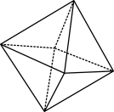

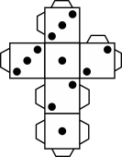
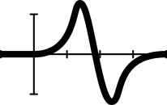


Solving equations with algebra mats
Notes:
This lesson will follow from the prior lessons where students were introduced to variables and substituting values to find knowns (it is intended that consolidation fluency activities should have likely occurred between the prior lesson and this one).
Summary
Students are introduced to solving one-variable linear expressions using a range of concrete materials. To ensure students experiences with formal algebra are founded on a strong sense of the importance of algebraic concepts in the real-world, students will explore a range of authentic and engaging contexts.
AC9M7A03
Solve one-variable linear equations with natural number solutions; verify the solution by substitution
Achievement standard
Students use algebraic expressions to represent situations, describe the relationships between variables from authentic data and substitute values into formulas to determine unknown values. They solve linear equations with natural number solutions.
Numeracy Progression: Algebraic expressions, Level 7
Critical and creative thinking:
Analysing - Interpret concepts and problems
Numeracy:
Number sense and algebra - Number patterns and algebraic thinking
Prerequisite student knowledge and language
The concept of variables
Constructing equations from word problems
Conventions associated with the order of operations for integers
Knowledge of algebraic conventions (covered in prior lessons)
How “=” indicates an equivalence statement
How to substitute values into equations
How to model equations and substitute values using cups and counters.
Resources
Equation mats (1 per student)
Cups and counters
Student worksheet printouts
Student Tarsia puzzle printouts

Slide 2
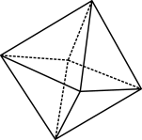

Learning intention
We are learning to:
construct equations for given word problems
substitute values into equations
solve equations involving addition and subtraction.
© 2023 Commonwealth of Australia, unless otherwise indicated. Creative Commons Attribution 4.0, unless otherwise indicated.
Notes:
Introduce students to the learning intentions of the lesson.
Remind them that this lesson follows on from what was previously learnt about constructing algebraic equations and substituting values.
Explain that in this lesson we will be continuing to construct algebraic expressions, and that in this lesson we will be solving equations.
Success criteria
By the end of the lesson, students can:
solve one-step equations involving addition and subtraction with and without concrete materials.
Some students may:
consider that the “=” sign indicates to record an example, rather than expressing an equivalence relationship
think that a particular variable always holds the same value
find identifying inverse integer operations counterintuitive, particularly when negative integers are involved
forget, or not realise they need to do the same thing to both sides of the equation
have trouble neatly recording each step of their working out when solving equations.
Strategies:
Use concrete materials and manipulatives to show that variables can represent any number and that they are place holders.
Use number lines to help students visually connect arithmetic with negative numbers.
Continue to use balancing scales or images of scales to connect the understanding of equivalence and balancing equations
Break down steps clearly, using colour coding to help identify terms and operations throughout the steps.

Slide 3
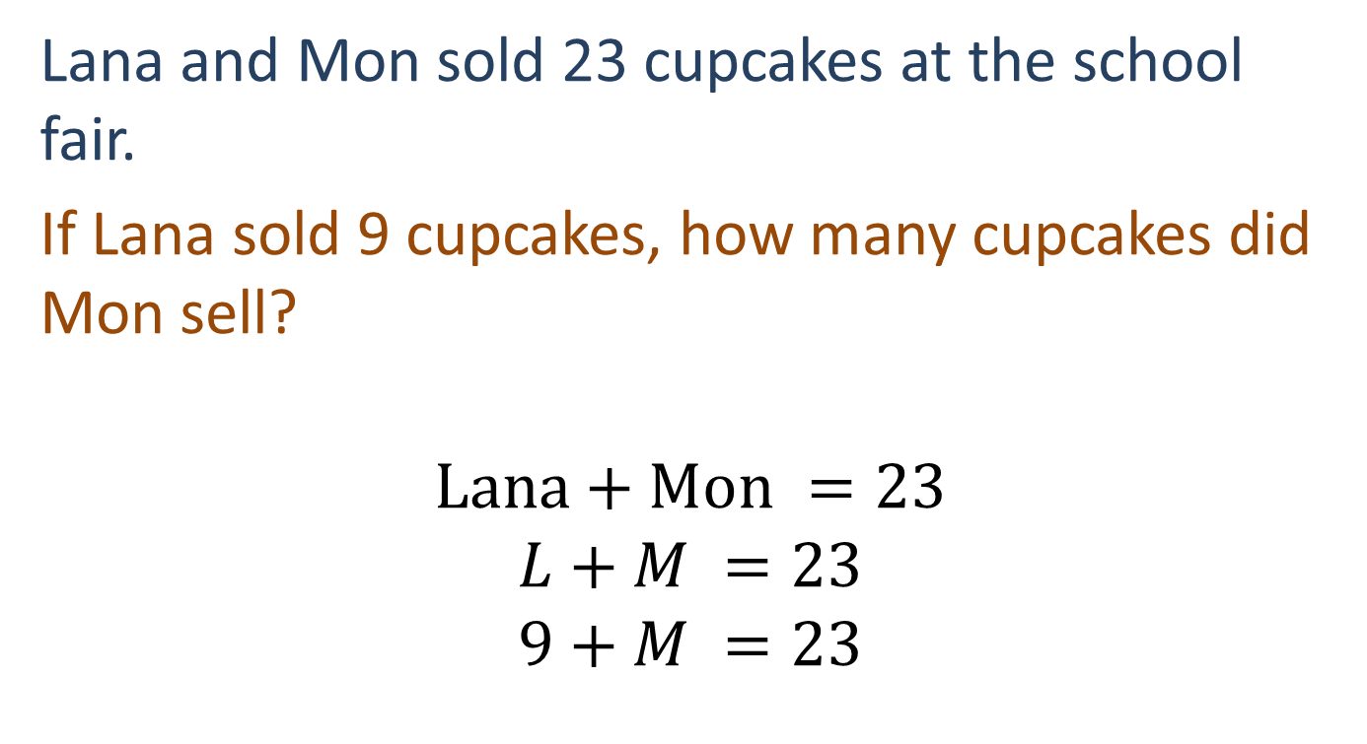
Solving equations
Lana and Mon sold 23 cupcakes at the school fair.
If Lana sold 9 cupcakes, how many cupcakes did Mon sell?
$$Lana+Mon =23$$
$$L+M =23$$
$$9+M =23$$
© 2023 Commonwealth of Australia, unless otherwise indicated. Creative Commons Attribution 4.0, unless otherwise indicated.
Notes:
The following slides progressively introduce more abstract algebraic representations. Skills taught in the previous lessons are reintroduced and built upon.
Allow students to consider the scenario. They may be able to produce some answers without needing the equation.
Discuss with students how we could construct an equation to represent the scenario.
Using cups and counters to model the equation on the equation matt, discuss with students how we might know what M is, emphasising that we are making the number sentence true.
Differentiation (enable): Provide pairs of students with cups/counters and allow them to model each problem whilst following along with the explicit introduction to the concept.

Slide 4
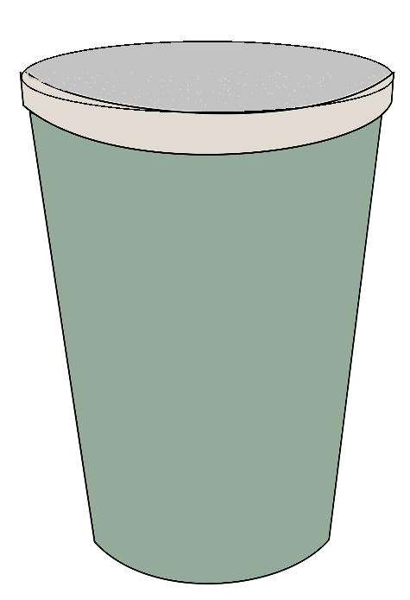
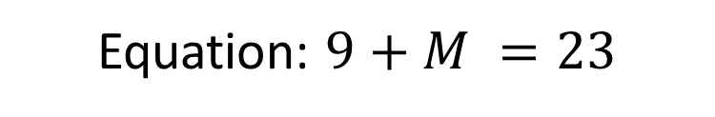
Balancing equations
Equation: $9+M =23$
Lana and Mon sold 23 cupcakes at the school fair.
If Lana sold 9 cupcakes, how many cupcakes did Mon sell?
© 2023 Commonwealth of Australia, unless otherwise indicated. Creative Commons Attribution 4.0, unless otherwise indicated.
Notes:
Allow the students to represent the equation using cups and counters.
Ask students to consider how many counters will go in the cup to make the equation true (remind them both sides must be equal).
Encourage students to fill up their cup with the 14 counters they need to make the equation true.
Encourage students to tip out the counters from their cup and combine all the counters on the LHD so that they can see they have equal amounts of counters on the LHS and RHS.

Slide 5


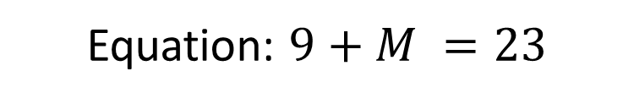
Showing equations
Equation: $9+M =23$
$$9−9+M =23−9$$
$$M =14$$
Lana and Mon sold 23 cupcakes at the school fair.
If Lana sold 9 cupcakes, how many cupcakes did Mon sell?
© 2023 Commonwealth of Australia, unless otherwise indicated. Creative Commons Attribution 4.0, unless otherwise indicated.
Notes:
Ask students to remove their 14 counters that they added to the cup and refresh their algebra mat to show what we started with before.
Discuss with students that the equals sign represent a balance – what is on one side is balanced to the other. If we do something to one side of the equation, we must do the same to the other.
Discuss that if we want to find the value of the cup, we must takeaway 9 counters from both sides.
Discuss how this is recorded symbolically in the equation.
Discuss the simplified equation that gives us M=14.
Discuss how we have found the same solution as we did before when we considered how many counters we need to fill the cup to make the equation true.
Support:
You may wish to rewrite the workings on the board and cancel/cross out 9 - 9 to show that M is left by itself on the LHS.

Slide 6
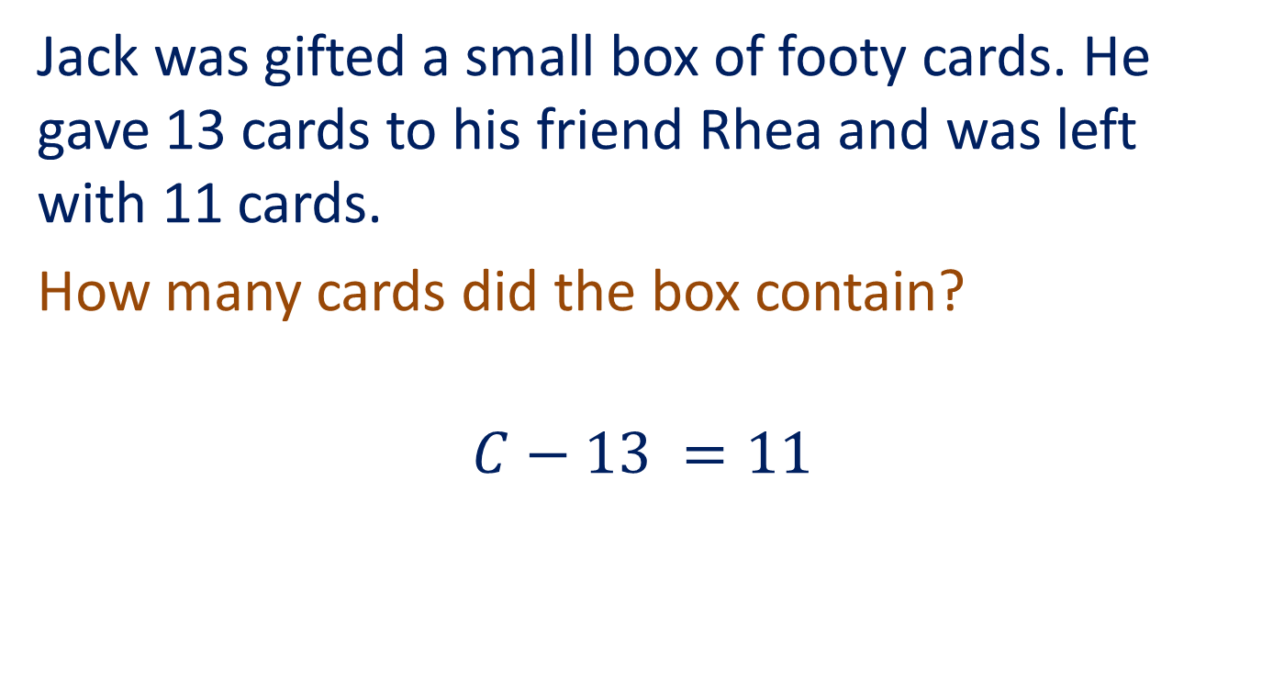
Solving the next equation
Jack was gifted a small box of footy cards. He gave 13 cards to his friend Rhea and was left with 11 cards.
How many cards did the box contain?
$$C−13 =11$$
© 2023 Commonwealth of Australia, unless otherwise indicated. Creative Commons Attribution 4.0, unless otherwise indicated.
Notes:
Allow students to consider the scenario. They may be able to come up with some answers without needing the equation.
Discuss with students how we could construct an equation to represent the scenario, using C to represent the total number of cards that Jack originally had.
Using cups and counters to model the equation on the equation mat, discuss with students how we might know what C is, emphasizing that we are making the number sentence true.

Slide 7



Jack was gifted a small box of footy cards. He gave 13 cards to his friend Rhea and was left with 11 cards. How many cards did the box contain?
$$C−13 =11$$
$$C−13+13 =11+13$$
$$C =24$$
© 2023 Commonwealth of Australia, unless otherwise indicated. Creative Commons Attribution 4.0, unless otherwise indicated.
Notes:
Note that this slide is animated so that the steps and the visuals are matched as you teach the concept of balancing the equation. Use the mouse clicks to go through the animation.
Allow the students to represent the equation using cups and counters.
Discuss with students that if we can find what C is (what is in the cup), what do we need to do? Draw students’ attention to our need to eliminate the 13 negative counters. Ask students to propose what we might do to achieve this.
Encourage students to lay 13 green counters on top of each red counter to make zero sum pairs. And as them to consider that is we’ve added 13 green counters to the LHS, we must add 13 green counters to the right side to make sure our equation is balanced.
Ask students to clear the counters from the LHS as -13+13=0.
Discuss the simplified equation that gives us C=24.
Ask students to consider whether that answer is reasonable.

Slide 8

Let’s reflect on what you know now!
What you do on the left, you must also do on the right.
$$x+2=10$$
$$x+2−2=10−2$$
$x=8$
© 2023 Commonwealth of Australia, unless otherwise indicated. Creative Commons Attribution 4.0, unless otherwise indicated.
Notes:
An individual activity that consolidates the concept
Now that students have explored solving equations with concrete materials, introduce them to the formalized idea of ‘what you do to one side, you have to do to the other’. (Slides 8–11)
Students can then complete the Tarsia puzzle and submit their completed puzzle as an exit ticket.
Differentiation: Students can complete the Tarsia puzzle collaboratively in pairs.

Slide 9

What do you do to both sides?
What you do on the left, you must also do on the right.
$$2=10+x$$
$$2−10=10+x−10$$ $−8=x$
© 2023 Commonwealth of Australia, unless otherwise indicated. Creative Commons Attribution 4.0, unless otherwise indicated.

Slide 10

Have you balanced it?
What you do on the left, you must also do on the right.
$$3=y−9$$
$$3+9=y−9+9$$ $9=$ $y$
$$y=9$$
© 2023 Commonwealth of Australia, unless otherwise indicated. Creative Commons Attribution 4.0, unless otherwise indicated.
Notes:
Explain that we finalise the answer with the variable on the left-hand side.

Slide 11

Class discussion
How would we solve the following?
$2−x=−1$
$$−2+2−x=−1−2$$ $−x=−3$ $x=3$
© 2023 Commonwealth of Australia, unless otherwise indicated. Creative Commons Attribution 4.0, unless otherwise indicated.

